Slide 1

Cyber Policy

Slide 2

Definition-
Cyber policy regulates all aspects of digital data exchange, including the Internet, data privacy and network usage, as well as cyber defense . cyber policy presents unique challenges as national security concerns and business interests must be weighed against
freedom of speech,
privacy and accessibility
concerns.

Slide 3
The need for Cyber Policy-
Regardless of size, all state, countries as well as businesses that use IT or online services should have a cyber security policy.
Irrespective of how you document and distribute your policy, you need to think about how it will be used. A cyber security policy has three main functions:
To tell people who don’t know what to do (and what not to do).
To remind people who have forgotten or fallen into bad habits.
To warn people what will happen if they don’t follow your policy.

Slide 4
The content of Cyber Policy-
The objectives of your policy.
Who has issued the policy and who is responsible for its maintenance.
Who is responsible for enforcing cyber security.
Your key security controls.
Staff practices at firm level.
Compliance by all.

Slide 5
Rights under Cyber Policy-
Privacy and Data protection.
Freedom of Expression, Association and Assembly
Right to Access

Slide 6

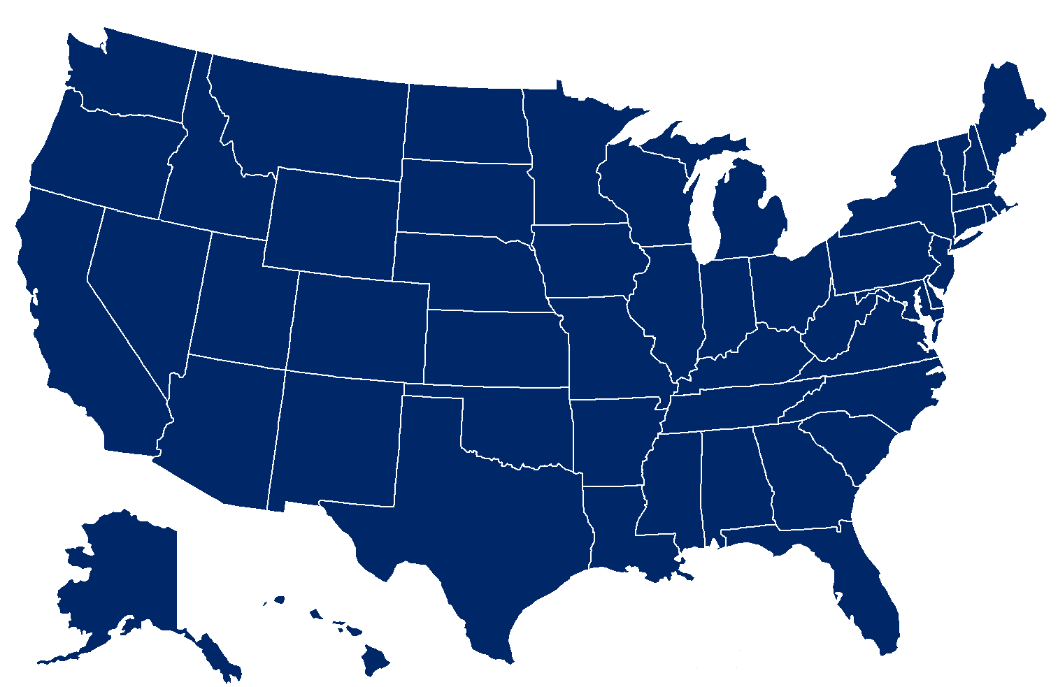
Cyber Policy at world level

Slide 7

“This world—cyberspace—is a world that we depend on every single day... [it] has made us more interconnected than at any time in human history.” —President Barack Obama, May 29, 2009
US Cyberspace Policy-
The United States will work internationally to promote an open, interoperable, secure, and reliable information and communications infrastructure that supports international trade and commerce, strengthens
international security, and fosters
free expression and innovation.

Slide 8
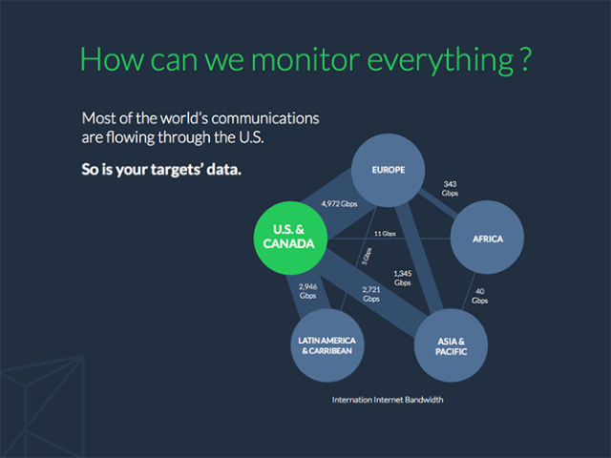
EU International Cyberspace Policy-
The European Commission and High Representative’s 2013 Cyber Security Strategy was the EU’s first comprehensive policy document in this area.
The strategy is accompanied
by a legislative proposal to
strengthen the security of
the EU’s information
systems.

Slide 9

Priorities for cyberspace policy-
Freedom and openness.
The laws, norms and core values apply as much in cyberspace as in the physical world.
Developing cyber security capacity building.
Fostering international cooperation and development in cyberspace.
Balance between privacy and security.
Protecting the Networks.
Law Enforcement.
Internet Freedom.
Tackling cyber threats.

Slide 10
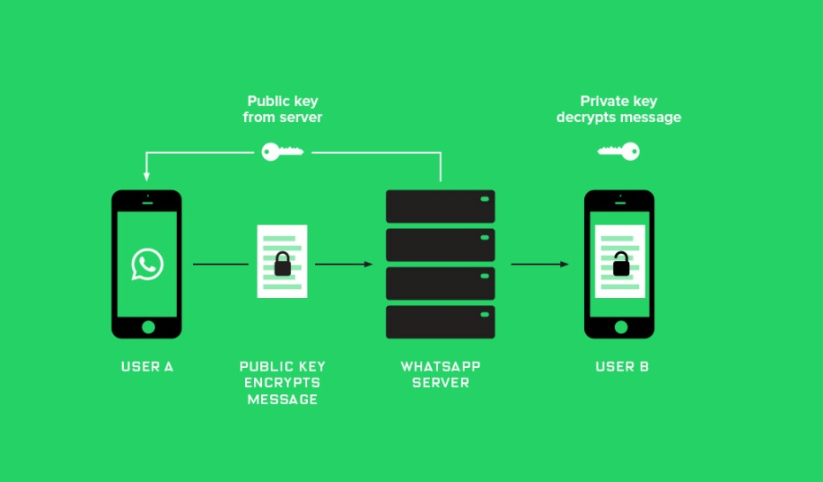
The core principles-
Fundamental Freedoms
  Our commitment to freedom of
  expression and association is
  abiding, but does not come at
  the expense of public safety or
  the protection of our citizens.
Privacy
  Our strategy marries our obligation to protect our citizens and interests with our commitment to privacy.
Free Flow of Information
  States do not, and should not have to choose between the free flow of information and the security of their networks

Slide 11
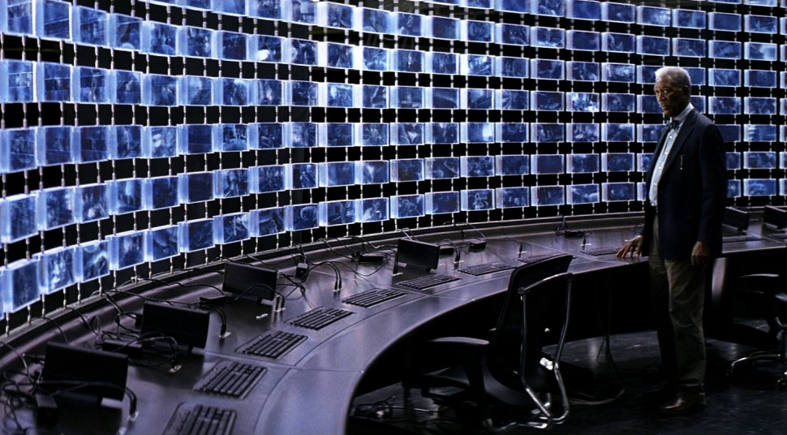
NSA and Snowden Effect
Case Study:
NSA (National Surveillance Agency) was formed in 1952. It was meant to monitor abroad communication.
But with the advent of new technology, it also started spying on its own citizen.
Shares work with Britain,
Australia, New Zealand and
Canada.
Edward Snowden who
worked for NSA, released
highly sensitive,
top secret data of NSA.

Slide 12
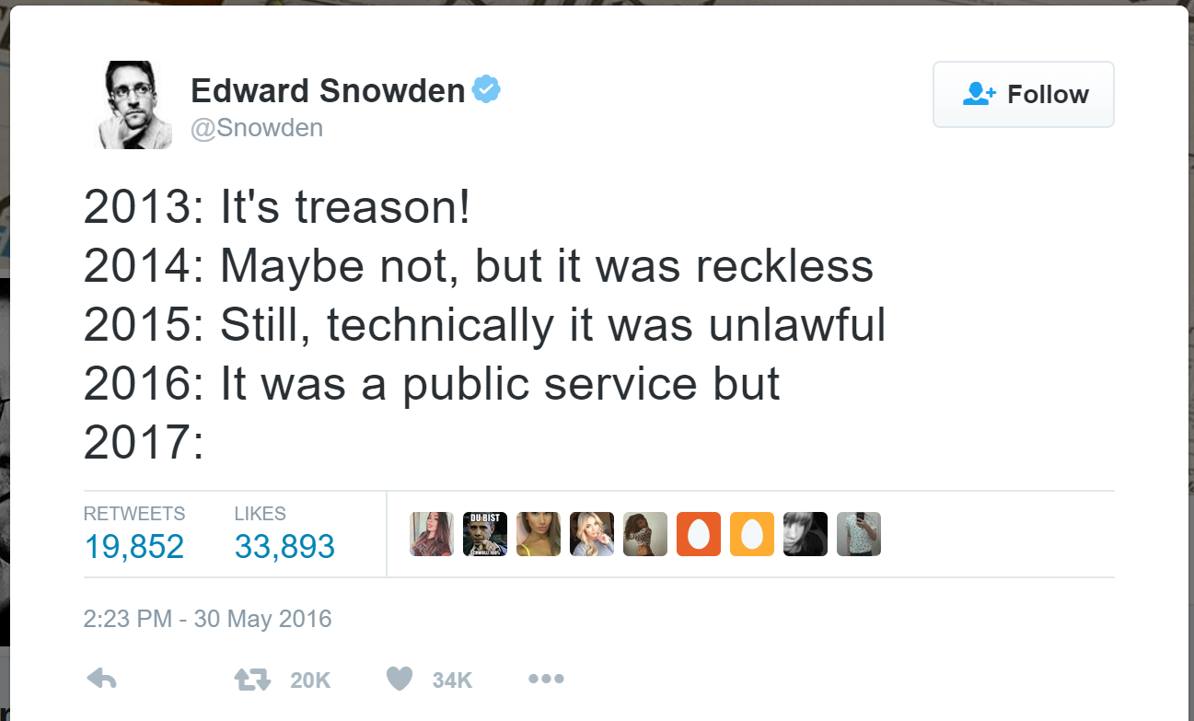
Snowden's documents
showed mass
surveillance in India.
The two main program
were-
1.Boundless Informant –
Data mining system
which keeps track of no.
of call, sms as well as
mails. Monitored
telecommunication calls, sms and access to internet.
2.PRISM –
Collects and intercepts actual data from network. It collects specific issues - not related to terrorism - through Google, Microsoft, Facebook, Yahoo, Apple, Youtube and other online services.

Slide 13
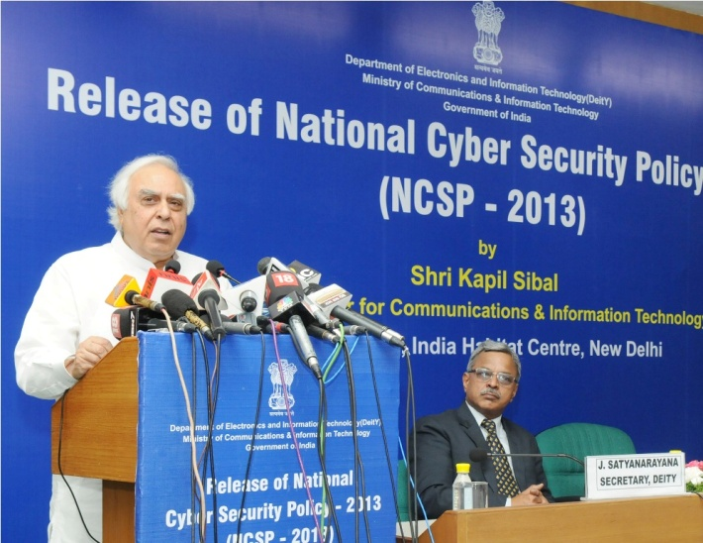
Advent of NCSP,2013-
National Cyber Security Policy, 2013 came to be because of the NSA leak.
Its a policy framework by Department of Electronics and Information Technology (DeitY) now made a full-fledged
ministry - Ministry of
Electronic and Technology.
(Initially a part of Ministry of
Information and Technology)

Slide 14
Vision and Mission-
Aims at protecting the public and private infrastructure from cyber attacks
Intends to safeguard "information, such as personal information (of web users), financial and banking information and sovereign data"
To build a secure and resilient cyberspace for citizens, business and government.
To protect information and information infrastructure in cyberspace, build capabilities to prevent and respond to cyber threat, reduce vulnerabilities and minimize damage from cyber incidents through a combination of institutional structures, people, processes, technology and cooperation.

Slide 15

Strategies-
Creating a secured Ecosystem.
Creating an assurance
framework.
Encouraging Open Standards.
Strengthening The regulatory
Framework.
Creating mechanism for Security
Threats Early Warning,
Vulnerability management and response to security threat.
Securing E-Governance services.
Protection and resilience of Critical Information Infrastructure.
Promotion of Research and Development in cyber security.
Reducing supply chain risks

Slide 16
Implementation-
The National and Sectoral 24 * 7 mechanism has been set up to deal with the cyber threats through the National Critical Information Infrastructure Protection Centre (NCIIPC).
Computer Emergency Response Team (CERT-In) acts as an agency to coordinate the crisis management efforts.
The government has engaged itself in the promotion of research and development in cyber security. The government is working to set up trustworthy systems to keep a safe and secure cyber environment in the country.

Slide 17
Achievements of the XIth Five Year Plan-
Information Technology (Amendment) Act, 2008 has been enacted and rules of important sections have been notified.
Computer Security Guidelines have been circulated to all Departments and Ministries. Crisis Management Plan for countering cyber attacks and cyber terrorism has been released and is being updated annually.
A Computer Emergency Response Team –India (CERT-In) has been set up and is operational as the national agency for cyber incidents. It operates a 24x7 Incident Response Help Desk to help users in responding to cyber security incidents

Slide 18
Targets of the XIIth Five Year Plan-
Security Incident - Early Warning and Response
The key priority is strengthening National Cyber Alert System for rapid identification and response to security incidents and information exchange to all desired elements that are critical for cyber security, to reduce the risk of cyber threat and resultant effects.
Security Awareness, Skill Development and Training
The key priority is to establish cyber security capacity building and training mechanisms for developing a strong and dynamic cyber security skilled work force and a cyber vigilant society.

Slide 19
Surveillance Program in India-
National Cyber Coordination Centre of India (NCCC) aims at coordinating intelligence gathering activities of other agencies and intends to screen metadata of communication.
CMS (Central Monitoring System) which keeps an eye on every electronic movement in our country. It is the Indian version of PRISM program run by NSA. Labeled one of the 3 worst online spies by Reporters Without Borders as 'Enemies of the Internet'.

Slide 20
Internet Spy System Network and Traffic Analysis System of India (NETRA)
It is meant to eavesdrop into Social Networking providers like BBM, Skype, Gmail.
NETRA can analyze voice traffic in Skype or GTalk and can flag people who use trigger words like bomb, attack, blast, kill and so on.
National Intelligence Grid (NatGRID).
Aadhaar Project of India.

Slide 21
RBI policy-
In Banking Sector, RBI mandates Cyber Security Policy for all banks as on 2nd June,2016.
All banks must discuss strategy, acceptable level of risks and an appropriate approach to combat cyber security threats.
It should focus on setting up of Security Operations Centres for continuous surveillance and management of cyber threats in real time.
There is an emphasis on CSP being distinct and seperate from banks IT policy.
The confirmation for this is to be submitted to RBI by 30th September,2016.

Slide 22
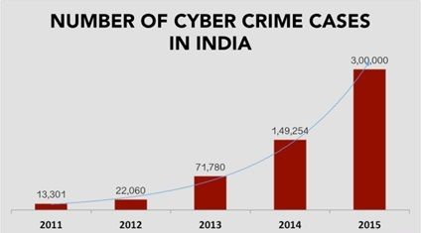
The banks are supposed to do comprehensive review network and database security to ensure they are not vulnerable to any cyber attacks.
To make Cyber Crisis Management Plan (CCMP) should be part of overall Board approved strategy.
CCMP addresses
(i)Detection
(ii)Response
(iii)Recovery
(iv)Containment.

Slide 23
Cyber Terrorism In India-
On 12th July, 2012, over 10,000 email accounts belonging to top officials were compromised, despite a warning from the country’s cyber security agency.
Email addresses belonging to officials working at the Prime Minister’s Office, defence, home, finance and external affairs ministries and intelligence agencies were nabbed in the attack.
However, the attack appears to have been more co-ordinated and carried out with the aim of obtaining specific information.

Slide 24

The attack came on 12th July, four days after the government was warned by the National Critical Information Infrastructure Protection Centre part of the National Technical Research Organisation that some sophisticated malware was spotted targeting specific individuals and organisations.

Slide 25
Limitation of Cyber Policy-
Require multidisciplinary thought and expertise.
Technological changes.
The framing of problems in cyber policy and security profoundly aﬀects how one might approach solutions.
While making policies only the major problems are targeted and thought for and small bugs, problems are not thought about.

Slide 26
Implementation problems-
The challenges involves in implementation of cyber policy:-
1)Multiple levels of debate
2)Political nuance
3)Far reaching impact on personal freedom and national security.

Slide 27
Conclusion-
At the end of this endeavor, further research and debate on cyber policy is imperative since such is the need of the hour.
Post implementation necessary troubleshooting can be done.
The key to success of the policy lies in its effective implementation. The public-private partnership in the policy, if implemented in true spirit, will go a long way in creating solutions to the ever-changing threat landscape.
-“The price of safety is the loss of privacy. When privacy is lost, freedom won't be far behind.”

Slide 28
References:
NCSP,2013 - http://meity.gov.in/content/national-cyber-security-policy-2013-1
NSA - https://en.wikipedia.org/wiki/National_Security_Agency
https://www.nsa.gov/
Impact on India - http://www.thehindu.com/news/national/india-among-top-targets-of-spying-by-nsa/article5157526.ece
Edward Snowden AMA- https://www.reddit.com/r/IAmA/comments/2wwdep/we_are_edward_snowden_laura_poitras_and_glenn/
Useful link - https://www.youtube.com/channel/UCow9ZGJMNsZtAkz4ZvTtcJA
The Cuckoo’s Egg: Tracking the Maze of Company Espionage – Cliff Stoll, Doubleday,1989.
No Place to Hide:Edward Snowden, the NSA and Surveillance State – Glenn Greenwald.

Slide 29
THANK YOU !

Slide 30
GROUP MEMBERS
Bini Gowadia
Aditya Jadeja
Swatej Harwande
Priyam Shah
Arsh Bhatia

