Slide 1
Hacking
Presented by:- Arpit Verma
Reg. No.:- CRO0422316

Slide 2
Contents
What is hacking?
Who are hacker?
Hacker Categories?
Types of Hacker?
Skill of hackers?
Advantages & Disadvantages?
How to save computer from hackers

Slide 3
What is Hacking?
Hacking is the act of breaking in to a computer system and is a criminal offence under the computer misuse
Or
The really simple definition of hacking: is gaining an unauthorized access to a computer system

Slide 4
Who is Hacker ?
The person who is consistently engaging in hacking activities, and has accepted hacking as a lifestyle and philosophy of their choice, is called a Hacker

Slide 5
HACKER CATEGORIES
1. Semi-Professional Hacking. Performed part-time and does not provide an income. They fit the classical hacker characteristics.. they work and play on the edge of society, have a gang mentality, strong negative responses to threats against his/her self-esteem, can have narcissistic personality disorders.
2. Inter-City Hacking. Inner-city residence (any race, color, religion, creed, etc,), exhibits anger at social condition, exhibits no social conscience, jail is not a deterrent. Hacking gives them a sense of power and allows them to make their own rules.

Slide 6
HACKER CATEGORIES
3. Euro hacking. More worldly , enlightened then US hackers and are generally motivated by philosophical or political concerns. Generally thought of as a way of life and not a crime, thinks hacking is treating technology without respect; thinks its great sport to spin up intelligence communities.
4. Professional Hacking. This encompasses any for profit activity such as spies, industrial espionage, Narco terrorist, White Collar criminals, etc.

Slide 7
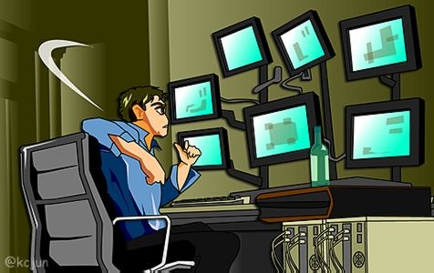
Type of hacker
White hat
Black hat
Grey hat

Slide 8

White-hat Hackers
The good guys who identify the security weakness of the system or network and inform the owner about them

Slide 9
Black Hat Hackers
  A black hat is the villain or bad guy, who crash into victim’s security to steal information and destroy the victims security network.
  Also known as ‘cracker’.

Slide 10
Grey hat Hackers
    A grey hat, in the hacking community, refers to a skilled hacker who is somewhere in between white and black hat hackers

Slide 11
Skill of a hacker
Routers: knowledge of routers, routing protocols, and access control lists
Microsoft: skills in operation, configuration and management.
Linux: knowledge of Linux/Unix; security setting, configuration, and services.
Firewalls: configurations, and operation of intrusion detection systems.
Mainframes
Network Protocols: TCP/IP; how they function and can be manipulated.
Project Management: knowledge of leading, planning, organizing, and controlling a penetration testing team.

Slide 12
ADVANTAGES OF HACKING
CAN BE USED TO RECOVER LOST INFORMATION WHERE THE COMPUTER PASSWORD HAS BEEN LOST.
TEACHES U THAT NO TECHNOLOGY IS 100% SECURE
TO TEST HOW GOOD SECURITY IS ON YOUR OWN NETWORK. ;)
THEY CALL IT WHITE HAT COMPUTER HACKING.
HACKING IS GOOD WITH GAMES ESPECIALLY WHEN YOU ARE ONLINE BUT THE ONLY PROBLEM IS
IF THE GAMING SERVER FINDS OUT THAT YOU HAVE BEEN HACKING THEN YOU COULD GET CHUCKED OFF THE GAMING SERVER SO WATCH OUT

Slide 13
DISADVANTAGES OF HACKING
CRIMINALS CAN USE IT TO THEIR ADVANTAGE.
IT CAN HARM SOMEONE'S PRIVACY.
IT'S ILLEGAL.
IT DESTROYS OTHER WORKS.

Slide 14
How to save computer from hackers
Protect Your Computer: Avoid Computer Holes/Vulnerabilities
Install only trusted software and delete unknown emails .
If you have any doubt about a piece of software's function, do not install it.
Avoid adult web sites, a hacker's paradise.
Whether in your e-mail or online, do not click on ads. If the ad is of interest, find the site. Be careful with what you physically put into your computer. This is especially true for shared R/W CDs, USB hard disks, or flash drives. This is an easy path for a virus to follow from computer to computer.

Slide 15
Thank You
e.mail i.d.- arpit.akiko@gmail.com
Mob. No.- +91 9540688557

