Slide 1





TOPICS COVERED IN THIS ISSUE..
Auditing IT General Controls in ERP Environment
Thinking Forum

Slide 2
Auditing IT General Controls (ITGC) in ERP Environment – An Integral Part of both Statutory & Internal Audits
Preface
What are IT General Controls (ITGC)?
IT general controls (ITGC) are controls that apply to all systems components, processes, and data for a given organization or information technology (IT) environment. The objectives of ITGCs are to ensure the proper development and implementation of applications, as well as the integrity of programs, data files, and computer operations”
ITGC represent the foundation of the IT control structure. They help ensure the reliability of data generated by IT systems and support the assertion that systems operate as intended and that output is reliable.
They are basically pervasive controls in the absence of which it becomes impossible to have a strong control over the information system.
Need for having strong ITGC?
In Today’s ERP governed environment, without effective General Computing Controls, reliance on IT systems may not be possible. Thus, it is utmost important for any organization working on ERP Environment to have strong ITGC.
Both Statutory Auditor & Internal Auditor should review the ITGC of the organization to have a reliance
on the organization’s integrated business processes & the reporting mechanism.
Nowadays, ITGC Reviews play a vital role for the auditors to form an opinion on the financial statement
& business processes of the company. The Statutory Auditor of a company can put a qualification in the clause (iv) of the CARO Report, in case it is felt that the IT general controls of the company are ineffective.
Who can carry out ITGC Reviews?
Any audit staff, whether Chartered Accountant or Articled Assistant can carry out ITGC Reviews. All one needs to do is apply basic common sense & follow some guidelines outlined in this &

Slide 3


forthcoming issues of the bulletin. No certificate course, No hardcore technical trainings & no thick study manuals are required to perform ITGC Reviews.
Time Duration required for ITGC Reviews
Reviewing ITGC for an organization general takes 80-100 hours which grosses up to 5-6 working days, if a team of one chartered accountant & one articled assistant is deputed.
Further, in case during the ITGC Review, certain material discrepancies are noted, then the auditor may be keen on carrying out a detailed testing of the IT Controls which will involve comprehensive procedures. The time duration in that case would be 350-400 hours which grosses up to 20-25 working days, if a team of one chartered accountant & one articled assistant is deputed.
What could be the Top 10 Deficiencies for the ITGC Reviews?
Following is a brief listing of Top 10 deficiencies that the auditor may come across while conducting ITGC Reviews:
Information Security policies & procedures are not formally documented and approved by top management.
Access of Super User Ids to many users, which may lead to misuse of this id.
Absence of Password policy and weak password parameters.
Segregation of Duties (SOD) Conflicts in the system due to excessive authorizations which inflates the risk of frauds in any organizations.
Weak Physical security of Server room. (Access not logged, loose wiring, inappropriate temperature).
Back Up Policy not defined, Back up not tested on regular basis.
No activation/monitoring of audit log in the system.
The Changes to the system have not been tested & documented.
User Acceptance Testing not documented by the software developer.
The developer & releaser for a software/program/change are same persons.

Slide 4



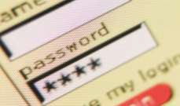
How To Approach / Conduct an ITGC Review:
One needs to obtain an understanding of the below mentioned guidelines in order to conduct a comprehensive & robust ITGC Review:
Types of ITGC:
Logical Access Controls (Being covered in this issue)
Program Change Management Controls. (Being covered in this issue)
Data Centre Physical Security Controls. (To be covered in the next issue)
System & Data Back Up & Recovery Controls. (To be covered in the next issue)
Segregation of Duties (SOD) Controls. (To be covered in the next issue)
A. Logical Access Controls:
Logical Access Controls are the tools used for identification, authentication & accountability in the computer information system.
Following are the types of logical access controls prevalent in the information system:
Password Management – Complexity of the password, Auto Lock on failed attempts, previous history & password sharing.
Access Management – Process of Approval, SOD Review, Regular Review of Access & Deactivation of Access.
Password Management
Complexity of the Password:
There should be a password policy of the company which should cover the following complexity aspects:

Slide 5
The password should be strong & must consist of a combination of numbers (1,2,3…) alphabets (a, b, c…) & special characters (@, _ , #.....)
Common passwords /alphabets/numbers should be predefined in the system so as to unable a user to keep a password which is prone to easy cracking.
The system should automatically prompt for a password change after a predefined time period fed in the master.
The Auditor should ask for the password policy of the company & review the same. The same policy should be incorporated in the system so that the system will function as per the policy. Sample Policy enclosed as an attachment.
Auto Lock on failed attempts:
The information system should be configured in such a way that in cases of a predefined number failed log-in attempts, the system locks the user automatically.
Auditor to verify that the system is configured as per the above rule & maximum wrong log-in attempts allowed should not be more than 5 in any case.
Previous History:
The system must be configured in a manner that it refuses to accept a new password if it is same as your last three/five passwords. (Persons using net banking facility must be aware of this concept)
Auditor to verify the same in the system by verifying the password master.
HOW TO CHECK PASSWORD MANAGEMENT PRACTICALLY:
Ask the concerned IT personnel to create a dummy user ID in your presence & set password for that ID.
Try to put in a few easy passwords like 12345, abc123, 123abc, abcxyz. If the system has a strong password policy, it should not accept any of these passwords simply because of the reason that these are against the password policy of the company. Further, these passwords are too easy to crack.
Secondly, enter a wrong password 5 times for that dummy ID. If the policy has been properly implemented the account should lock out immediately after the 5th failed attempt.
Further, ask the IT Person to give you a screenshot of the password parameters that have been fed into the system. It looks something like this.

Slide 6
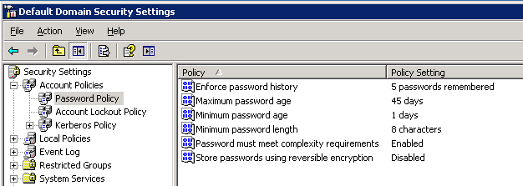
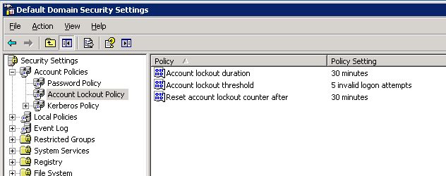
Password Sharing can be tested in the following manner:
  Extract the list of employees on leave for the last 5-10 days of the month (Monthly Closing Time) & simultaneously extract an activity log report for these employees for the
same period. Ideally, if there is any activity for these users during this period, then there is certainly password sharing in the organization.
  Secondly, we can verify the same using the concept of IP Addresses. Every Machine
connected to the system has its own unique IP Addresses & ideally one user id should be accessed from the one unique machine only. So , if a user id is accessed from more than one machine, then the same needs to be reported. However, the same can be ignored if there are genuine & approved reasons for the same.

Slide 7

Access Management
Process of Approval:
The approval granted for access to the system must be properly documented so as keep a record of what all rights have been approved for each user.
Further the access actually provided to the users must be reconciled with the access approved. This will help in ensuring unauthorized approvals & thus will retain confidentiality of information.
The Auditor should review the process of approval for access & check whether the same has been documented or not. Further it must be ensured that the approval should match with the actual access provided in all cases.
Regular Review of Access:
Review of the access provided on a regular basis helps in analyzing the genuine requirement of access & thereby restricting unauthorized & redundant.
As the profile of the users keep on changing regularly, the review should be carried out regularly by the respective process owners to ensure that only the access required by the user has been provided. For instance, an employee might be shifted from commercial team to finance team, thus his previous rights should be deleted prior to assignation of new rights to him.
The Auditor should verify whether there is a policy for regular review of the access. Further, if the review is carried, whether the same is documented (Sample document enclosed). This will help the auditor in ensuring the access provided to the users is being properly managed.

Slide 8

Deactivation of Access:
The system must be configured in such a manner so that as soon as any user is separated from the organization, his access is removed immediately. This will help in controlling fraudulent transactions in the system.
Practically, the leaving date of the employee is punched in the HR Master. The system is configured in a way that on a daily basis its runs a program & as & when the leaving date of the user arrives, on that day his ID is automatically locked. But this control fails if the leave date is not fed into the HR Master.
The Auditor can verify this control in the following manner:
Obtain a list of separated employees from the HR Department during the audit period. Secondly obtain a list of User IDs deactivated during the same period. Comparing the two, you may find cases where the users have left but their IDs are still active in the system.
B. Program Change Management Controls:
Program Change Controls focus on the following:
The modifications to the program/ system are approved by the owner(s).
The changes to the system are made in a secured & controlled environment.
The modifications made in the system must be adequately tested & documented.
Further an Auditor should keep the following points in mind while testing theses controls:
  The Change request for a program should be documented & should strictly be entertained on requirement basis. Further the impact of change to the existing system as well as the overall IT set up must be analyzed.
  Change requirement should be given to the developer who should be different from the releaser
& development should happen in an environment which is different from the Quality & Production environment.

Slide 9
Development testing should be comprehensive enough to cover unit, interface & user acceptance testing & the same should be documented.
User Acceptance testing should be done before the change goes live in the system & sign off from the user for the same must be obtained.
The access to make the changes directly in the production environment should not be available to developers, programmers & system administrator.

Slide 10


THINKING FORUM
As per one of the recent articles published in the Economic Times,
India has estimated Coal Reserves of 280 billion tonnes;
Of this, 110 billion are “proven reserves”;
At our current rate of production, even proven reserves are enough to carry on for more than 100 years;
But even then our coal production fall short of Actual requirement and to meet the deficit, our Country has to import Coal from Countries such as Indonesia, Australia, South Africa,
etc. (spent precious $ 116 billion during 2012-13 alone and making current account deficit to bloat )
Possible reasons for this mismatch could be low level of mechanization, inadequate use of
modern techniques in mining, low productivity and inefficiency levels, lack of adequate infrastructure, policy issues, etc.
(This is the amount of potential in this area which could be well explored by with the expertise of Professionals to help assist in Nation Building)

