Slide 1

Project on: DIGITAL SIGNATURE
Submitted To:
Faculty Incharge = Mr. Chandesh Chhabra

Slide 2
INDEX
Signatures and The Law
What is Digital Signature?
Objectives and Drawbacks of DS
Creation and Verification of DS
Cryptography
Data encryption and decryption
Digital Signature Certificate(DSC)
Classes of Digital Certificate
Challenges and Opportunities

Slide 3
Signatures and The Law
A signature is a handwritten depiction of someone’s name or nickname that a person writes on documents as proof of identity and intent. Signature writing serves the following purposes:
Evidence
Ceremony
Approval
Efficiency and Logistics
To achieve the basic purposes of signatures, a signature must have following attributes:
Signer authentication
Document authentication
Affirmative act
Efficiency

Slide 4
What is Digital Signature?
Digital signature means, Signature in digital form.
A digital signature is a code attached to an electronic document that uniquely identifies the sender.
Digital signature is a secure electronic signature which uses the encryption to authenticate the entity who signed the document.

Slide 5
Objectives and Drawbacks of Digital Signature
Objectives:-
Authentication- The process of verifying the identity of the owner is referred as authentication. There are two types of authentication in digital sign:
  Signer authentication
  Document authentication
Integrity- It refers to the accuracy of the data. In other words, the objective is that message should not be modified during transmission. It will remain intact. One way of verifying the data integrity in digital signature is referred as Hash Function.

Slide 6
Non-repudiation- It means owner cannot repudiate or reject the message. In other words, he cannot say that he did not signed the document or never seen this document.
Drawbacks:-
WYSIWYS- WYSIWYS refers to what you see is what you sign. It means that a message cannot contain hidden information that the signer is unaware of, and that can be revealed after the signature has been applied.
Association of digital signatures and trusted time stamping- Digital signature algorithms and protocols do not inherently provide certainty about the date and time at which the underlying document was signed. The signer might have included a time stamp with the signature, or the document itself might have a date mentioned on it.

Slide 7
Creation and Verification of Digital Signature
Digital signatures are created and verified by Cryptography.
Creation of Digital Signature:
Private key is used for the creation of Digital Signature. There are two steps involved in creating a digital signature from a message. The first step involves creating a Hash value (also known as a message digest) from the message. This hash value is then signed, using the signer's private key. Encrypting a message digest with a private key creates a digital signature as explained in the next slide.

Slide 8
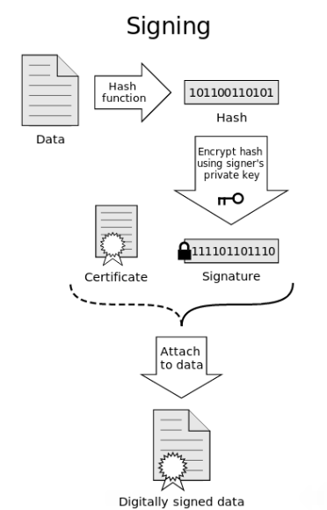

Slide 9
Verification of Digital Signature:
To verify a signature, both the message and the signature are required. First, a hash value must be created from the message in the same way the signature was created. This hash value is then verified against the signature by using the public key of the signer. If the hash value and the signature match, you can be confident that the message is indeed the one the signer originally signed and that it has not been tampered with.
The recipient uses the sender’s public key to decrypt the digital signature which authenticates that the message was from the trusted sender .

Slide 10
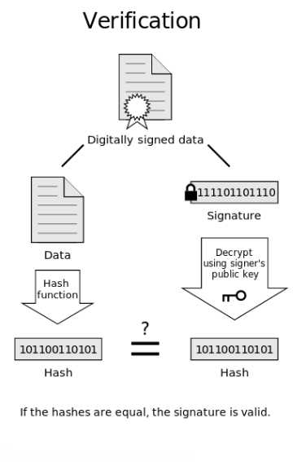

Slide 11
Cryptography
Cryptography is the use of codes to convert data so that only a specific recipient will be able to read it, using a key.
Cryptography transforms a message into a seemingly unintelligible form. It provides a secure environment, especially over non-secure media such as the Internet.
There are three classes of Cryptography:
  Symmetric/Private key cryptography
  Asymmetric/Public key cryptography
  Hash function

Slide 12
Data Encryption and Decryption
Encryption is the process of translating plain text data into something that appears to be random and meaningless.
Decryption is the process of converting encrypted/cipher text back to plaintext.
To encrypt more than a small amount of data, symmetric encryption is used. A symmetric key/private key is used during both the encryption and decryption processes. To decrypt a particular piece of cipher text, the key that was used to encrypt the data must be used.

Slide 13
The goal of every encryption algorithm is to make it as difficult as possible to decrypt the generated cipher text without using the key. If a really good encryption algorithm is used, there is no technique significantly better than methodically trying every possible key. For such an algorithm, the longer the key, the more difficult it is to decrypt a piece of cipher text without possessing the key.
It is difficult to determine the quality of an encryption algorithm. Algorithms that look promising sometimes turn out to be very easy to break, given the proper attack. When selecting an encryption algorithm, it is a good idea to choose one that has been in use for several years and has successfully resisted all attacks.

Slide 14
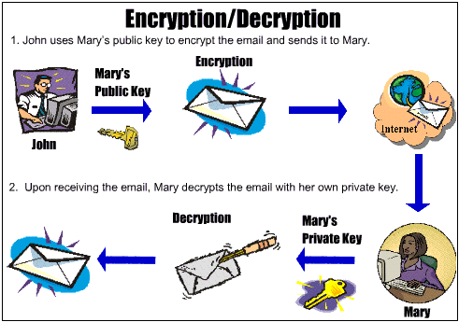

Slide 15
Digital Signature Certificate (DSC)
The digital certificate is a common certificate that provides a means to verify identity. A certificate is a set of data that identifies an entity. We can present a Digital Certificate electronically to prove our identity or our right to access information or services online.
Digital certificates are the electronic counterparts to driver license, passports and membership cards.
A digital certificate is issued by a Certification Authority (CA)
And signed with the CA’s private key.
A digitally signed certificate contains following:

Slide 16
Owner’s public key
Owner’s name
Expiration date of the public key
Name of the issuer
Serial number of the digital certificate
Digital signature of the issuer
Use of Digital Certificate:-
Digital certificates can be used for a variety of electronic transactions including e-mail, electronic commerce, groupware and electronic funds transfers. Netscape’s popular enterprise server requires a Digital Certificate for each secure server.

Slide 17
Need of Digital Certificate:-
Encryption alone is not enough as it provides no proof of the identity of the sender of the encrypted information.
Digital certificate removes this problem by verifying someone’s identity Electronically. Used in conjunction with encryption, Digital Certificate provides a more complete security solution, assuring the identity of all parties involved in a transaction.
Types and Status services for Digital Certificate:-
Certifying authority provide issuing, revocation, and status services for following three types of digital certificates:

Slide 18
Server Certificates- It enables web server to operate in a safe mode. They simply allow website visitors to safely transfer their personal information like credit cards etc. without worrying about theft or tempering,
Developer Certificates- They are used in conjunction with Microsoft AuthenticodeTM technology and provide customers with the information and assurance they need when downloading software from the internet.
Personal Certificates- They are used by individuals when they exchange messages with other users. These certificates allows to validate a website visitor’s identity and even restrict their access to certain portions of the websites.

Slide 19
Classes of Digital Certificate
Certificates can be issued (for a fee) in the following four classes:-
Class 1 certificates- Quickest and simplest to issue as they contain minimum checks on the user’s background. Only the name of the user, address, email address are checked.
For example : Library Card.
Class 2 certificates- Check for information like real name, social security number and date of birth. It requires proof of physical address and email.
For example : Credit Card.

Slide 20
Class 3 certificates- Strongest types certificates. It is used for loans acquired online and other sensitive transactions.
For example : Driving License.
Class 4 certificates- Most secured business certificates. In addition to the class 3 requirements, the certificate authority checks on things like Users position in his/her organization.
NOTE:-Considering the security in mind, Class 3 certificates and above are authorized by Ministry of Company Affairs 21 for online transactions.

Slide 21
Challenges and Opportunities
The prospect of fully implementing digital signatures in general commerce presents both challenges and opportunities.
Challenges: Implementing Digital Signature increases the following costs:-
Institutional overhead- The cost of establishing and utilizing certification authorities, repositories, and other important services, as well as assuring quality in the performance of their functions.
Subscriber and relying party costs- A digital signer will require software and has to pay Certifying Authority some price to issue a certificate.

Slide 22
Opportunities: Digital signatures, if properly implemented and utilized offer promising solutions to the problem of:-
Imposters, by minimizing the risk of dealing with imposters or person who attempt to escape responsibility by claiming to have been impersonated;
Message integrity, by minimizing the risk of undetected message tampering and forgery that a message was altered after it was sent;
Formal legal requirements, by strengthening the view that legal requirements of form are satisfied;
Open system, by retaining a high degree of information security, even for information sent over open, insecure, but inexpensive and widely used channels.

Slide 23
Thanks and Regards
Sagar

