Slide 1
Revised Schedule VI
Vs
MCA Taxonomy
Chapter 1
Loans & Advances

Slide 2
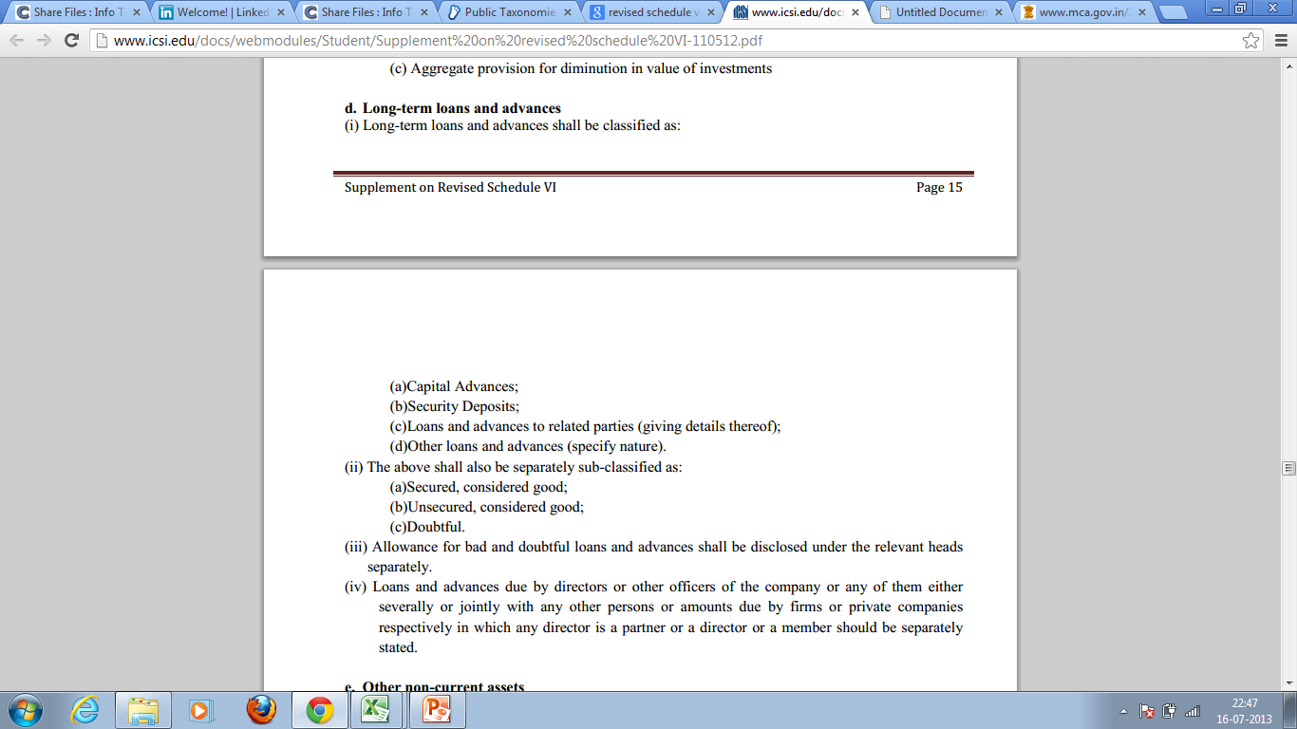
What does Revised Schedule say…
Generally, an organization can have different type of loans and advances, which can be classified into different categories as described above. However, Revised schedule VI doesn’t specifically requires to disclose the sub-classes of (d)Other Loans & advances. Although entities are required to disclose the nature in detail such as Prepaid Expenses, Advance TDS, Advance VAT, Other Advance Tax, MAT Credit, CENVAT Receivable, Service Tax receivable etc. Most of the entities club them into various common groups.

Slide 3
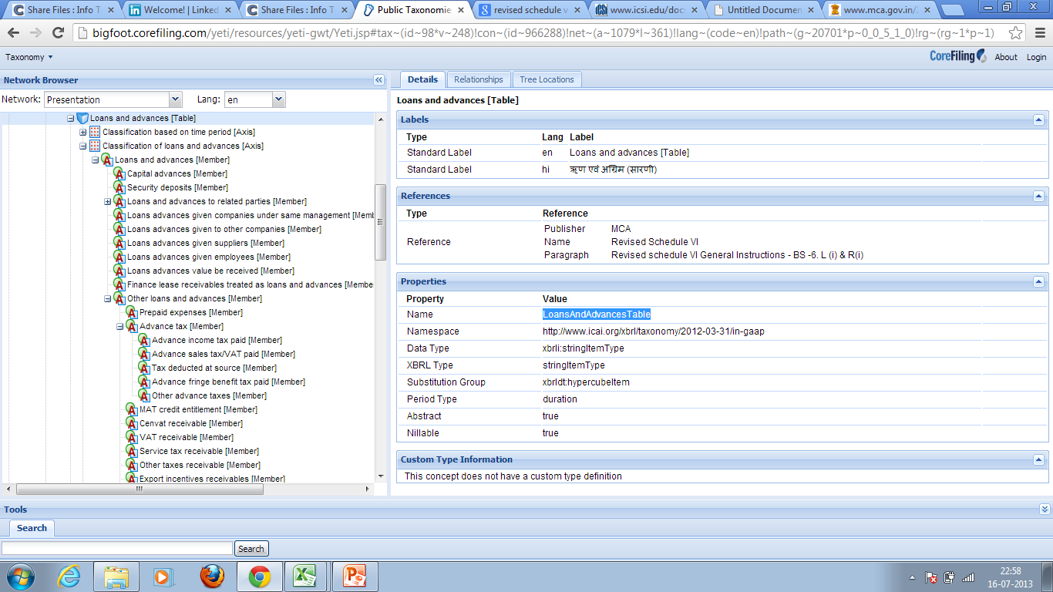
Now, check MCA Taxonomy hierarchy
As per Indian Taxonomy released by MCA, Loans & Advances needs to be disclosed in detailed manner as shown in screenshot. One can’t club all Advance Taxes to “AdvaceTaxMember” or all other loans & advances to “OtherLoansAndAdvancesMember”. This table is covered under “Exempt Parent Member Dimension” which means if child is provided, it is not mandatory to provide parent i.e. if “PrepaidExpensesMember”
& “MATCreditEntitlementMember” are provided,
it is not necessary to provide “OtherLoansAndAdvancesMember”.
However, it is not the other way round i.e. this table is not exempt under “child member dimension” which means that if some value for “OtherLoansAndAdvancesMember”is provided, it shall be mandatory to provide value to at least one of its child say “PrepaidExpensesMember”
or “MATCreditEntitlementMember”.
Therefore, it shall be mandatory to give details while filing XBRL to MCA. While preparing annual report, one should take care of these items, as if details is not given in annual report, your XBRL Vendor shall ask you these details or he/she will use dummy figures to reconcile the value at broader level.

Slide 4
For any procedure or pricing related query,
Contact us at :
CA XBRL SPECIALIST
Email : caxbrlspecialist@gmail.com
Mob. : 09718306191

