Slide 1


KUNA SAHU
(The group Leader)(Mob-8652869281)
Mr. Kuna k. Sahu
Reg. No.
WRO-________
ICAI-Kandivali Center
Mr. Pravin P. Rane
Reg. No.
WRO-________
ICAI-Kandivali Center
BATCH TIME: 8.00 a.m. – 12.00
BATCH STARTED FROM 17 DEC.2012

Slide 2


PROCESS TO OBTAIN DIGITAL SIGNATURE

Slide 3



Reason for selection of the Topic
NOW A DAYS DIGITAL SIGNATURE IS PLAYING A VITAL ROLE IN VIRTUAL MALLS, ELECTRONIC BANKING & OTHER ELECTRONIC SERVICES

Slide 4
PART-I
DIGITAL SIGNATURE
1. Definition
2. Digital Signature Certificate
3. Physical Signature V/s Digital
Signature
4. Types of User
5. Process to obtain DSC
6. Classes of DSC

Slide 5
Definition
PART-II
“Digital Signature” means authentication of any electronic record by a subscriber by means of an electronic method or procedure in accordance with the provisions of section 3 of the Information technology Act,2000.

Slide 6
What is a Digital Signature Certificate
( DSC) ?
Digital Signature Certificate is your PASSPORT on the Internet used to:
Identify yourself
Help the software application to authenticate you and:
  Help you to secure your data
  Give legal sanctity to the transaction

Slide 7
Physical Signature /
Digital Signature
Physical Signature | Digital Signature
Physical Signature is just a writing on paper | Digital Signature encompasses crucial parameters of identification
Physical Signature can be copied | It is IMPOSSIBLE to copy a Digital signature
Physical Signature does not give privacy to content | Digital Signature also enables encryption and thus privacy
Physical Signature cannot protect the content | Digital Signature protects the content

Slide 8
Types Of Users
MCA (Government) Employees.
Professionals (CS,CA,CWA & Lawyers) who interact with MCA and Companies in the context of Companies Act.
Authorized Signatories of the Company including MD,Directors,Managers or Secretary.
Representatives of Banks & Financial Information.

Slide 9

Process to obtain DSC.
Step 1 : Download Root Certificate.
Step 2 : Selecting a Certifying Authority.
Step 3 : Visit the Website of the Certifying Authority.
Step 4 : Select the type of Certificate needed.
Step 5 : Submit an Online Request.

Slide 10
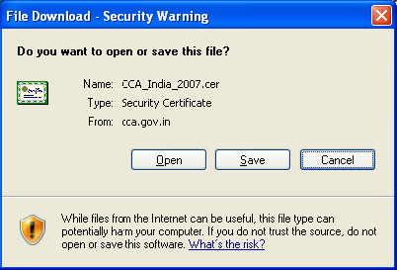

Step-1: Downloading root certificate
Visit the website of the Controller of Certifying Authorities (CCA)
at www.cca.gov.in to obtain the digital signature certificate of the
CCA. This certificate must be installed on our computer before we
begin the process to obtain our personal digital signature
certificate. The detailed procedure for the same is outlined below:

Slide 11

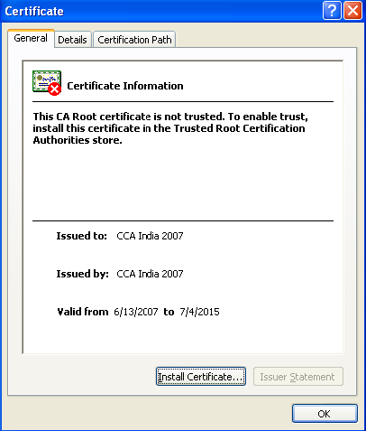
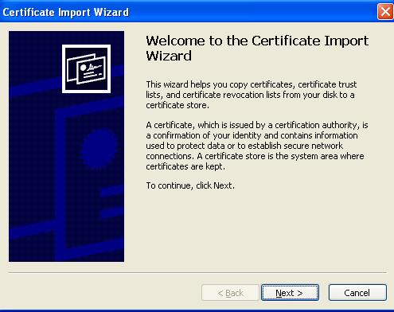

Slide 12

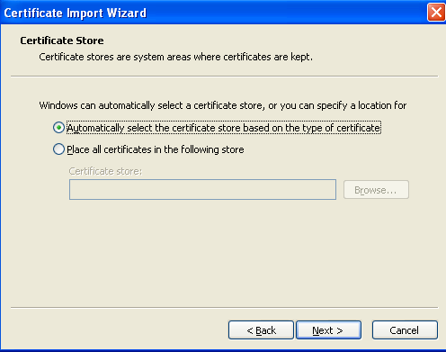
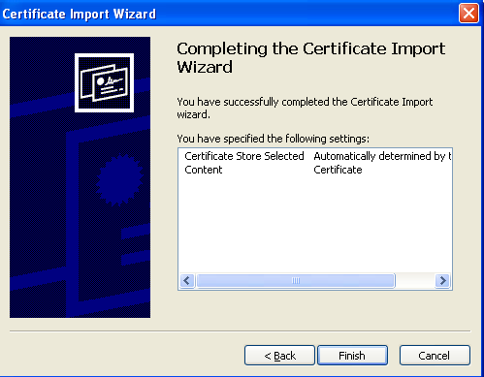

Slide 13

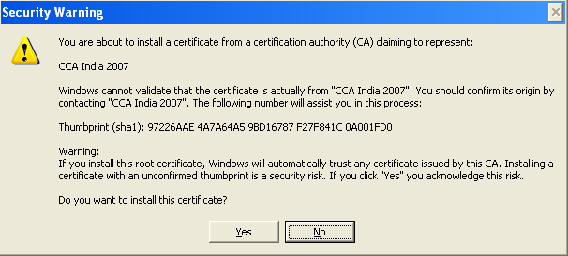
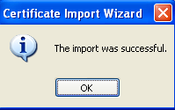

Slide 14

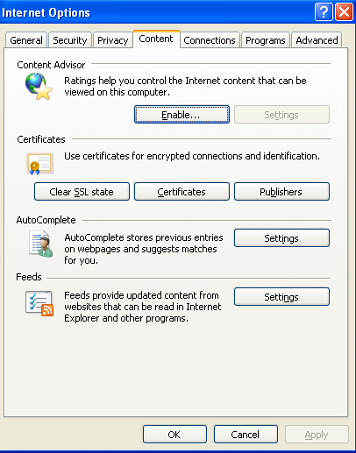
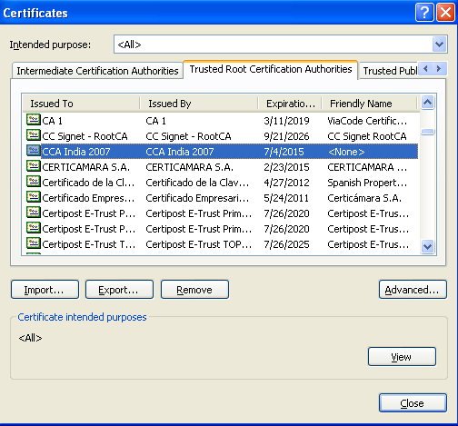

Slide 15
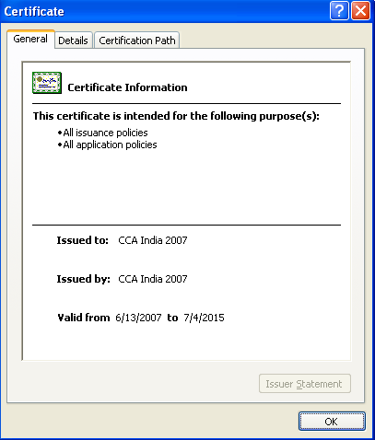

Slide 16

Step-2 : Selecting a Certifying Authority
Visit the website of the Controller of Certifying Authorities at www.cca.gov.in to obtain a list of licensed Certifying Authorities in India. This website also provides the disclosure records of the various licensed Certifying Authorities. The links to the websites of these Certifying Authorities are also provided.
For this illustration we have selected the Tata Consultancy Services Certifying Authority (CA) which has the official website www.tcs-ca.tcs.co.in

Slide 17

Step-3 : Visit the Website of the Certifying Authority.
A visit to the www.tcs-ca.tcs.co.in website shows that the CA provides three types of digital signature certificates.
These are:
Classes of DSC:
Class-1 Certificate
Class-2 Certificate
Class-3 Certificate

Slide 18
Step-4 :
Select the type of certificate needed
We need a legally valid digital signature certificate for an individual. The relevant certificate is a Class 3 certificate.
Step-5 :
Submit an online request
The next steps are to create a user account on the TCS CA
website, complete an online enrollment form and generate a
cryptographic key pair on our computer.

Slide 19

Class-1 Certificates
Class-1 Certificates are personal email Certificates that allow
you to secure your email messages. These Certificates can be
used to:
Digitally sign email
Encrypt email
Authenticate to Web Servers
Class-1 Certificates however, do not facilitate strong
authentication of the identity of the Subscriber; hence are not
intended for, and shall not be relied upon, for commercial use
where proof of identity is required.

Slide 20
Class-2 Certificates
Class-2 Certificates are issued as Managed Digital Certificates to
employees/ partners/ affiliates/ customers of business and government
organizations that are ready to assume the responsibility of verifying
the accuracy of the information submitted by their employees/ partners/
affiliates/ customers.
The organization is given a Digital Certificate signed by TCS-CA to
initiate the process of issuing Certificates to its employees/ partners/
affiliates/ customers.
In the case of a Class-2 Certificate, the verification of details supplied
with the request for a Digital Certificate is done by the organization
appointed as a Sub-CA/RA under the TCS-CA Trust Network.

Slide 21

Class-3 Certificates
Class-3 Certificates are issued to individuals, companies and
government organizations. They are typically used for electronic
Commerce applications such as electronic banking, electronic data
Interchange (EDI), and membership-based on-line services, where
security is a major concern.
The level of trust created by the Digital Certificate is based
on the authentication procedures used by the CA to verify your identity
and the service guarantees offered by the CA to back up that
authentication.
TCS-CA uses various procedures to obtain evidence of your identity
before issuing you the Class-3 Certificate. During verification, you will
also need to be physically present before a Registration Authority (RA),
qualified by TCS-CA due to their neutrality and reliability.

Slide 22

BIBLIOGRAPHY OF DSC
PART III
FIST INVENTED BY : Whitfield Diffie and Martin
Hellman
IN THE YEAR : 1976
GOVERNED BY : Controller of Certifying
Authorities
ISSUED BY : MTNL, TCS, NIC, IDBRT,
E-MUDHRA etc.

Slide 23
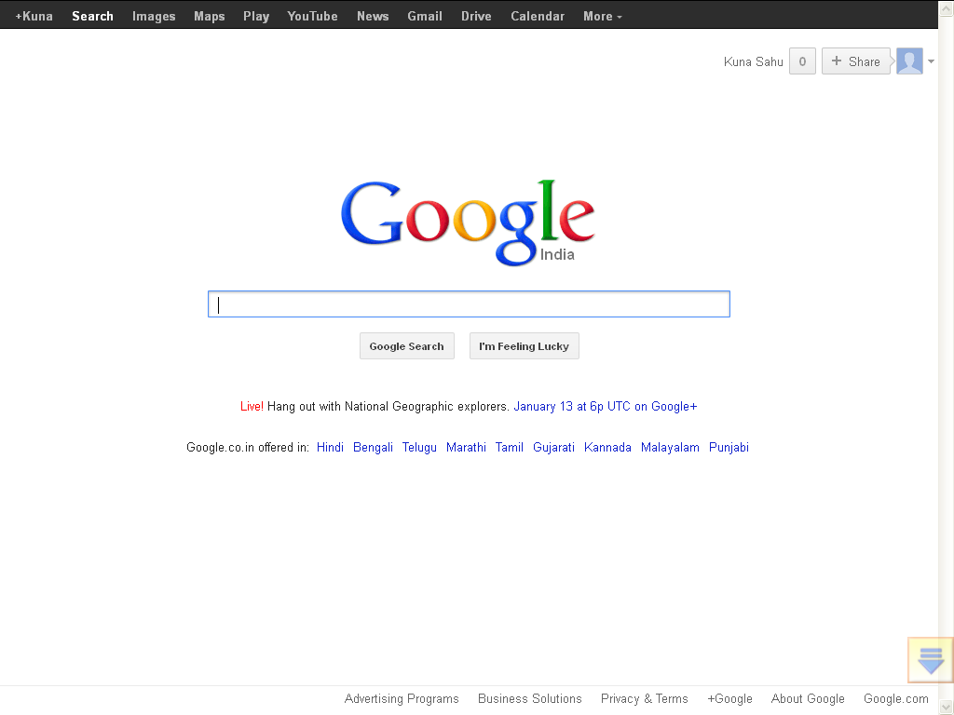
SOURCE OF INFORMATION

Slide 24


