Slide 1
EXCEL
as an Audit tool
present by
P. NAGALAKSHMI
CA (final)
Articled Assistant – CA PAUL THANGAM
COIMBATORE

Slide 2
Objective of this presentation
To disseminate the underlying concepts of Excel to help practitioners, fraud examiners and management to analyze the financial transactions and to improve their professional efficiency.

Slide 3
Presentation sequence
Introduction
Data export to Excel
Scope of Excel in auditing
Excel features in Tax audit
Excel features in Internal audit
Excel features in VAT audit
General Excel features
Conclusion

Slide 4
History of Excel
Excel 2.05 11/1987
Excel 1.0 30/09/1985
Multiplan 1982
Excel 5.0 – Excel 9.0 1989 - 1994
Microsoft
Excel 95
Excel 97
Excel 2000
xcel
Excel XP 2001
Excel 2003
Excel 2007
Excel 2010

Slide 5
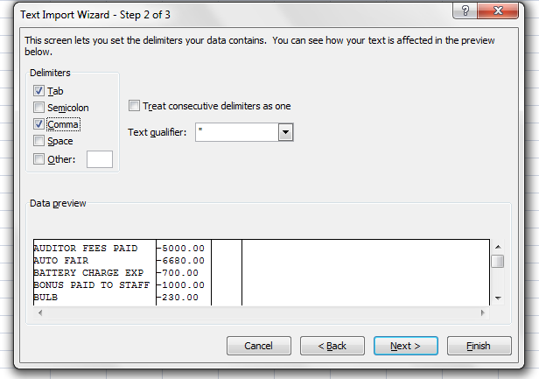
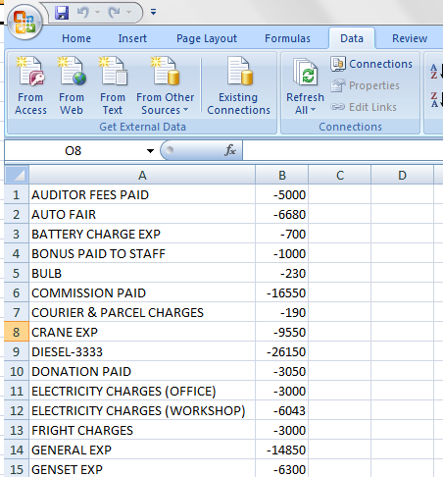
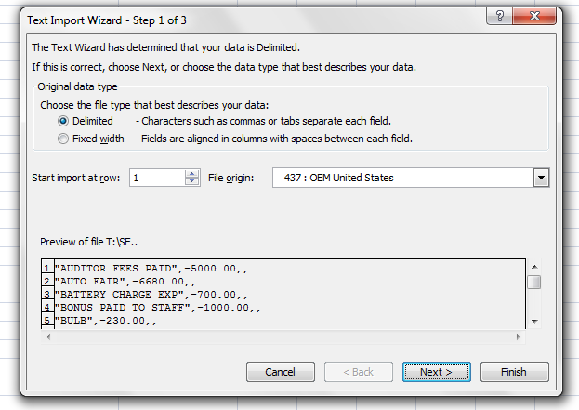
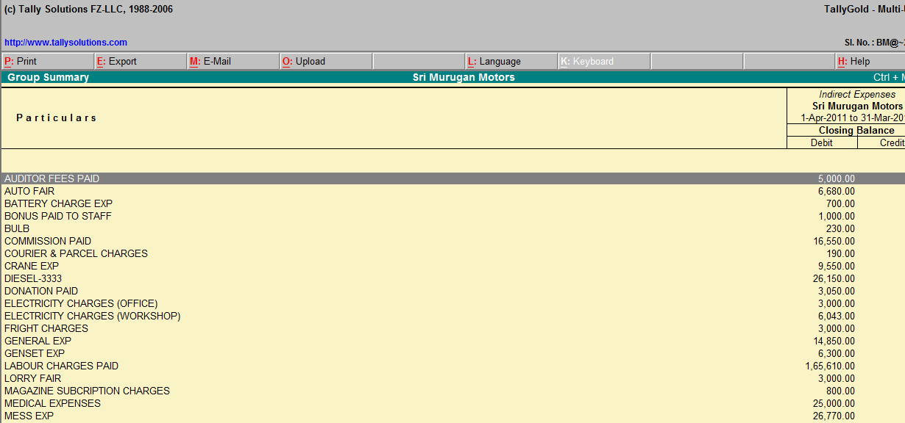
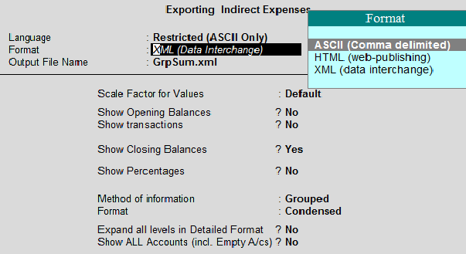
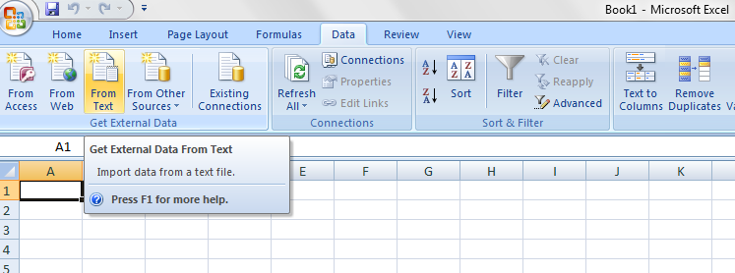
Data export to Excel

Slide 6
Scope of Excel in auditing
Tax audit
Vat audit
Bank audit
Internal audit
Concurrent audit

Slide 7
Excel features for Tax Audit
To check TDS provisions
To check compliance u/s 40 A(3)
[Payment exceeding Rs 20000/- to a single person in a single day]
3. To calculate depreciation allowable u/s
35D
4. To prepare Vat audit report (form 3CD)

Slide 8
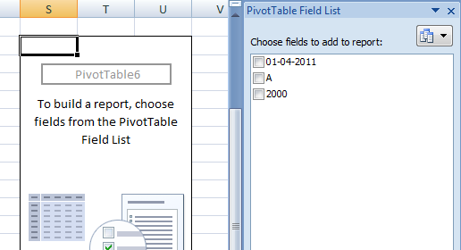
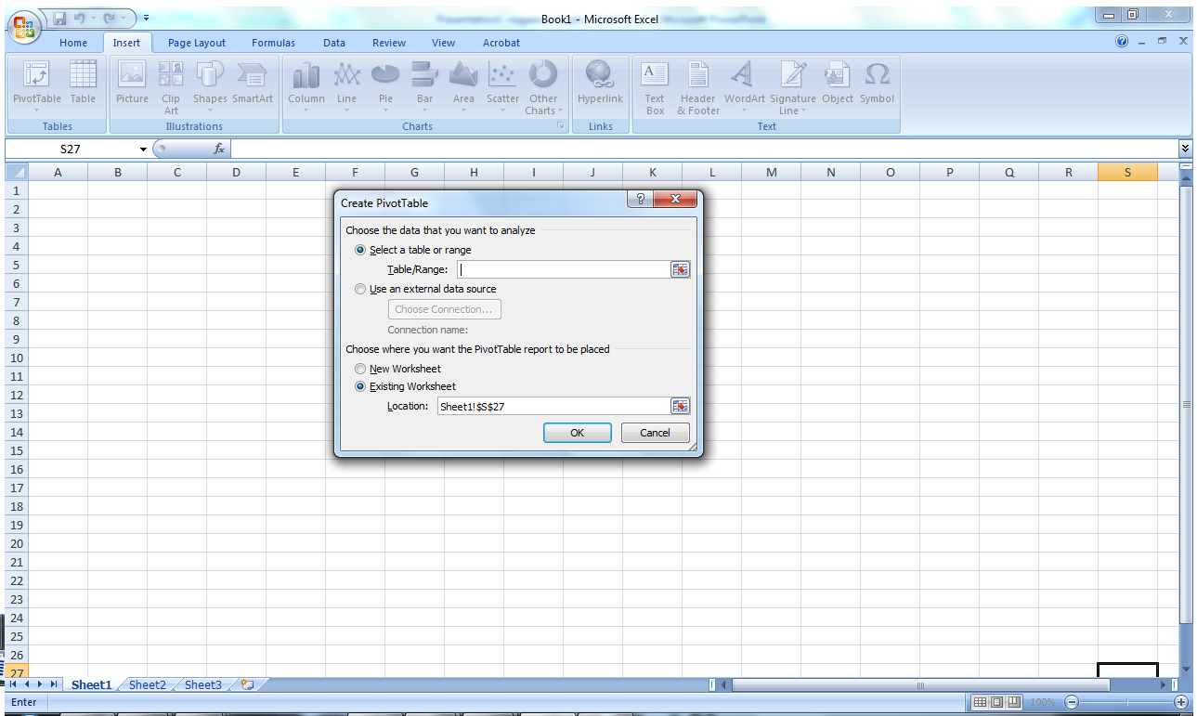
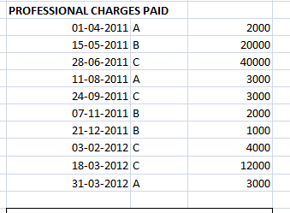
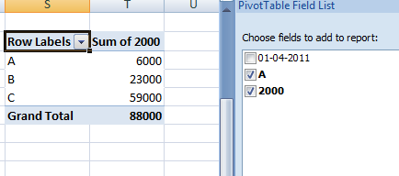
Excel features to check TDS

Slide 9
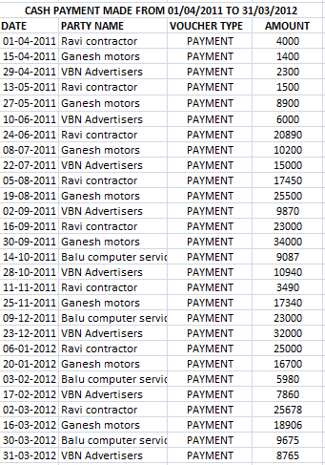
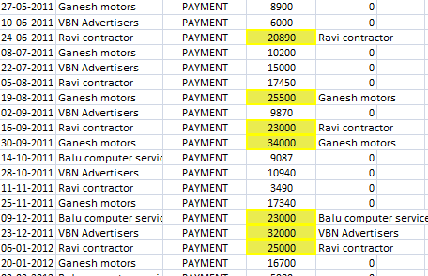
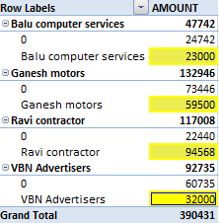
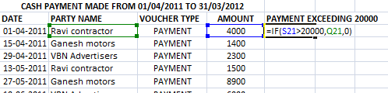
Excel feature to check compliance u/s sec 40 A(3)

Slide 10
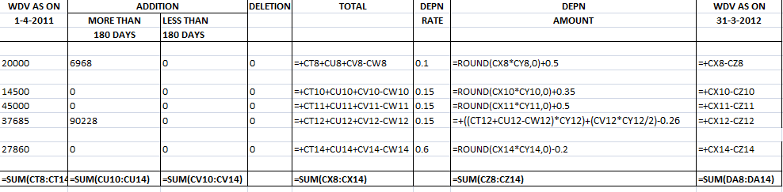
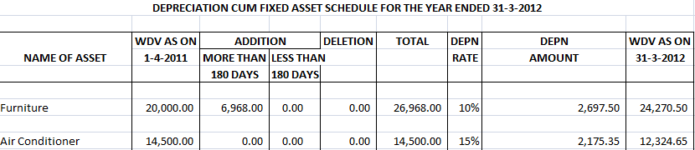
Excel feature to calculate depreciation
u/s 35D

Slide 11
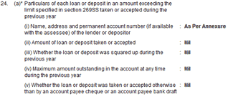
Excel features in preparation of Form 3CD
Line no:24(a) – As per sec 269SS, any loan repaid or accepted exceeding Rs 20000/-
IF function

Slide 12

2. Line no:28 – Calculation of percentage of yield, shortage or excess of raw material and finished products
Percentile (array, k)

Slide 13

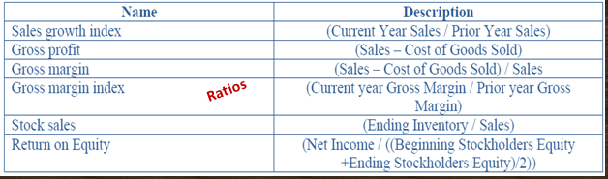
3. Line no:32 – Calculation of ratios

Slide 14
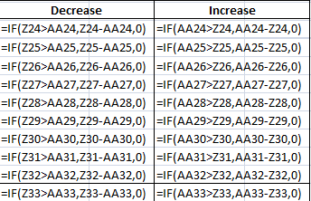
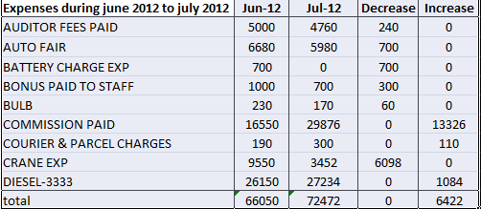
Excel features in Internal audit

Slide 15
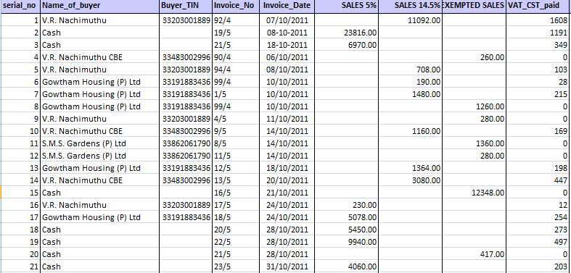
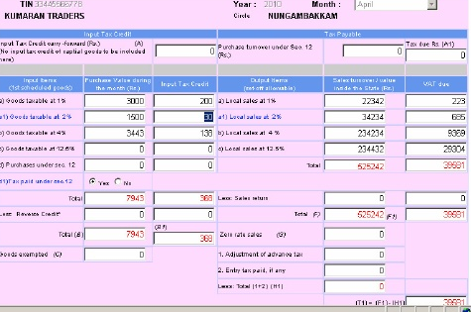
Excel features in VAT audit

Slide 16
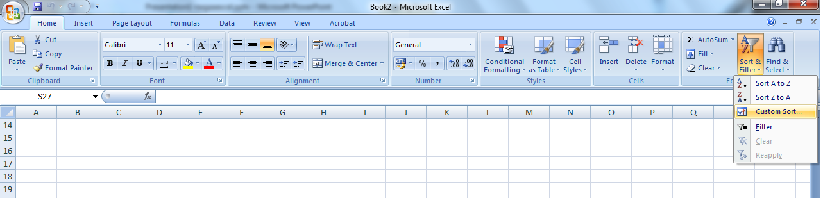
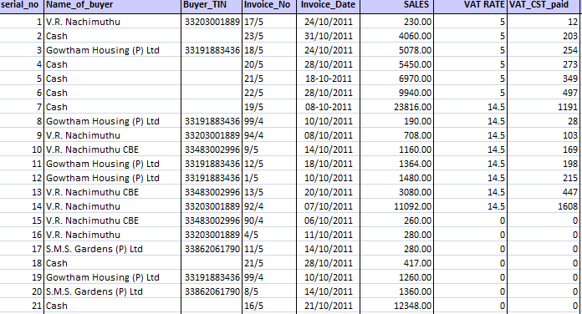
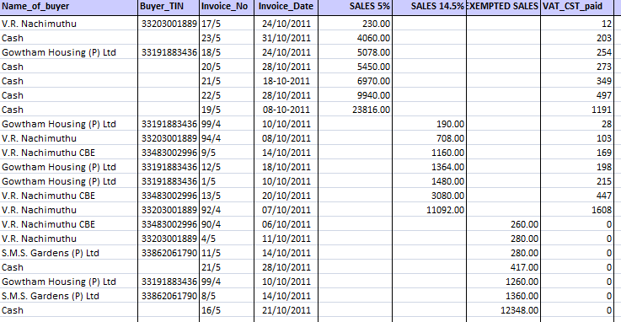
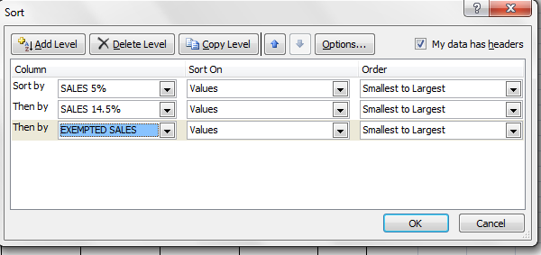

Slide 17
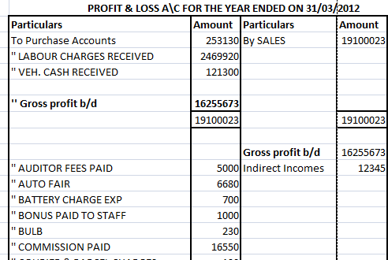
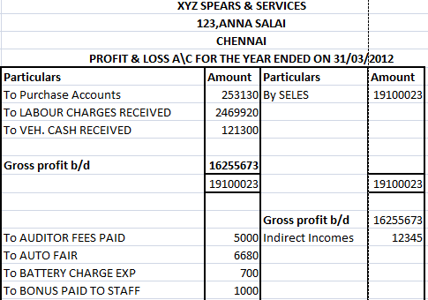
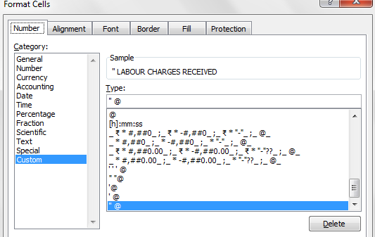
GENERAL EXCEL FEATURES
Profit & Loss A\c {use of ‘’@}

Slide 18
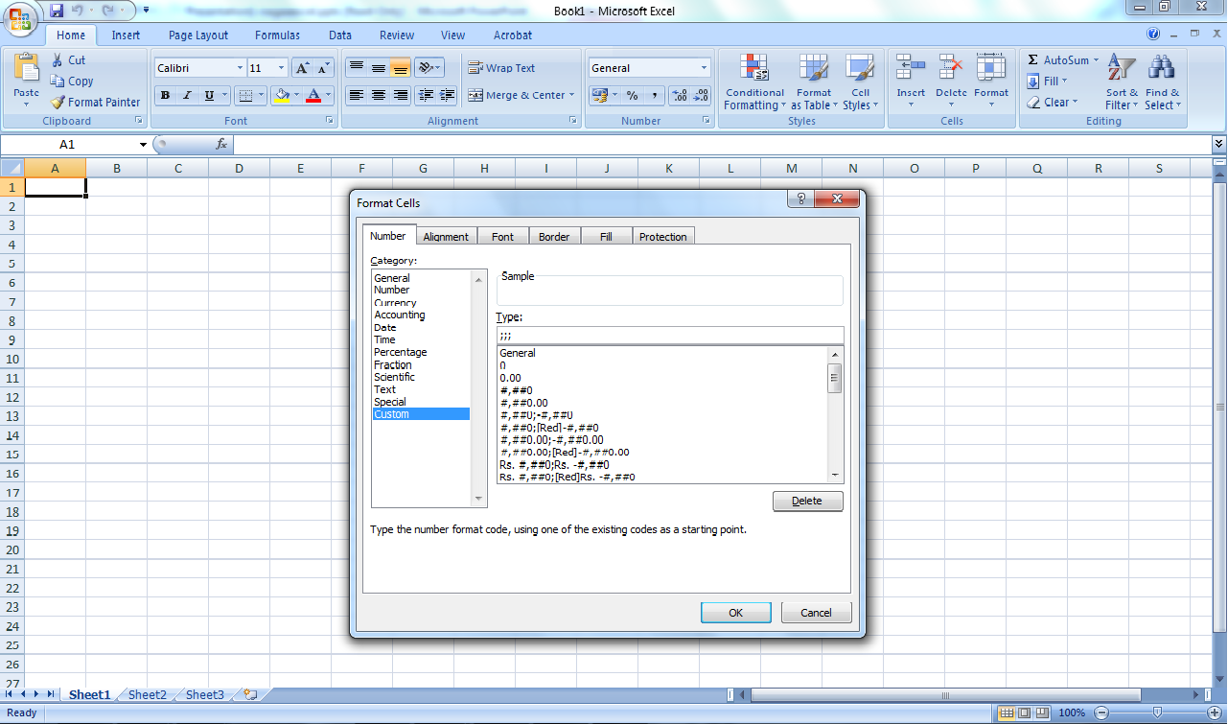
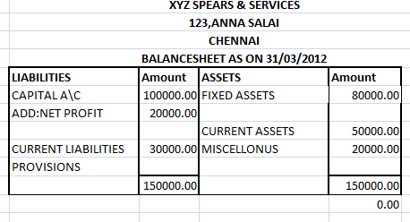
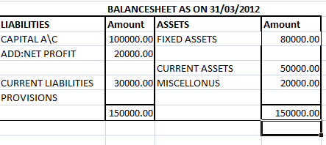
Balance sheet A\c {use of ;;;}

Slide 19
Conclusion
The audit features in Excel software was disseminated to prevent and proactively detect auditing inefficiencies and ineffectiveness.
The scope of Excel software was briefed in terms of different audits.
Few of general Excel auditing features were illustrated.

Slide 20
“no one can’t survive without
MS Excel to excel”
Thank you all
P. Nagalakshmi

