Slide 1
V- Look Up

Slide 2
Lookup Tables
Often, we need to retrieve data that is stored in a table
For example, consider these metals and their properties:
Metal | Modulus of Elasticity, psi | Density, lb/in³ | Yield Strength, psi
Aluminum 2014-T6 | 10,600,000 | 0.101 | 60,000
Aluminum 6061-T6 | 10,000,000 | 0.098 | 37,000
Stainless Steel 304 | 28,000,000 | 0.284 | 30,000
Structural Steel A36 | 29,000,000 | 0.284 | 36,000

Slide 3
Lookup Table Example
A design engineer at a certain company performs calculations using the properties of these four materials often
Rather than looking up and typing in these values every time, Excel can use a lookup table to store these values and retrieve the correct values for the specified material

Slide 4
Lookup Table Example
In this example, since the properties to be retrieved are in columns, the table is called a vertical lookup table
If the data to be retrieved were in rows, instead, the table would be a horizontal lookup table
The vertical lookup table command in Excel is:
VLOOKUP(lookup value, table range, column number, true/false)

Slide 5
Vertical Lookup Table Command
VLOOKUP(lookup value, table range, column number, true/false)
Lookup value is the cell containing the identifier for the data to be looked up. In our case, the cell will contain the name of the material
Table range is the group of cells containing the lookup table
Column number is the column containing the desired property of the material
The true/false argument is optional: true allows for an approximate match, while false requires an exact match

Slide 6
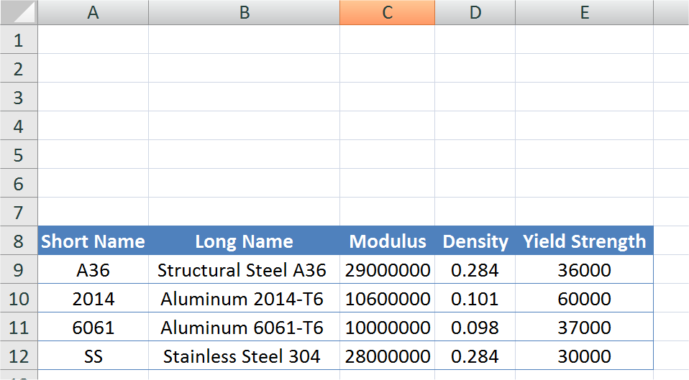
VLOOKUP Example
Here is the data entered into Excel
Sometimes it is convenient to enter the data table into a separate sheet of the workbook
Note that we have given each material a “Short Name” so that we do not have to type in the complete name every time

Slide 7
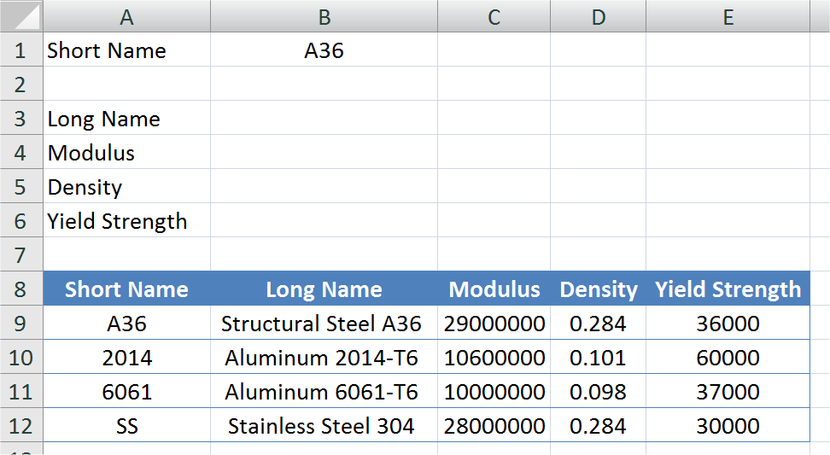
VLOOKUP EXAMPLE
The short name is entered into cell B1. We want to have the other information filled in automatically

Slide 8
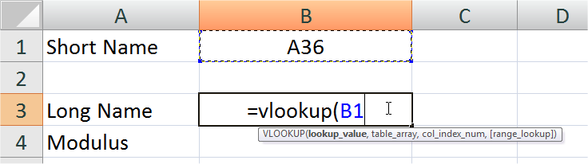
VLOOKUP EXAMPLE
The first argument is the cell address containing the short name of the material to be looked up

Slide 9
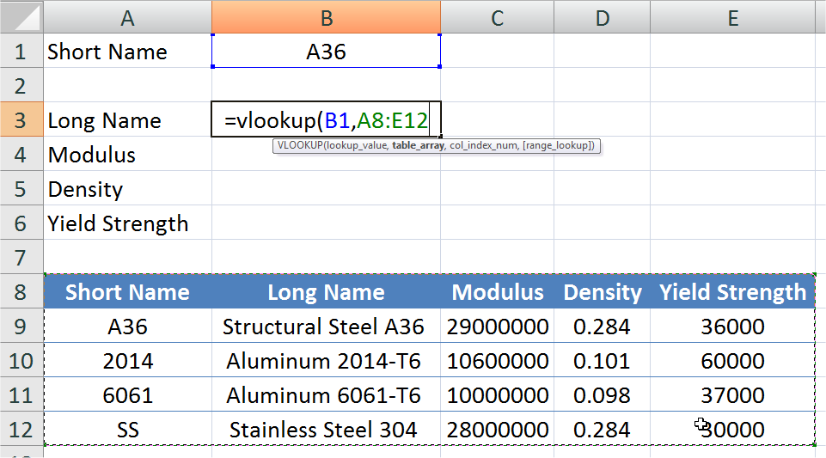
VLOOKUP EXAMPLE
The second argument is the cell range containing the lookup table. The first column of the highlighted range must contain the independent variable (the Short Name)

Slide 10
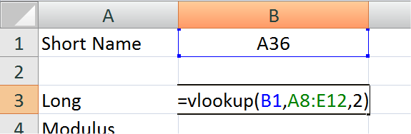
VLOOKUP EXAMPLE
The third argument contains the column number containing the desired property. Remember that the column containing the short name is column number 1. Therefore, the long name is in column number 2.

Slide 11
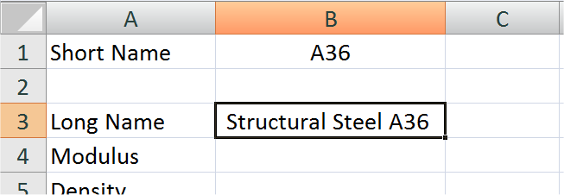
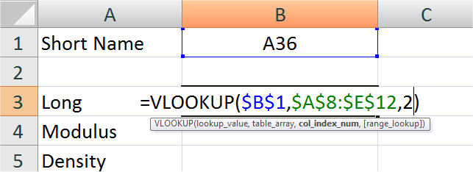
VLOOKUP EXAMPLE
Result:
By locking the cell addresses, this formula can be copied to other cells…

Slide 12
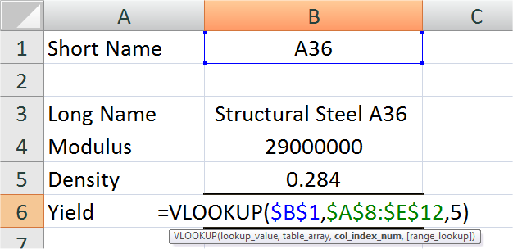
VLOOKUP EXAMPLE
Change only the column number to correspond to the property desired:
Yield Strength is in the 5th column

Slide 13
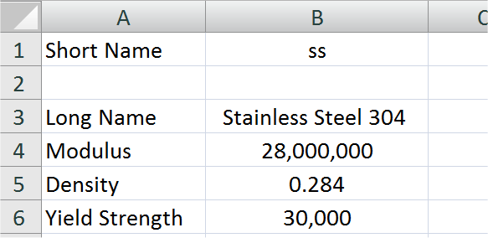
VLOOKUP EXAMPLE
Note that the names are not case-sensitive:

Slide 14
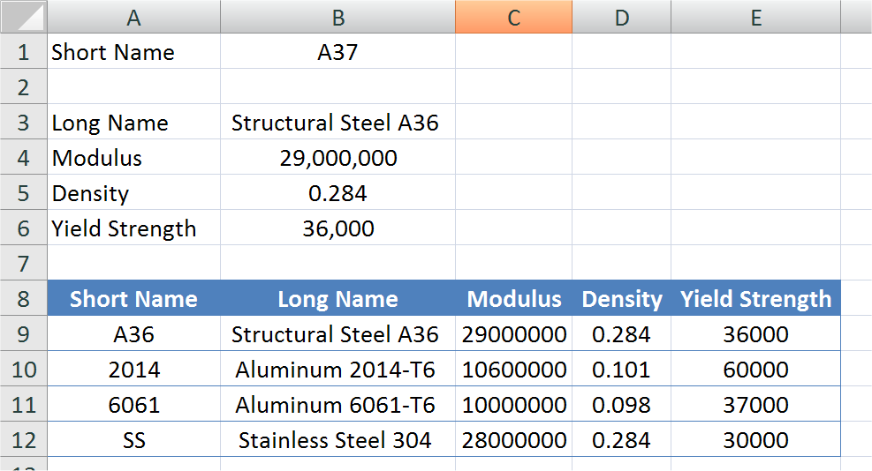
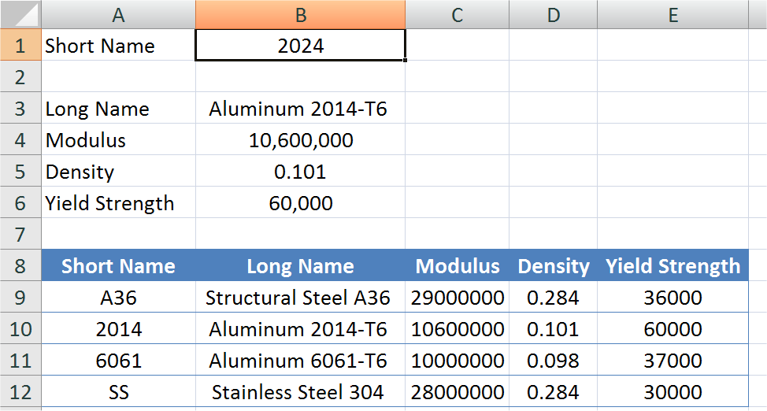
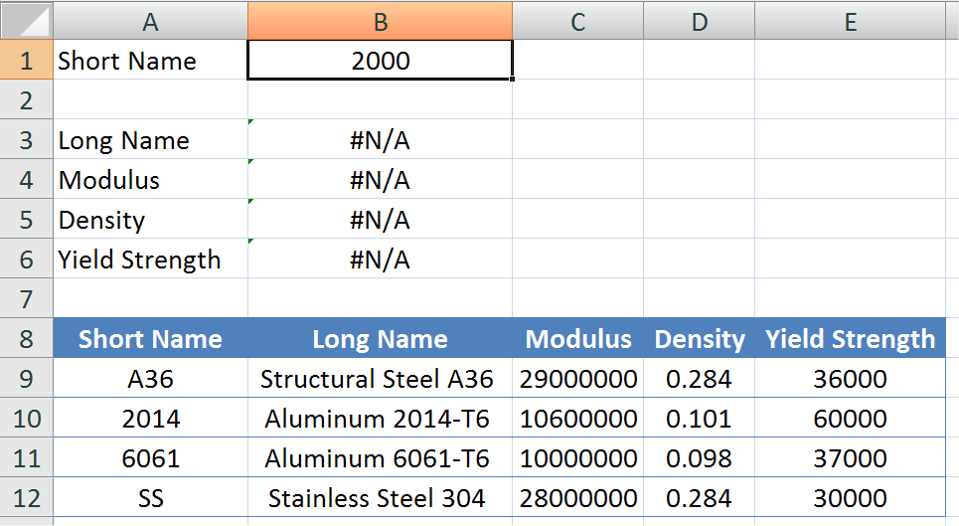
VLOOKUP EXAMPLE
In these cases, note that an inexact match still often returns a value:

Slide 15
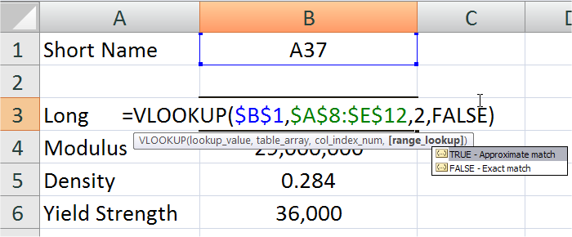
VLOOKUP EXAMPLE
Often, we want to require an exact match
To do this, set the optional fourth argument is added:
  TRUE = find approximate match
  FALSE = require exact match

Slide 16
A Note About Lookup Tables
Lookup tables will not interpolate values!
When looking up a numerical value, if an exact match is not found (and the “TRUE” option allows for an approximate match), then the value searched for is rounded down to the next tabulated value.
We will illustrate this in the following example

Slide 17
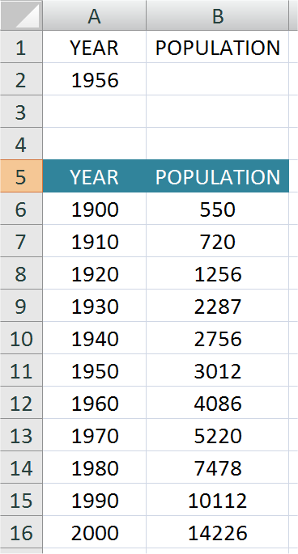
Population Example
The population data of a town is given in the table
We want to use a lookup table to report the population for any year entered

Slide 18
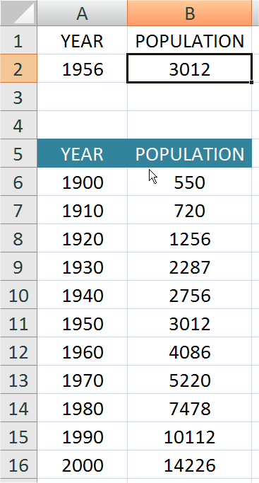
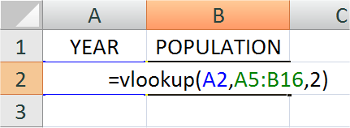
Lookup Table Solution
Note that using the VLOOKUP function (with the TRUE/FALSE option left off or set to TRUE) returns the population for the next year in the table lower than the input value:

Slide 19
THANK YOU

