Slide 1
INFORMATION TECHNOLOGY TRAINING PROGRAMME
PROJECT
SUBMITTED TO: SUBMITTED BY :MANISH KUMAR
Mr. Alok Gupta ROLL NO.57
(FACULTY INCHARGE) REG.NO.NRO
BATCH TIMING : 12.30PM TO 5.30PM
(NOV-DEC)
.

Slide 2
Project Title
MS ACCESS – QUERY TAB

Slide 3
QUERRY WIZARD
CONTENTS
Queries
1.Select Query………………………………………………………………………….
2.Crosstab query…………………………………………………………………..
3.Action Query……………………………………………………………………
I. Append Query………………………………….
II. Delete Query………………………………......
III. Make Table Query…………………………......
IV. Update Query…………………………………
4. Parameter Query………………………………………………………………..
5. Aggregate Query………………………………………………………………...

Slide 4
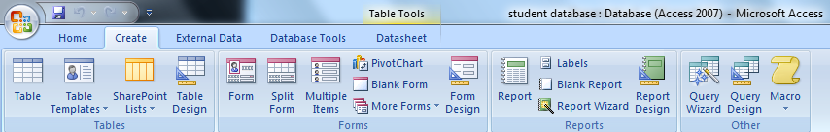
QUERY
Query can be defined as an operation that extracts records from a database based on a given condition. A query consists of search criteria expressed in a database language called SQL. For example, the query can specify that only certain columns or only certain records be included in a result.

Slide 5
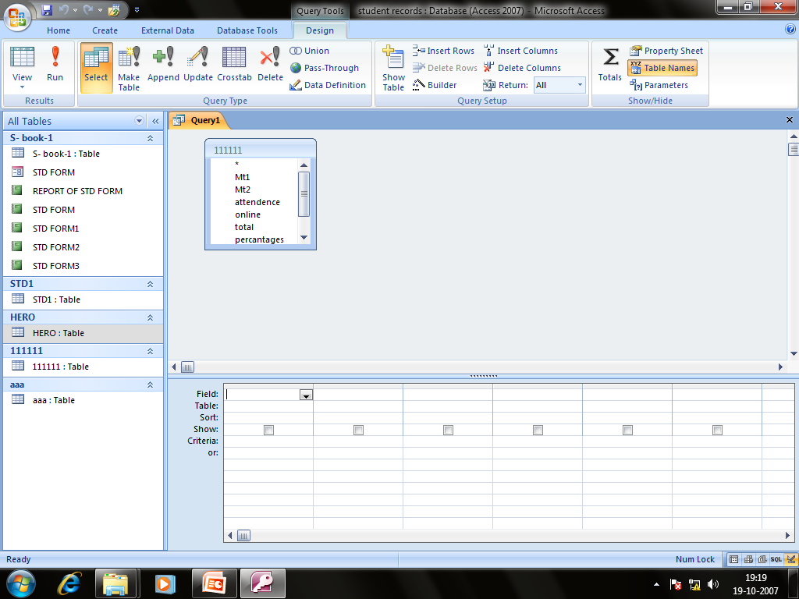
Select query:
The select query is the simplest and most common type of query available in MS-Access. Such queries may be used to select and display data from either one or more table(s) depending upon the requirement.

Slide 6
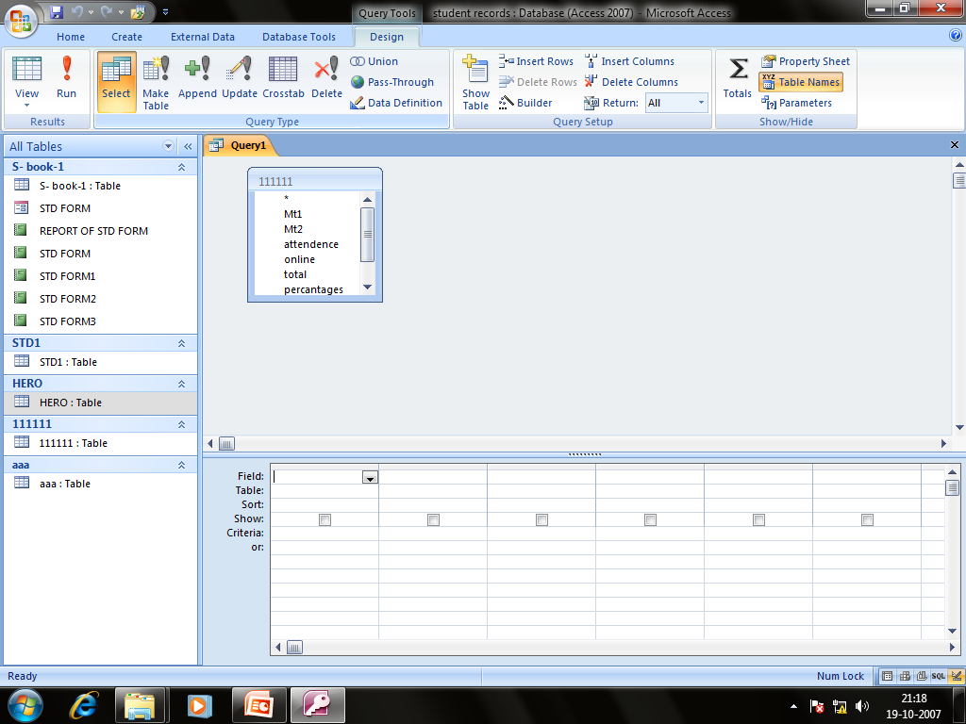
Crosstab query:
Crosstab queries are useful for summarizing information, calculating statistic, spotting bad data and looking for trends.

Slide 7
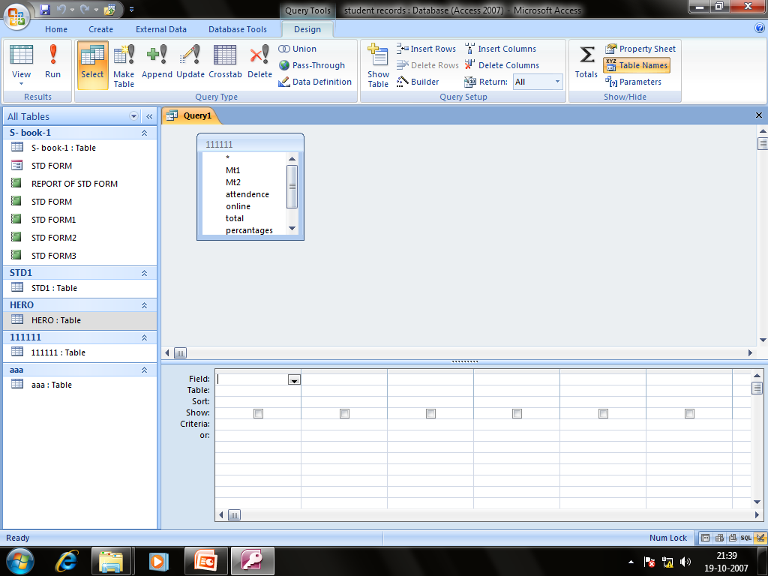
Action query:
Action query is used to create new table(S) and update records or creating entirely new ones in a table(s).

Slide 8
Types Of Action Query
Append Query
Delete Query
Make Table Query
Update Query

Slide 9
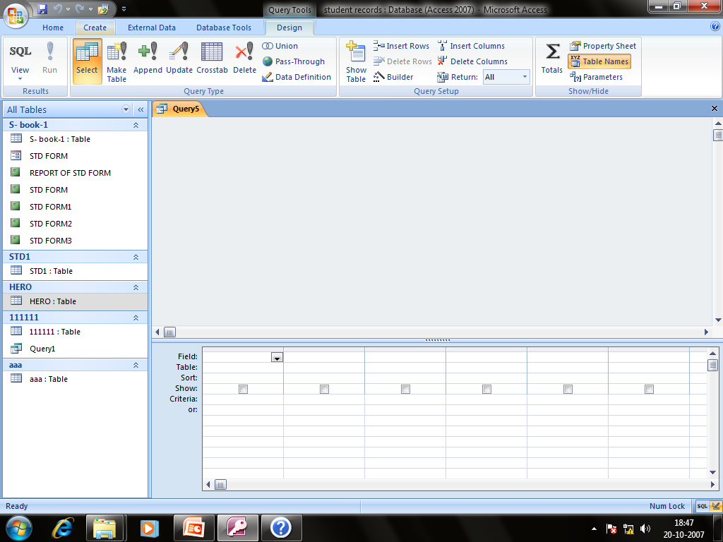
Append query
  An append query adds a set of records (rows) from one or more source tables (or queries) to one or more destination tables.

Slide 10
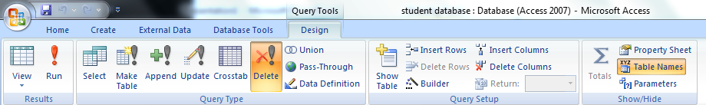
DELETE
The delete query deletes all records in an underlying tables from the set results of a query. In simpler terms, we can say that, the delete query is used to delete a group of records that meets specific search criteria. The process for setting up a delete query depends on whether the user wants to delete records from single table or from multiple tables that have an established and valid relationship among them.
Fig.1.11 Delete Query Option

Slide 11
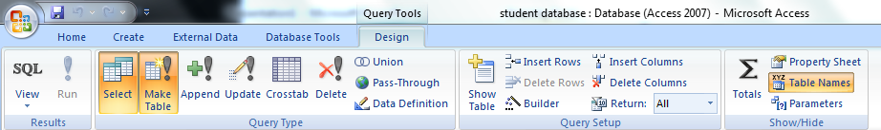
MAKE TABLE
The make table query creates a table based on the set results of a query. In simpler terms, we can say that, the make table query is used to create a new table and populate it with data from one or more existing tables. By creating a make table query, the users actually created a backup copy of a table. Moreover, it may be useful, when the user wants to save delete records in a separate history table for future use. In may also be useful in situations, where a subset of data needs to be generated as a report and may be created as a table for exporting to other applications.
Fig.1.15 Make Table Query

Slide 12
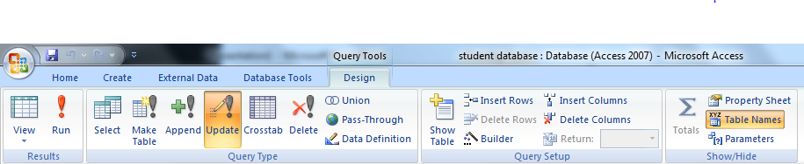
UPDATE QUERY
The update query allows for one or more field in tables to be updated. In other words, we can say that, the update query allows the user to make global changes to data in one or more tables.
Fig.1.5 Update Query Option

Slide 13
PARAMETER QUERY
A Parameter Query is used to pass a parameter to different query such as an action or a select query. The parameter can either be a value or a condition. This parameter conveys to the other query what is supposed to be done. It allows for a dialog box where the end user can enter whatever parameter value they wish each time the query is run. The parameter query can be seen as a modified select query.

Slide 14
Aggregate Query
Aggregate query is a special type of query which works on other queries such as selection, action or parameter but instead of passing a parameter to another query it totals up the items by selected groups.

Slide 15
SQL Aggregate function
  SUM
  AVG
  MIN
  MAX
  FIRST
  LAST
  GROUP BY
  COUNT

Slide 16
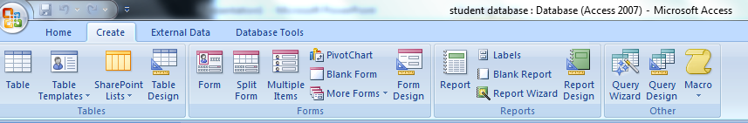
QUERY WIZARD
Query wizard may be used by a user to automatically create a simple query. Although, the query wizard provides less control in handling a query but surely, query once created using query wizard can always be modified using design view.
On the create tab ,in the other group ,click Query wizard
Fig.1.25 Query Wizard

Slide 17
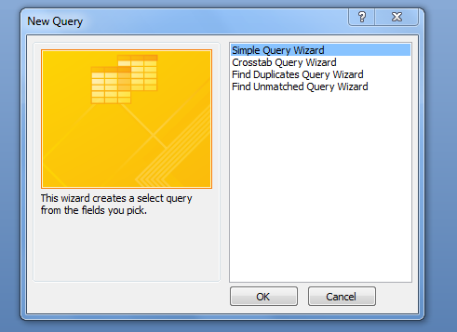
QUERY WIZARD
In the New Query dialog box, click Simple Query Wizard, and then click OK.
Fig.1.26 New Query Dialog Box

Slide 18
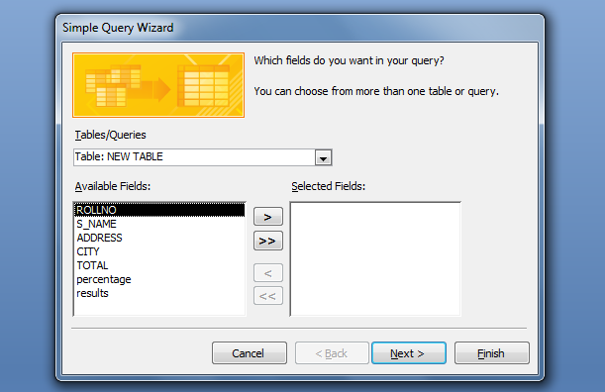
QUERY WIZARD
We will see screen similar as shown below:
Fig.1.27 Simple Query Wizard

Slide 19
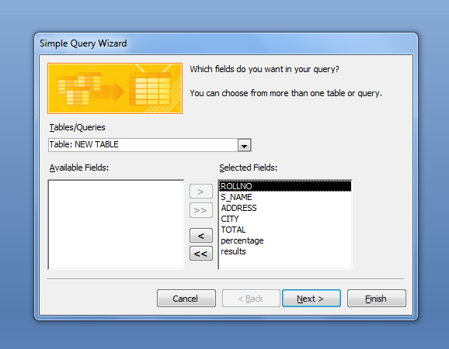
QUERY WIZARD
After selecting the desired fields from the table ,the results is as shown below
Fig.1.28 Simple Query Wizard

Slide 20
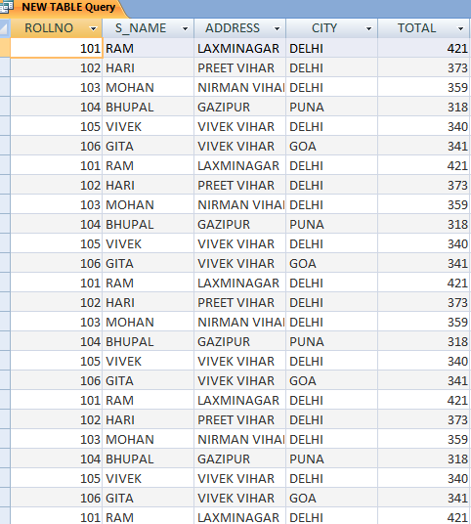
QUERY WIZARD
Resultant Sheet

