Slide 1
Project Report
On
Digital signatures
Submitted by:-
Submitted to:-
“ Sir Vinay Jain”
Student Name:- Rahul Kumar
Class roll.no :- 30
Reg.no :- Nro 0267701
Batch timing :- 4:00pm-8:00pm

Slide 2
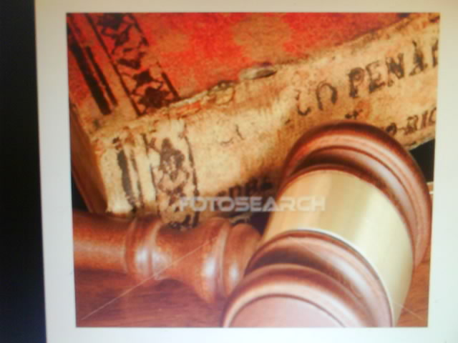
contents
1. what is digital signatures 3-6
2. its advantages 7-8
3. technology 9-15
4. encryption 16
5. digital certificate 17-23

Slide 3
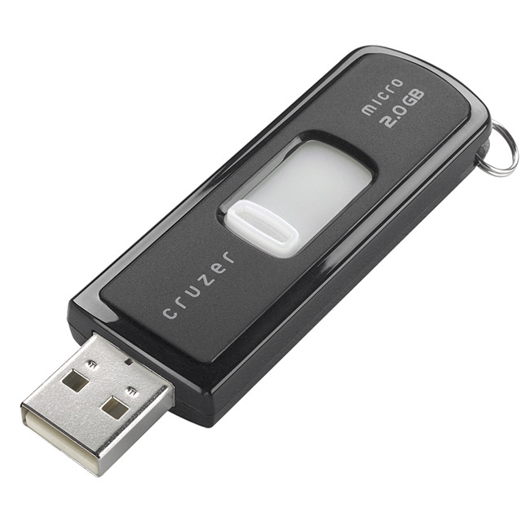
Digital signature

Slide 4

What is digital signatures?
Digital signatures are created and verified by cryptography , the branch of applied mathematics that concern itself with transformation messages into seemingly unintelligible form and back again.

Slide 5
Digital signatures use what is known as “Public key cryptography” which employs an algorithm using two different but mathematical related “keys”, one for creating a digital signature or transforming data into a seemingly unintelligible form, and another key for verifying a digital signature or returning the message to its original form.computer equipment and software utilizing two such keys are often collectively termed an “asymmertic cryptosystem”

Slide 6
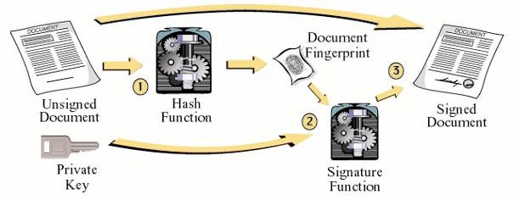
Creation of a Digital Signature

Slide 7
Advantages Of Digital Signatures
1. Authentication:-
    Digital signature can be used to authenticate the source of message.when ownership of a digital signature secret key is bound to a specific users,a valid signature shows that message was sent by that user .
    The importance of high confidence in sender authenticity is espically obvious in a financial context.

Slide 8
2. Integrity:-
      In many scenario,the sender and receiber of a message may have a need for confidenece that the message has not been altered during transmission,although encrypion hides the contents of a message,it may be possible to change an encrypted message without understanding it.however,if a message is digitally signed,any change in the message will invalidate the signature.

Slide 9
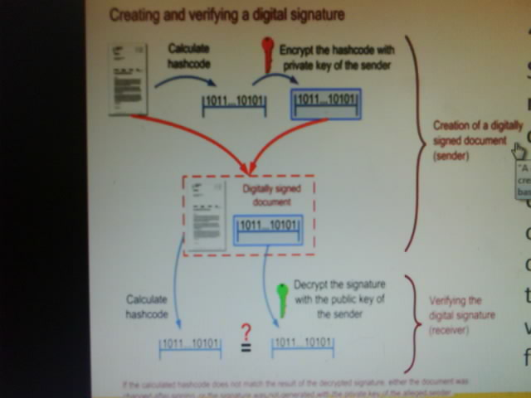
Technology in digital signature

Slide 10
VERIFICATION OF DIGITAL SIGNATURE
The sender generates a message digest , encrypts it with his private key and sends the digital signature to the recipient along with the plain text message.
The recipient uses the sender’s pubic key to decrypt the digital signature which authenticates that the message was from the trusted sender .
The recipient uses “Hash function” to encode its own message digest of the sender’s text . If the encoded message turns out the same as one send by the sender , the digital signature is considered to be authentic and the message has not been tampered with .

Slide 11
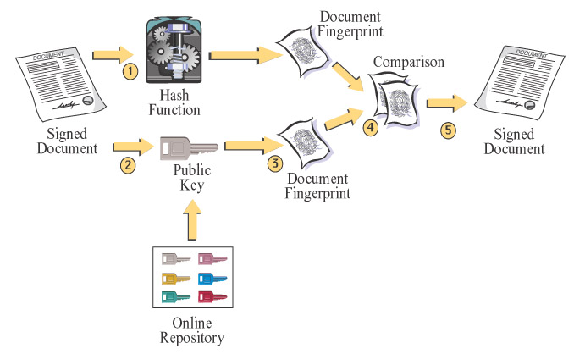
Verification of Digital Signature

Slide 12
Signature and Law
Signing a document serves the following purposes:-
Evidence-A signature authenticates writing by identifying the signer and the writing becomes attributable to the signer who makes a mark in a distinctive manner
Ceremony-The art of signing a document calls to the signers attention the legal significance of the signer’s act , prevents inconsiderate agreements
Continued…………………

Slide 13
Approval- A signature expresses the signers approval or authorization of the writing , or the signers intention that it has legal effect.
Efficiency and Logistics- A signature on a written document imparts a sense of clarity and finality to the transaction, lessens the subsequent need to inquire beyond the face of the documents
like negotiable instruments.

Slide 14
ATTRIBUTES OF A SIGNATURE
Signer’s authentication-Should indicate who has signed a document, message or record, and should be difficult for another person to produce without authorization.
Document Authentication- Identify what is signed, making it impracticable to falsify or alter either the signed matter or signature without detection.
Continued………

Slide 15
Affirmative Act-The fixing of the signature should be an affirmative act –serving the ceremonial and approval functions of a signature and establishing the sense of having legally accomplish a transaction
Efficiency- A signature- its creation and verification processes should provide the greatest possible assurance of both signers authenticity and document authenticity , with the least possible expenditure of resources

Slide 16
ENCRYPTION
It is based on the use of mathematical procedures to scramble data so that it is extremely difficult for anyone other than authorized recipients to recover the original message.
The formula or algorithm converts the intended data into an encoded message using a key to decode or decipher the message.

Slide 17
DIGITAL SIGNATURE CERTIFICATES(DSC)
A digital certificate is a electronic document issued by a Certificate Authority (CA) to establish a merchants identity by verifying its name and public key
These are the electronic counter parts to drive licenses , passports and membership cards.
One can present DSC electronically and prove ones identity or right to access information or services online

Slide 18

What does Digital Certificate contain?
Owners name
Owners public key
Expiration date of the public key
Name of the Certifying Authority
Serial No. of digital certificate
Duration and class of certificate
Certificate ID number

Slide 19
Classes of Digital Certificate
Certificates can be issued (for a fee) in the following 4 classes:-
Class 1 certificates- Quickest and simplest to issue as they contain minimum checks on the user’s background. Only the name of the user, address, email address are checked
Example: Library Card.

Slide 20
Class 2 certificates- Check for information like real name, social security number and date of birth. It requires proof of physical address and email
Example: Credit Card
Class 3 certificates- Strongest types . It is used for loans acquired online and other sensitive transactions
Example: Driving License

Slide 21
Class 4 certificates- most secured business certificates. In addition to the class 3 requirements, the certificate authority checks on things like Users position in his/her organization.
NOTE:-Considering the security in mind, Class 3 certificates and above are authorized by Ministry of Company Affairs 21 for online transactions

Slide 22
Uses and Need of a Digital Certificate
Used for following electronic transactions:-
Email
E- Commerce
Groupware
Electronic Fund Transfers
Need: Encryption alone is not enough as it provides no proof of the identity of the sender of the encrypted information.
Digital certificates addresses the above problem by providing an electronic means of verifying the senders identity .

Slide 23
Types and Status Services for Digital Certificate
Certifying Authorities provide issuing, revocation and status services for following 3 types of digital certificates:
Server Certificates- Enable web servers to operate in a secure mode.
Developers Certificates- Used in conjunction with Microsoft Authenticode TM Technology, Provides customers with information and assurance they need when downloading software from the internet.
Personal Digital Certificates- Used by individuals when they exchange messages with other users or online services.

Slide 24
Thank you!!!!!!!!!

