Slide 1

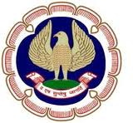
The Institute of Chartered Accountants of India.
NAME: SANIL SHIVAN TP
ADDRESS:ROOM NO6, MARRIYAMA CHAWL,
BHUVAPADA, AMBARNATH(W),
DIST-THANE,421501.
CONTACT NO: Mob:9767763441
REGISTRATION NO : WRO 0224358
IT CENTER &BATCH : THANE(AFTERNOON-JANUARY-2011)
BRANCH CODE : WI020
BATCH NUMBER : 01/11/70
PROJECT NAME:THE JOURNEY OF TELEPHONE TO MOBILE PHONE.
Date: 27/01/2010.

Slide 2
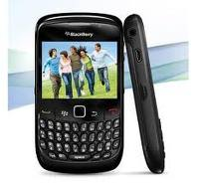
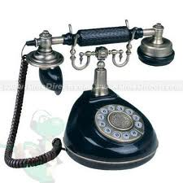
A journey of Telephone to Mobile Phone
A Journey

Slide 3
Sources:
Coe, Lewis (1995), The Telephone and Its Several Inventors: A History. Jefferson, North Carolina: McFarland & Co., Inc. ISBN 0-7864-0138-9
Evenson, A. Edward (2000), The Telephone Patent Conspiracy of 1876: The Elisha Gray - Alexander Bell Controversy. Jefferson, North Carolina: McFarland & Co., Inc. ISBN 0-7864-0883-9
Baker, Burton H. (2000), The Gray Matter: The Forgotten Story of the Telephone. St. Joseph, Michigan: Telepress. ISBN 0-615-11329-X
Huurdeman, Anton A. (2003), The Worldwide History of Telecommunications. Hoboken: New Jersey: Wiley-IEEE Press. ISBN 978-0-471-20505-0
John, Richard R. Network Nation: Inventing American Telecommunications (Harvard University Press; 2010) 520 pages; traces the evolution of the country's telegraph and telephone networks.
Josephson, Matthew (1992), Edison: A Biography. Hoboken, New Jersey: John Wiley & Sons, Inc. ISBN 0-471-54806-5
Bruce, Robert V. (1990), Bell: Alexander Graham Bell and the Conquest of Solitude. Ithaca, New York: Cornell University Press. ISBN 0-8014-9691-8

Slide 4
INDEX
Contents
Introduction
Mechanical devices
Electrical devices
Early commercial instruments
Development ‘s:
Software and applications
Power supply
SIM card
Multi-card hybrid phones
Full HD 1080p mobile phone
3D mobile phone
Mobile phones in society
Market share
Media
Usage
Examples
Sharing:
Restrictions:
Privacy:
Health effects
Environmental effects.
Future evolution: Broadband Fourth generation (4G)
Comparison to similar systems:
Conclusions

Slide 5
Emergence of Telephone
Mechanical Devices
Transmitting spoken words over a greater distance
Sound transmission through pipes or other physical media.
Electrical Devices
The telephone emerged from the creation of, and successive improvements to the electrical telegraph.

Slide 6
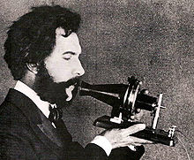
Important dates in the history
of Telephone
1844: Innocenzo Manzetti first mooted the idea of a “speaking telegraph” (telephone).
Alexander Graham Bell was the first to obtain a patent for the telephone in 1876, an "apparatus for transmitting vocal or other sounds telegraphically"
Alexander Graham Bell

Slide 7
Early commercial instruments Developments:
Liquid transmitters
Dynamic: Diaphragms wriggled a coil of wire in the field of a permanent magnet or vice versa.
carbon transmitters
dynamic transmitter or else powering the transmitter with a local battery.
transmitter Exchange
"magneto" or hand cranked generator to produce a high voltage alternating signal
The carbon microphone
"candlestick"

Slide 8
Emergence of Mobile
Phone:
The history of mobile phones begins with early efforts to develop mobile telephony concepts using two-way radios and continues through emergence of modern mobile phones and associated services.
Radiophones- (RADIO TELEPHONY)- Radiophones have a long and varied history going back to Reginald Fessenden's invention and shore-to-ship demonstration of radio telephony, through the Second World War with military use of radio telephony links and civil services in the 1950s, , radio telephony was introduced on passenger airplanes for air traffic security. Later radio telephony was introduced on a large scale in German tanks during the Second World War. After the war German police in the British zone of occupation first used surplus tank telephony equipment to run radio patrol cars.

Slide 9
Cellular concept-In December 1947, Douglas H. Ring and W. Rae Young, Bell Labs engineers, proposed hexagonal cells for mobile phones in vehicles. Philip T. Porter, also of Bell Labs, proposed that the cell towers be at the corners of the hexagons rather than the centers and have directional antennas that would transmit/receive in three directions
Push-button telephone-MTA phones consisted of vacuum tubes and relays, and weighed 40 kg. In 1962, an upgraded version called Mobile System B (MTB) was introduced. This was a push-button telephone, and used transistors and DTMF signaling to improve its operational reliability.
Altay system -trunking system The "Altay" national civil mobile phone service was based on Soviet MRT-1327 standard. The main developers of the Altay system were the Voronezh Science Research Institute of Communications (VNIIS) and the State Specialized Project Institute (GSPI). In 1963 the service started in Moscow, and by 1970 was deployed in 30 cities across the USSR. Versions of the Altay system are still in use today as a trunking system in some parts of Russia.

Slide 10
Dial up service through their local switchboard-. This system was a direct dial up service through their local switchboard, and was installed in many private vehicles including grain combines, trucks, and automobiles. For some as yet unknown reason, the system, after being placed online and operated for a very brief time period, was shut down. The management of the company was immediately changed, and the fully operable system and related equipment was immediately dismantled in early 1960, not to be seen again.
Analogue mobile phone -Radio telephone system-There was a long race between Motorola and Bell Labs to produce the first portable mobile phone. Cooper is the first inventor named on "Radio telephone system" filed on October 17, 1973 with the US Patent Office and later issued as US Patent 3,906,166.John F. Mitchell, Motorola's chief of portable communication products (and Cooper's boss) was also named on the patent. He successfully pushed Motorola to develop wireless communication products that would be small enough to use anywhere and participated in the design of the cellular phone

Slide 11
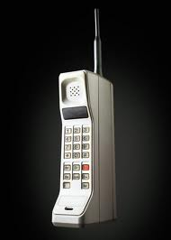
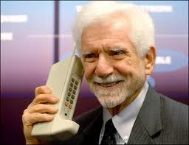
First Generation 1G
Cellular Networks.
the use o f multiple cell sites, and the ability to transfer calls from one site to the next as the user travelled between cells during a conversation.
The first commercially automated cellular network (the 1G generation) was launched in Japan by NTT in 1979.
E.g.:-Analog Motorola DynaTAC 8000X

Slide 12
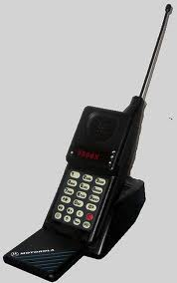
Second Generation 2G
Digital Networks
In the 1990s, the 'second generation' (2G) mobile phone systems emerged, primarily using the GSM standard.
using digital instead of analog transmission
prepaid mobile phones
higher density of cell sites to accommodate increasing usage
The second generation introduced a new variant of communication called SMS or text messaging. It was initially available only on GSM networks but spread eventually on all digital networks.
2G also introduced the ability to access media content on mobile phones. In 1998 the first downloadable content sold to mobile phones was the ring tone, launched by Finland's Radiolinja (now Elisa).

Slide 13
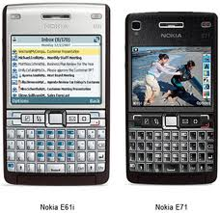
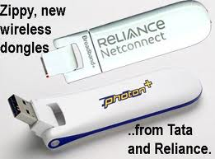
Third Generation 3G
Speed IP data networks and mobile broadband :
. The main technological difference that distinguishes 3G technology from 2G technology is the use of packet switching rather than circuit switching for data transmission.
The standard 2G CDMA networks became 3G compliant with the adoption of Revision A to EV-DO, which made several additions to the protocol whilst retaining backwards compatibility:
The first pre-commercial trial network with 3G was launched by NTT DoCoMo in Japan in the Tokyo region in May 2001.

Slide 14
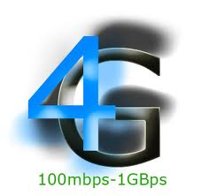
Fourth Generation:4G
All IP Address.
One of the main ways in which 4G differed technologically from 3G was in its elimination of circuit switching, instead employing an all-IP network.
By 2009, it had become clear that, at some point, 3G networks would be overwhelmed by the growth of bandwidth-intensive applications like streaming media.^{[21]} Consequently, the industry began looking to data-optimized 4th-generation technologies, with the promise of speed improvements up to 10-fold over existing 3G technologies.
The first two commercially available technologies billed as 4G were the WiMAX standard (offered in the U.S. by Sprint) and the LTE standard, first offered in Scandinavia by TeliaSonera

Slide 15
Features of Mobile Phone
All mobile phones have a number of features in common, but manufacturers also try to differentiate their own products by implementing additional functions to make them more attractive to consumers. This has led to great innovation in mobile phone development over the last 20 years.
Features
A rechargeable battery
a keypad, but touch screens are also found in some high-end smart phones.
Basic mobile phone services to allow users to make calls and send text messages.
Handsets with more advanced computing ability through the use of native software applications became known as smart phones.
GPS navigation, music (MP3) and video (MP4) playback, RDS radio receiver, alarms, memo recording, personal digital assistant functions, ability to watch streaming video, video download, video calling, built-in cameras (1.0+ Mpx) and camcorders (video recording), with autofocus and flash, ringtones, games, PTT, memory card reader (SD), USB (2.0), dual line support, infrared, Bluetooth (2.0) and Wi-Fi connectivity, instant messaging, Internet e-mail and browsing and serving as a wireless modem.

Slide 16
Battery
Formerly, the most common form of mobile phone batteries were nickel metal-hydride, as they have a low size and weight. Lithium ion batteries are sometimes used, as they are lighter and do not have the voltage depression that nickel metal-hydride batteries do. Many mobile phone manufacturers have now switched to using lithium-polymer batteries as opposed to the older Lithium-Ion, the main advantages of this being even lower weight and the possibility to make the battery a shape other than strict cuboid. Mobile phone manufacturers have been experimenting with alternative power sources, including solar cells.
SIM CARD:
GSM mobile phones require a small microchip called a Subscriber Identity Module or SIM Card, to function. The SIM card is approximately the size of a small postage stamp
The SIM card allows users to change phones by simply removing the SIM card from one mobile phone and inserting it into another mobile phone or broadband telephony device.

Slide 17
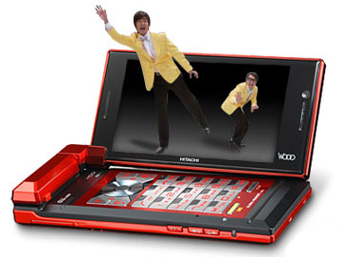
Multi-card hybrid phones
A hybrid mobile phone can take more than one SIM card, even of different types. The SIM and RUIM cards can be mixed together, and some phones also support three or four SIMs
They are popular in India and Indonesia, attributed to lower on-net call rates.
Full HD 1080p mobile phone
At January 2011, LG released LG Optimus 2X which has capability to take Full HD 1080p video and also has processor dual core Nvidia Tegra-2 1GHz. Both are the first in the world.
3D mobile phone
Spice Mobile has launched Spice View M-67 3D Dual-SIM Mobile Phone. India's first 3D mobile phone allowing users to view 3D pictures and videos along with phone's user interface without 3D glasses. The phone is equipped with 2 megapixel camera, but only takes 2D.

Slide 18
Mobiles Phones in Society
Market Share:
The world's largest individual mobile operator by subscribers is China Mobile with over 500 million mobile phone subscribers. Over 50 mobile operators have over 10 million subscribers each, and over 150 mobile operators have at least one million subscribers by the end of 2009 (source wireless intelligence).
Media:
In 1998, one of the first examples of selling media content through the mobile phone was the sale of ringtones by Radiolinja in Finland. Soon afterwards, other media content appeared such as news, videogames, jokes, horoscopes, TV content and advertising. Most early content for mobile tended to be copies of legacy media, such as the banner advertisement or the TV news highlight video clip. Recently, unique content for mobile has been emerging, from the ringing tones and ringback tones in music to "mobisodes," video content that has been produced exclusively for mobile phones.

Slide 19
USAGE:
Mobile phones are used for a variety of purposes, including keeping in touch with family members, conducting business, and having access to a telephone in the event of an emergency. Some people carry more than one cell phone for different purposes, such as for business and personal use.
SHARING
In some parts of the world, mobile phone sharing is common. It is prevalent in urban India, as families and groups of friends often share one or more mobiles among their members. There are obvious economic benefits, but often familial customs and traditional gender roles play a part. For example, in Burkina Faso, it is not uncommon for a village to have access to only one mobile phone. The phone is typically owned by a person who is not natively from the village, such as a teacher or missionary, but it is the expected that other members of the village are allowed to use the cell phone to make necessary calls.

Slide 20

Restrictions:
There exists a community that believes mobile phone use represents a long-term health risk, although this is currently disputed by the World Health Organization, with forthcoming mobile phone usage recommendations in 2010. Certain countries, including France, have warned against the use of cell phones especially by minors due to health risk uncertainties. Groups of scientists, such as the U.S.-based group Bioinitiative, argue that because mobile phone use is recently introduced technology, long-term "proof" has been impossible and that use should be restricted, or monitored closely, while the technology is still new.
Use while driving:
Mobile phone use while driving is common but controversial. Being distracted while operating a motor vehicle has been shown to increase the risk of accident.
Schools:
Some schools limit or restrict the use of mobile phones. Schools set restrictions on the use of mobile phones because of the use of cell phones for cheating on tests, harassment and bullying, causing threats to the schools security, distractions to the students and facilitating gossip and other social activity in school. Many mobile phones are banned in school locker room facilities, public restrooms and swimming pools due to the built-in cameras that most phones now feature.

Slide 21
Privacy:
Cell phones have numerous privacy issues.
Governments, law enforcement and intelligence services use mobiles to perform surveillance in the UK and the U.S. They possess technology to activate the microphones in cell phones remotely in order to listen to conversations that take place near to the person who holds the phone.
Health effects
The effect mobile phone radiation has on human health is the subject of recent interest and study, as a result of the enormous increase in mobile phone usage throughout the world (as of June 2009^{[update]}, there were more than 4.3 billion users worldwide). Mobile phones use electromagnetic radiation in the microwave range, which some believe may be harmful to human health.
Environmental effects.
The ubiquitousness and rapid technological change has led to mobile phones becoming a component of the waste stream. Electronic waste such as mobile phones contain materials that are toxic when they enter into ecosystems and recycling is now carried out to some extent.

Slide 22
Comparisons to Similar Systems:
Car phone -A type of telephone permanently mounted in a vehicle, these often have more powerful transmitters, an external antenna and loudspeaker for hands free use. They usually connect to the same networks as regular mobile phones.
Cordless telephone (portable phone) -Cordless phones are telephones which use one or more radio handsets in place of a wired handset. The handsets connect wirelessly to a base station, which in turn connects to a conventional land line for calling. Unlike mobile phones, cordless phones use private base stations (belonging to the land-line subscriber), which are not shared.
Professional Mobile Radio -Advanced professional mobile radio systems can be very similar to mobile phone systems. Notably, the IDEN standard has been used as both a private trunked radio system as well as the technology for several large public providers. Similar attempts have even been made to use TETRA, the European digital PMR standard, to implement public mobile networks.

Slide 23
Radio phone :- This is a term which covers radios which could connect into the telephone network. These phones may not be mobile; for example, they may require a mains power supply, or they may require the assistance of a human operator to set up a PSTN phone call.
Satellite phone:- This type of phone communicates directly with an artificial satellite, which in turn relays calls to a base station or another satellite phone. A single satellite can provide coverage to a much greater area than terrestrial base stations. Since satellite phones are costly, their use is typically limited to people in remote areas where no mobile phone coverage exists, such as mountain climbers, mariners in the open sea, and news reporters at disaster sites.
IP Phone :- This type of phone delivers or receives calls over internet, LAN or WAN networks using VoIP as opposed to traditional CDMA and GSM networks. In business, the majority of these IP Phones tend to be connected via wired Ethernet, however wireless varieties do exist. Several vendors have developed standalone WiFi phones. Additionally, some cellular mobile phones include the ability to place VoIP calls over cellular high speed data networks and/or wireless internet.

Slide 24
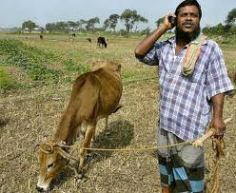
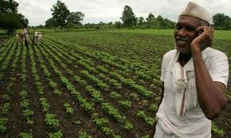
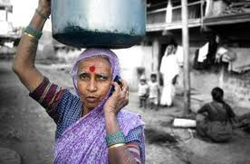

The Common Man in Use of Mobile Phone in India

Slide 25
Conclusion:
Mobile phone is a good technology which is not lacking from our lives. This report will discuss the advantages and disadvantages of using mobile phones.
Today, mobile phone has become popular to everybody since it is very convenient. The most advantage of having a mobile phone is you can communicate to your family and your friends no matter what where you are. For instance, you can contact easily to your friends by calling or sending messages everywhere without electricity. It is maybe the main reason why almost all people today choose to own a mobile phone. From the customer’s point of view, it is obvious that mobile phones assist you in business a lot, such as, make schedule of working, surf the internet, and keep in touch with their companies. Moreover, you can relax with mobile phone’s applications, for example, play games, listen to music, or chat with your friends.
On the other hand, there are also disadvantages. Using a lot mobile phone can harm your brain, particularly teenager and children who are under 16 years old. If you use mobile phones too much, you will get bad effects like dizzy, blood-brain barrier, or ears problems. In addition, when you use mobile phones while you are driving, you will get an accident. It is essential not good for you and others. Moreover, “radiations emitted from the phone are dead harmful for the eardrum”, has proved by many scientist.

Slide 26

Owning a mobile phone in your hand is you can solve many issues and hold most of information around the world. Even though is not good for your health and you have to thankyou yourself from bad effects of mobile phones if you choose to have one.

