Slide 1

PROJECT ON TALLY.ERP9
PRESENTED BY: MAHENDRA PRAJAPAT

Slide 2
Acknowledgement
We are thankful to the NIIT Center, to give us an opportunity to prepare this project. We will be inharmonious to express our gratitude to our faculty Nagesh Sir.
This project would not have been completed without those people who co-operated with us and helped us in completing the project. It was such a great experience for us & will definitely helpful in improving our skills.
(THANX)

Slide 3
Introduction to Tally.ERP9
A leading accounting package
No accounting codes
Complete business solution
Integrated/ Non-integrated accounting and inventory
Flexible and easy to use
Speed
Power

Slide 4
Features of Tally.ERP9
Flexibility
Concurrent multi-lingual capability
Real time processing
Versatility
Multi-platform availability
Online help
Auditor’s Edition

Slide 5
Technology
Simple and rapid installation
Unlimited multi-user support
Internal backup/restore
Data reliability
User- defined security levels
Data security
Tally audit
Tally vault
Removal of data into a separate company
Multi-directory for company management

Slide 6
VERSIONS OF TALLY
VERSION | FEATURE
4.5 | DOS based, Accounts only.
5.4 | Window based accounts with inventory.
6.3 | 5.4 with online finalization, auditing and import & export
7.2 | 6.3 with VAT, TDS and service tax.
8.1 | 7.2 with FBT and excise duty.
9.0 | 8.1 with Payroll system, multi language and extra formatting feature.
ERP.9 | Tally.net, control center, Remote Access, Support Center, POS. etc

Slide 7
How to start TALLY
Create Company
Master Creation : ledgers and vouchers creation
Transaction : entry of voucher
Reports : auto created by tally

Slide 8
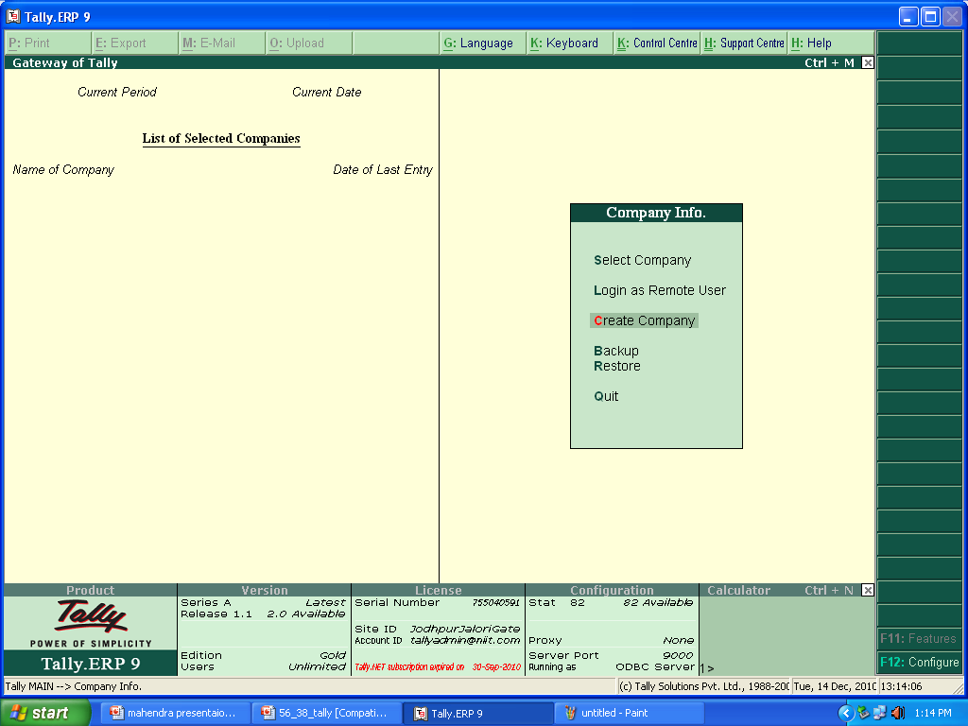
Tally.ERP 9 Start-up
Horizontal Button Bar
Main Area
Close Button
Button bar
Calculator pane
Info panel
Task Bar

Slide 9
Tally.ERP 9 screen components
Title bar:
  Displays the Tally. ERP 9 version number
Horizontal button bar:
  Selection of Language key, keyboard language and Tally.ERP 9 Help
Close button:
  Performs the standard windows operating systems function (window 95 onwards) , allowing you to minimize Tally. ERP 9 and work on other applications. To restore Tally. ERP 9, click the Tally .ERP 9 icon on the taskbar.

Slide 10
Gateway of Tally:
  Displays menus, screens, reports and accepts the choices and options which you select to view data as req uired
Buttons toolbar:
  Displays buttons which provide q quick interaction with Tally. ERP 9. only buttons relevant to the current task are visible
Calculator Area:
  Used for calculator functions
Info Panel:
  Displays version number, License details, configuration details

Slide 11
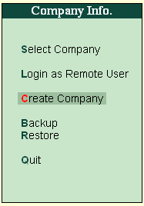
Company Info → Create Company
Select Company
  Allow you to select or load a company.
Create Company
  Allow you to create company.
Backup
  Allow you to take backup of company data.
Restore
  Allows you to restore Backup data
Q uit
  Exit from Tally.

Slide 12
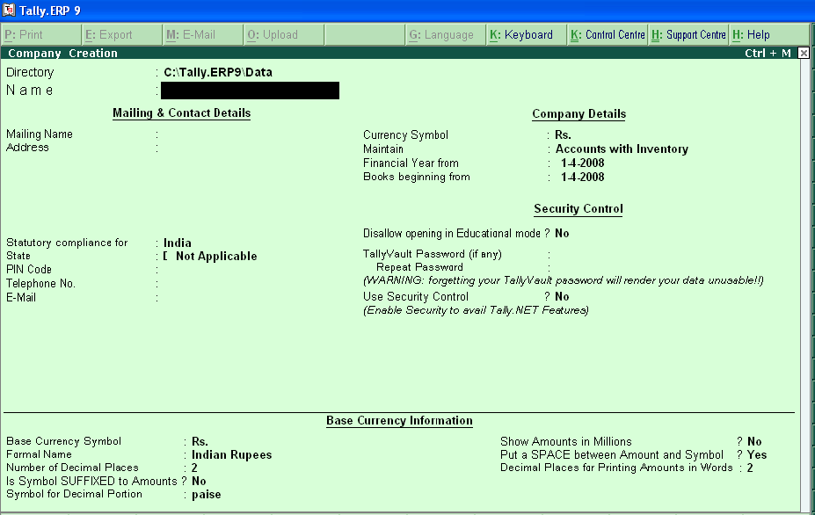
Company Creation…
Fields
  Name
  Mailing name, address
  Email address
  Statuary compliance for
  State
  C urrency symbol
  Financial year
  Books beginning from
  Tally vault password
  Security control
  Base currency information
  Accept/reject

Slide 13
Company Creation…
Fields : Go to Gateway of Tally > Company Info > Create Company
Name | NIIT
Mailing name, address | Abhay Chamber, J alori gate jodhpur
Email address | Change.pali@gmail.com
Statuary compliance for | India
State | Rajasthan
C currency symbol | Rs.
Financial year | 01 / 04 / 2010
Books beginning from | 01 / 04 / 2010
Tally vault password | No
Security control | Yes User Name – ABC Password – 123
Base currency information | Default Set
Accept/reject | Yes for save and No for delet.

Slide 14
Accounting Vouchers
Contra voucher
Payment voucher
Receipt voucher
Journal voucher
Sales invoice
Purchase invoice

Slide 15
Accounting in a Service Organisation
Customer
Payment of Bill
Services Organisation
Services

Slide 16
Financial Reports in Tally.ERP9
Gateway of Tally
Reports
Balance sheet
Profit and Loss A/c
Display
Trial Balance
Account Books
Cash/Bank Books (S)
Ledger
Group Summary
Group Vouchers
Journal Register
Day Book
List of Accounts

Slide 17
Accounting in Trading Organisations
Collections
Trading Organization
Arrival of Stock
sale
Customer
Inventory Based on customer demand
Demand

Slide 18
Introduction to Trading Organisations
Traders can be broadly classified as:-
  Wholesalers
  Retailers

Slide 19
REPORTS
Profit & Loss Account
Balance sheet
Cash flow statement
Fund flow statement
Ratio analysis

Slide 20
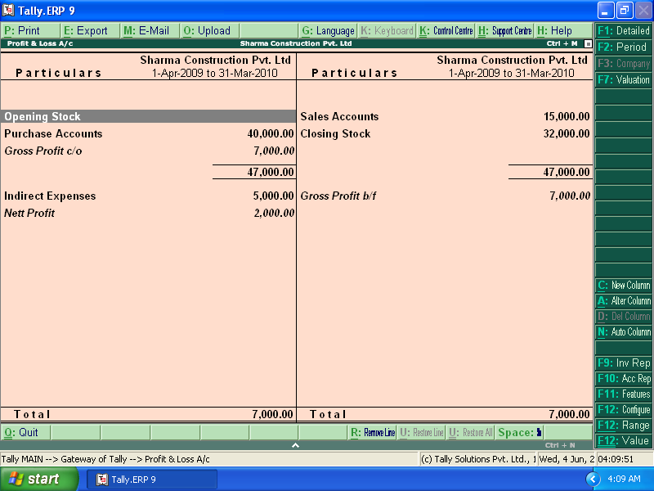
Profit and loss account

Slide 21
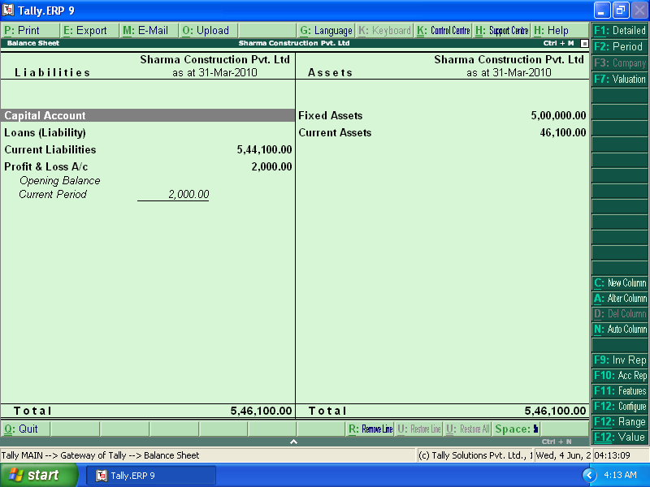
Balance Sheet

Slide 22
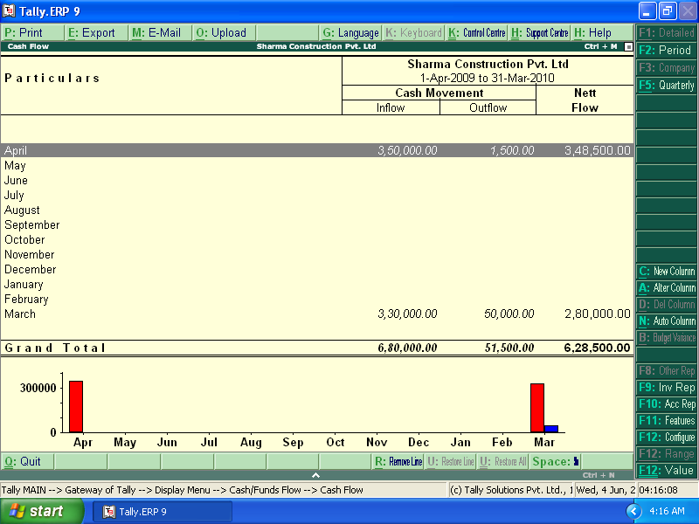
Cash Flow Statements
Gateway Of Tally>Cash Flow

Slide 23
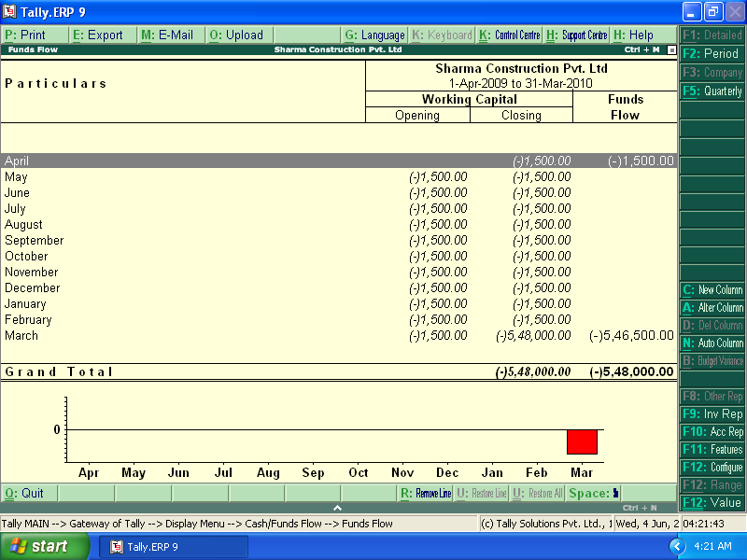
Fund Flow Statement
Gateway of Tally>Fund Flow

Slide 24
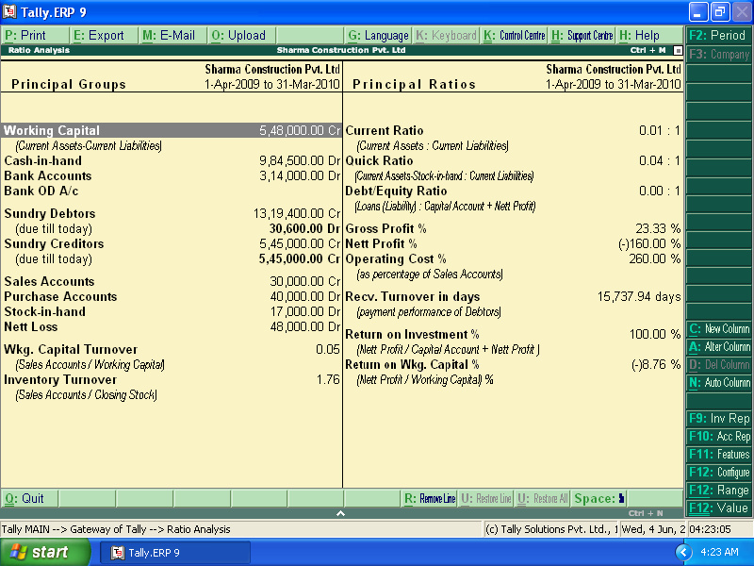
Ratio Analysis
Gateway of Tally>Ratio Analysis

Slide 25
Thank You

