Slide 1

A Very Warm Good Evening to Everyone…
“National Conference of
CA Students, 2011, Pune”

Slide 2

E.R.P.
Enterprise Resource Planning

Slide 3

To plan out a healthy & wealthy Picture of enterprise, business or organization in respect of its various Resources like;
Human Resources
Supply Chain Management
Customer Relationship
Finance
Logistics

Slide 4

The History of ERP
In 1960:- the manufacturing units laid emphasis mainly on Inventory control and hence there was the emergence of Inventory Management and Control Systems.
In 1970:- the focus shifted to
Material Requirement Planning (MRP)
In 1980:- witnessed the evolvement of MRP -II
MRPII Expanded to
Enterprise Resource planning (ERP).

Slide 5
A software package must provide the function of at least two systems. For example, a software package that provides both payroll and accounting functions could technically be considered an ERP software package.

Slide 6
The Components of an ERP System:-
ERP Software:-
Product planning, Parts purchasing, Inventory Control, Finance, Accounting and HR aspects of an organization.
Business Processes:-
All levels of an organization like strategic planning, management control and operational control.
ERP Users:-
All levels, from workers, supervisors, mid-level managers to executives.
Hardware and Operating Systems:-
Many huge ERP systems are UNIX based. Windows NT and Linux are other popular operating systems to run ERP software.

Slide 7
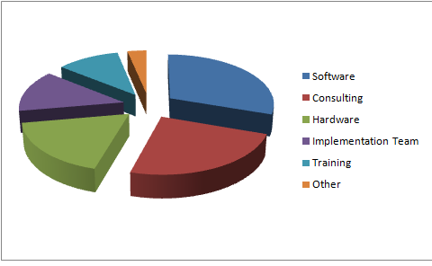
ERP System - Cost Components
Software 30.2
Consulting 24.1%
Hardware 17.8%
Implementation
Team 13.5%
Training 10.9%
Other 3.3%

Slide 8
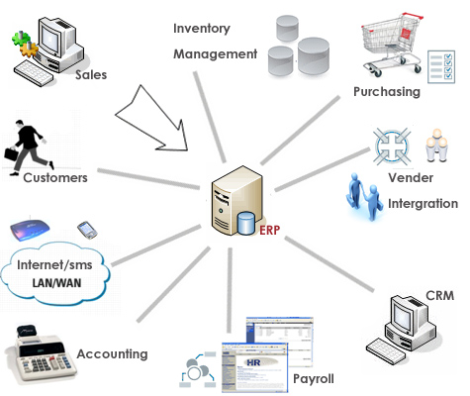
Understanding of ERP
Business Process Reengineering:-
A common ERP software modules include product planning, inventory control and various aspects of an organization.
Database integration:-
At all levels of an organization like strategic planning, management control and operational control.
Enhanced user interfaces:-
At all levels, from workers to supervisors and from mid-level managers to executives.
Data transport between companies

Slide 9
ERP - Advantages
Paperless environment in business
Design engineering (how to best make the product)
Tracking the 3-way match
Allow departments to talk to each other
Integrated and a common set of data
Gain visibility into supply chain
Ensure compliance with regulations
Readymade solution to most of the problems.

Slide 10
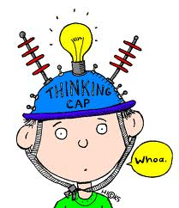
ERP – Disadvantages
ERP systems can be very expensive to install often ranging from Thousands to Cores for multinational companies.
The system may be over-engineered relative to the actual needs of the customer and
Integration of truly independent businesses can create unnecessary dependencies.

Slide 11

ERP - Implementation Aspect

Slide 12

To derive the benefits of an ERP implementation, a number of considerations must be evaluated. These include considering:
Both the current and future/growth business requirements
Trade-off between application software complexity and related user needs
The software version of the application being selected
The stability of the software vendor
The ability of the organization to devote sufficient resources
Specific, measurable, achievable, realistic, time-oriented project plan and budget;

Slide 13

By taking few steps at the initial stage minimize chances for the failure of any ERP software. These steps can be briefly described as under:-
Understanding the business
Selection of Software
Training of users
Creation of Blue Print for implementation
Going for Implementation
Security Concerns

Slide 14
ERP Softwares
SAP,
Oracle Corporation,
People soft, Inc.
JD Edwards & Company, and
Baan International

Slide 15

The Hidden Costs of ERP
Training Cost
Data conversion Cost
Data analysis Cost
Replacing Your Best and Brightest
Implementation Teams Can Never Stop
Post-ERP Depression

Slide 16

Roles of Chartered Accountants
Chartered Accountants with good industry experience are preferred for their business understanding. The Chartered Accountants are hired as functional consultants for financial domain of ERP because of their expertise in Accounts and Finance.

Slide 17

Oracle E-Business Suite which has following financial modules:
General Ledger Analysis
Fixed Assets Management
Cash and Treasury Management
Internal Control Manager
Enterprise Planning and Budgeting

Slide 18

CA’s role spans throughout the lifecycle of implementation which includes stages like:-
Current Business Process study,
Analysis of business requirements,
Solution building and design,
Data migration,
User training
Initiation and Internal Planning

Slide 19

Skill required:-
Soft skills: Good communication& presentation skills
Analytical skills: High degree of analytical, problem-solving skills & creative thinking.
Team skills: Relationships skills, cooperation, networking & handling disagreement.
Project management skills
Customer orientation: Commitment for customer satisfaction.
Fast learners

Slide 20

Conclusion…
Although Business practices growing with new technologies in terms of their dependencies, creating a concrete need of considerations of core values of society, because society gives license to business for its existence, so on the basis of getting advantages of Enterprise Resource Planning and modern technology, will not provide any excuse in terms of core values, security and environment itself.

Slide 21

www.google.com ☺
Mohit Goyal, INDORE
Mob.: +91-99260-87562
E-mail Id: mohit28@icai.org

