Slide 1
Xbrl
eXtensible Business Reporting Language
Prepared by : Rinkesh shah
Notes:
"Technology is fueling a radical change in the way that business and individuals
receive, process, and interact with data.”

Slide 2
What is XBRL ?
eXtensible Business Reporting Language, is a standard means of communicating information between businesses and on internet.
  Provides a standardized electronic platform for financial reporting
  Defined by meta-data set out in taxonomies which capture the definition of individual reporting concepts and the relationships between them.
  XBRL allows information modeling and the expression of semantic meaning commonly required in business reporting. XBRL is XML-based. It uses the XML syntax and related XML technologies.
  XBRL is being developed by an international non-profit consortium of approximately 450 major companies, organizations and government agencies. It is an open standard, free of license fees.
Notes:
XBRL began with the idea of a single individual - Charlie Hoffman, from a small CPA firm in Tacoma, Washington.

Slide 3
What is included in Xbrl
Multi dimensional financial data representations
Financial reporting vocabularies (taxonomies)
Aliases and other definition relationships
Mathematical relationships between concepts
Structure for authoritative policies and guidance
Definitions
Liquid Assets
Presentation
Cash & Cash Equivalents
References
GAAP I.2.(a)
CoA 1100
XBRL
Item
“200”
Calculations
Cash = Currency + Deposits
Formulas
Cash ≥ 0
Contexts
US $
FY2003
Budgeted
Notes:
“XBRL is ..perhaps the most revolutionary change in financial reporting since the first
general ledger”
- Accounting Today

Slide 4
What are the uses of XBRL?
XBRL can be applied to a very wide range of business and financial data. Among other things, it can handle:
Company internal and external financial reporting.
Business reporting to all types of regulators, including tax and financial authorities, central banks and governments etc.
Exchange of information between government departments or between other institutions, such as central banks.
A wide range of other financial and statistical data which needs to be stored, exchanged and analyzed.

Slide 5
Xbrl around the world
It is already being put to practical use in a number of countries(Like Australia, Belgium, Canada, China, Denmark, France, Germany, Hong Kong,
India, Israel, Italy, Japan, Korea, the Netherlands, Singapore, Spain, Sweden,
Thailand, the United States of America and the United Kingdom)
and implementations of XBRL are growing rapidly around the world.
Its currently being used mostly by regulatory authorities like banking ,Tax , Stock exchanges etc.
The United States’ Capital Market regulatory SEC has made the statutory fillings compulsory in Xbrl.
The IASB has developed an illustrative taxonomy which reflects International Financial Reporting Standards (IFRS).

Slide 6
Xbrl around the world (Cont…)
National XBRL jurisdictions will extend this taxonomy to reflect their particular local implementation of IFRS.
Taxonomies will thus be available to enable those reporting under IFRS in different countries to use XBRL, enhancing efficiency and comparability as adoption of IFRS expands around the world.
This taxonomies includes every report and disclosure required which is translation of the IFRSs as issued on 1st January 2010.

Slide 7
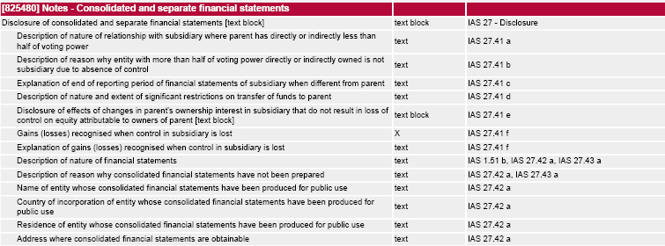
Example of IFRS Taxonomy.
Notes:
Example on statement on financial position -CFS

Slide 8
Example of IFRS Taxonomy(Cont…)
Here we can see that every line items is tagged.
There is a standard for every line item, for e.g. in “gain or loss when the control is lost for any subsidiary” its defined that it should be “x “ i.e. number and its defined in IAS 27 para 41 f.
Similar way every line item is tagged with its nature, mathematical relationship, presentation etc.

Slide 9
XBRL-Indian Initiatives
  IRIS was awarded project to convert the historical filings of US Companies into XBRL format in 2005.
  ICERS – XBRL based filing platform was developed for BSE 2006.
  Corpfiling – XBRL based filing platform adopted by BSE and NSE 2007
  Corpfiling – XBRL based filing platform is made mandatory by SEBI.
  RBI launches XBRL based filing platform for Capital Adequacy Returns.

Slide 10
XBRL-Indian Initiatives(Conti..)
  Appreciating XBRL’s role in financial reporting, ICAI, the premier accounting body and the national standard-setter constituted a Group on XBRL in January 2007.
Objective of the group is to establish forum for development of Xbrl in India including its promotion.
Carrying the task of XBRL in India forward, the XBRL Group established the XBRL India jurisdiction(Provisional) of XBRL International in December 2008.
  To begin, the XBRL India jurisdiction has developed the general purpose taxonomy for Commercial and Industrial Companies C&I taxonomy.
  The ministry of corporate affairs (MCA), Government of India (GoI) has resolved to implement Extensible Business Reporting Language (XBRL) for all companies in India from 2011, reports Financial Express.

Slide 11
Practical consequences of the adoption of XBRL
Some of the challenges that preparers of financial statements and information presented using XBRL could face are:
Time and effort required to learn XBRL
Cost of investing in XBRL software
Implementing new procedures and processes
Managing the proliferation of taxonomy elements
Moving from traditional paper based documentation to Electronic documentation.

Slide 12
Thank you
Notes:
Official Site on XBRL – www.Xbrl.org

Slide 13
Thank you

