Slide 1


THE INSTITUTE OF CHARTERED ACCOUNTANTS OF INDIA
MS ACCESS DATABASE
Submitted by:
ROLL NO-
Submitted to:

Slide 2

INTRODUCTION TO DATABASE
Database is a combination of two words “data” and “base” data means the raw facts which not yet been processed to reveal their meaning and the base means the base data from where the records are invented.
Database is a collection of related and ordered information organised in such a way that information can be accessed quickly and easily as well as collection of logically related data.
Complexity. Examples of database:
Name | Reg. No. | Dept | Course | Year of study
Bishal | 10001 | Phys | B. Sc | I
Anshika | 10002 | Bio | M .Sc | II
Janu | 10003 | Math | B. Sc | III
Shiva | 10004 | Tamil | B.A | II

Slide 3

Third Generation Language
. 1)COBOL-Common Business Language
2)BASIC- Beginners All Purpose Symbolic Instruction Code
3)FORTRAN-Formula Transaction
FOURTH GENERATION LANGUAGE
1)SQL-Structured Query Language
SQL consist of english like statement

Slide 4

Database &File system
PERSONNEL DEPT. A FILESYSTEM
SALES DEPT. ACCOUNTING DEPT.
Employee
Customers
Sales
Inventory
Accountants

Slide 5

Components of database system
1.HARDWARE:The hardware comprises of
a)Computer-microcomputer, minicomputer,or a miniframe computer.
b)computer peripherals-physical devices that control computer input and output such as keyboards,mice,modems,printers,any electronic devices that are used to connect two or more computers to produce a computer network.Such networks are very important for database that are likely to be remotely accessed.example-ATM.
2.Software:Software means the collection of programs ,instruction that make the hardwarework.
-System software:eg.operating software
-Dbms software:SQL
-Application software:Visual basic
-Utility software
3.People
a.System administrator-This person is responsible for managing the overall operation of database.

Slide 6

Continued components of database
b)DBA: This person is responsible for giving the guidelines of database.
c)DB designer:They design the database.
d)Application Programme:T hey design the frundant.
e)End user: is the one who is operator.
4)Procedure: It is set of rules
5)Data
FUNCTION OF DATABASE MANAGEMENT SYSTEM
DBMS performs several important functions that guarantee the integrity and
Consistency of the database.
1.It performs backup and data recovery procedures to ensure data.
2.It creates a security system and enforces security within that system.
3)it creates complex structures that allow multiple user access to the data.

Slide 7
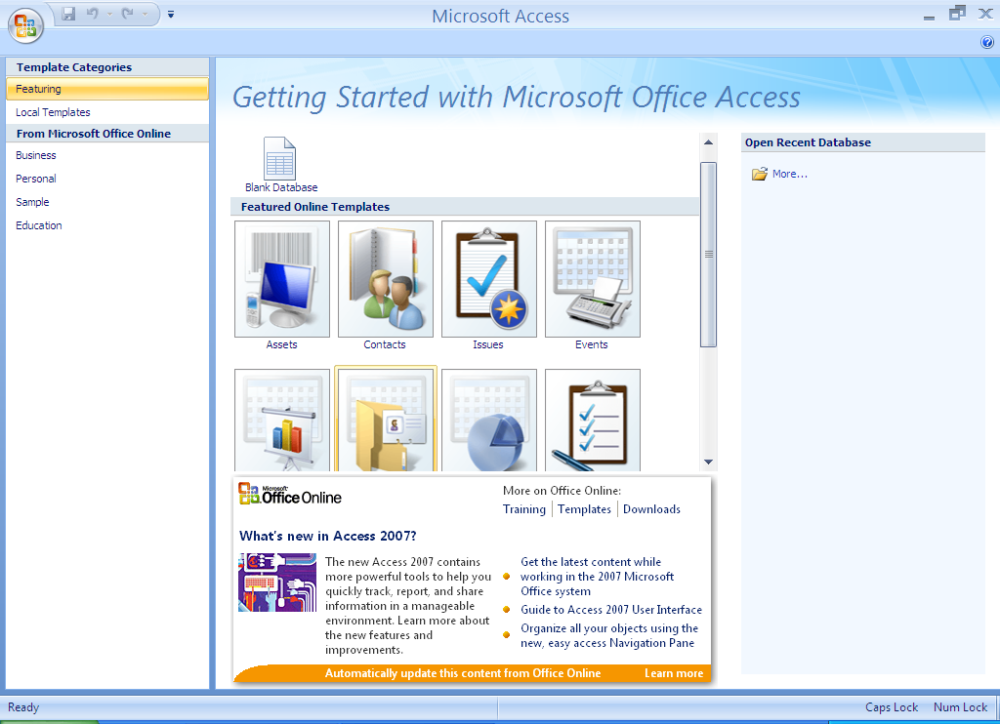
Getting started with Ms-access
This is the starting screen of Ms-Access 2007.
Introduction
Microsoft access 2007 for windows is a database management system, or DBMS, which helps us manage data stored in a computer database.
Notes:
DBMS is a computer software that provides support to database.

Slide 8
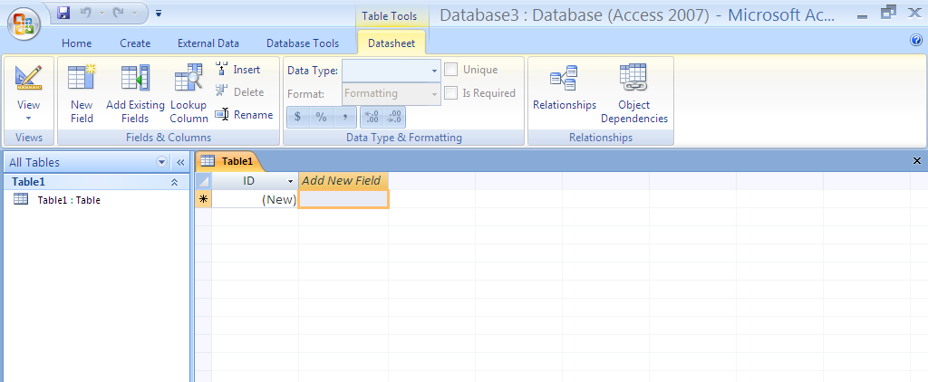
Creating Databases
On the starting screen of ms-access, under new blank database, click BLANK DATABASE.
In the blank database pane, type a file name in the filename box.
Click create.
Begin to add data in table 1. if you want to rename it right click on table 1 in navigation pane then.

Slide 9

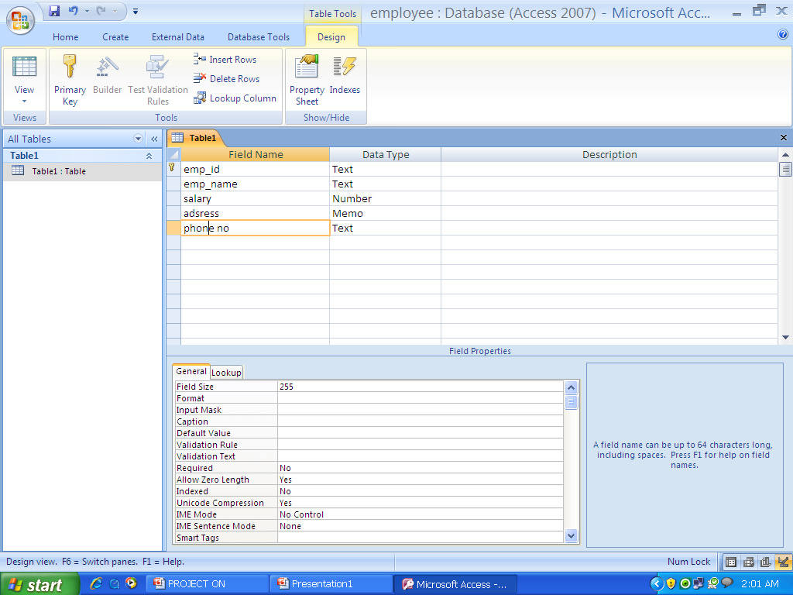
SETTING FIELD PROPERTIES
This can be done in design view. To switch to design view, right click the table in the navigation pane and then click design view.
To see a description of each property, click the field in the design grid.
The properties are displayed below the design grid under field properties.

Slide 10

FIELD PROPERTIES
PROPERTY | DESCRIPTION
1. FIELD SIZE | This property helps you to change the number of characters that can be inserted. By default, For TEXT fields, the maximum number of characters that can be stored is 255. For number fields long integer, double and so on. In MEMO, provides 65000 characters.
2. FORMAT | This property sets how the data is displayed. For example, in salary- currency( Rs. , $, etc.)
3. CAPTION | Caption is used to give a heading to a particular field.

Slide 11

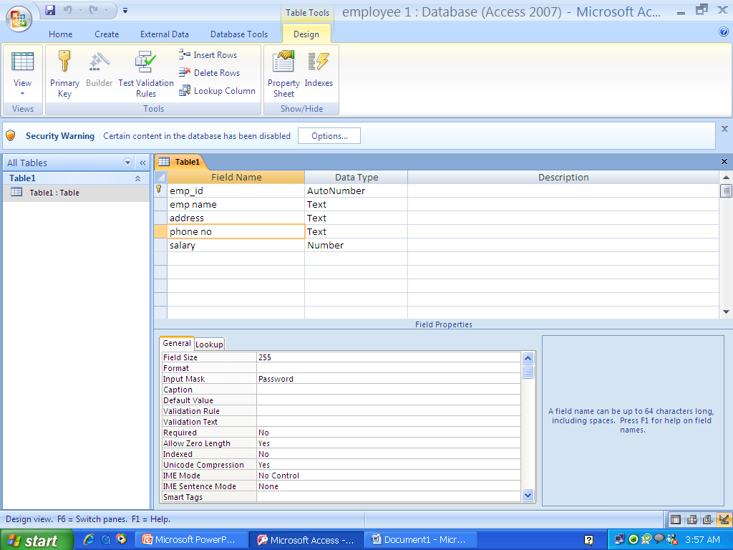
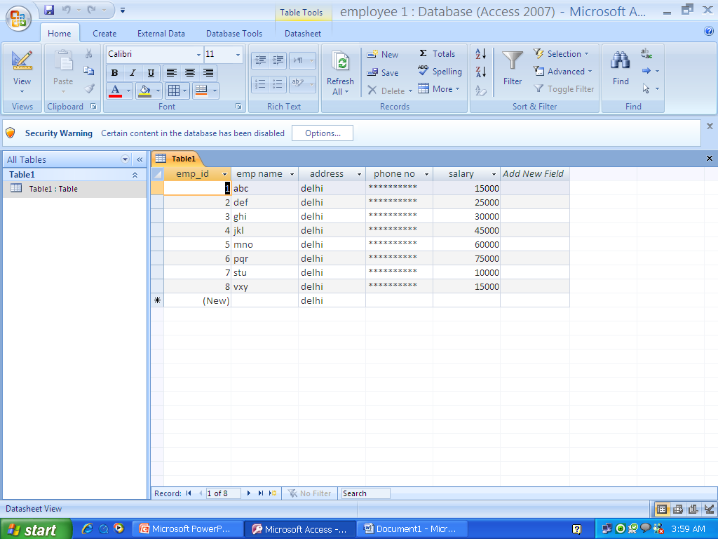
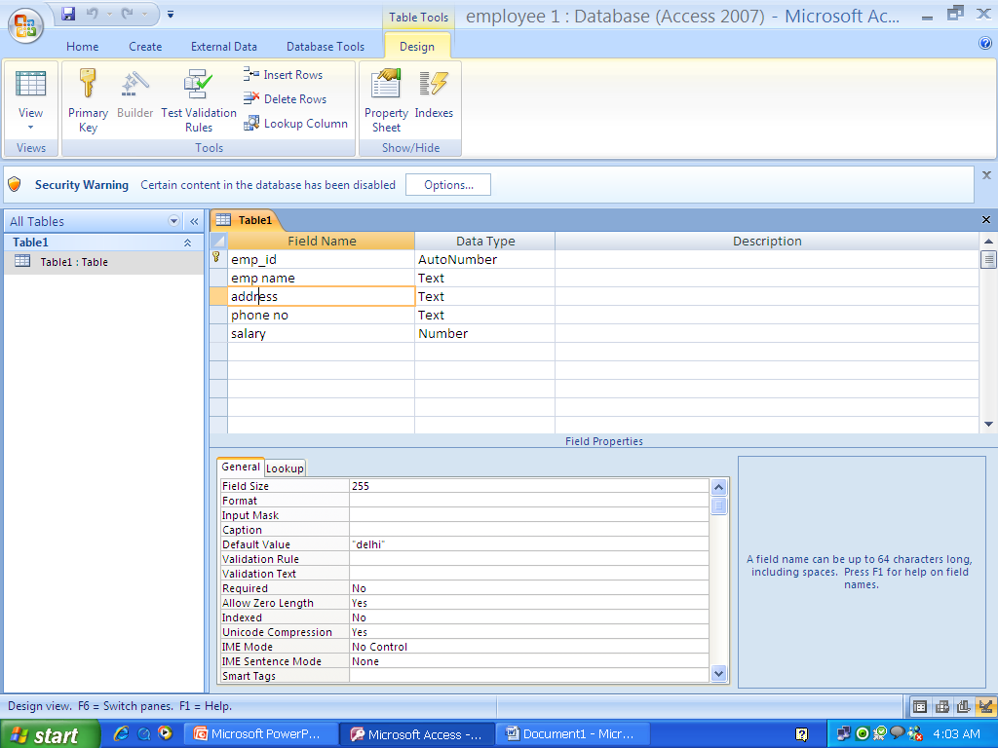
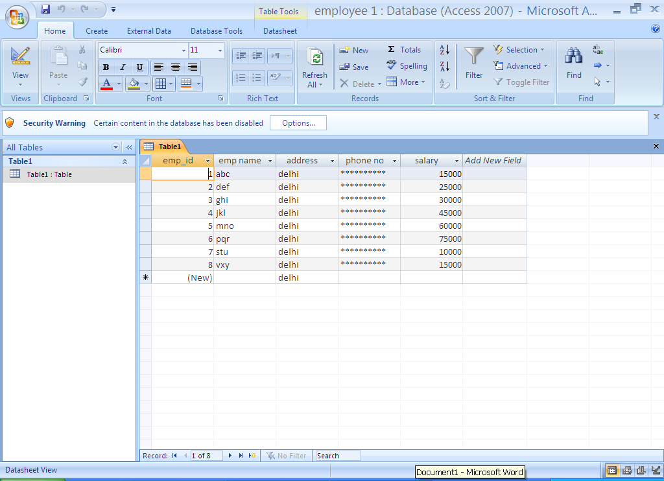
4.INPUT MASK | This property is used to hide data. For example, if to hide phone no. of employees go to input mask in field properties and write “password”. When you will open the table instead of phone no. “****” will appear
5.DEFAULT VALUE | Use this property to specify the default value that will appear each time you enter a new record. For example, in address field you can give Delhi as default value

Slide 12

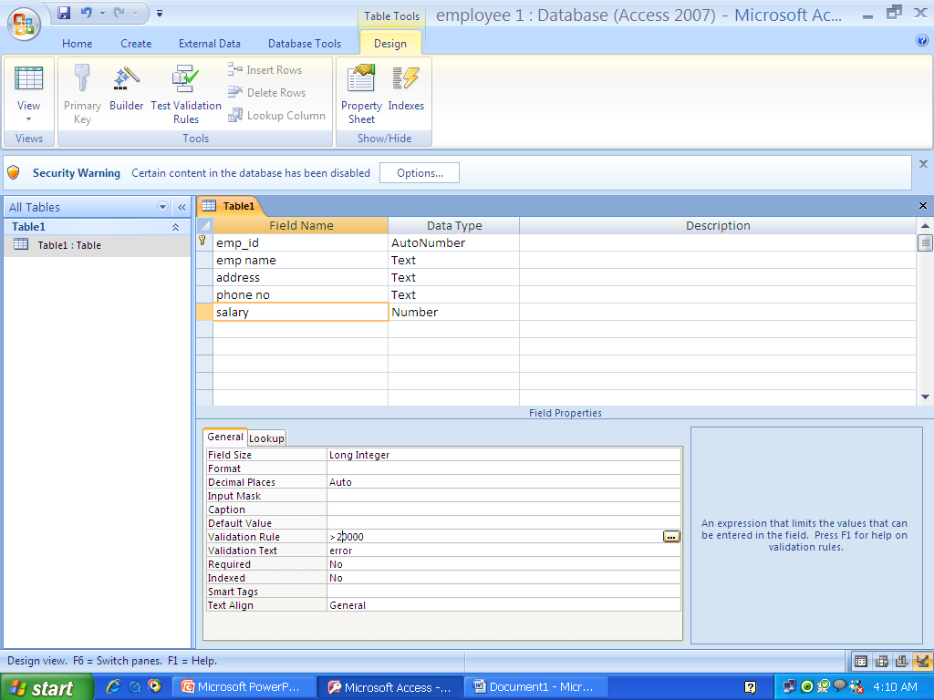
6.VALIDATION RULE | This property is used to give constraints to a specific field. For example, in salary field you can add salary( >20000, between 20000 and 100000, etc.)
7. VALIDATION TEXT | This property is used to set the text that appears when the given validation rule is violated. For example, you can give text as “error”.

Slide 13

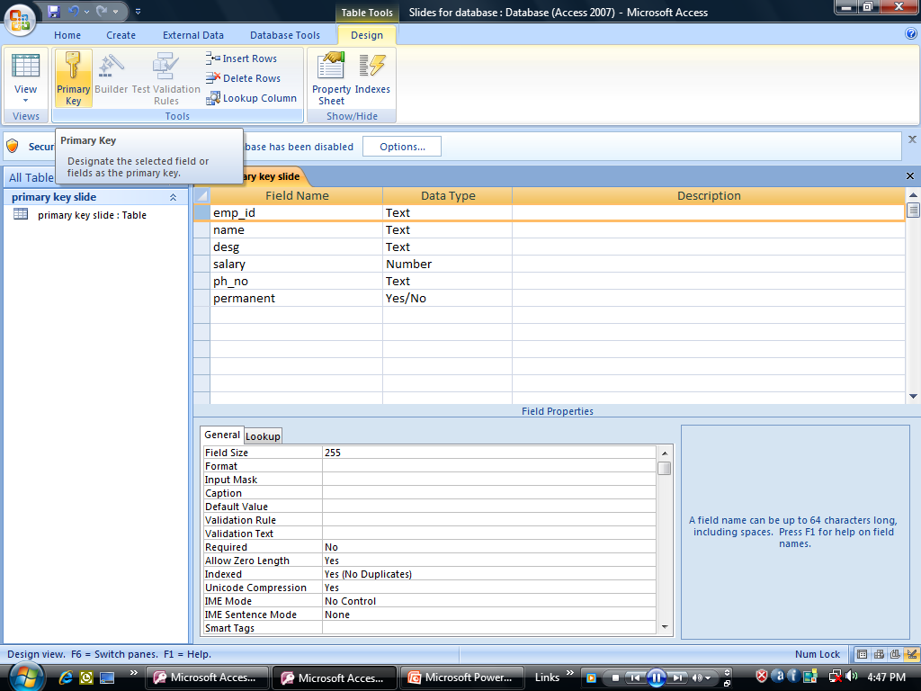
Primary key
Characteristics:
1.It uniquely identifies a particular entity.
2.It cannot a duplicate value.
3.It cannot take null values.

Slide 14
Foreign key
Characteristics:
1.The domain of foreign key is equal key to domain of primary key.
2.The foreign key cannot take value without having any corresponding value in primary key.
S. No | name | City | Dept.no
1 | Abc | Delhi | 1
2 | Pqr | Agra | 3
3 | Xyz | delhi | 5
Dept. no | Section | Floor | Faculty
1 | B | First | Def
3 | C | Second | Lmn
5 | D | First | Abc

Slide 15
Relationships
Relationship helps to create link and add two table.
There are three types of relationship:
One to one
One to many
Many to many
One to one: both tables have primary key.
One to many: only one table has primary key.
Many to many : both tables do not have any primary key.

Slide 16

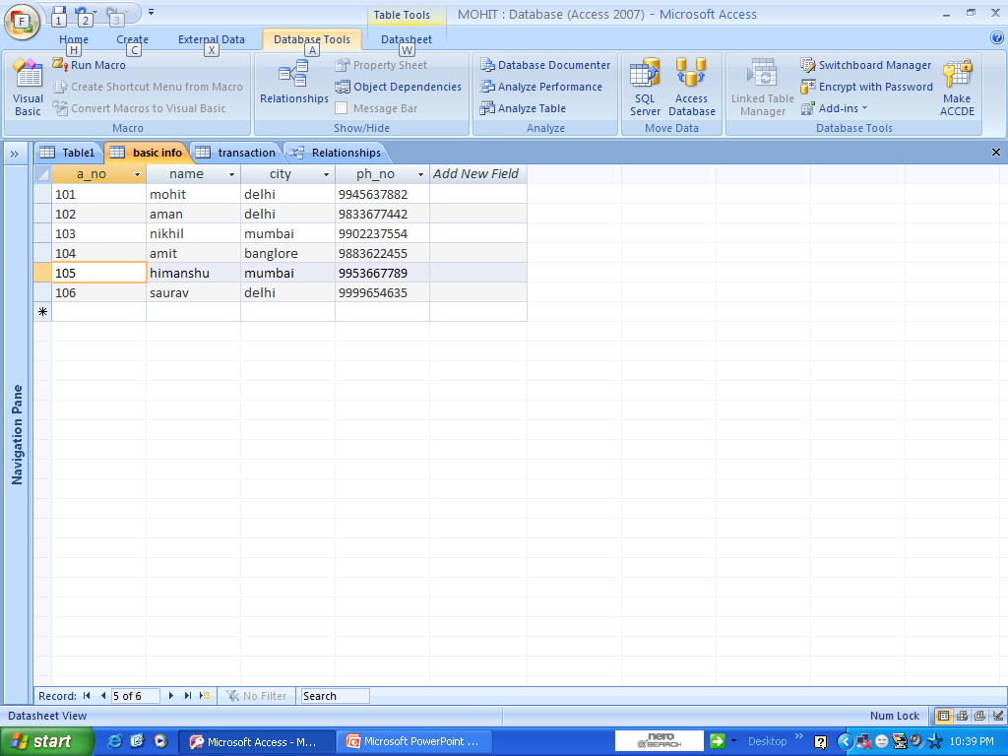
Ribbon which represents diff Tabs
Database tool tab which
Shows the relationship
option
Tuple
Attribute

Slide 17
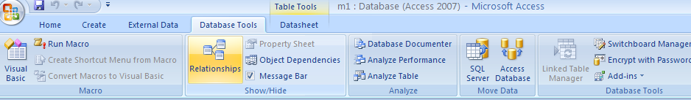
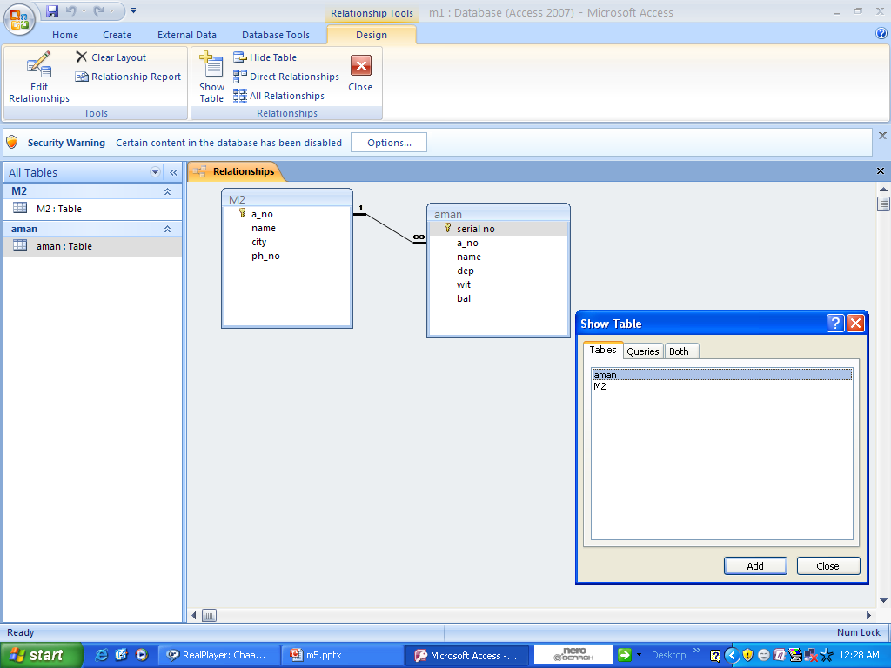
Relationship option which
Relates Two entities
It show One-To-Many
Relationship
which Means
One table consist
primary key
Tables added
In
Show table

Slide 18

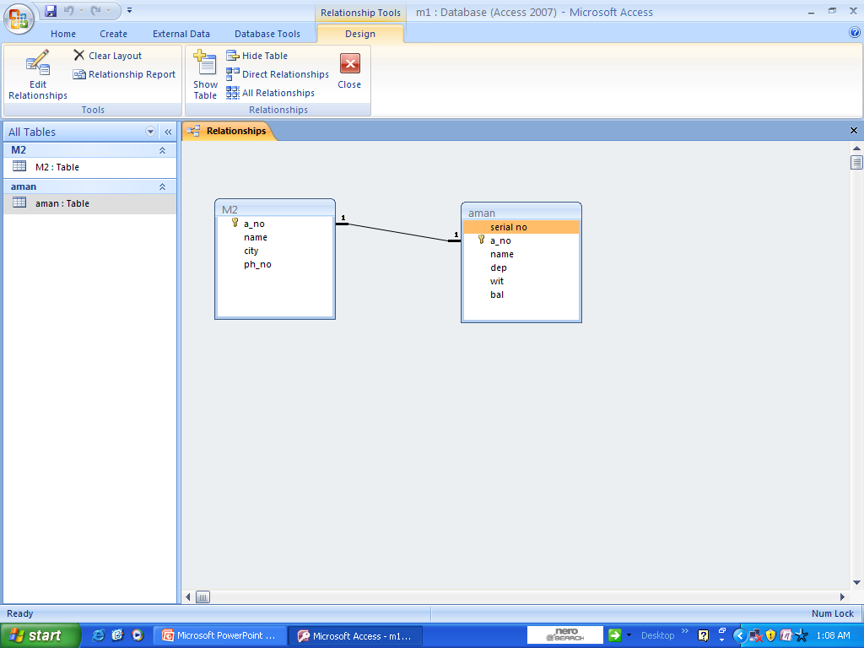
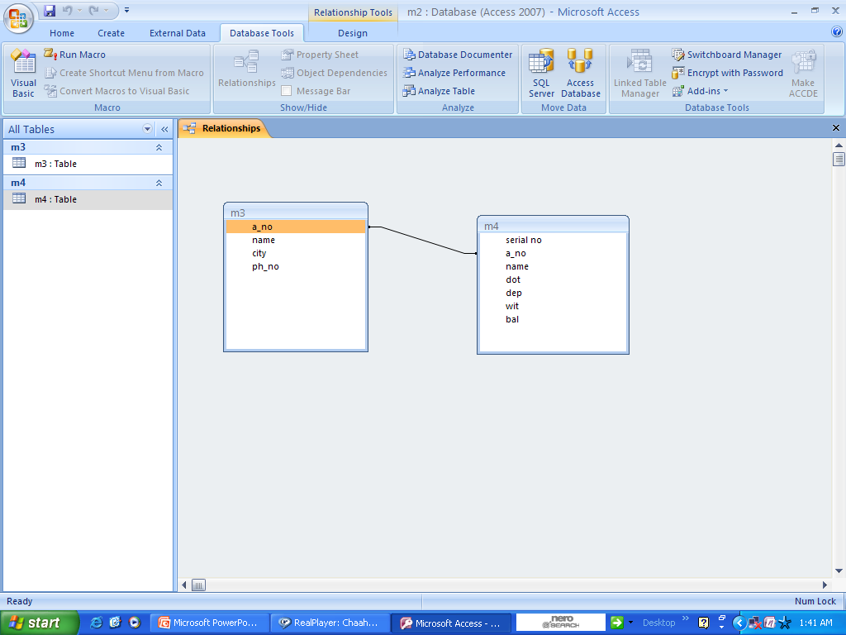
It show One-To-One
Relationship
which means
Both tables consist
primary key
It show Many-To-Many
Relationship
which means
Both tables
doesn’t consist
Primary Key

Slide 19

Examples Of Relationship
Manages
1.)
One-to-one:
Manager
Department
Belongs to
2.)
Students
Department
One-to-many:
Works For
3.)
Many-to-many:
Students
Projects

Slide 20

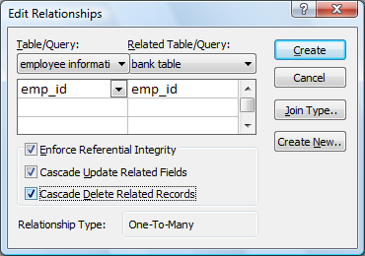
Cascade update and cascade delete
Cascade update:(in sequence)any change made in one table will be reflected in another table also.
Cascade delete : if we delete a column then deletion will also be reflected in another table

Slide 21
Abstraction
Abstraction – it is the process of indulging all the essential features with including the complete detail
Levels of abstraction
I - 1
I - 2
I - 3
Mapping
Logical level it contains the constrains for the database
Logical data independence
Physical level –it contain the actual data and the access path
Physical data independence
Mapping is used to relate two levels
Logical data independence – it changes at the logical level does not require changes at view level only the corresponding mapping has to be changed
Physical data independence – it changes at the physical level will not require any change at the logical level

Slide 22

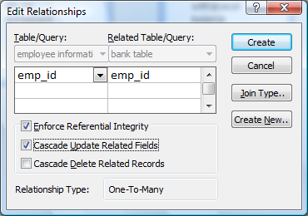
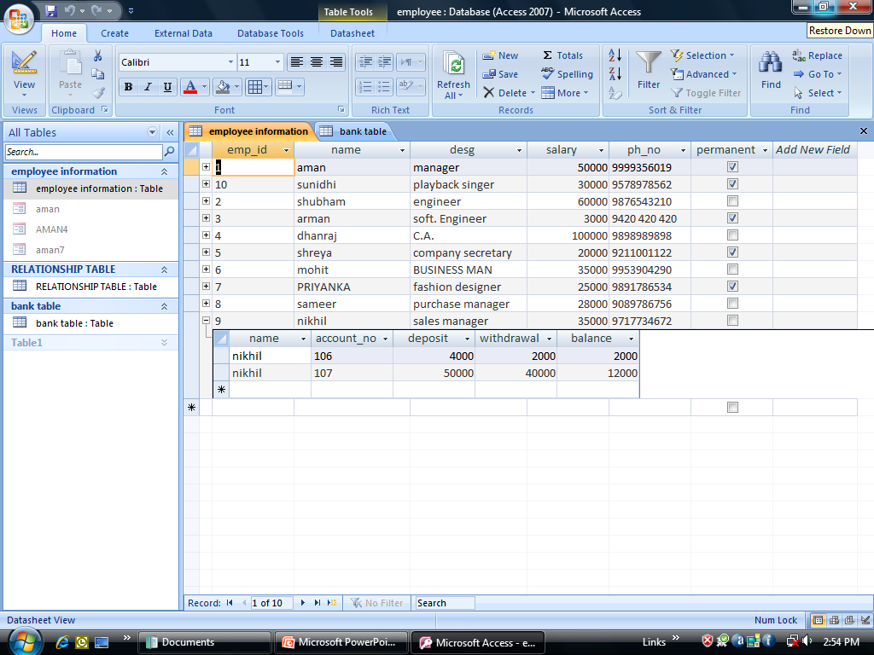
When cascade update option is activated, then the updation performed in details table would provide with details in main table.

Slide 23

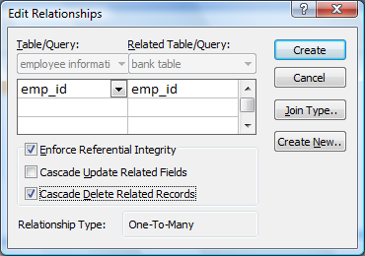
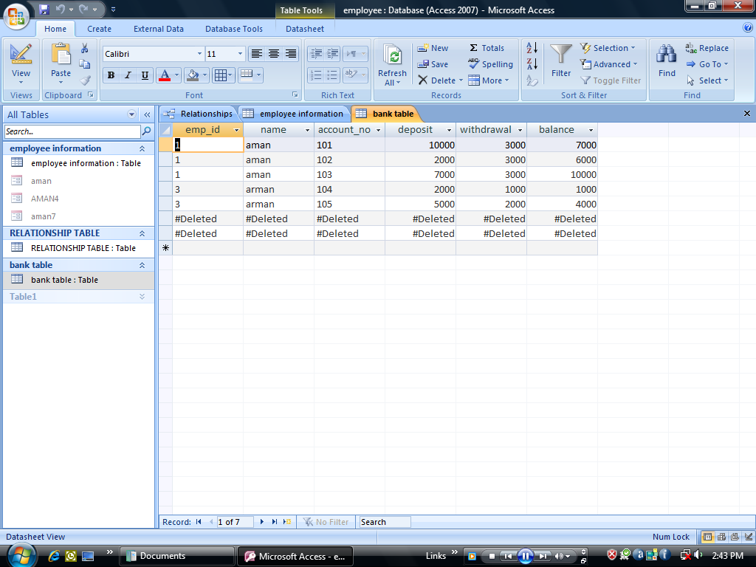
if cascade delete option is activated ,then the deletion will be performed in the employee details table.

Slide 24
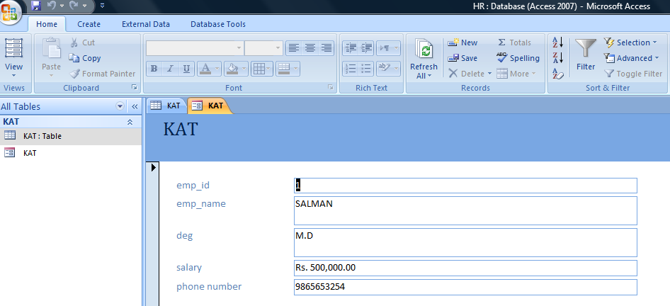

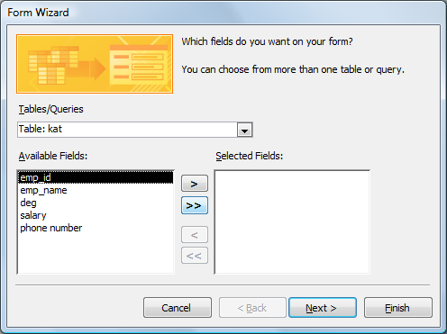
FORMS
Forms is the screen which display the information and we can edit the data easily.
Path for creating form:-
After creating go to the CREATE tab and then click on the more forms and then click on form wizard a dialogue box will appear then click on “>>” symbol and click on NEXT and then FINISH we can get the form as shown above
In forms we change the data like salary, phone number etc..
This is a form view

Slide 25
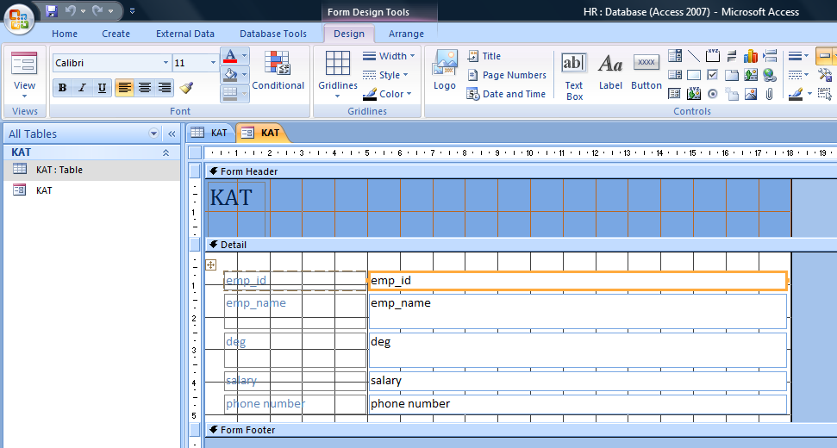
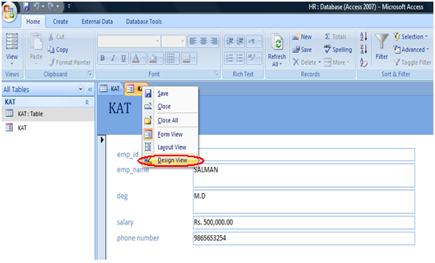
FORMS
This the DESIGN VIEW of FORM here we can set what should be the size of the column.
With the help of this design view we can set the length and breadth of column.
Path of DESIGN VIEW :-
Right click on the name of the table dialogue box will appear then click on the DESIGN VIEW we can get the above format
THIS IS THE DESIGN VIEW

Slide 26

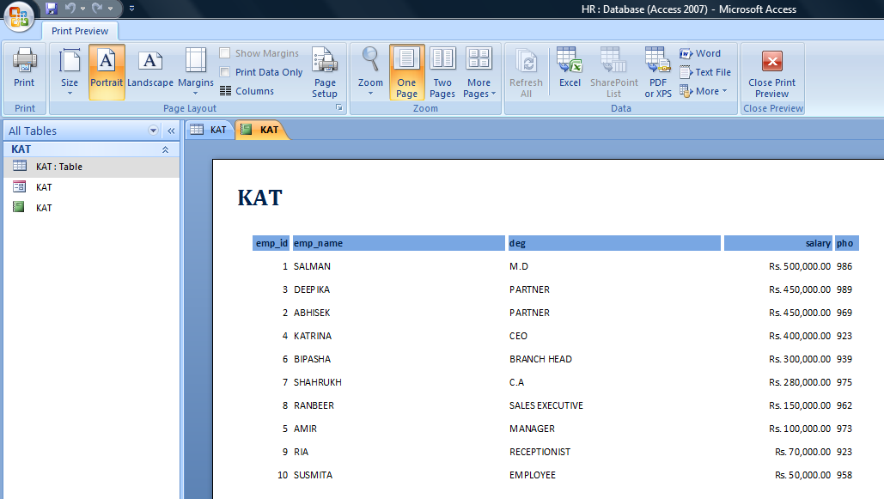
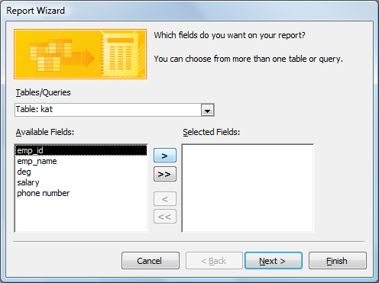
REPORTS
Reports helps in generating professionals results. It can be either basic or tabular,columnar,group etc.
Path of creating report:-
After creating data go to the CREATE tab and click on REPORT WIZARD then a dialog box will appear and click on “>>” and then NEXT and FINISH. We can get the report and with this we can either publish it or use it in company meeting.
THIS IS A REPORT

Slide 27

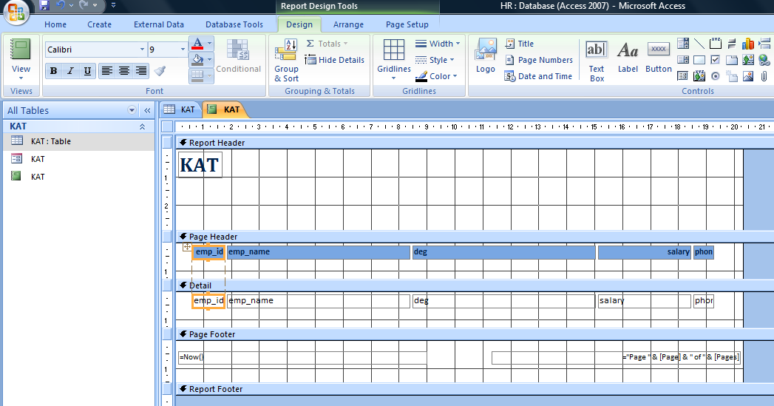
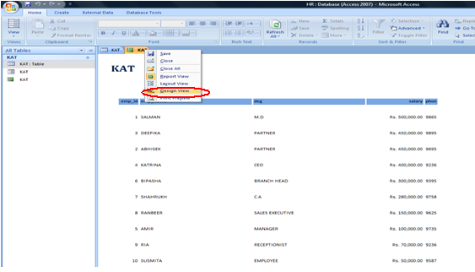
REPORTS
This is the DESIGN VIEW of report and here we can set REPORT HEADER,REPORT FOOTER,PAGE HEADER,PAGE FOOTER and can change INFORMATION OF REPORT.
Path of DESIGN VIEW:-
Right click on the name of the table a dialog box will appear then click on the DESIGN VIEW and this way we can get the design view of REPORT and we can change it according to our choice or demand of REPORT.
THIS IS THE DESIGN VIEW OF REPORT

Slide 28
INTRODUCTION TO QUERIES
We can use queries to filter our data, to perform calculations with our data , and to summaries our data.We can also use queries to automate many data management tasks and to review changes in our data before we commit to those changes.
Following are the examples of query:
1.Delete query
2.Append query
3.Select query
4.Update query
5.Select table query etc.

Slide 29

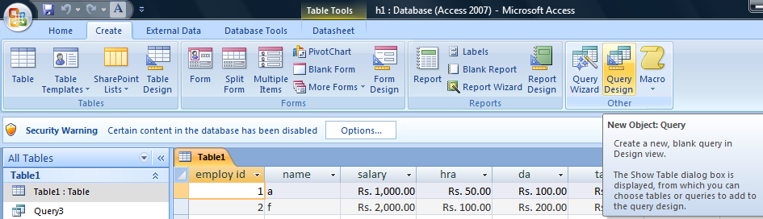
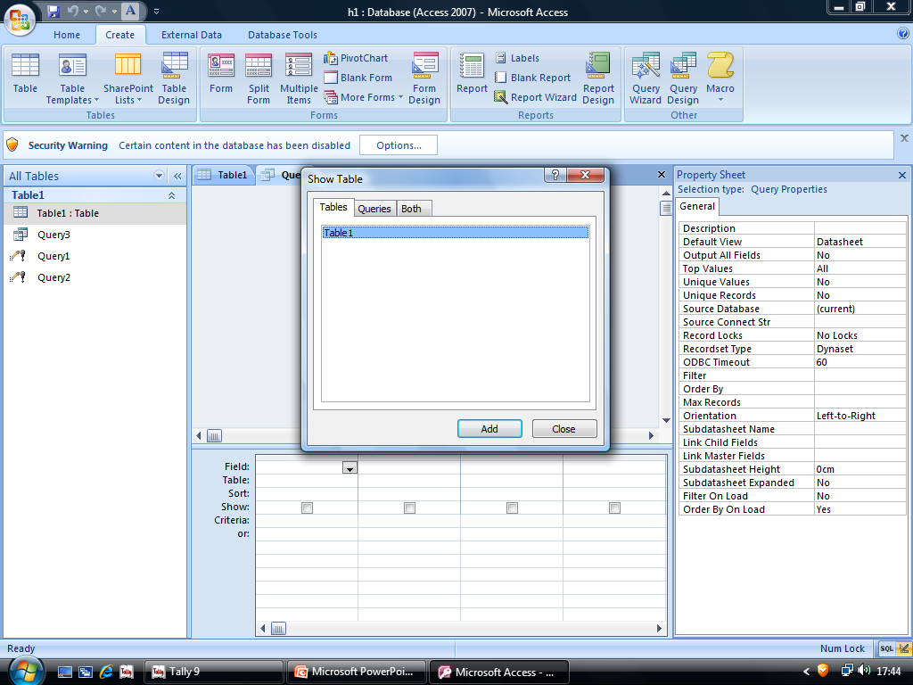
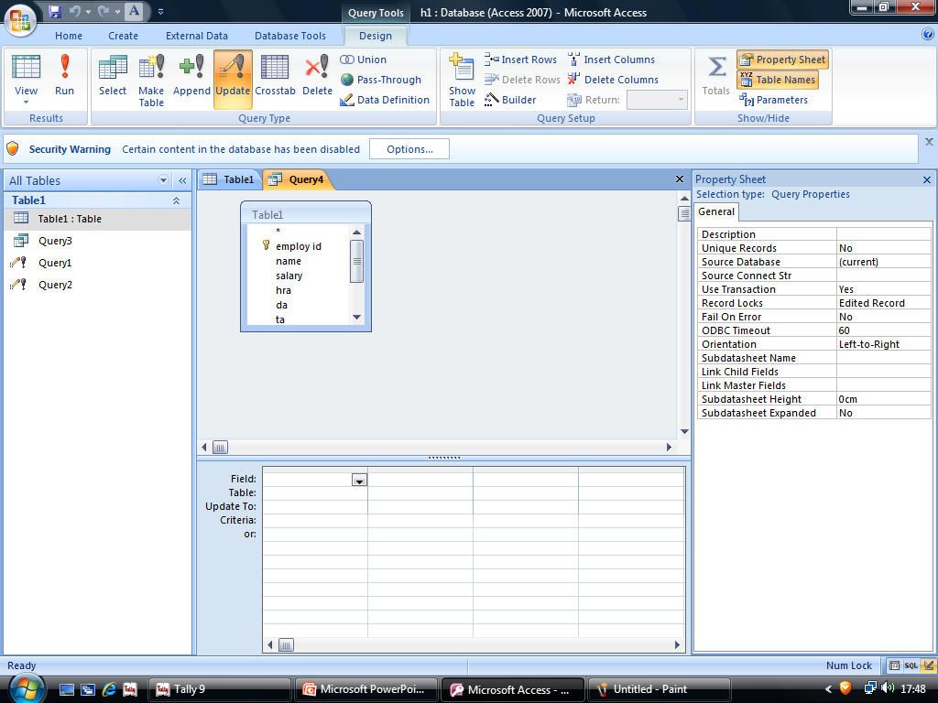
HOW TO MAKE QUERY
Step1.Create Query design Step2.Select table Select field
Step3. update
Fill query in “update to”
Step4. Run

Slide 30

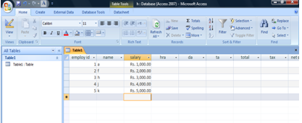
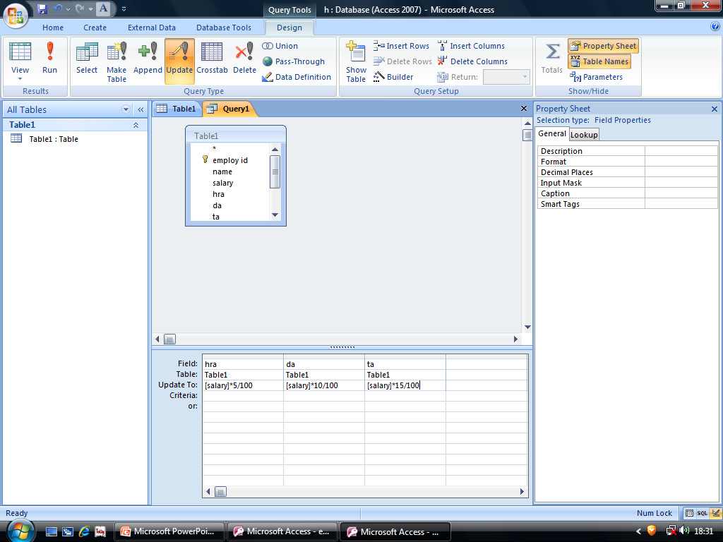
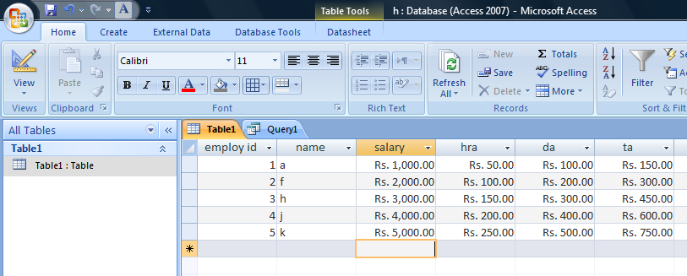
UPDATE QUERY
Step 1. CREATE QUERY DESIGN SELECT TABLE UPDATE SELECT HRA DA AND TA
Step2. FILL UPDATE TO OPTION WITH FORMULAS
E.G: [SALARY]*5/100,[SALARY]*10/100,[SALARY]*15/100
Step3. RUN TO TAKE QUERY EFFECT

Slide 31

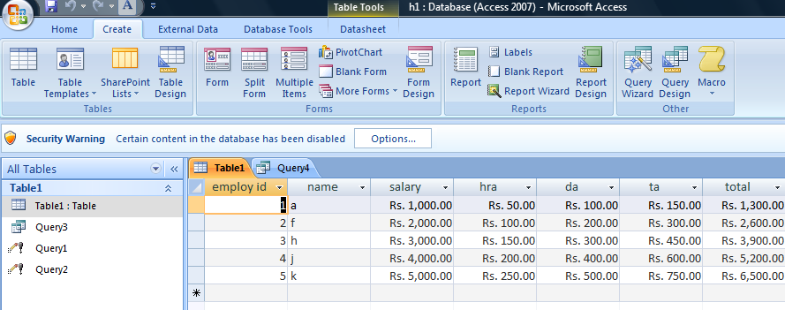
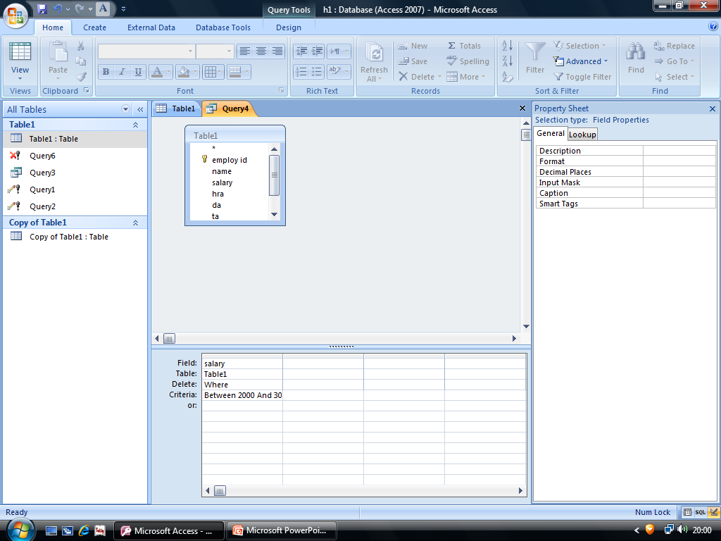
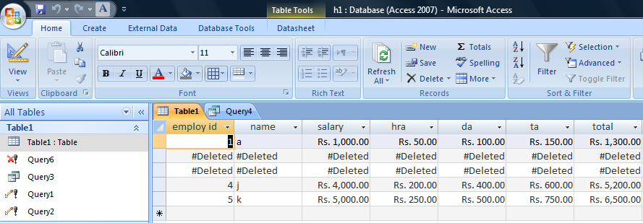
DELETE QUERY
Step1.create query design
Step2.select table
Delete
Step3.fill criteria
Step4.Run

Slide 32
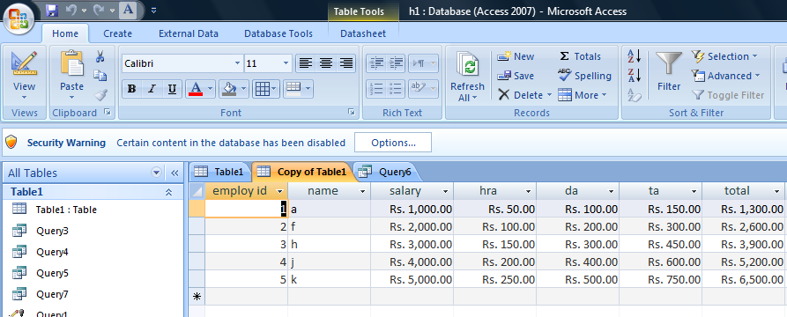
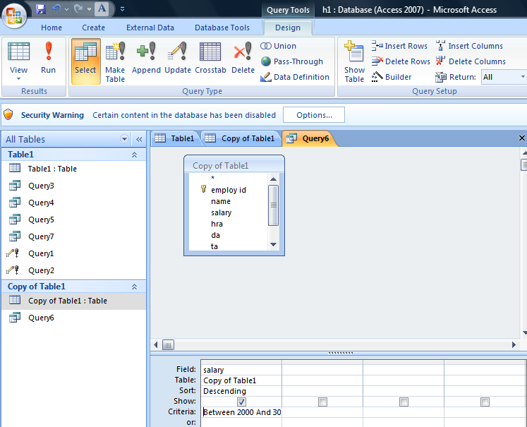
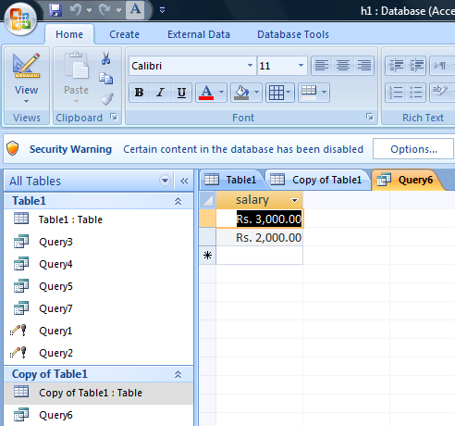
SELECT TABLE QUERY
Step1.create design query
Step2.select table select
Step3.select field fill criteria
Step4. run

Slide 33
SQL
Structured query language
a database computer language designed for managing data in RDBMS
Appeared in 1974
Designed by Raymond F Boyce
Most commonly used language of 4th Generation Language
Most common operation - Queries

Slide 34

Components
DDL – manages tables and index structure
DCL- authorizes users and groups of users to access and manipulate data
DML – used to perform insertion, updation and deletion
VDL – used to create views

Slide 35

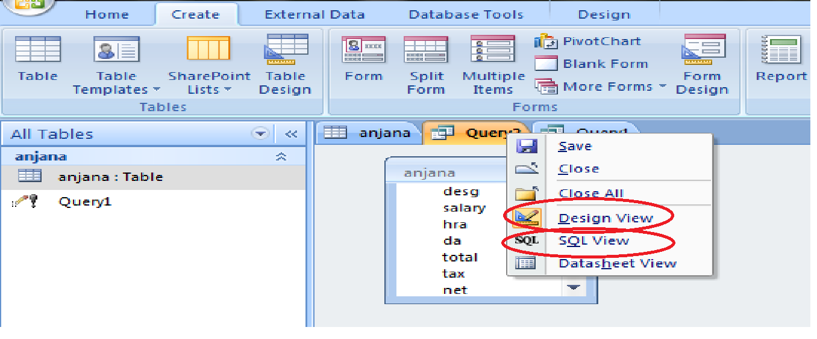
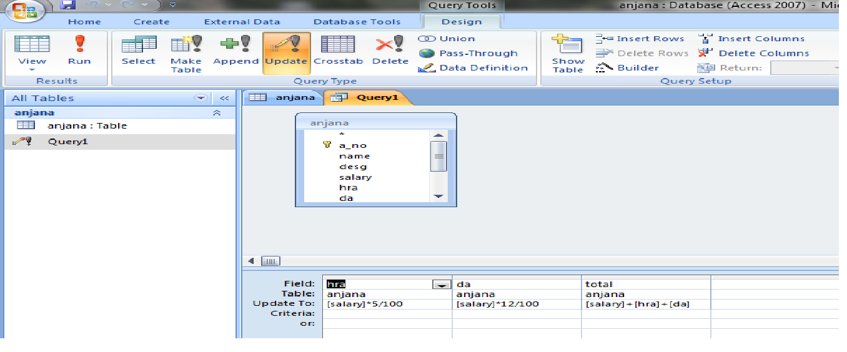
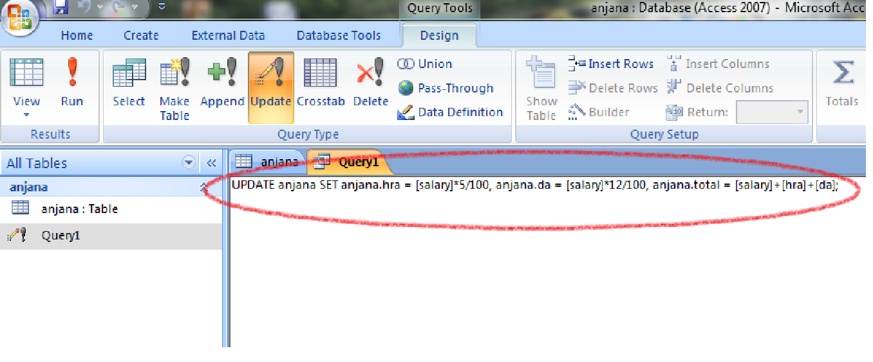
When
update
query
is applied

Slide 36
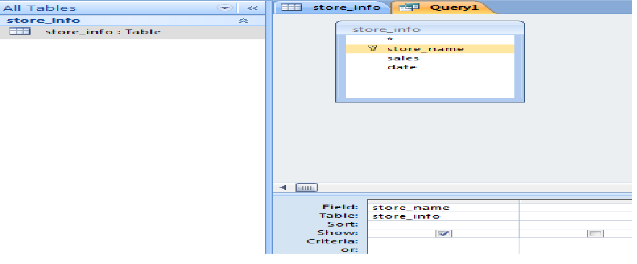
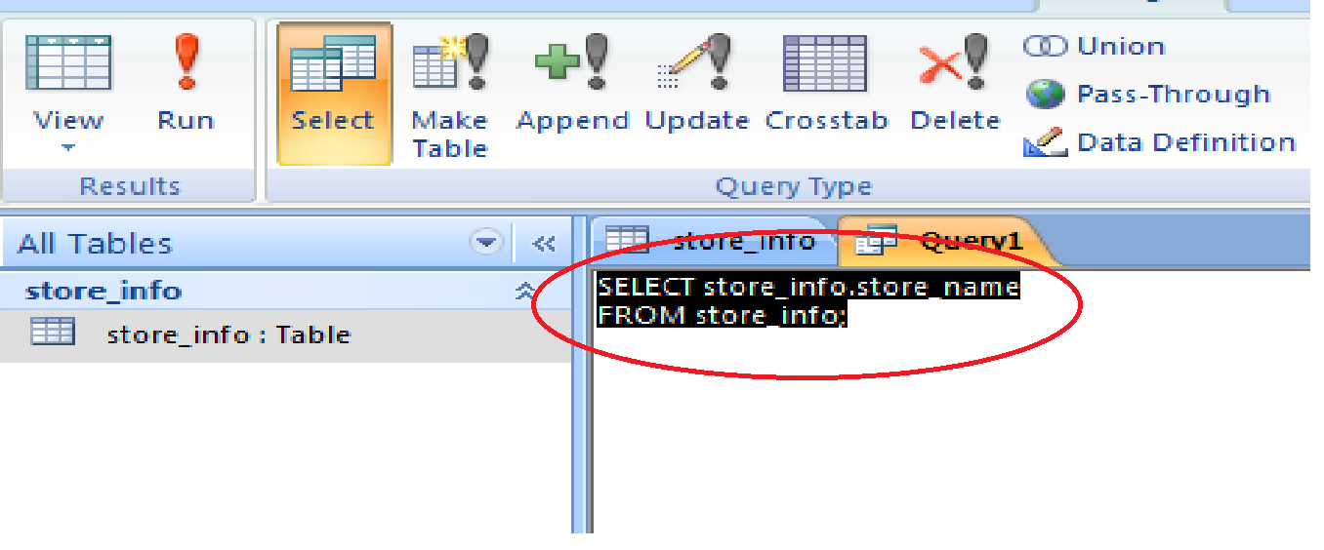
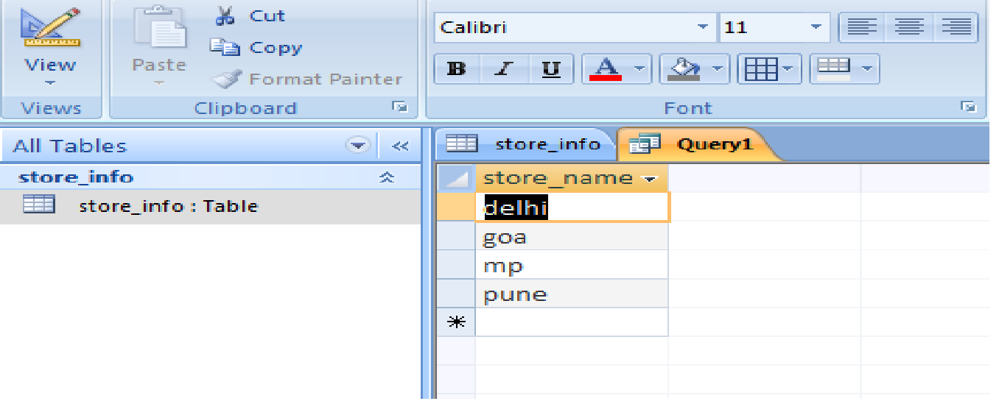
Design view of
selecting a record
Design view into
SQL coding
Resulting
Data sheet view

Slide 37

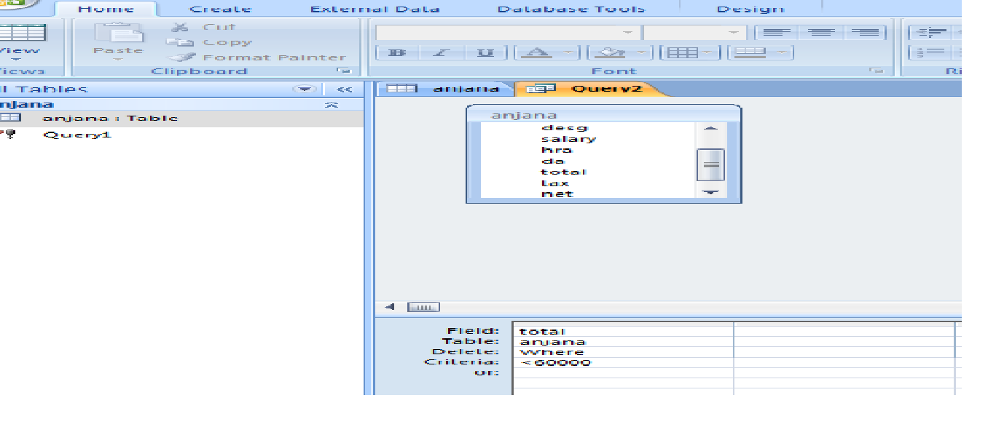
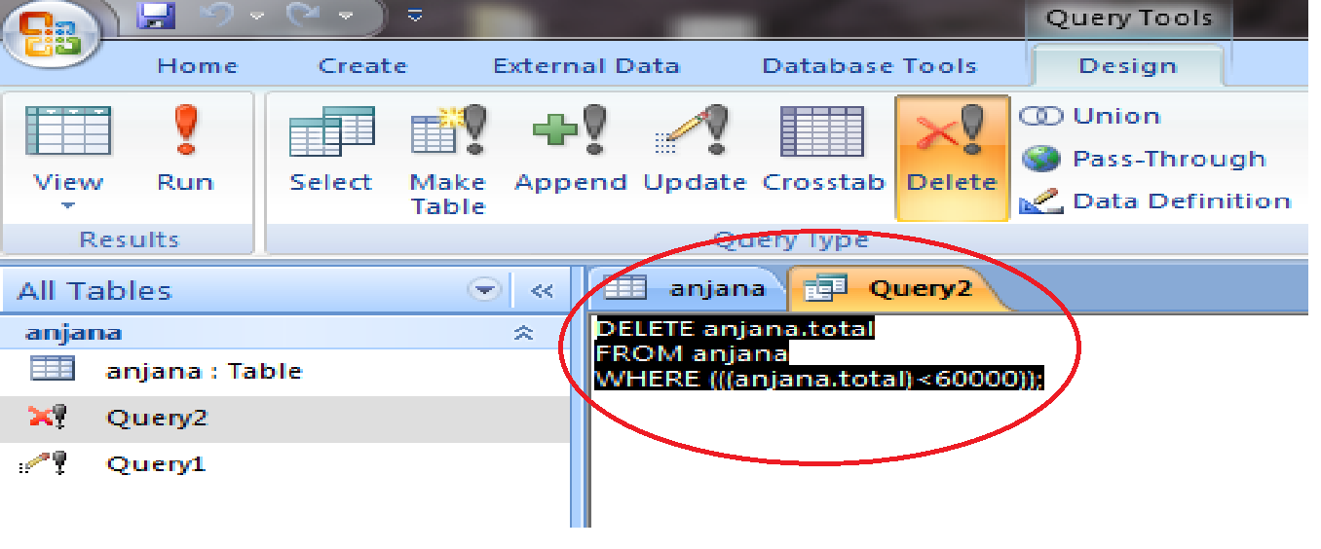
Design view –
When
delete query
is used
SQL coding – when
delete query
is used

Slide 38
COMPARISION BETWEEN MS ACCESS AND MS EXCEL
MS EXCEL
MS ACCESS
It as a database that is used to manage large amount of data by creating links within the various table of data performing analysis and creating complex calculation and derivation from data and report,
It has RDBMS concept,
We have tables in MS ACCESS,
While entering data only few records are concurrently available to the user.
It is a financial tool that perform mathematical calculations and organises data into tabular form within worksheets,
MS EXCEL is used for calculations and making graphs etc,
We have sheets in MS EXCEL,
While entering data whole records are concurrently available to the user.

Slide 39

THANKING YOU

