Slide 1
INFORMATION TECHNOLOGY
(ipcc)

Slide 2
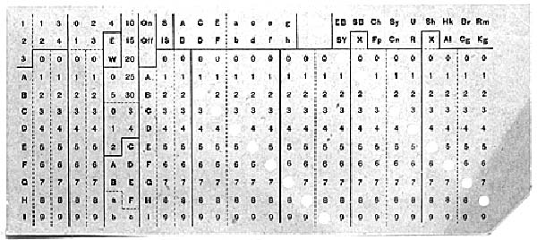
1890: punched cards used by Herman Hollerith to automate Census

Slide 3
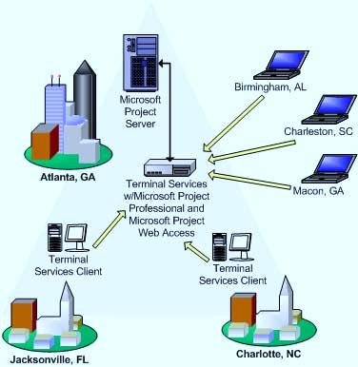
Wide area network

Slide 4
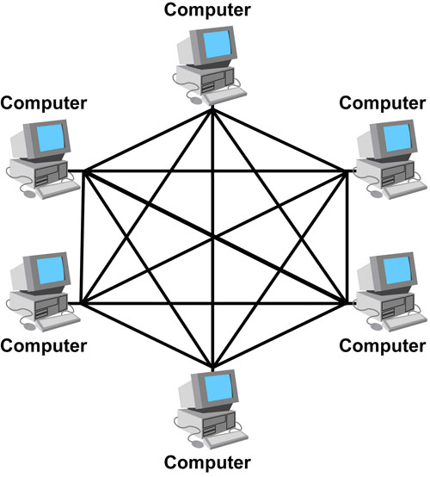
MESH TOPOLOGY

Slide 5
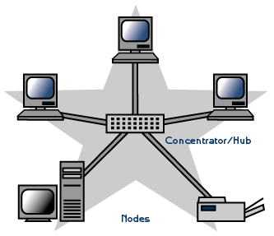
STAR TOPOLOGY

Slide 6
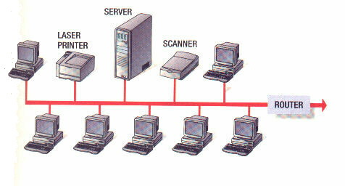
BUS TOPOLOGY

Slide 7
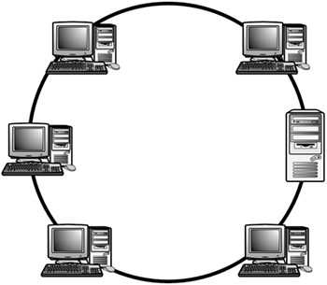
RING TOPOLOGY

Slide 8
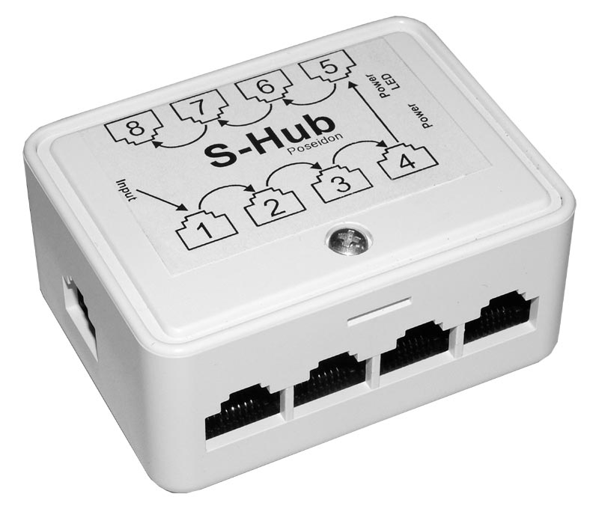
HUB

Slide 9
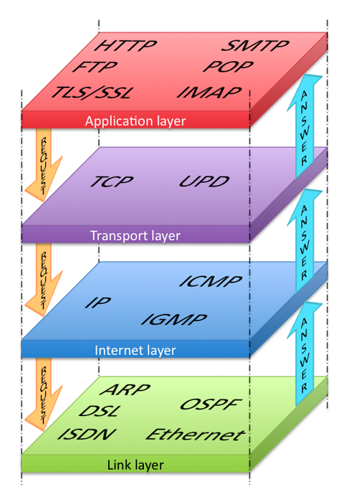
PROTOCOL STAKE

Slide 10
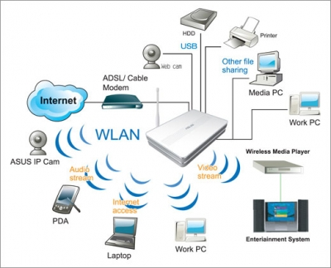
ROUTER
IT SELECT THE BEST PATH AND SEND THE DATA WITH OUT ANY DISTRUBANCES

Slide 11

TORJAN

Slide 12
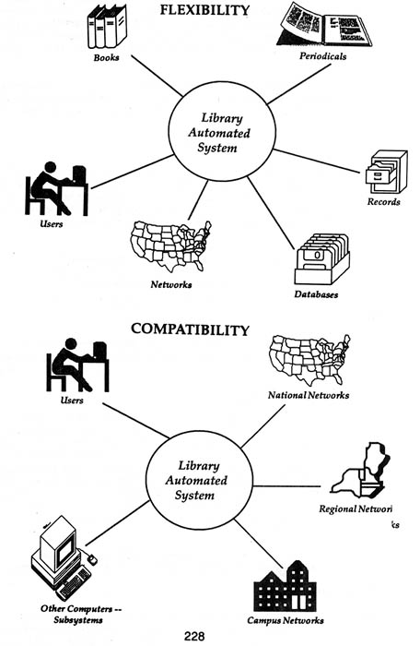
COMMUNICATION PROTOCOLS

Slide 13
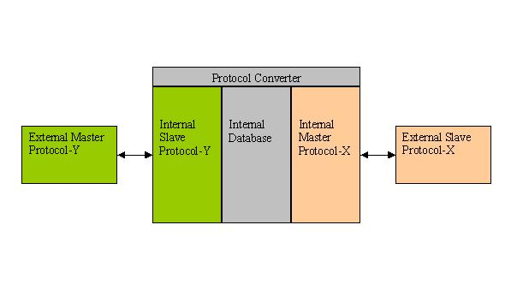
PROTOCOL CONVERTER

Slide 14
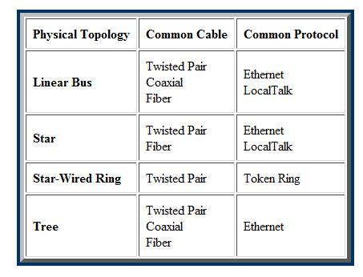
COMMON CABLE
COMMON PROTOCL

Slide 15
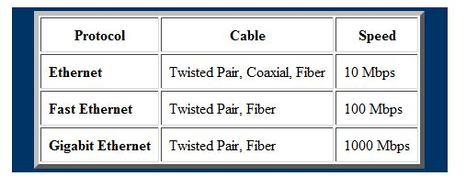
PROTOCOL SPEED TROUGH CABLE

Slide 16
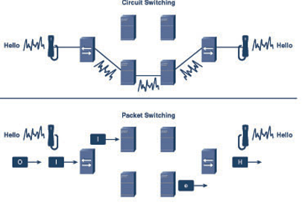
Circuit switching

Slide 17
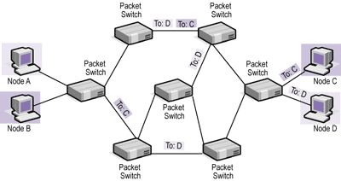
Packet switching

Slide 18
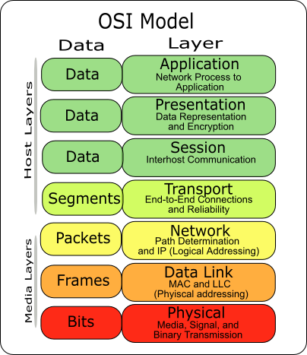
OSI 7LAYERS MODEL

Slide 19
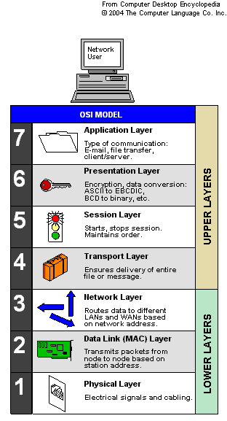
WHAT DOES IT MEAN?

Slide 20

OPTICAL FIBER.

Slide 21
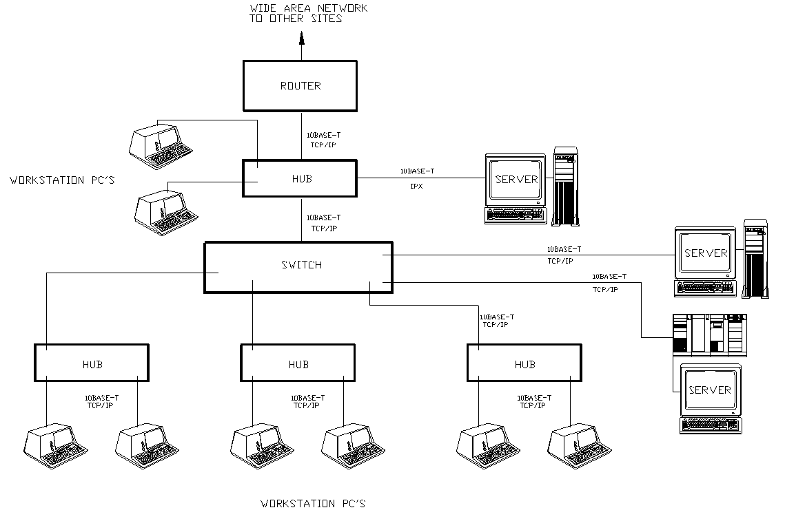
EXAMPLE OF TCP/IP

Slide 22
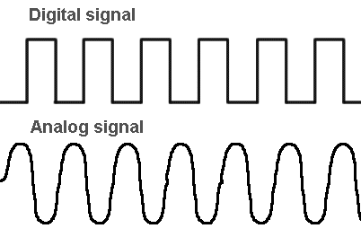
Digital & Analog

Slide 23
COSTING

Slide 24
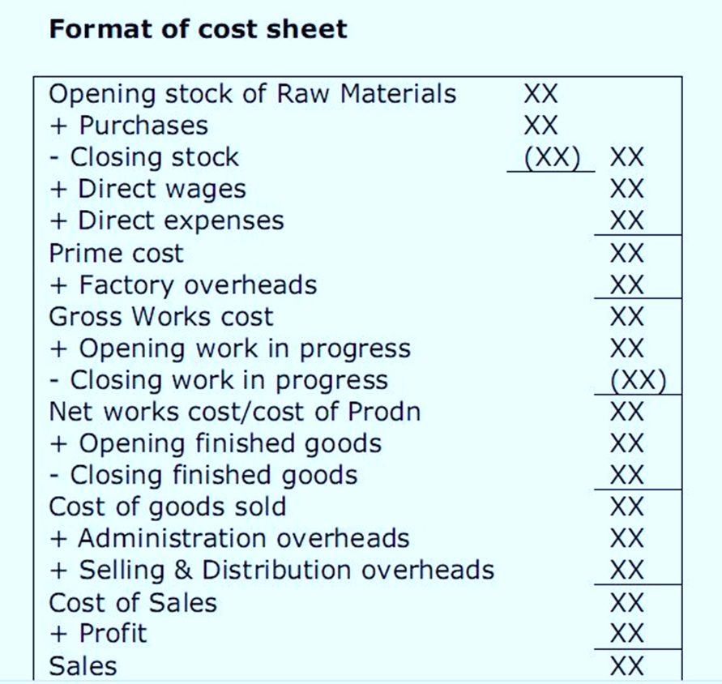
Format of cost sheet

Slide 25
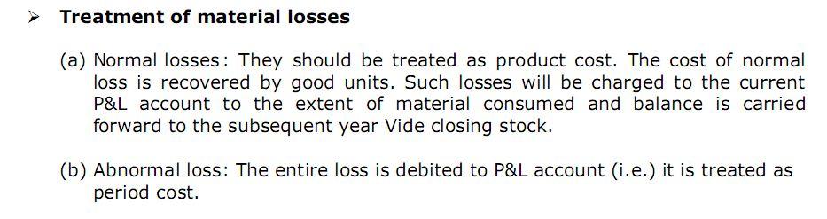
TREATMENT FOR MATERIAL LOSSES

Slide 26
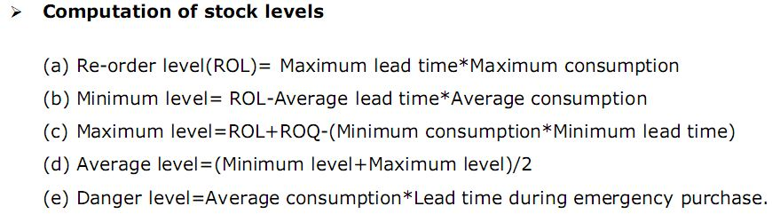
COMPUTATION OF STOCK LEVELS

Slide 27
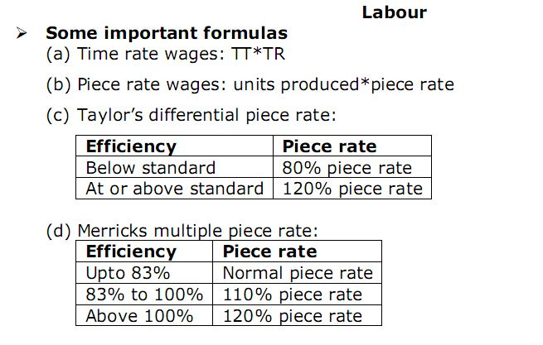
LABOUR LESSON FORMULA

Slide 28
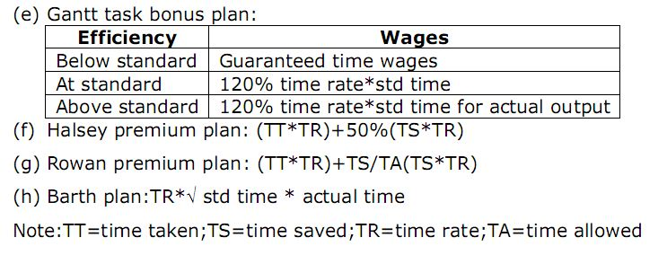
LABOUR CONTD….

Slide 29
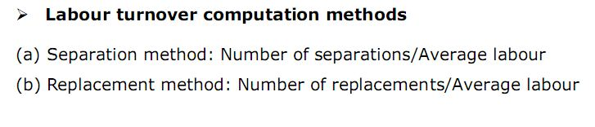
LABOUR TRUNOVER COMPUTATION

