Slide 1


Introduction to SAP
Maheswaran Sundaram
Akshayaa_mahes@yahoo.com
ssmahes@wepl.com

Slide 2
Introduction to SAP
What is SAP ?
Systems Application and Products in Data Products
What is ERP?
Enterprise Resource Planning
Any busines Men
Material Machinery Money

Slide 3
Introduction to SAP
CDB
Production
Warehouse
Purchase
Finance
Central Data Base (CDB)
Production Dept
Warehouse Dept
Finance Dept
Purchase Dept

Slide 4
Introduction to SAP
Production Dept – Material Requisition(MR) is posted in CDB whenever a Material requires
Warehouse Dept – Access the MR and makes a Purchase Requisition (PR) and is posted in CDB
Purchase Dept – Access the PR and makes a Purchase order and the Invoice is posted in the CDB
Accounts Dept – No need to check the physical invoice and they have to verify the invoices in CDB.

Slide 5
Introduction to SAP
The Main Advantages of SAP is at any time the CFO/GMF has to login the CDB and has to see the total purchase volumes and also to know the Account balance of Vendors.
All the relevant data relating to purchase by the purchase department.
How ERP helps
All data is available in CDB
Limited data duplicate
One point entry of data

Slide 6
Introduction to SAP
History of SAP
SAP R/1 suite – implemented in 1972
SAP R/3 suite -- implemented in 1990
ECC 6.0 – ERP Central Component
R/3 – R- Real Time Data Processing
3- Three Tier Architecture - ie Instant Update

Slide 7
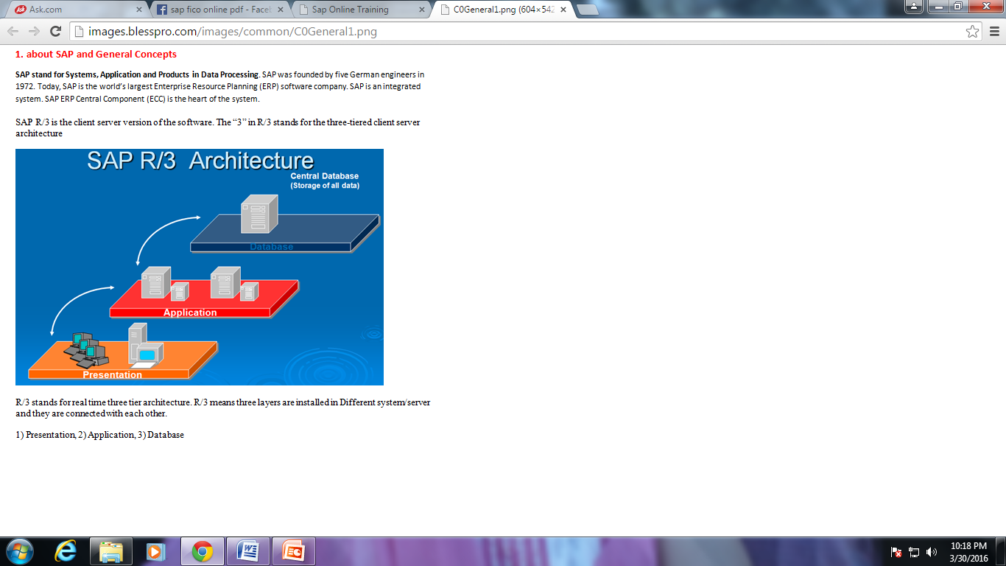
Introduction to SAP

Slide 8
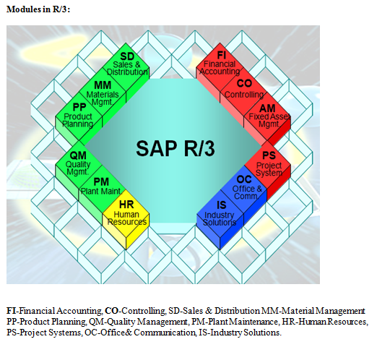
Introduction to SAP
Notes:
Thank you all Friends – Maheswaran Shanmugasundaram, Manager – AP – WEPL Chennai Plant – akshayaa_mahes@yahoo.com – 90429 52653

Slide 9
Thank you all Friends –
Maheswaran Shanmugasundaram, Manager – AP – WEPL Chennai Plant – akshayaa_mahes@yahoo.com

