Slide 1
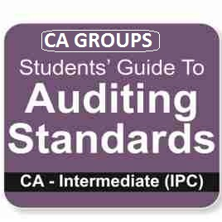
AUDITING STANDARDS
- SOURAV BAGARIA

Slide 2
Download CA IPCC Auditing and Assurance Standards Notes in PowerPoint. Here we are providing total 16 CA IPCC Auditing standards . These auditing standards notes in table format (diagrammatic representation). You can easily revise auditing standards from this notes in easy way. Remember, This Notes are only for Revision Purpose before the exam time. This Notes are Prepared keeping in mind the situation of CA IPCC Students as they are not getting time for revision. We CA GROUPS are not held any responsibility for any discrepancy in this notes. People if found any discrepancy in this notes can mail us at cagroups4all@gmail.com , we will rectify the same. Copyright of this notes is Prohibited.
WISH YOU GOOD LUCK
S
O
U
R
A
V
B
A
G
A
R
I
A

Slide 3
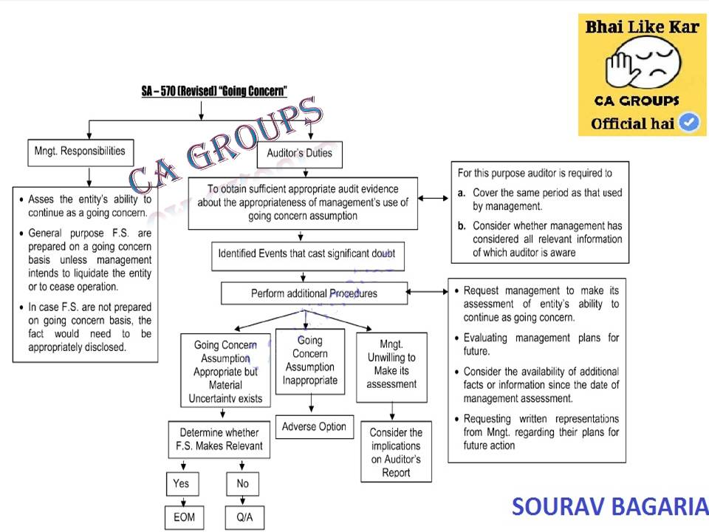
SA 570(REVISED): GOING CONCERN
S
O
U
R
A
V
B
A
G
A
R
I
A

Slide 4
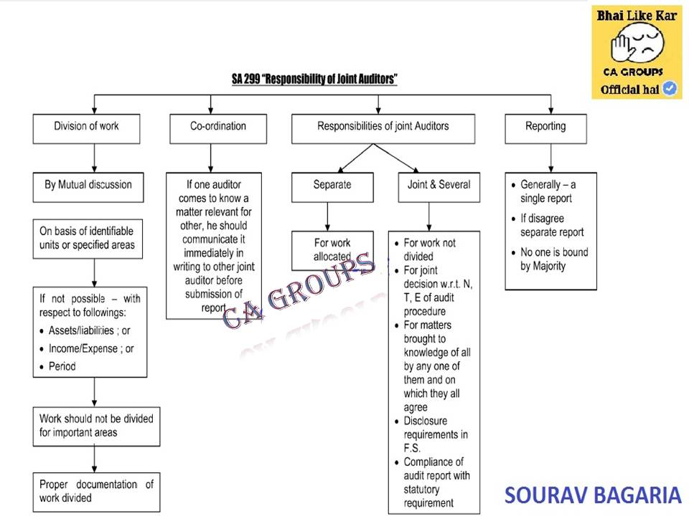
SA 299: Responsibility of Joint Auditors
S
O
U
R
A
V
B
A
G
A
R
I
A

Slide 5
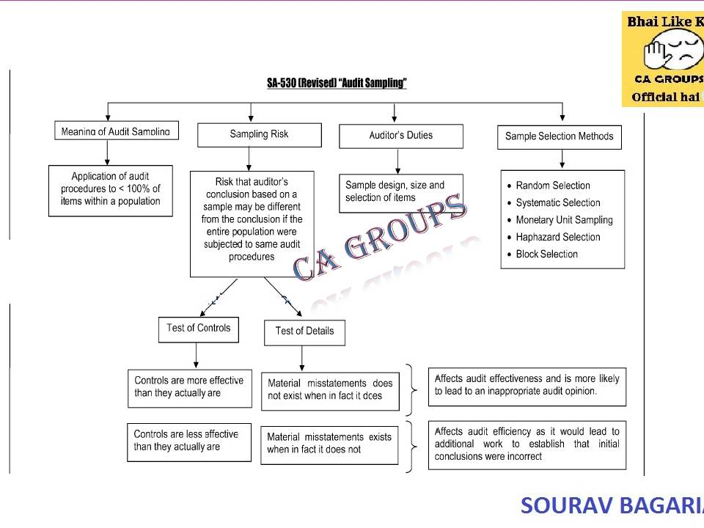
SA 530: Audit Sampling notes
S
O
U
R
A
V
B
A
G
A
R
I
A

Slide 6
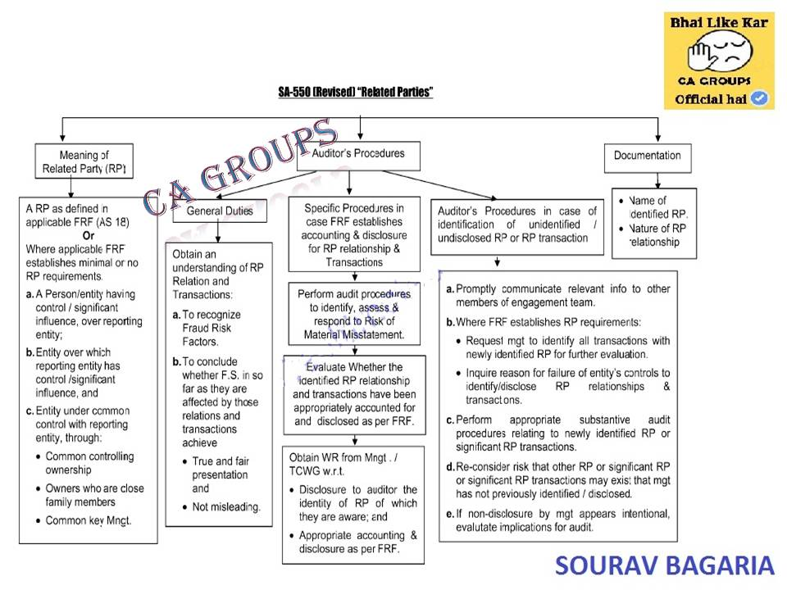
SA 550(revised) related parties
S
O
U
R
A
V
B
A
G
A
R
I
A

Slide 7
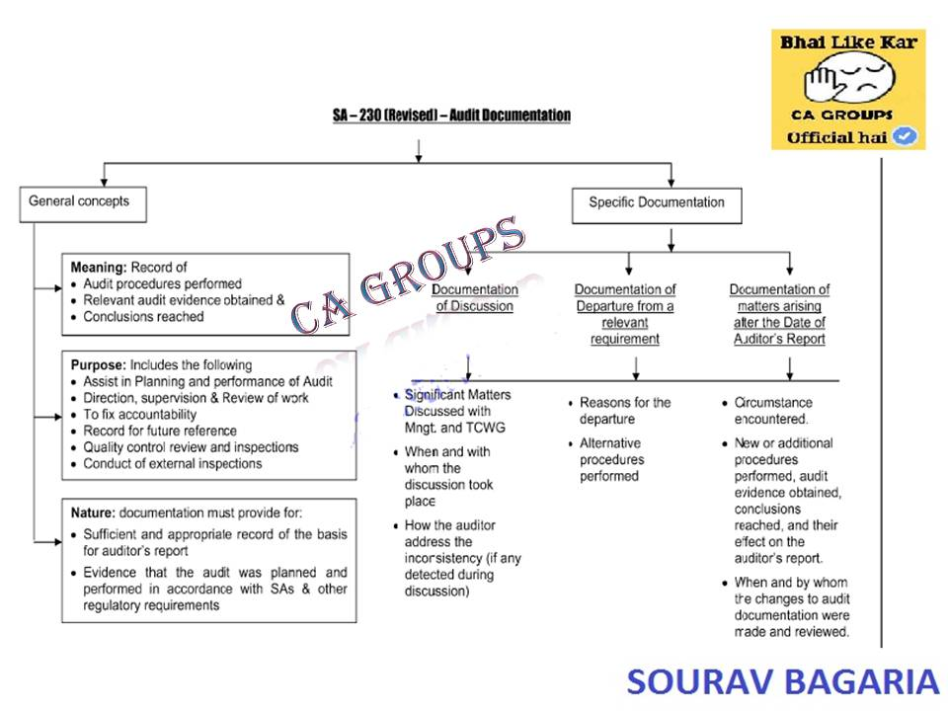
SA-230 Audit Documentation
S
O
U
R
A
V
B
A
G
A
R
I
A

Slide 8
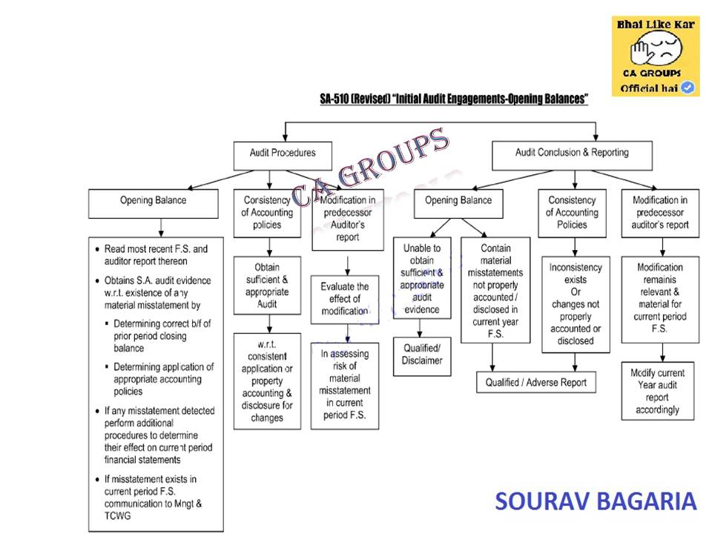
SA-510 Initial Engagements – Opening Balances
S
O
U
R
A
V
B
A
G
A
R
I
A

Slide 9
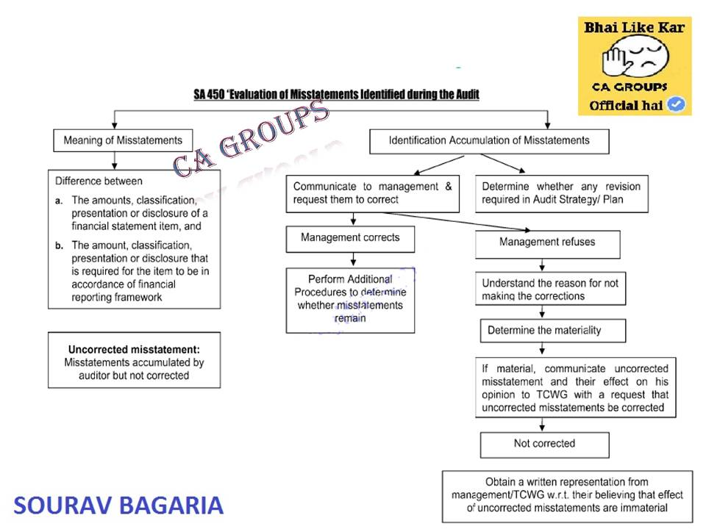
SA-450 Evaluation of Misstatements Identified during the Audit
S
O
U
R
A
V
B
A
G
A
R
I
A

Slide 10
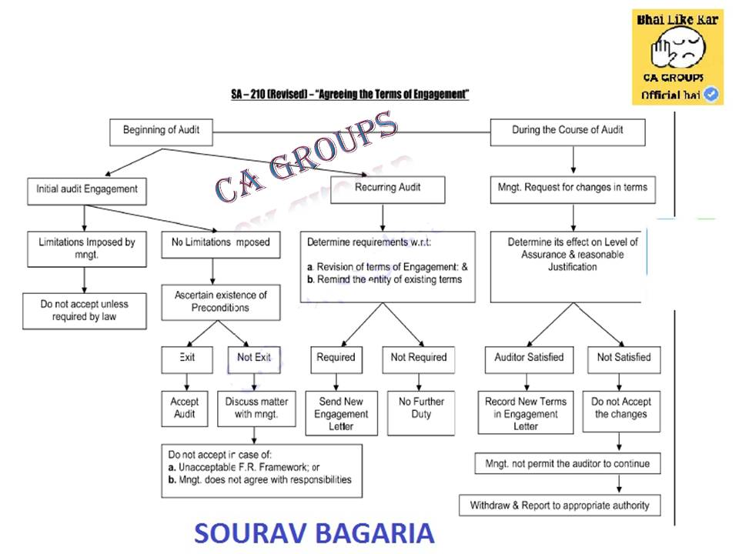
SA-210 (Revised) “Agreeing the Terms of Audit Engagements”
S
O
U
R
A
V
B
A
G
A
R
I
A

Slide 11
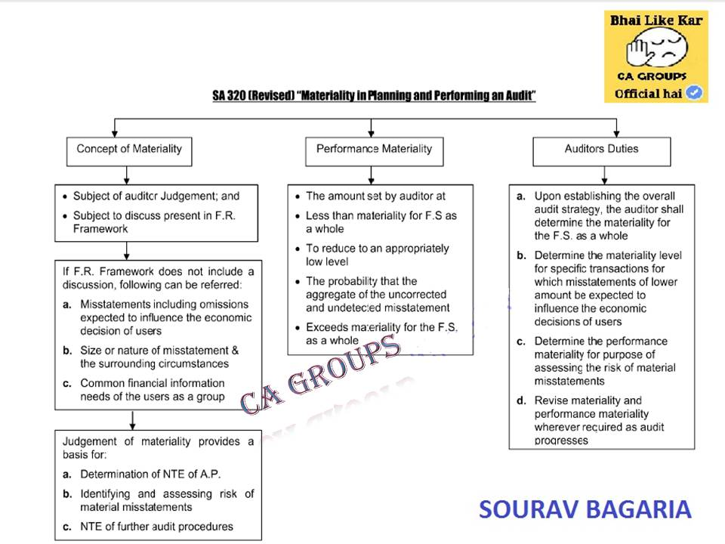
SA 320 Materiality in Planning and Performing an Audit
S
O
U
R
A
V
B
A
G
A
R
I
A

Slide 12
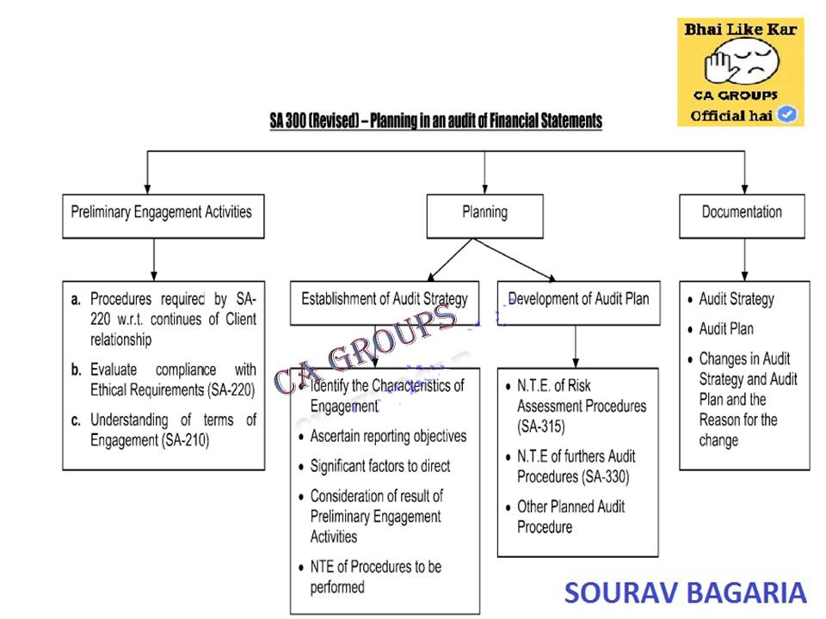
SA-300 (Revised) Planning an Audit of Financial Statements
S
O
U
R
A
V
B
A
G
A
R
I
A

Slide 13
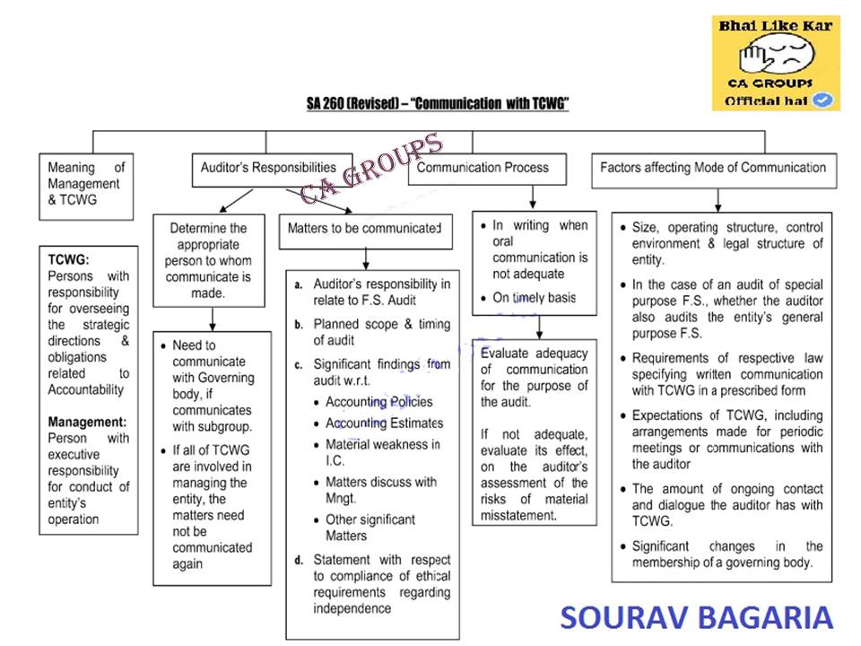
SA-260 Communication with Those Charged with Governance
S
O
U
R
A
V
B
A
G
A
R
I
A

Slide 14
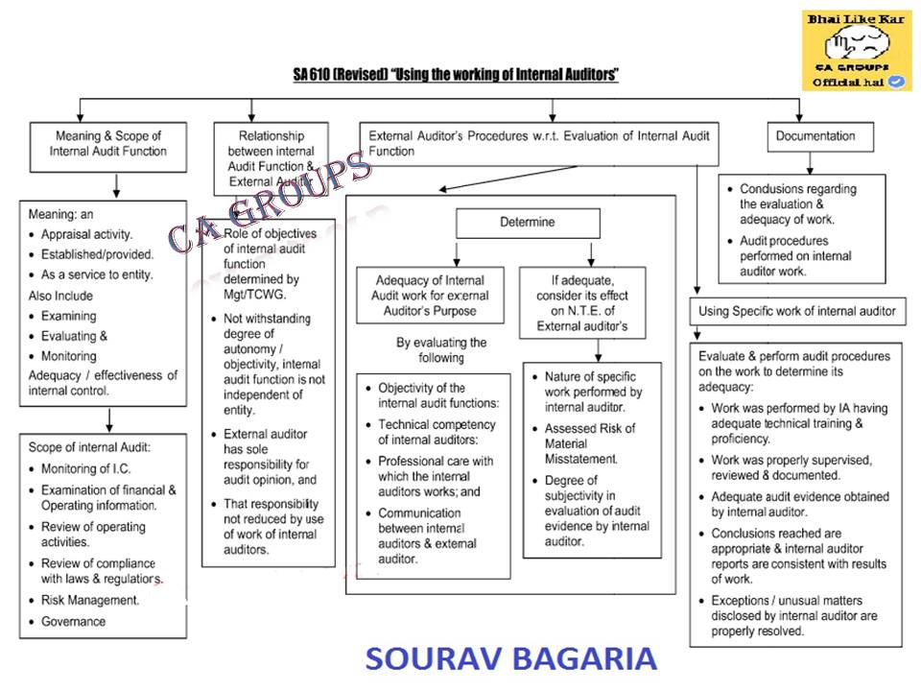
SA 610 (Revised) -Using the Work of Internal Auditors
S
O
U
R
A
V
B
A
G
A
R
I
A

Slide 15
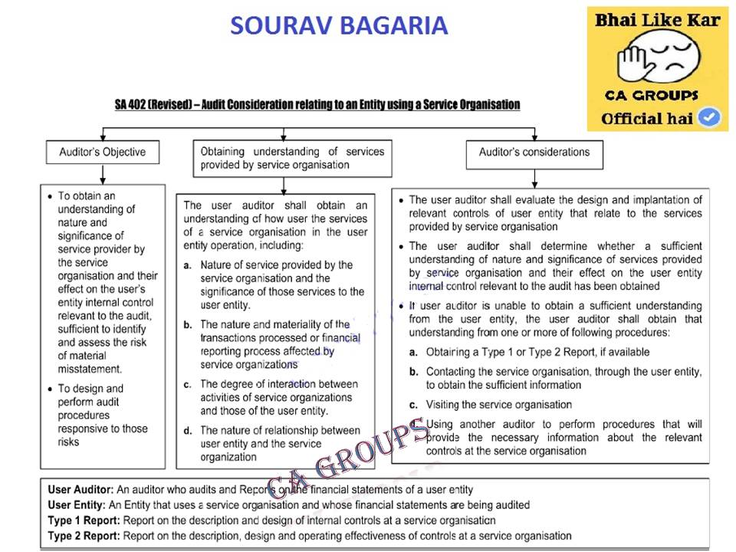
SA-402 Audit Considerations Relating to an Entity Using a Service Organisation
S
O
U
R
A
V
B
A
G
A
R
I
A

Slide 16
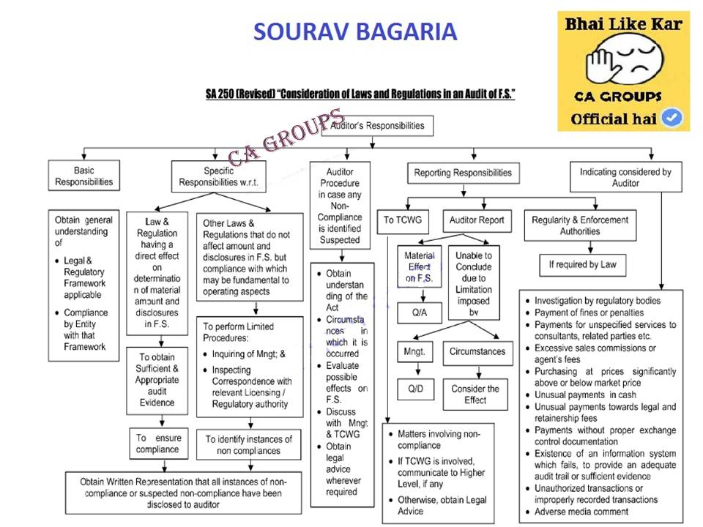
SA-250 Consideration of Laws and Regulations in an Audit of Financial Statements
S
O
U
R
A
V
B
A
G
A
R
I
A

Slide 17
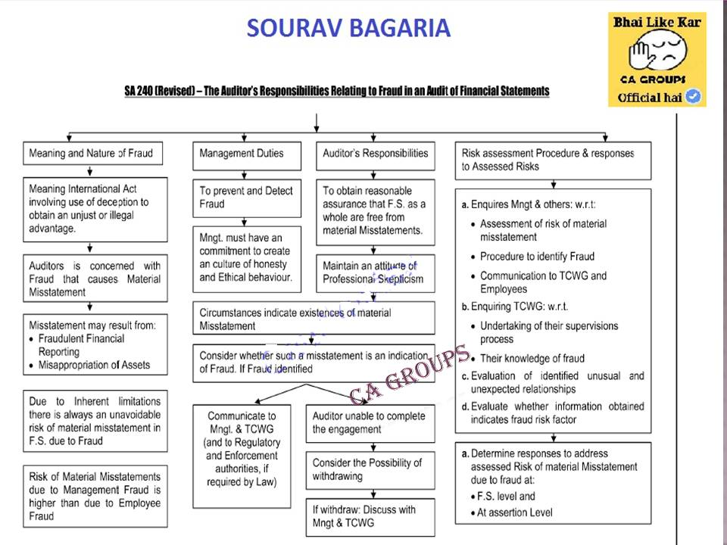
SA-240 The Auditor’s Responsibilities Relating to Fraud in an Audit of Financial Statements
S
O
U
R
A
V
B
A
G
A
R
I
A

Slide 18
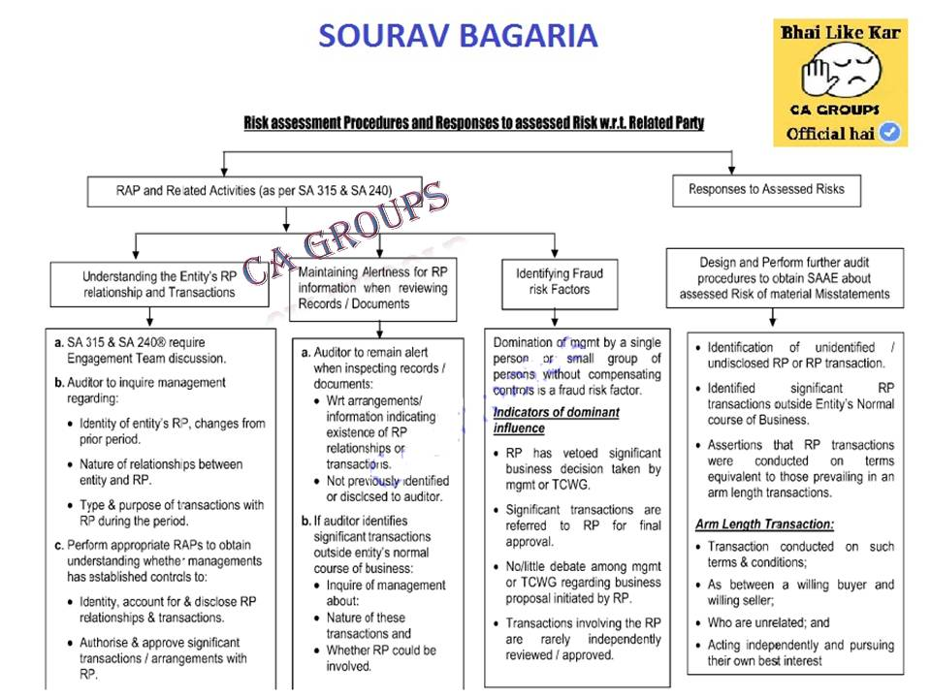
Risk assessment Procedures and Responses to assessed Risk w.r.t Related Party notes
S
O
U
R
A
V
B
A
G
A
R
I
A

Slide 19
S
O
U
R
A
V
B
A
G
A
R
I
A
If you have any Queries/Suggestions/Complaints regarding our Notes, den u can mail us at cagroups4all@gmail.com. This Notes are prepared by CA GROUPS to save time of IPCC Students before Exam.. Kip in touch with us for more Exam tips/Suggestions/Notes.. If you want to share your article wid CA/CS/CWA Students via our blog, you can mail us at above email id. We will post the same in our blog with your name and contact.

Slide 20
CONTACT DETAILS
S
O
U
R
A
V
B
A
G
A
R
I
A
FACEBOOK PAGE: https://www.facebook.com/CAgroups
FACEBOOK GROUP: https://www.facebook.com/groups/cagroups4all/
OUR BLOG: https://casouravbagaria.wordpress.com
OUR BLOG2: http://cagroups4all.blogspot.in/
ADMIN PROFILE: https://www.facebook.com/ca.cs.sourav

