Slide 1
100 HOURS ITT Programme
PROJECT REPORT
Submitted By:
Name :-
Roll No. :-
Regn. No. :-
Batch :- 27TH August’14(Morning)
Timings :- 7:30AM To 11:30AM
Section :-
Submitted To:
Ms.

Slide 2
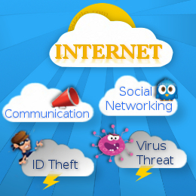
INTERNET : BOON OR BANE

Slide 3
INDEX
INTRODUCTION
HISTORY OF INTERNET
ADVANTAGES OF INTERNET
  FASTER COMMUNICATION
  ABUNDANT INFORMATION RESOURCES
  ENTERTAINMENT FOR EVERYONE
  ONLINE SERVICES
  E-COMMERCE
  INEXHAUSTIBLE EDUCATION
  SOCIAL NETWORKING
DISADVANTAGES OF INTERNET
  THEFT OF PERSONAL INFORMATION
  SPAMMING
  VIRUS THREATS
  Age-inappropriate Content
  SOCIAL DISCONNECTION
  ADDICTION AND DEPRESSION
CONCLUSION
BIBLIOGRAPHY

Slide 4
ACKNOWLEDGMENT
We, as a Group take this opportunity to express our profound gratitude and deep regards to my guide (Faculty Name- Ms Himani Bhatia) for her exemplary guidance, monitoring and constant encouragement throughout the course of this project. The blessing help and guidance given by her time to time shall carry us a long way journey of life on which we are about to embark.

Slide 5
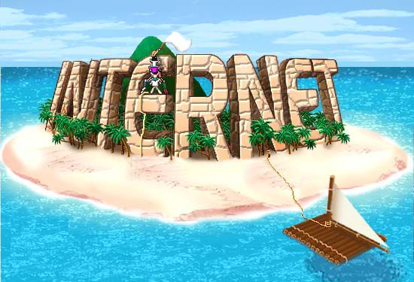
INTRODUCTION
The Internet:
A global computer network providing a variety of information and communication facilities, consisting of interconnected networks using standardized communication protocols. - The Oxford Dictionary
Internet is world wide system of computer network-
network of networks in which user at any one
computer can, if they have permission, get
information from any other computer.

Slide 6
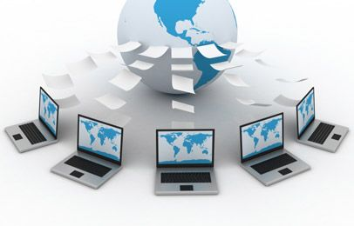
Internet is a global network i.e. it is available
everywhere in the world
Internet is a hub of information i.e. it contain large
volume of information on various subjects.
Internet is a medium of low cost data communication
from anywhere to anywhere in the world
Internet is based on TCP/IP Protocols:
TCP- Transmission Control Protocols
IP- Internet Protocols

Slide 7
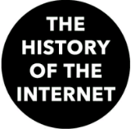
HISTORY OF THE INTERNET
The internet history is date back to more than 25 years, when the defense department set up the ARPAnet (Advance Research Project Agency Network) to have a failure proof communication network for defense department of US.
Objective of APRAnet:
  It should be a network of network rather than network of computer.
  The network should work on loose connectivity concept

Slide 8
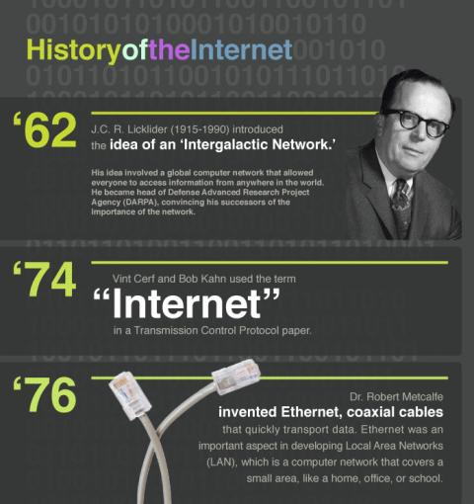
  If any part of network is not working, it should automatically route the data from other path.
  It should allow offline communication also, now this feature provides us a service known as Email.
  The APRANET architecture was latter adopted by education institute for exchange of views among research scholars and then it was thrown open to public.

Slide 9
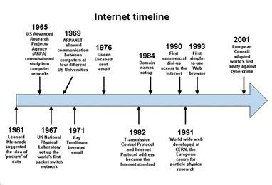
  Since 1994, the internet has grown by leaps and bounds, driven by cheaper bandwidth ( in expensive accessibility), availability of easy to use browser and increase in content.

Slide 10
ADVANTAGES
OF THE
INTERNET

Slide 11

Faster Communication
The Internet has been mankind's greatest means of communication yet.
Newer innovations are only making it faster and more reliable.
Today, we can initiate real-time communication with someone who is in another part of the world.
For more personal and interactive communication, it is possible to avail the facilities of video conferencing, chat and messenger services.

Slide 12

With the help of these services, the geographically fragmented countries have come together to form a community that is able to share its thoughts on global issues, that affect each and every one of us.
The Internet has given us a common platform and medium through which we are able to explore other cultures and ideologies.

Slide 13

Abundant Information Resources
The Internet is a treasure trove of information; which offers knowledge on any given topic under the sun.
Search engines make information accessible on various subject matters such as, government law and services, trade fairs and conferences, market information, new innovations and technical support etc.
It has become common practice to seek assistance from the web in order to research and gather resources for homework, office presentations, and supplement ones own research.

Slide 14

The web also updates news about the latest breakthroughs in the field of medicine, technology, and other domains of science.
Numerous websites such as America's Doctor, have made it possible to seek online advice from specialist doctors without having to actually fix an appointment.

Slide 15
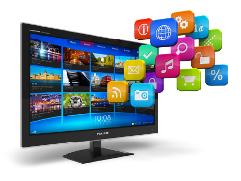
Entertainment for Everyone
Entertainment is one of the foremost reasons why people prefer surfing the Web. In fact, the Internet has gained much success by marketing for several multifaceted entertainment industries.
Finding the latest updates about celebrities and exploring lifestyle websites have become day-to-day activities of many Internet consumers.
On the other hand, even celebrities are using the Internet effectively for promoting their cause and for keeping their fans happy.

Slide 16
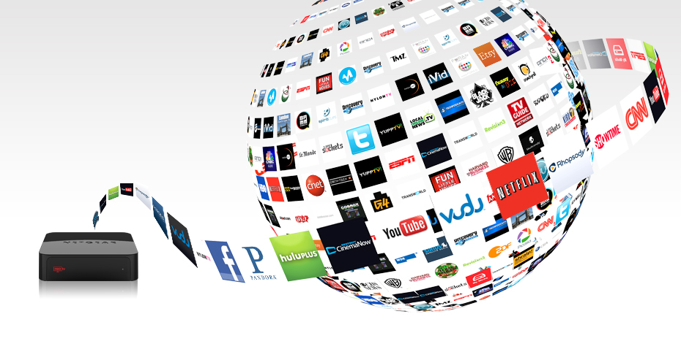
There are innumerable games that can be download, either for a price or for free.
Indeed, online gaming has tasted dramatic and phenomenal success because of its ever-increasing demand throughout the world.

Slide 17
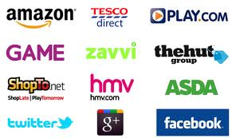
Online Services
Thanks to numerous monetary services, we can perform all our financial transactions online.
We can book tickets for a movie, transfer funds, pay utility bills and taxes without having to leave our homes or offices.
Travel websites for instance, offer quick booking schemes and plan itineraries as per the preferences of their clients.
Often these services are not available off-line and can cost you more.

Slide 18

E-Commerce
E-commerce is used for all type of business dealing that involves the transfer of money or information across the globe through the Internet. .
Online transaction of money has become the norm with almost all kinds of business.
E-commerce, with its vast reach over a variety of products and services, makes it possible to have the client's orders delivered at their doorsteps.
Websites such as eBay allow customers to bid, buy, sell, and even auction of products online.

Slide 19

Inexhaustible Education
The Internet has become an essential propagator of knowledge, both through free as well as paid services.
The World Wide Web has become a remarkable avenue for the academically unprivileged, to amass greater knowledge and know-how on subjects.
The entire scope of homeschooling has expanded because of increased accessibility to videos lectures, and explaining concepts, much like a real classroom.
There are also sites like Wikipedia, Coursera, Babbel, Archive, and Teachertube, among others, that have dedicated themselves to the art of imparting knowledge to people of all age groups.

Slide 20

Social Networking
One cannot imagine a social life without Facebook or Twitter.
These portals have become our means to stay connected with friends and family, and stay in touch with the latest happenings in the world.
Social networking has also evolved as a great medium to connect with like-minded individuals and become a part of interesting groups and communities.
Apart from finding long-lost friends, the Internet also makes it easier to search and apply for jobs and business opportunities on forums and communities.

Slide 21
DISADVANTAGES
OF THE
INTERNET

Slide 22
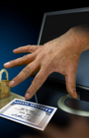
Theft of Personal Information
Unscrupulous hackers can access our sensitive information through unsecured connections by planting phishing software.
When using the Internet, there’s high likelihood that the personal particulars like address, title and credit card number might be used by people and employed for deceptive purposes.
Thus, the Internet has got the potential to create your life easy and easy, along with cause havoc in your life.
Lack of security as hackers can easily theft data or can manipulate it.

Slide 23

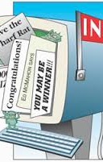
Spamming
Spamming refers to sending unwanted e-mails in bulk, which serve no purpose and needlessly obstruct the computer system.
Such illegal activities can be very frustrating as it makes it slower to access our email accounts and makes the entire service unreliable for users.
Most spam mails includes commercial advertising, mostly for dubious products , get-rich-quick schemes or quasi-legal activities.
These actions are treated as illegal.
You should make an effort to stop these activities so that using the Internet can become that much safer.

Slide 24
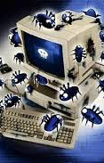
Virus Threats
Virus is nothing but a program which disrupts or harm the normal functioning and important files of computer systems.
Internet virus can be of three types:
The first type of virus affects files and goes directly for a particular file or file type.
The second type harms system and executable boot files. These can be particularly nasty, as they can effectively stop the computer from starting again.
Lastly, macro virus, which is the most common and harmless of them all. The macro virus simply keep changing things like symbols on word files.

Slide 25

Age – inappropriate content
This is perhaps the biggest disadvantage of the Internet.
There are thousands of adult sites on the Internet that can be easily found and can be a detrimental factor to letting children use the Internet.
It is the lack of control over the distribution and unrestricted access of adult material, that is detrimental to children.
Children and youth can be easily mis-leaded by the wrong content in some wrong websites.
All that parents can do, is lock harmful sites and monitor the sites viewed by their children.

Slide 26

Social Disconnection
Because of the Internet, people now generally meet through social media system.
More and more individuals are finding surrounded in world and moving aside from their family and friends.
Actually kiddies choose to play games in the place of heading out and interacting with other children.
A healthy social development may be hampered by this in kiddies.
Some people are getting addicted to the internet and thus causing problems with their interactions of friends and loved ones.

Slide 27

Addiction and Depression
Prolong usage of the Internet can form unhealthy addiction not only for children, teenagers but for adult as well.
There is an addiction for everything that pertains to the internet and that includes excessive surfing, social networking, and gaming addiction.
This might withdrawal, loss of relationship or jobs, significant time consumption, sleep deprivation decrease in performance, and even negative effect on the family relationship because of bonding.
These addictions create both physical as well as mental issues for the health of humans.

Slide 28
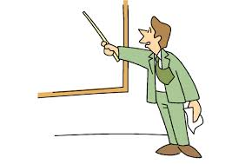
CONCLUSION
INTERNET : BOON OR BANE
“USE OF THE INTERNET IS IN OUR HANDS,
WE CAN USE IT TO BUILD OR DESTROY”

Slide 29
BIBLIOGRAPHY
All the material have been gathered from the following sources:
http://www.buzzle.com/articles/advantages-disadvantages-internet.html
http://www.scribd.com/doc/15987754/Internet-is-a-Boon-or-Bane
http://www.articlesnatch.com/Article/Internet--Boon-Or-Bane-/109000#.VBK-yvmSyY8
http://www.articlesfactory.com/articles/education/is-internet-a-boon-or-bane-for-students.html
ITT Programme Book

Slide 30
THANK YOU

