Slide 1

ONLINE BANKING
Take Charge of your Finances
Submitted by-
Ankita Pabale
WRO0528075

Slide 2
Topic Covered…..
Online Banking
Features
Benefits
Drawbacks
Security Features
Conclusion

Slide 3
Online Banking
Online Banking allows customers to conduct financial transactions on a secure website operated by the institution.
It may include of any transaction related to online usage.
To access a financial institutions online banking facility, a customer having internet must register with the institution & set up some password for customer verification.

Slide 4

FEATURES
A bank customer can perform some non-transactional tasks through online , including-
Funds transfer
Bill payments
Investment purchase or sale
Viewing account balances
Viewing recent transaction
Downloading bank statements
Viewing images of paid cheques
Ordering cheque books

Slide 5
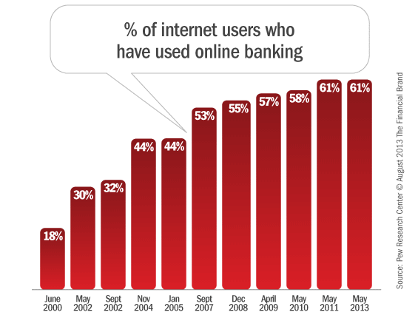
ONLINE BANKING GRAPH

Slide 6

BENEFITS OF ONLINE BANKING
Anytime banking & anywhere banking
Reduction in cost of transaction
Easy to make utility payment
Online purchase
Service is available 24x7
Online banking is much cheaper for the bank. A survey says the online banking costs only 10% of branch services

Slide 7
DRAWBACKS OF ONLINE BANKING
Difficult in adoption of technology
Bank site changes
Need an account with an Internet Service Provider
Security concern, like “hackers” accessing your bank account
Must have basic computer skills & internet knowledge

Slide 8
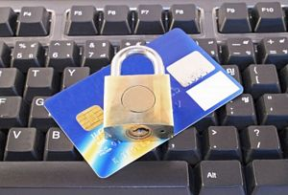
SECURITY FEATURES
Security is a primary concern in internet banking
SSL(secure sockets layer) protocol is used to ensure data security between customer browser & web server
Customer database is protected by double firewalls
User name & pins
Anti-virus

Slide 9
SAMPLE SAFETY MEASURES
Change your password periodically
Review your bank accounts frequently
Try to low limit credit card for internet transaction

Slide 10
CONCLUSION
The strategy of bank is to provide value added service & product to the customer, utilizing the internet extensively
The main aim is to making transaction through online possess & make customer more beneficial

Slide 11
Thank You

