Slide 1
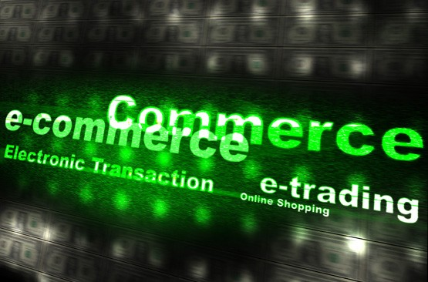
New trends in securing
E-Commerce

Slide 2
Presented By:
Parth Shah WRO0443790
ITT VASAI BRANCH JUNE 2013,AFTERNOON BATCH
COMMENCEMENT DATE: 6TH JUNE 2013

Slide 3
Reasons for selection of the topic
E-commerce has been found to be the emerging pillar in trade and commerce in the modern world.
To understand the importance and working of e-commerce
To identify the scope of e-commerce in future

Slide 4

Introduction:
E-COMMERCE is a type of industry where buying and selling of product or service is conducted over electronic systems such as the Internet and other computer networks.
E-commerce draws on technologies such as m-commerce, EFT, supply chain mgmt., internet marketing, EDI, automated data collection systems, etc.
It also consists of the exchange of data to facilitate the financing and payment aspects of business transactions. This is an effective and efficient way of communicating within an organization and one of the most effective and useful ways of conducting business.

Slide 5
Early history:
E-commerce began in the early 1970 with electronic funds transfer (EFT) used by the banking industry to exchange account information.
In Late 1970s, larger corporations and companies started creating private networks to share information through EDI.
In 1992, CompuServe offers online buy products to its customers, and that gives people the first chance to buy products off their computer

Slide 6

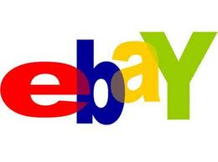

Amazon.com, eBay.com and Anything.lk some biggest names in E-Commerce launched in 1995. But, at present, there are many other E-Commerce websites who deals in most important e-commerce categories today, which are computers, books, music and a variety of electronics like digital cameras and need to updated with business trends.

Slide 7
Amazing facts:
Few most visited websites in 2012:
Flipkart.com
Ebay.com
Snapdeal.com
Jabong.com
Yebhi.com
myntra.com
naaptol.com
tradus.in
fashionyou.com
in beam.com

Slide 8
Trends securing e-commerce:
1.
  M-commerce
2.
  Electronic fund transfer
3.
  Supply chain mgmt.
4.
  Internet marketing
5.
  Online Banking

Slide 9
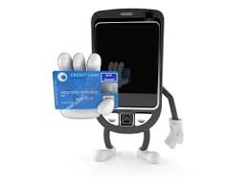

1.M-Commerce
The phrase mobile commerce was originally coined in 1997 to mean "the delivery of electronic commerce capabilities directly into the consumer’s hand, anywhere, via wireless technology." Many choose to think of Mobile Commerce as meaning "a retail outlet in your customer’s pocket."
According to BI Intelligence in January 2013, 29% of mobile users have now made a purchase with their phones.

Slide 10
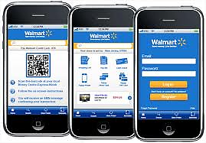
Walmart estimated that 40% of all visits to their internet shopping site in December 2012 was from a mobile device.
Bank of America predicts $67.1 billion in purchases will be made from mobile devices by European and U.S. shoppers in 2015.

Slide 11
Examples of M-Commerce:
Mobile money transfer
Mobile ATM
Mobile ticketing
Mobile vouchers, coupons and loyalty cards

Slide 12
Steps to perform M-Commerce:
1
  Price Comparison: Check the price of the product using the mobile device and compare with other competitor product pricing
2
  Product Information: Browse the catalogue to view products, price and specifications
3
  Product reviews and ratings: Read product reviews and ratings provided by other consumers
4
  Locate stores: Navigate through the app to find the store location-maps and direction. Specially, if it is location based and relevant deals/discount coupons are sent to mobile user.
5
  Product purchase: Buy the product, more in-store. Specially, if mobile coupons are offered with special deals and discount via barcode and QR code promotions.

Slide 13
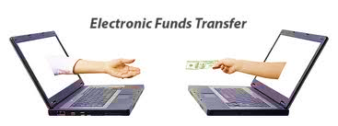
2.Electronic fund transfer:
Electronic funds transfer (EFT) is the electronic exchange, transfer of money from one account to another, either within a single financial institution or across multiple institutions, through computer-based systems.

Slide 14
EFT COVERS:
Wire transfer via an international banking network
Cardholder-initiated transactions, using a payment card such as a credit or debit card
Direct deposit payment initiated by the payer
Direct debit payments, sometimes called electronic checks, for which a business debits the consumer's bank accounts for payment for goods or services

Slide 15
EFT COVERS (Continued):
Transactions involving stored value of electronic money, possibly in a private currency
Electronic Benefit Transfer
Electronic bill payment in online banking, which may be delivered by EFT or paper check

Slide 16
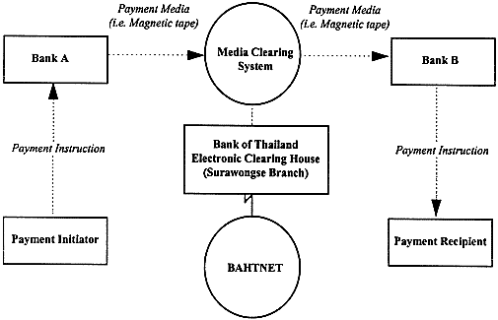
Working of EFT:

Slide 17
3.Supply Chain Management
Supply chain management (SCM) is the management of an interconnected or interlinked between network, channel and node businesses involved in the provision of product and service packages required by the end customers in a supply chain. Supply chain management spans the movement and storage of raw materials, work-in-process inventory, and finished goods from point of origin to point of consumption.
SCM draws heavily from the areas of operations management, logistics, procurement, and information technology, and strives for an integrated approach

Slide 18
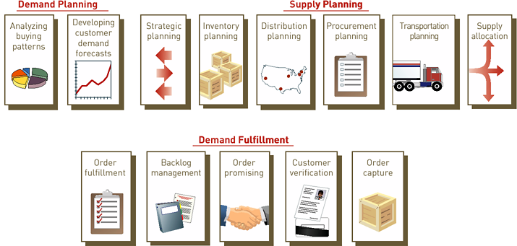
Working of SCM

Slide 19
4.Internet Marketing:
Online advertising, also known as online advertisement, internet marketing, online marketing or e-marketing, is the marketing and promotion of products or services over the Internet.
Examples of online advertising include contextual ads on search engine results pages, banner ads, blogs, rich media ads, social network advertising, interstitial ads, online classified advertising, advertising networks, dynamic banner ads, cross-platform ads and e-mail marketing, including e-mail spam.

Slide 20
Types of Internet marketing:
Search engine marketing
Video marketing
Affiliate marketing
Internet marketing
Inbound marketing
Social media marketing
Email marketing

Slide 21
5.Internet Banking:
Online banking (or Internet banking or E-banking) allows customers of a financial institution to conduct financial transactions on a secure website operated by the institution, which can be a retail or virtual bank, credit union or building society.
To access online banking, the customer would go to the financial institution's website, and enter the online banking facility using the customer number and password. Some financial institutions have set up additional security steps for access, but there is no consistency to the approach adopted.

Slide 22
Features:
  Funds transfers between the customer's linked accounts
  Paying third parties, including bill payments (see, e.g., BPAY) and telegraphic/wire transfers
  Investment purchase or sale.
  Loan applications and transactions, such as repayments of enrolments
  Register utility billers and make bill payments

Slide 23
Features (Continued):
6.
Some non-transactional Tasks through online banking
To View account balances
Ordering cheque books
Download periodic account statements
To View recent transactions
Download bank transactions

Slide 24
Electronic Payment Systems :
Digital certificate: an attachment that uses a digital signature to bind public key with an identity information such as a person or an organisation.
Certificate authority (CA): a trusted third party that issues digital certificates
Secure Sockets Layer (SSL): a communications protocol used to secure sensitive data
Electronic cash: an amount of money that is computerized, stored, and used as cash for e-commerce transactions

Slide 25
Electronic Payment Systems (Continued):
Electronic wallet: a computerized stored value that holds credit card information, electronic cash, owner identification, and address information
Credit card
Charge card
Debit card
Smart card

Slide 26
HERE’S AN EXAMPLE OF AN
ONLINE TRANSACTION:

Slide 27

1
Consumer finds something she wants to buy at a “shop” on the Net
6
Verification and remittance of actual funds
Shop
2
Consumer sends on enciphered request for payment to her bank
The electronic bank sends back a secure packet of e-cash
Consumer’s Bank
3
Consumer Public Key
The shop sends the packet of cash to its bank
Merchant Server
5
Consumer sends the e-cash to the shop
4
Shop
Merchant Bank

Slide 28
SECURITY THREATS IN
E-COMMERCE :
E-commerce Security is a part of the Information Security framework and is specifically applied to the components that affect e-commerce that include Computer Security, Data security and other wider realms of the Information Security framework.
E-commerce security has its own particular nuances and is one of the highest visible security components that affect the end user through their daily payment interaction with business.

Slide 29

Threats: Anyone with the capability, technology, opportunity, and intent to do harm. Potential threats can be foreign or domestic, internal or external, state-sponsored or a single rogue element. Terrorists, insiders, disgruntled employees, and hackers are included in this profile
1.Intellectual property threats -- use existing materials found on the Internet without the owner's permission, e.g., music downloading, domain name (cybersquatting), software pirating
2. Client computer threats
– Trojan horse
– Active contents
– Viruses

Slide 30

3. Communication channel threats
– Sniffer program
– Backdoor
– Spoofing
– Denial-of-service
4. Server threats
– Privilege setting
– Server Side Include (SSI), Common Gateway Interface (CGI)
– File transfer
– Spamming

Slide 31

Case laws:
THE EBAY STORY :
eBay, with a simple concept (Web-based auctions) and a market capitalization of $16 billion, has harnessed the resources of the Internet to capture over two million registered users.
Has it stopped looking ahead? No! eBay is constant looking for ways to increase its markets by providing international sites and moving into new markets.
This year, eBay partnered with zipReality.com to provide a new category of products and services called eBay Real Estate. zipRealty.com will provide professional real estate services as part of the new category.

Slide 32
Case laws(continued) :
By taking advantage of zipRealty.com and the powerful technology and infrastructure of eBay, both companies will win in this market. Even though eBay is a brand name for auctioning online, it still keeps moving forward and thinking of the next steps it must take to stay ahead of the market.

Slide 33
Future trends:
Over the past five years, ecommerce has grown at a pace at least twice as fast as total retail sales and that trend will continue over the next five years, according to published reports.
In 2012, ecommerce had a healthy 14.8 percent growth rate over 2011, easily eclipsing the total retail sales growth rate of 5.3 percent.
By 2017, the Internet will account for ten percent of all U.S. retail sales when online sales will reach $370 billion, up from $231 billion this year, according to Forrester Research.
Growth is coming mainly from existing customers, who are spending more money online, rather than from new shoppers

Slide 34
Conclusion:
The e-commerce is one of the biggest platform that has taken the business by a storm.
It is creating an entire new economy, which has a huge potential and is fundamentally changing the way businesses are done.
It has advantages for both buyers as well as sellers and this win-win situation is at the core of its phenomenal rise. The e-commerce market is fairly new.

Slide 35
Conclusion (Continued):
Companies will need to test what works and what does not work. The key is to do it right once. You may find over time that what you thought would work does not work.
Though there are some weak links, with improvements in technology and commitment in the advancement, they will be ironed out, making the e-commerce easy, convenient and secure. The ecommerce is certainly here to stay.

Slide 36


Slide 37


