Slide 1

Project on “MULTITHREADING & MULTIPROCESSING
IN
OPERATING SYSTEM”
Submitted by
Roll no.43
Batch shift-Morning
NAME
ADITYA MOHAN
Submitted to-
MISS PRIYANKA KAPOOR

Slide 2

INDEX
1.MULTITHREADING
2.ADVANTAGES OF MULTITHREADING
3.DISADVANTAGES OF MULTITHREADING
4.MULTIPROCESSING
5.ADVANTAGES OF MULTIPROCESSING
6.DISADVANTAGES OF MULTIPROCESSING
7.DIFFERENCE BETWEEN MULTITHREADING & MULTIPROCESSING {MEAN...
8.Common in MULTIPROCESSING & MULTITHREADING
9.SOURCES

Slide 3

MULTITHREADING
MULTITHREADING computer central processing units have hardware support to efficiently execute multiple threads. These are distinguished from multiprocessing systems (such as multi-core systems) in that the threads have to share the resources of a single core: the computing units, the CPU caches and the translation look aside buffer (TLB).
Where multiprocessing systems include multiple complete processing units, multithreading aims to increase utilization of a single core by using thread-level as well as instruction-level parallelism. As the two techniques are complementary, they are sometimes combined in systems with multiple multithreading CPUs and in CPUs with multiple multithreading cores.
The multithreading paradigm has become more popular as efforts to further exploit instruction level parallelism have stalled since the late-1990s. This allowed the concept of throughput computing to re-emerge to prominence from the more specialized field of transaction processing:
Even though it is very difficult to further speed up a single thread or single program, most computer systems are actually multi-tasking among multiple threads or programs.

Slide 4

MULTITHREADING CONTD.(II)
TYPES OF MULTITHREADING
Block multi-threading
The simplest type of multi-threading occurs when one thread runs until it is blocked by an event that normally would create a long latency stall. Such a stall might be a cache-miss that has to access off-chip memory, which might take hundreds of CPU cycles for the data to return. Instead of waiting for the stall to resolve, a threaded processor would switch execution to another thread that was ready to run. Only when the data for the previous thread had arrived, would the previous thread be placed back on the list of ready-to-run threads. This type of multi-threading is known as Block or Cooperative or Coarse-grained multithreading. The goal of multi-threading hardware support is to allow quick switching between a blocked thread and another thread ready to run. To achieve this goal, the hardware cost is to replicate the program visible registers as well as some processor control registers (such as the program counter).
The thread switch can be done in one CPU cycle.

Slide 5

MULTITHREADING CONTD.(III)
Interleaved multi-threading
Barrel processor
The purpose of interleaved multithreading is to remove all data dependency stalls from the execution pipeline. Since one thread is relatively independent from other threads, there's less chance of one instruction in one pipe stage needing an output from an older instruction in the pipeline.
Conceptually, it is similar to pre-emptive multi-tasking used in operating systems. One can make the analogy that the time-slice given to each active thread is one CPU cycle.
The most advanced type of multi-threading applies to superscalar processors. A normal superscalar processor issues multiple instructions from a single thread every CPU cycle.

Slide 6

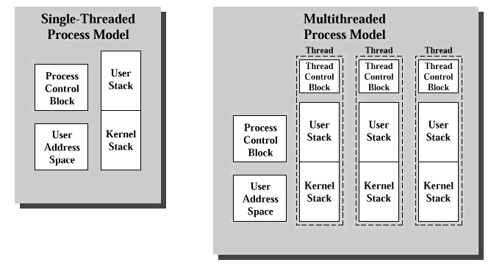
MULTITHREADING END
PROCESSES IN MULTITHREADING
Single threaded correspond to traditional OS. At particular instances of time, a thread can be in anyone of several states namely, running blocked ,ready ,or terminated. Due to these similarities, threads are often viewed as miniprocesses . In fact, in OS with threads facility, a process having a single thread corresponds to a process of a traditional OS as shown in figure. Threads are often to as lightweight processes and traditional process are referred as heavyweight process

Slide 7

ADVANTAGES OF MULTITHREADING
Same set of caching - If a thread gets a lot of cache misses, the other thread(s) can continue, taking advantage of the unused computing resources, which thus can lead to faster overall execution, as these resources would have been idle if only a single thread was executed.
If a thread cannot use all the computing resources of the CPU (because instructions depend on each other's result), running another thread can avoid leaving these idle.
Faster - if several threads work on the same set of data, they can actually share their cache, leading to better cache usage or synchronization on its values. Multiple threads can lead to improved application performance. For example, if there are a number of calculations to be performed or the contents of a file are being processed, then there the application can be made faster by performing multiple operations at the same time.
Better responsiveness to the user - if there are operations which can take long time to be done, these operations can be put in a separate thread, and the application will preserve its responsiveness to the user input - Faster application - the work will be done by more objects
Improved responsiveness — when it comes to application performance I am a firm believer that perception is reality. If the user perceives that my application is slow, then it that means it is in reality slow. If the application is performing operations that take a perceivably long time to complete, these operations can be put into a separate thread which will allow the application to continue to be responsive to the user.
Prioritization — Threads can be assigned a priority which would allow higher priority tasks to take precedence over lower priority tasks.

Slide 8

DISADVANTAGES OF MULTITHREADING
Multiple threads can interfere with each other when sharing hardware resources such as caches or translation look aside buffers (TLBs).
Execution times of a single thread are not improved but can be degraded, even when only one thread is executing. This is due to slower frequencies and/or additional pipeline stages that are necessary to accommodate thread-switching hardware.
Hardware support for multithreading is more visible to software, thus requiring more changes to both application programs and operating systems than multiprocessing.
Hardware techniques used to support multithreading often parallel the software techniques used for computer multitasking of computer programs.
Thread scheduling is also a major problem in multithreading.
Creating overhead for the processor - each time the CPU finishes with a thread it should write in the memory the point it has reached, because next time when the processor starts that thread again it should know where it has finished and where to start from - The code become more complex - using thread into the code makes the code difficult read and debug - Sharing the resources among the threads can lead to deadlocks or other unexpected problems
Programming and debugging is more complex — with multithreaded applications the programmer must account for race conditions and deadlocks.
Threads add overhead to the system — In order for the operating system to track a large number of threads it is going to consume processor time. If there are too many threads then each thread may not be given enough time to execute during its time slice. In addition, each thread is scheduled for execution less frequently due to the volume and time slice committed to each thread.

Slide 9

MULTIPROCESSING
Multiprocessing is the use of two or more central processing units (CPUs) within a single computer system. The term also refers to the ability of a system to support more than one processor and/or the ability to allocate tasks between them. There are many variations on this basic theme, and the definition of multiprocessing can vary with context, mostly as a function of how CPUs are defined (multiple cores on one die, multiple dies in one package, multiple packages in one system unit, etc.).
Multiprocessing sometimes refers to the execution of multiple concurrent software processes in a system as opposed to a single process at any one instant. However, the terms multitasking or multiprogramming are more appropriate to describe this concept, which is implemented mostly in software, whereas multiprocessing is more appropriate to describe the use of multiple hardware CPUs. A system can be both multiprocessing and multiprogramming, only one of the two, or neither of the two of them.

Slide 10

MULTIPROCESSING CONTD.(2)
Processor symmetry
In a multiprocessing system, all CPUs may be equal, or some may be reserved for special purposes. A combination of hardware and operating-system software design considerations determine the symmetry (or lack thereof) in a given system. For example, hardware or software considerations may require that only one CPU respond to all hardware interrupts, whereas all other work in the system may be distributed equally among CPUs; or execution of kernel-mode code may be restricted to only one processor (either a specific processor, or only one processor at a time), whereas user-mode code may be executed in any combination of processors. Multiprocessing systems are often easier to design if such restrictions are imposed, but they tend to be less efficient than systems in which all CPUs are utilized.
Systems that treat all CPUs equally are called symmetric multiprocessing (SMP) systems. In systems where all CPUs are not equal, system resources may be divided in a number of ways, including asymmetric multiprocessing (ASMP), non-uniform memory access (NUMA) multiprocessing, and clustered multiprocessing.

Slide 11
MULTIPROCESSING CONTD.(3)
Processor coupling (types of multiprocessing systems i.e. tightly &loosely coupled)
Tightly-coupled multiprocessor systems contain multiple CPUs that are connected at the bus level. These CPUs may have access to a central shared memory (SMP or UMA), or may participate in a memory hierarchy with both local and shared memory (NUMA). The IBM p690 Regatta is an example of a high end SMP system. Intel Xeon processors dominated the multiprocessor market for business PCs and were the only x86 option until the release of AMD's Opteron range of processors in 2004. Both ranges of processors had their own on board cache but provided access to shared memory; the Xeon processors via a common pipe and the Opteron processors via independent pathways to the system RAM.
Chip multiprocessors, also known as multi-core computing, involves more than one processor placed on a single chip and can be thought of the most extreme form of tightly-coupled multiprocessing. Mainframe systems with multiple processors are often tightly-coupled.
Loosely-coupled multiprocessor systems (often referred to as clusters) are based on multiple standalone single or dual processor commodity computers interconnected via a high speed communication system (Gigabit Ethernet is common). A Linux Beowulf cluster is an example of a loosely-coupled system.

Slide 12

MULTIPROCESSING CONTD.(4)
Tightly-coupled systems perform better and are physically smaller than loosely-coupled systems, but have historically required greater initial investments and may depreciate rapidly; nodes in a loosely-coupled system are usually inexpensive commodity computers and can be recycled as independent machines upon retirement from the cluster.
Power consumption is also a consideration. Tightly-coupled systems tend to be much more energy efficient than clusters. This is because considerable economy can be realized by designing components to work together from the beginning in tightly-coupled systems, whereas loosely-coupled systems use components that were not necessarily intended specifically for use in such systems.

Slide 13

MULTIPROCESSING end
Software implementation issues
SISD multiprocessing
single data stream computer one processor sequentially processes instructions
SIMD multiprocessing
In a single instruction stream, multiple data stream computer one processor handles a stream of instructions, each one of which can perform calculations in parallel on multiple data locations.
MISD multiprocessing
offers mainly the advantage of redundancy, since multiple processing units perform the same tasks on the same data, reducing the chances of incorrect results if one of the units fails.
MIMD multiprocessing
MIMD multiprocessing architecture is suitable for a wide variety of tasks in which completely independent and parallel execution of instructions touching different sets of data It is the utilization of multiple CPUs in a single computer system. This is also called parallel processing.

Slide 14

ADVANTAGES OF MULTIPROCESSING
Better throughput: It improves the performance of computer systems by allowing parallel processing of segments of programs.
Better reliability: It provides a built –in backup. If one of the CPUs breaks down, the other CPUs automatically takes over the complete workload until repairs are made. Due to multiplicity of processors system also have better reliability than single processors system ,for example if a system has 4 processors and one fails, then the remaining 3 processors can be utilized ,however system gives his 75% best efforts. This process is called “graceful degradation “.Hence, multiprocessor systems have better reliability.
Better utilization of resource: In additions to the CPUs, it also facilitates more efficient utilization of all the other devices of the computer system.
Saving Cost
Such system shares the memory, buses, clock etc. So it reduces the cost of the system.

Slide 15
DISADVANTAGES OF MULTIPROCESSING
A large main memory is required.
Sophisticated operating system; A very sophisticated operating system is required to schedule, balance and co-ordinate the input, output and processing activities of multiple CPUs.
Expensive; multiprocessing systems are expensive to procure and maintain.in addition to the high charge paid initially, the regular operation and maintenance of these systems is also called costly affair
Complex & Time taking job

Slide 16

DIFFERENCE BETWEEN MULTITHREADING & MULTIPROCESSING {MEANING}
MULTITHREADING
MULTIPROCESSING
Refers to the ability of an operating system to execute different parts of a program, called threads, simultaneously. The programmer must carefully design the program in such a way that all the threads can run at the same time without interfering with each other.
Refers to a computer system's ability to support more than one process (program) at the same time. Multiprocessing operating systems enable several programs to run concurrently.

Slide 17
DIFFERENCE BETWEEN MULTITHREADING & MULTIPROCESSING (contd.)
MUTLITHREADING
MULTIPROCESSING
Multithreading thread with in a process share & state well as memory
In multithreading threads of a process share same address space
Threads in multithreading exists as a subset of process.
context switching between threads in the same process is typically FASTER
Multiprocessing carries only considerable store information
In multiprocessing ,processes have separate address space
Processes are independent & free In multiprocessing.
Multiprocessing is comparatively SLOWER than multithreading

Slide 18
DIFFERENCE BETWEEN MULTITHREADING & MULTIPROCESSING (contd.)
MULTITHREADING
MULTIPROCESSING
Multi-threading is a more "light weight" form of concurrency: there is less context per thread than per process. As a result thread lifetime, context switching and synchronisation costs are lower. The shared address space (noted above) means data sharing requires no extra work.
Multi-processing has the opposite benefits. Since processes are insulated from each other by the OS, an error in one process cannot bring down another process. Contrast this with multi-threading, in which an error in one thread can bring down all the threads in the process. Further, individual processes may run as different users and have different permissions.

Slide 19
DIFFERENCE BETWEEN MULTITHREADING & MULTIPROCESSING (contd.)
MULTITHREADING
MULTIPROCESSING
Same job can be broken logically and executed simultaneously and the results are combined at the end of processing
Cost of thread intercommunication is relatively low
Threads (of the same process) run in a shared memory space
Several jobs can run at the same time.
Cost of process intercommunication is quiet high
In multiprocessing processes run in separate memory spaces.

Slide 20

DIFFERENCE BETWEEN MULTITHREADING & MULTIPROCESSING (contd.)
MULTITHREADING
MULTIPROCESSING
Concurrent execution of different tasks in a thread
Multithreading opens up separate streams within a single process. The streams look like individual processes, but utilize a shared address space on the computer memory within the same process.
Concurrent execution of multiple jobs(by same or different users)
Multiprocessing, however, opens up multiple process to perform simultaneous functions and these processes each get their own parcel of memory.

Slide 21

DIFFERENCE BETWEEN MULTITHREADING & MULTIPROCESSING (contd.){HARDWARE}
MULTITHREADING
MULTIPROCESSING
Multithreading is not entirely without its own hardware, but only requires motherboards that support multithreading code instructions. Most modern motherboards include this ability.
Multithreading can actually be used in conjunction with multiprocessing.
Multiprocessing requires, as the name implies, multiple physical processing cores. Previously, multiple processor motherboards came with multiple separate slots to input Central Processing Units (CPU). Today, newer technologies from manufacturers such as AMD and Intel allow for multiple processing cores to be built into a single CPU "chip

Slide 22
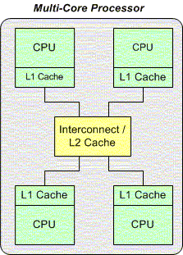
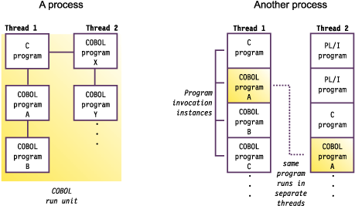
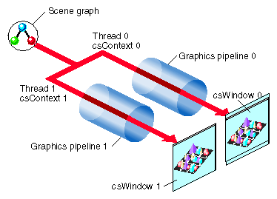
DIFFERENCE BETWEEN MULTITHREADING & MULTIPROCESSING (contd.)
MULTITHREADING
MULTIPROCESSING

Slide 23
Common in MULTIPROCESSING & MULTITHREADING
Multithreading and multiprocessing are terms associated with the speed at which computer programs run. Both are methods which require a marriage of programming knowledge and hardware development in order to be properly utilized. The two terms are not always mutually exclusive; they are used in tandem to increase the efficiency of a computer.

Slide 24
SOURCES
1. http://en.wikipedia.org/wiki/Multiprocessing
2. http://www.webopedia.com/TERM/M/multiprocessing.html
3. http://searchdatacenter.techtarget.com/definition/multiprocessing
4. http://en.wikipedia.org/wiki/Multithreading_(computer_architecture)
5. http://whatis.techtarget.com/definition/multithreading
6. http://www.ehow.com/info_8695905_difference-between- multithreading-multiprocessing.html#ixzz2JHb1o7v8
7.ITT COURSE MATERIAL/MODULE .1/UNIT-2 OPERATING SYSTEMS/Pg53 , 54 & 55
8. http://www.paulbridger.com/node/17/
9. http://www.youtube.com/watch?v=EDPZ7hDQOxk
10.http://www.google.co.in/search?hl=en&q=MULTITHREADING+AND+MULTIPROCESSING&bav=on.2,or.r_gc.r_pw.r_qf.&bvm=bv.41642243,d.bmk&biw=1360&bih=667&um=1&ie=UTF-8&tbm=isch&source=og&sa=N&tab=wi&ei=vAgJUaiNIY2qrAeKvoHoCQ(FOR IMAGES)
END

