Slide 1
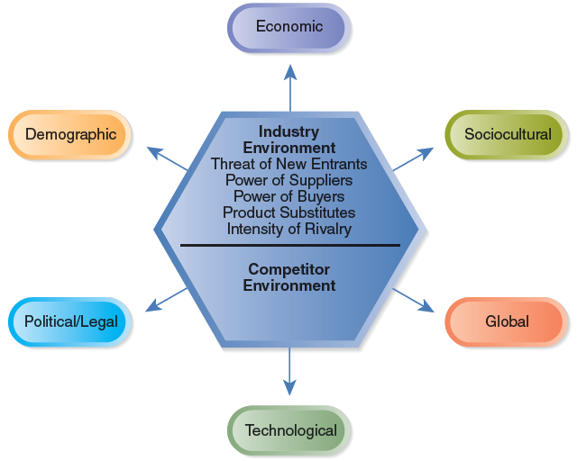
SN 2A - The External Environment

Slide 2
General Environment
Dimensions in the broader society that influence an industry and the firms within it:
  Demographic
  Economic
  Political/legal
  Sociocultural
  Technological
  Global

Slide 3
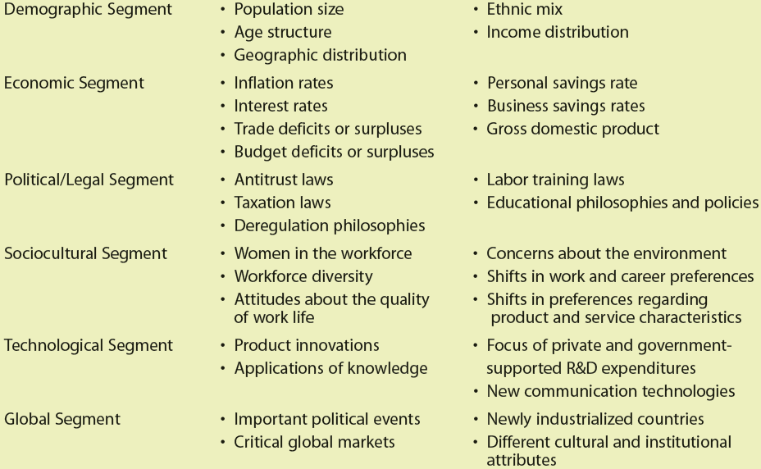
TABLE 2.1 The General Environment: Segments and Elements

Slide 4
Components of the External Environmental Analysis
Scanning • Identifying early signals of environmental changes and trends
Monitoring • Detecting meaning through ongoing observations of environmental changes and trends
Forecasting • Developing projections of anticipated outcomes based on monitored changes and trends
Assessing • Determining the timing and importance of environmental changes and trends for firms’ strategies and their management

Slide 5
Segments of the General Environment
The Demographic Segment
  Population size
  Age structure
  Geographic distribution
  Ethnic mix
  Income distribution

Slide 6
Segments of the General Environment (cont’d)
The Economic Segment
  Inflation rates
  Interest rates
  Trade deficits or surpluses
  Budget deficits or surpluses
  Personal savings rate
  Business savings rates
  Gross domestic product

Slide 7
Segments of the General Environment (cont’d)
The Political/Legal Segment
  Antitrust laws
  Taxation laws
  Deregulation philosophies
  Labor training laws
  Educational philosophies and policies

Slide 8
Segments of the General Environment (cont’d)
The Sociocultural Segment
  Women in the workplace
  Workforce diversity
  Attitudes about quality of worklife
  Concerns about environment
  Shifts in work and career preferences
  Shifts in product and service preferences

Slide 9
Segments of the General Environment (cont’d)
The Technological Segment
  Product innovations
  Applications of knowledge
  Focus of private and government-supported R&D expenditures
  New communication technologies

Slide 10
Segments of the General Environment (cont’d)
The Global Segment
  Important political events
  Critical global markets
  Newly industrialized countries
  Different cultural and institutional attributes

Slide 11
Competitor Analysis - Purpose of
Five-Forces Analysis
The five forces are environmental forces that impact on a company’s ability to compete in a given market.
The purpose of five-forces analysis is to diagnose the principal competitive pressures in a market and assess how strong and important each one is.

Slide 12
Michael E. Porter’s Five Forces
Model of Competition
Threat of New Entrants
Threat of New Entrants
Bargaining Power of Suppliers
Rivalry Among Competing Firms in Industry
Bargaining Power of Buyers
Threat of Substitute Products
Notes:
23

Slide 13
Threat of New Entrants
Economies of Scale
Barriers to Entry
Product Differentiation
Capital Requirements
Switching Costs
Access to Distribution Channels
Cost Disadvantages Independent of Scale
Government Policy
Notes:
12

Slide 14
Bargaining Power of Suppliers
Suppliers are likely to be powerful if:
Supplier industry is dominated by a few firms
Suppliers exert power in the industry by:
Suppliers’ products have few substitutes
* Threatening to raise
prices or to reduce quality
Buyer is not an important customer to supplier
Powerful suppliers can squeeze industry profitability if firms are unable to recover cost increases
Suppliers’ product is an important input to buyers’ product
Suppliers’ products are differentiated
Suppliers’ products have high switching costs
Supplier poses credible threat of forward integration
Notes:
15

Slide 15
Bargaining Power of Buyers
Buyer groups are likely to be powerful if:
Buyers are concentrated or purchases are large relative to seller’s sales
Buyers compete with the supplying industry by:
Purchase accounts for a significant fraction of supplier’s sales
Products are undifferentiated
* Bargaining down prices
Buyers face few switching costs
* Forcing higher quality
Buyers’ industry earns low profits
* Playing firms off of
each other
Buyer presents a credible threat of backward integration
Product unimportant to quality
Buyer has full information
Notes:
18

Slide 16
Threat of Substitute Products
Keys to evaluate substitute products:
Products with similar function limit the prices firms can charge
Products with improving price/performance tradeoffs relative to present industry products
Example:
Electronic security systems in place of security guards
Fax machines in place of overnight mail delivery
Eyeglasses vs. Contact Lens
Sugar vs. Artificial Sweeteners
Notes:
21

Slide 17
Rivalry Among Existing Competitors
Intense rivalry often plays out in the following ways:
Using price competition
Staging advertising battles
Increasing consumer warranties or service
Making new product introductions
Occurs when a firm is pressured or sees an opportunity
Price competition often leaves the entire industry worse off
Advertising battles may increase total industry demand, but may be costly to smaller competitors
Notes:
25

Slide 18
Rivalry Among Existing Competitors
Cutthroat competition is more likely to occur when:
Numerous or equally balanced competitors
Slow growth industry
High fixed costs
High storage costs
Lack of differentiation or switching costs
Capacity added in large increments
Diverse competitors
High strategic stakes
High exit barriers
Notes:
26

Slide 19
Interpreting Industry Analyses
Low entry barriers
Suppliers and buyers have strong positions
Unattractive
Industry
Strong threats from substitute products
Intense rivalry among competitors
Low profit potential

Slide 20
Interpreting Industry Analyses (cont’d)
High entry barriers
Suppliers and buyers have weak positions
Attractive
Industry
Few threats from substitute products
Moderate rivalry among competitors
High profit potential

Slide 21
Generic Business Level Strategies
Source of Competitive Advantage
Cost
Uniqueness
Cost
Leadership
Cost
Leadership
Differen-
tiation
Broad
Target
Market
Breadth of Competitive Scope
Focused Differen-
tiation
Narrow
Target
Market
Focused Low Cost
Notes:
8

Slide 22
Porter’s generic strategies
Overall cost leadership – business works hard to achieve lowest production & distribution costs so that it can price lower than competition & win a large market share. Firms pursuing this strategy must be good at engineering, purchasing, manufacturing & physical distribution (they need less marketing skills). Problem is competition operating with even lower costs (e.g. the Chinese Dragon!).

Slide 23
Cost Leadership
Requirements:
Constant effort to reduce costs through:
Building efficient scale facilities
Tight control of production costs and overhead
Minimizing costs of sales, R&D and service
State of the art manufacturing facilities
Monitoring costs of activities provided by outsiders
Simplification of processes
Notes:
20

Slide 24
Porter’s generic strategies
Differentiation – business concentrates on achieving superior performance in an important customer benefit area valued by a large part of the market. So the firm seeking quality leadership must make products with best components, put them together expertly etc. (It’s a Sony!).

Slide 25
Differentiation Business Level Strategy
Requirements:
Constant effort to differentiate products through:
Developing new systems and processes
Shaping perceptions through advertising
Quality focus
Capability in R&D
Maximize Human Resource contributions through low turnover and high motivation
Notes:
59

Slide 26
Create Value with Differentiation by:
Lowering Buyers’ Costs
Raising Buyers’ Performance
Creating Sustainability through:
Creating barriers by perceptions of uniqueness
Creating switching costs through differentiation
Notes:
79

Slide 27
Porter’s generic strategies
Focus – business focuses on 1 or more narrow market segments, gets to know these segments intimately & pursues either cost leadership or differentiation within the target segment (niche marketing).

Slide 28
Create Value with Differentiation by:
Lowering Buyers’ Costs
Raising Buyers’ Performance
Creating Sustainability through:
Creating barriers by perceptions of uniqueness
Creating switching costs through differentiation
Notes:
79

Slide 29
Generic Business Level Strategies
Source of Competitive Advantage
Cost
Uniqueness
Cost
Leadership
Differen-
tiation
Broad
Target
Market
Integrated Low Cost/
Differentiation
Breadth of Competitive Scope
Focused Low Cost
Focused Differen-
tiation
Narrow
Target
Market
Notes:
102

Slide 30
Integrated Low Cost/Differentiation Strategy
Firms using an Integrated Strategy may:
Adapt more quickly
Learn new skills and technologies
Utilize Flexible Manufacturing Systems to create differentiated products at low costs
Leverage core competencies through Information Networks across multiple business units
Utilize Total Quality Management (TQM) to create high quality differentiated products which simultaneously driving down costs
Notes:
103

Slide 31
Value Chain Analysis
Identifying Resources and Capabilities That Can Add Value
Firm Infrastructure
Human Resource Management
Support
Activities
MARGIN
Technological Development
Procurement
Service
Inbound
Logistics
Outbound
Logistics
Marketing
& Sales
Operations
MARGIN
Primary Activities

Slide 32
Value Chain Analysis (Cont’d)
Allows the firm to understand the parts of its operations that create value and those that do not
Identify Value Added Activities Vs Non Value Added Activities.
A template that firms use to:
  Understand their cost position
  Identify multiple means that might be used to facilitate implementation of a chosen business-level strategy

Slide 33
Value Chain Analysis (Cont’d)
Primary activities involved with:
  A product’s physical creation
  A product’s sale and distribution to buyers
  The product’s service after the sale
Support activities
  Provide the support necessary for the primary activities to take place

Slide 34
The Value-Creating Potential of Primary Activities
Inbound logistics
  Activities used to receive, store, and disseminate inputs to a product (materials handling, warehousing, inventory control, etc.)
Operations
  Activities necessary to convert the inputs provided by inbound logistics into final product form (machining, packaging, assembly, etc.)
Outbound logistics
  Activities involved with collecting, storing, and physically distributing the product to customers (finished goods warehousing, order processing, etc.)

Slide 35
The Value-Creating Potential of Primary Activities (cont’d)
Marketing and sales
  Activities completed to provide means through which customers can purchase products and to induce them to do so (advertising, promotion, distribution channels, etc.)
Service
  Activities designed to enhance or maintain a product’s value (repair, training, adjustment, etc.)
Each activity should be examined relative to competitors’ abilities and rated as superior, equivalent or inferior

Slide 36
The Value-Creating Potential of Support Activities
Procurement
  Activities completed to purchase the inputs needed to produce a firm’s products (raw materials and supplies, machines, laboratory equipment, etc.)
Technological development
  Activities completed to improve a firm’s product and the processes used to manufacture it (process equipment, basic research, product design, etc)
Human resource management
  Activities involved with recruiting, hiring, training, developing, and compensating all personnel

Slide 37
The Value-Creating Potential of Primary Activities: Support (cont’d)
Firm infrastructure
  Activities that support the work of the entire value chain (general management, planning, finance, accounting, legal, government relations, etc.)
    Effectively and consistently identify external opportunities and threats
    Identify resources and capabilities
    Support core competencies
Each activity should be examined relative to competitors’ abilities and rated as superior, equivalent or inferior

Slide 38
Outsourcing
The purchase of a value-creating activity from an external supplier
  Few organizations possess the resources and capabilities required to achieve competitive superiority in all primary and support activities
By forming and emphasizing fewer capabilities
  A firm can concentrate on those areas in which it can create value
  Specialty suppliers can perform outsourced capabilities more efficiently

Slide 39
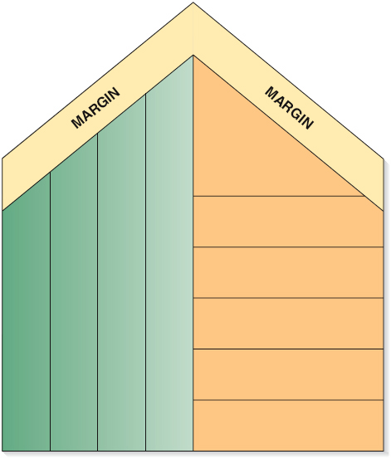


Outsourcing Decisions
A firm may outsource all or only part of one or more primary and/or support activities.
Service
Outsourced activity
Marketing and Sales
Human Resource Management
Outbound Logistics
Technological Development
Firm Infrastructure
Procurement
Operations
Inbound Logistics

Slide 40
Pareto Analysis
80:20 Principle
Concept Devoloped by Italian Economist Vilfredo Pareto
80% of wealth was held by 20% of People
80% of decisions in meetings come from 20% of the time.
Use:
1. Quality Mgt – Joseph Juran observd dat most quality problems arose from only a few causes. Suitable action on these bring the greatest benefit to the Enterprise.
2. Mgt A/cg Tool – can b applied to company’s customers, products, depts, branches, suppliers employees – with a view to Improve efficiency and effectiveness

Slide 41
Application of Pareto Analysis
1. Product Pricing
- 80% of total sales revenue is earned from 20% of its products.
So Company dealing with variety of products can focus especially in these 20% .
adopt sophisticated pricing methods 4 importnt products & Cost based pricing for other products.
2. Customer Profitability Analysis
modern business focus – Customer satisfaction
20% of customers generate 80% of profits.
Helps in developing customer profile and activities necessry to serve such group effectively.
3. Stock Control
20% of RM contributes to 80% of value.
Materials r classified – A, B, C. Focus on ‘A’ items – EOQ
4. ABC
20% of firm’s cost drivers contribute to 80% of total cost.

Slide 42
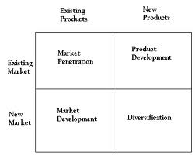
Ansoff Matrix

Slide 43
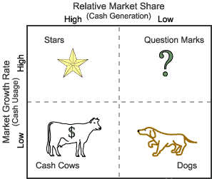
BCG Matrix

