Slide 1
Marketing
Identifying & Meeting Human and social needs.
In Simple “Meeting Needs Profitably”.
Defn:
Mktg is a performance of business activities that direct the flow of goods & Services from producer to consumer
Marketing Mgt – Defn:
‘The art and science of choosing target mkts and getting, keeping and growing customers thru creating, delivering, and communicating superior customer value.
Market:
Mkt is an arrangement tat provides an opportunity of exchang of goods & services for money or money’s worth.

Slide 2
Selling vs. Marketing
Selling focuses on the needs of the seller, marketing on the needs of the buyer.
Selling is preoccupied with the seller’s need to convert his product into cash, marketing with the idea of satisfying the needs of the customer by means of the product & the whole cluster of things associated with creating, delivering & finally consuming it.
Selling is “push”, Marketing is “pull”.

Slide 3
Factory Products Selling & Promoting Profits thru Sales Volume
Starting Point Focus Means Ends
The selling concept
Target Mkt Customer Needs Co-ordinated Mktg Profit thru
Customer Satisfaction
The Market Concept

Slide 4
Societal Marketing
Societal Marketing Concept holds that the organization’s task is to determine the needs, wants & interests of target markets & to deliver the desired satisfactions more effectively & efficiently than competitors in a way that preserves or enhances the consumer’s & society’s well-being.

Slide 5
Marketing Mix
Set of marketing tools that the firm uses to pursue its marketing objectives in the target market:
Product
Price
Promotion
Place
Also known as the 4 P’s of Marketing
Now 7Ps – People, Process & Physical Evidence.

Slide 6
What is a Product?
A product is anything that can be offered to a market to satisfy a want or need, including physical goods, services, experiences, events, persons, places, properties, organizations, information, and ideas.
Includes – Quality, Design, Brand Name, variety, Features, Size.

Slide 7
Place Price Promotion
Channels * List Price * Sales Promn
Coverage * Discounts * Advertising
Assortments * Allowances * Public Relations
Locations * Credit Terms
Inventory
Transport

Slide 8
4 P’s vs. 4 C’s
Product – Customer needs/wants
Price – Cost to customer
Place – Convenience
Promotion - Communication

Slide 9
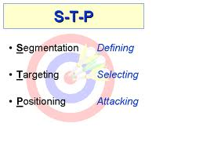
STP
Mkt Segmentation is t division of mkt into Fairly Homogenous subsets where each subsets can b chosen, reached and served by its own tailored mktg mix.
Criteria for Effectiv Segmentn : Measurability
Accessibility
Action ability

Slide 10
Segmentation
Market segment is a group of customers sharing a similar set of wants. To be useful, a segment must be:
Measurable - in terms of size, purchasing power etc.
Substantial – large/profitable
Accessible – can be effectively reached & served
Differentiable/Actionable

Slide 11
Targeting
Single segment concentration – small car only
Selective specialization – FM channel targeting all age groups with different programs
Product specialization – one product selling to different segments (paint)
Market specialization – many needs of 1 group – selling only to schools
Full market coverage - Coke

Slide 12
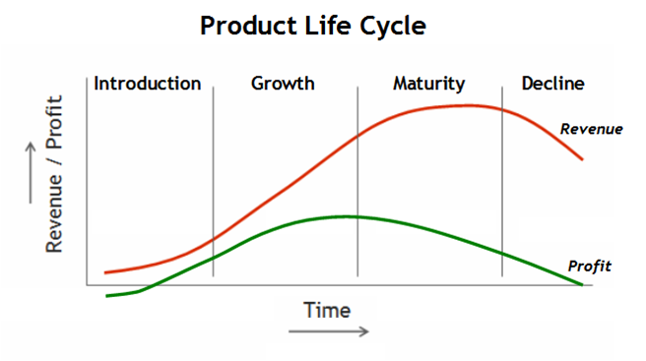
Product Life Cycle

Slide 13
Introduction Stage of the PLC
Sales
Low sales
Costs
High cost per customer
Profits
Negative
Marketing Objectives
Create product awareness
and trial
Product
Offer a basic product
Price
Use cost-plus
Distribution
Build selective distribution
Advertising
Build product awareness among early adopters and dealers
Notes:
Introduction. In this stage marketers spend heavily on promotions to inform the target market about the new product's benefits. Low or negative profits may encourage the company to price the product high to help offset expenses. companies can concentrate on skimming strategies to generate high profits now or on penetration strategies to build market share and dominant the market for larger profits once the market stabilizes.
Product Life Cycle Strategies
Product Life-Cycle Strategies
This CTR relates to the material on pp. 289 and 293.

Slide 14
Growth Stage of the PLC
Sales
Rapidly rising sales
Costs
Average cost per customer
Profits
Rising profits
Marketing Objectives
Maximize market share
Product
Offer product extensions, service, warranty
Price
Price to penetrate market
Distribution
Build intensive distribution
Advertising
Build awareness and interest in the mass market
Notes:
Product Life-Cycle Strategies
This CTR relates to the material on pp. 289-290 and 293.
Product Life-Cycle Strategies
Growth. In this stage the company experiences both increasing sales and competition. Promotion costs are spread over larger volume and strategic decisions focus on growth strategies. Strategies include adding new features, improving quality, increasing distribution, and entering new market segments.

Slide 15
Maturity Stage of the PLC
Sales
Peak sales
Costs
Low cost per customer
Profits
High profits
Marketing Objectives
Maximize profit while defending
market share
Product
Diversify brand and models
Price
Price to match or best competitors
Distribution
Build more intensive distribution
Advertising
Stress brand differences and benefits
Notes:
Product Life Cycle Strategies
Maturity. In this stage the company must manage slower growth over a longer period of time. Strategic decisions made in the growth stage may limit choices now. Marketing managers must proactively seek advantage by either market modification to increase consumption, product modification to attract new users (quality, feature, and style improvements), or marketing mix modification in an attempt to improve competitive position.
Product Life-Cycle Strategies
This CTR relates to the material on pp. 290-292 and 293.

Slide 16
Decline Stage of the PLC
Sales
Declining sales
Costs
Low cost per customer
Profits
Declining profits
Marketing Objectives
Reduce expenditure and milk the brand
Product
Phase out weak items
Price
Cut price
Distribution
Go selective: phase out unprofitable outlets
Advertising
Reduce to level needed to retain
hard-core loyal customers
Notes:
Product Life-Cycle Strategies
This CTR relates to the material on pp. 292-293.
Product Life Cycle Strategies
Decline. In this stage the costs of managing the product may eventually exceed profits. Rate of decline is a major factor in setting strategy. Management may maintain the brand as competitors drop out, harvest the brand by reducing costs of support for short term profit increases, or drop the product (divest) altogether.

Slide 17
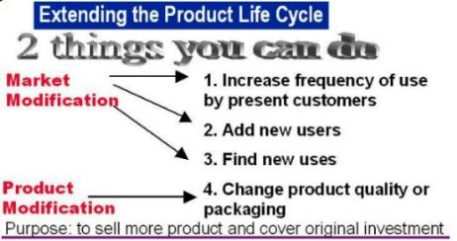

Slide 18
Uses of PLC
PLC helps the marketing managers in market forecasting, planning and control.
By knowing the phase through which a particular product is passing, marketers can plan the strategies to be followed.
May help the firm to identify when a product needs support, redesign, reinvigorating, withdrawal, etc.
May help in forecasting and managing cash flow

Slide 19
New Product Development
Marketing
Strategy
Business
Analysis
Concept
Development
and Testing
Product
Development
Idea
Screening
Test
Marketing
Idea
Generation
Commercialization

Slide 20
New Product Development
A new product is a product that is new to the company. They include major modification to the existing product, duplication of competitor’s products’ or innovative original products.
Need for new products:
  Changes in consumers’ tastes and preferences.
  Changes in technology.
  Changes in competition.
  Company growth.
  Higher profit margins.
  Utilization of excess capacity.
  Recycling of waste product.

Slide 21
Why most of the organizations are reluctant to introduce new products?
  High rate of product failure - 40% of the new products fail.
  Shortage of new product ideas.
  Growing social and governmental constraints.
  Costliness of new product development process.
  Capital shortage.
  Shorter life spans of successful products.

Slide 22
New Product Development Process
Idea generation:
New product development starts with idea generation – the systematic search for new product ideas.
Sources of ideas:
Company employees, customers, competitors, distributors & dealers, suppliers, scientists, R & D, magazines, journals .
Idea Generation Techniques:
Consumer problem analysis.
Product modification analysis.
Brain storming.
Attribute listing.
Forced relationship.

Slide 23
Idea Screening
The purpose of idea generation is to create a large number of ideas. The purpose of screening is to identify good ideas and drop poor ones as soon as possible.
  A drop error occurs when the company dismisses a good idea.
  A go error occurs when the company permits a poor idea to move into development and commercialization.

Slide 24
Concept Development and Testing
An attractive idea must be developed in to a product concept.
A product concept is a detailed version of the idea stated in meaningful consumer terms. The product concept may be presented in any one of the following ways :
  A written description
  A Picture
  A Simulation of the advertising

Slide 25
Concept Testing
Concept testing calls for testing new product concepts with groups of target consumers.
Example : Concept of an Electric car
It is an efficient electric powered car. Four persons can travel. It is very useful for shopping and visiting friends. Operating costs – half as much as similar diesel driven cars. Goes up to 80 k.m. per hour and need not be recharged for 150 kms. Priced at Rs.2.0 lakhs.
  Is the concept of electric car clear to you?
  Will the electric car meet a real need of yours?
  Do you need any improvements in its features?
  Is the price reasonable?
  Would you buy such a car?

Slide 26
Business Analysis
In this stage the sales, costs and profits of the new product will be estimated. The business analysis is also called as profitability analysis.
Estimate the total sales
Estimate the costs and profits (ROI Analysis and Breakeven Analysis)
If the new product is not profitable, then it will be dropped.

Slide 27
Prototype Development
Up to this stage the existence of the product is entirely theoretical. In this stage an actual prototype of the product will be produced and then tested.
Lab tests – to test whether the new product is technically feasible.
Consumer tests – to test whether the new product is acceptable to the consumers.
Development of branding, packaging and labeling.

Slide 28
Test Marketing
In test marketing, a company markets the new product in a limited geographic area and measures the sales of the new product.
With the help of this sample study, the company estimates the sales over a larger area.
Test marketing is used to determine whether there is sufficient demand for the new product. Various features of the new product and the marketing strategies can also be evaluated.

Slide 29
Test Marketing
Trial rate Repurchase rate Action
High High Commercialization.
High Low Redesign product or
drop it.
Low High Increase Ad. and sales
promotion.
Low Low Drop the product.

Slide 30
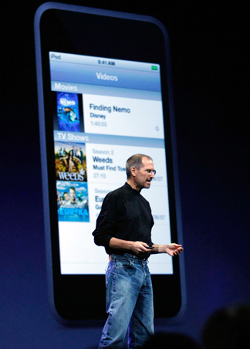
Commercialization
Commercialization is the step during which the product is introduced to the market.

Slide 31
Commercialization
When (timing) – the product has to be introduced at the right time. Seasonal products should not be introduced during the off season.
Where (geographical coverage) – initially the product will be introduced in a smaller area. Afterwards it will be extended to a larger area.
To whom (target market) – innovators, early adopters, opinion leaders, venture some, heavy users.

Slide 32
Reasons for New Product Failure
Inadequate market analysis. (Over estimation of the potential sales) – too small a target market.
Product problems and defects: Poor quality and performance. Technological mistakes in the process of product. Unsatisfactory performance of the product.
Poor packaging, inappropriate size, etc.,
Lack of product uniqueness: Insignificant point of difference. Similar to competitor’s products.
Higher cost than estimated costs.
Poor timing of introduction.

Slide 33
Reasons for New Product Failure
Failure to estimate the strength of competition.
Insufficient marketing effort.
Inadequate sales force.
Weaknesses in distribution.
Too many new products entering the market.
Misguided enthusiasm.
Inadequate capital.
Cost of production may be higher than the estimated cost.
Prices may be high.
Poor packaging, inappropriate size etc.
Technical and production problems

Slide 34
How to Overcome Failure ?
Better Mkt Research to evaluate market needs and competitive conditions.
Improved screening and evaluation of ideas and products.
Producing new products, which are having unique advantage over the existing products.

Slide 35
Pricing – Objectives
Survival
Target ROI
Mkt Share
Cash Flow Mgt
Resource Mobilisation
Profit Maximisation
Meeting Killer Competition.

Slide 36
PRICING - SELECTING THE PRICING OBJECTIVE
SURVIVAL
Due to problems of overcapacity, intense competition, changing consumer wants etc. This is a short run objective. Covers variable cost & a part of fixed cost.
2. Max Current Profit - To Choose price that maximises current profit, Cash Flow, ROI.
3. Max Mkt Share:
To set lowest price, assuming market is price-sensitive, in the belief that higher sales volume will lead to lower unit cost & higher long-run profit. Also, called market-penetration pricing.
4. Mkt Skimming Price - High Price (consumer assumes High Quality)

Slide 37
Methods of Setting Prices
Cost Plus Pricing – Costs (Fix Cost, Var Cost, Semi variable, ATC = AFC + AVC.)
Break Even Analysis
Price based on Balance btwn Demand & Supply.
Psychological pricing – Odd Pricing (Rs.99,999/-)
Read buk regdg dis

Slide 38
COMPETITOR PRICE CHANGE REACTIONS
Maintain price
Maintain price & add value
Reduce price
Increase price & improve quality
Launch a low-price fighter brand

Slide 39
Distribution Channels
A channel of distribn is d combination of institutions thru which a seller mkts products 2 industrial buyers/ultimate consumers.
Channel Levels:
0 level – Direct marketing
1 level – One intermediary (retailer)
2 level – Two intermediaries (wholesaler/retailer)
3 level – Three intermediaries (stockist/wholesaler/retailer)

Slide 40
Advertising
Any paid form of nonpersonal presentation & promotion of ideas, goods, services by an identified sponsor
5 M’s:
Mission – sales goals/advtg. objectives
Money – how much to spend?
Message – what message?
Media – what media to use
Measurement – how to evaluate results?

Slide 41
Cont.
Setting advtg. objectives:
Informative – awareness/knowledge
Persuasive – liking/preference/conviction/ purchase
Reminder – stimulate repurchase
Reinforcement – reinforce choice
“yehi hai right choice, baby”

Slide 42
MEDIA SELECTION
Media selection is finding the most cost-effective media to deliver the desired no. & type of exposures to target audience. The effect of exposures on audience awareness depends on reach, frequency & impact.
Print Ad, TV, Newspapers, Pamplets, Mail, Radio, Magazines, Brochures, Notices, Circulars…..

Slide 43
Sales Promotion
Consists of a diverse collection of incentive tools, mostly short term, designed to stimulate quicker or greater purchase of particular products or services by consumers or trade. Advertising offers “reason” to buy whereas sales promotion offers “incentive” to buy. Includes consumer promotion, trade promotion & business & sales force promotion. Earlier a to sp ratio was 60:40, now in many cases it is 30:70!

Slide 44
WHAT IS A BRAND?
Name, term, sign, symbol, design, or a combination intended to identify & differentiate the company’s product from its rivals.
BRANDING:
Endowing products & Services with the power of a brand. Its all abt creating differences btwn products.
Think abt Practical Scenario & explain on ur own – Kalyan Jewellers (Trust), Johnson & Johnson (Kids Care), Veega Land (Experience), Tata Nano (Economical)………

Slide 45
Desirable qualities of a brand name
Should suggest something about product benefit (Friendly Wash)
Should suggest product/service category
(Business Today)
Should suggest “high imagery” (Mercedes)
Should be easy to spell, pronounce, recognize & remember (Tide)
Should be distinctive (Kodak)
Should not carry negative connotations (Nova/ car in Spanish means “doesn’t go”)

Slide 46
Brand building tools
Public relations & press releases
Sponsorships
Clubs
Factory visits
Trade shows
Event marketing
For any queries contact: click2manick@gmail.com

