Slide 1




Business Communication
-A presentation by Dwarkesh Diwan

Slide 2
CONTENTS
PART 1 -BASIC
PART 2 -IN SMALL GROUPS
PART 3 -INTERNAL ORGANISATION
PART 4 -EXTERNAL ORGANISATION

Slide 3
Now lets see PART 1- BASICS

Slide 4
“You can’t communicate. Everything you say or you don’t say and don’t say sends message to others”
--John Woods

Slide 5
Functions of Organization
1. To inform
2. To persuade
3. To promote goodwill
External communication with
Customers
Suppliers
Government
Public
Internal communication
Superiors
Co-workers
sub-ordinates

Slide 6
Communication Process
Receiver’s
External
Environment
And
Internal
Stimuli
i.e.
Experiment
Skills
Attitude
Perception
etc.
Sender’s
External
Environme---nt
And Internal
Stimuli
i.e.
Experience
Skills
Attitude
Perception
etc.
1.Sender has an idea
7.Receiver sends feedback
2.Sender encodes the idea
6.Receiver decodes message
4.Channel
And
Medium
3.Sender transmits the message
5.Receiver gets the message

Slide 7
Organization’s Dimensions
Downward
Upward
Horizontal
Diagonal

Slide 8
An Average Organizational Structure
Board of directors
Managing Directors
Purchase
Production
Sales
Admnstr.n

Slide 9
Channels of Communication
Everybody is familiar with the phrase ‘through proper channel’ which means that the a sender of a written communication means to pass it to the addressee through someone occupying an important position in the hierarchical system of the organization.
  So there are two channels of communication :
  Formal
  Informal

Slide 10
Types of Communication
Media/Means of communication
Verbal
Non-verbal
Oral Written
Sign language Body language
Visual Audio

Slide 11
Tips for improve your speech
Pitch Variation
Speaking Speed
Pause
Volume Variation
Non – fluencies –’oh’, ’ah’, ‘you know’, ‘ok’

Slide 12
Proxemics - space language
Over 12 ft public
4 – 12 ft Social
18”- 4 ft Personal
0-18” Intimate
You

Slide 13
Even colours also communicates....
Layouts & design...........

Slide 14
Barriers of communication
Noise
Lack of planning
Semantic problem or double meaning
Cultural barriers
Wrong assumption
Emotions
Filtering
Information overload
Poor listening
Goal conflicts.........................& etc.

Slide 15
Tips for effective communication
!
?
Clarity of purpose
Sharing of an activity
Use of symbols
Focusing on the need of the receiver
Feedback
Controlling emotions
Listening
politeness in manners
Elimination of noise
?
?..!
(Contd.)

Slide 16
(Cntd.)
Conciseness of expression
Proper use of body language
Think before communicating
Know your audience
Visionary
To improve your communication skills
Watch your timing
Don’t oversell the idea
Plan your communication carefully
Keep your language simple as possible
Invite the participation by the other person
Leave enough time for discussion

Slide 17
Tips for effective listening:-
Stop talking & participate genuinely in the discussion
Indicate by gesture & posture your interest in listening
Be polite
Avoid judgment untill message is complete
Concentrate only on central theme or the idea
Make an eye contact

Slide 18
Now lets see PART 2- IN SMALL GROUPS

Slide 19
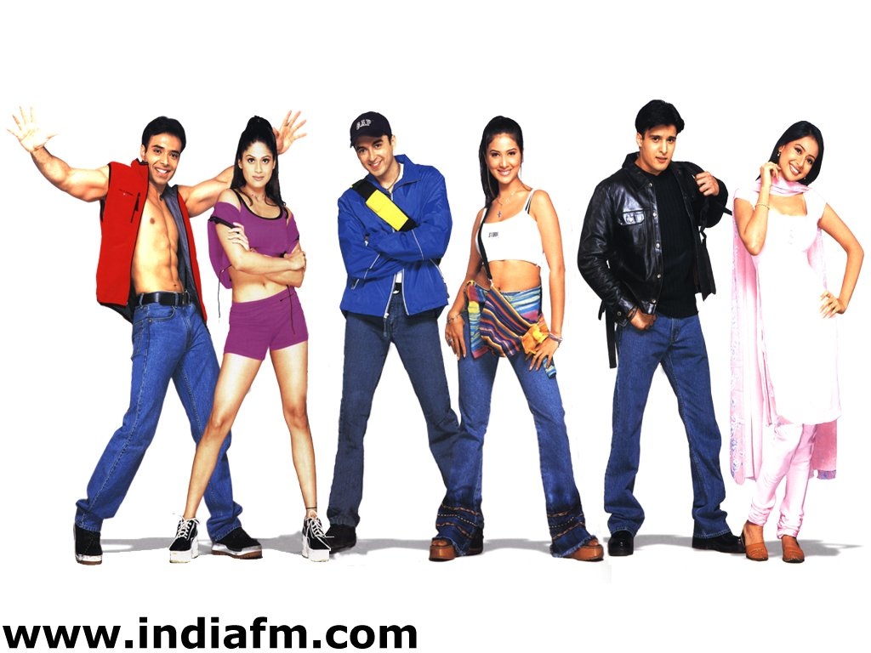
Two types of groups:- 1. Formal , 2. Informal
Informal
Formal

Slide 20
Group Dynamics:-
Today workers and managers are experienced in participating in different kind of groups. Members of any group many opportunities for interaction.
Thus the direct manifestation for the interaction and process take place in the group or taem is known as “Group Dynamics”

Slide 21
Group Discussion:-
Ingredients of group discussion:-
Purpose
Planning
Participation
Informality
Leadership

Slide 22
Techniques of group discussion:-
Committee meetings –meets for investigate the problem
Commanding committees - a meeting between manager and subordinates for sharing information ,clear up misunderstanding ,state the policies of the company ,spell out instructions
Brain storming sessions -encourage free flow of ideas ,quantity of ides are important than quality

Slide 23
Now lets see PART 3- INTERNAL ORGANISATION

Slide 24
Types of internal organisation:-
1. Memos or memoranda - a short official note that you write to the people you work
Calvin Cloth Mills
Memorandum
No.:-.......... Date:-..........
To.:-..........
From:-.........
Subject:-.................................
(1).................................................................................................................................................................
(2).............................................................................................................................................................................
(3)..........................................................................................................................
CC To
..................................................................Signature

Slide 25
Office orders :-
They are for the matters relating to certain right ,withdrawing rights ,imposing restrictions ,making posting or transfer ,granting or withholding increment etc.
Office circulars:-
They are for the audience important matters of organization for change in work hours ,inviting suggestions etc.
Office notes:-
They are for done between different departments.

Slide 26
Effective meetings:-
Meeting
Notice & agenda
Proceedings
Attendance
Reading of Report
Passing of the report
Procedure
Action plans
Minutes
Resolution

Slide 27
Agenda:-
Generally the agenda means for overall outcome we want from the upcoming meeting for which the agenda is for.....
For example-1. reading of the minutes of the previous meeting,
2. Matters arising
3. Discussion of Divisional Reports
4. Matters arising
5. Any other matter with the permission of the chair
6. Date of the next meeting.

Slide 28
Minutes:-
In general what is done in the meeting or we say a running notes.....
For example- 1. member present
2. member absent
3. decisions taken etc...

Slide 29
Now lets see PART 3- EXTERNAL ORGANISATION

Slide 30
Generally in the external organisation by the following way communication has done:-
Letters of inquiry
Letters of quotations
Tender and bids
Complain Letters
Sales or Circular letters
Corresponding with customer for payment
(cont.)

Slide 31
(contd.)
7. Import export corresponding
8. Corresponding with the bank
9. Corresponding with insurance company

Slide 32

Hey....this is not the end of the communication................
COMMUNICATION is forever with us..................!!!!!

Slide 33
Thanking you...!!!
By Dwarkesh K. Diwan

