Slide 1
learn
Grow
Achieve

Slide 2
Financial Accounting
Manufacturing and Trading Accounts
Profit and Loss account
Balance Sheet

Slide 3
Uses of Manufacturing Account
It is used to ascertain Production Cost of Goods Completed
Uses of Trading Account and Profit & Loss A/c
It is used to ascertain Gross Profit and Net Profit.

Slide 4
Accountability and Forum of Manufacturing Account
Raw Material Accounting
Opening Stock xxx
Purchases (Raw Materials) xxx
Add : Carriage Inwards xxx
xxx
Less: Return Outwards (Purchase Return) xxx
xxx
Less: Closing Stock (Raw materials) (xxx)
Cost of Raw Materials Consumed xxx
Direct Material
This is referred to Material which is directly Used to Production (Other than Raw Material)
Direct Labour
This is referred to labour used ( Manpower used in Production) for Production

Slide 5
Formula of PRIME COST :
Cost of Raw Materials Consumed
Direct Material
Direct Labour
Direct Expenses
PRIME COST

Slide 6
Factory Overheads : It is the Expenses incurred due to Production and accountable to cost of production, it may Fixed or Variable Nature.
Factory Expenses :
Factory Rent
Fuel and Power
Indirect Wages
Depreciation of Plant and Machinery(Used in Production only)

Slide 7
WORK-IN-PROGRESS
Opening Work-in-Progress (1.MM.YYY ) xxx
Less: Closing Work-in-Progress (31.MM.YYY) xxx
xxx

Slide 8

The Formula of Calculation of Production of
Cost of Good Completed :
PRIME COST
FACTORY OVERHEADS
WORK-IN-PROGRESS
PRODUCTION COST OF GOODS COMPLETED c/d

Slide 9
Trading Account :
The Trading account calculates the amount of profit earned from buying and selling goods in a particular time period.
Profit and Loss Account :
The Profit and loss accounts calculate Net Profit earned over a period of Time normally one year, may vary in nature. Dividend of company is declared based on Net profit after appropriate reserves and charging provisions.
Format of Trading Account and Profit & Loss Account

Slide 10
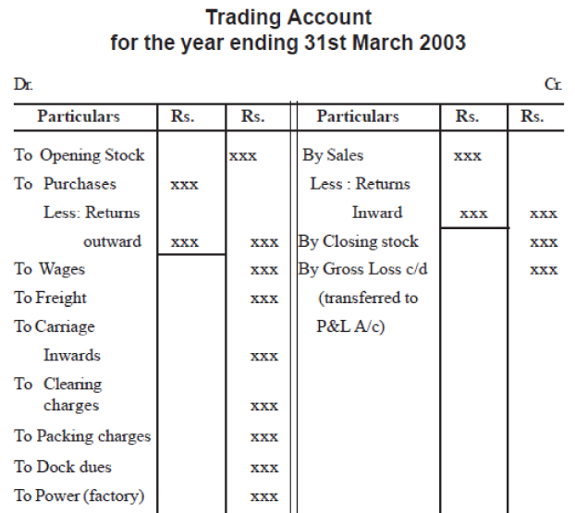
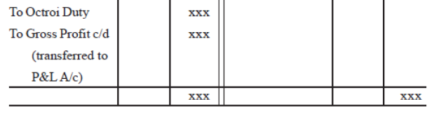
xxx
Opening Stock
To
Cost of Production

Slide 11
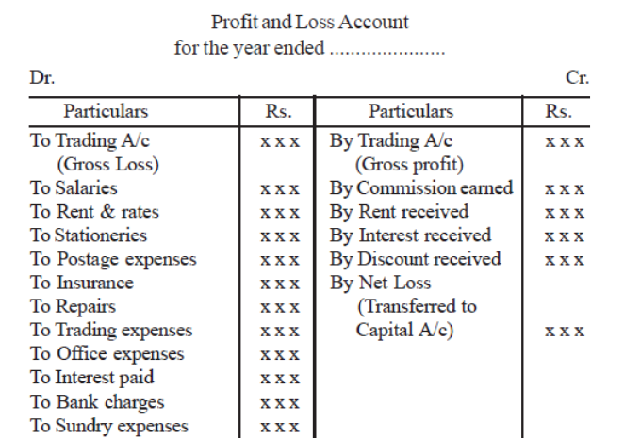

Slide 12
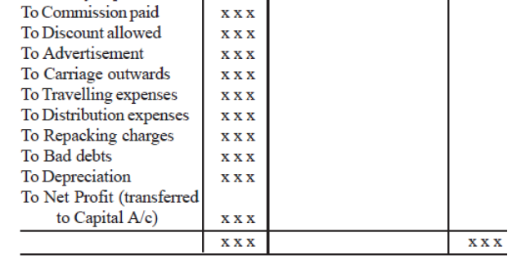

Slide 13
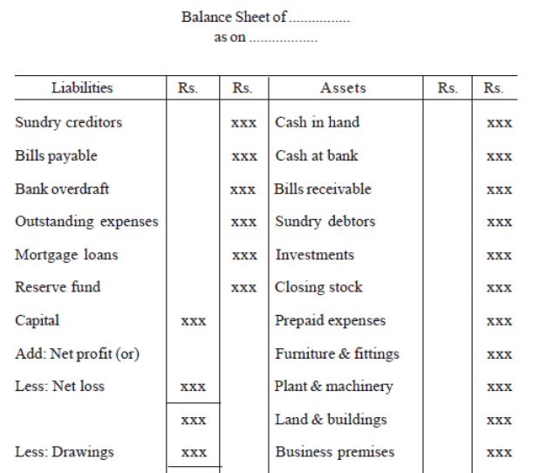
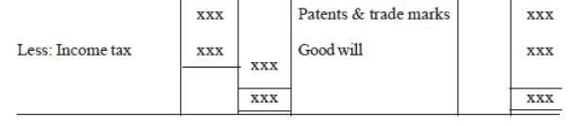

Slide 14
Balance Sheet is Prepared at the end of closure of accounting period.
It is used by Stake holders – Shareholders,Creditors,Government Agencies and other Financial statement users.

Slide 15
THANK YOU

