Slide 1

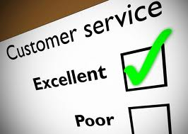
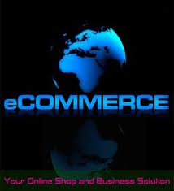
NEW TRENDS IN SECURING
E-COMMERCE

Slide 2
GROUP MEMBERS
MITESH TRIVEDI WRO 0402455
HARSHAL UDANI WRO 0410155
RINESH MEHTA WRO 0415341
NAKUL SONI WRO 0372263
RAJAN SHAH WRO 0407493
ASPIRANTS 5

Slide 3
REASONS FOR SELECTING THIS TOPIC
The Insight Belief Of this Topic compelled Us to Select The Topic Which is so close to our normal walks of life..
To show how E-commerce actually works.
To show the various trends and developments in securing E-commerce over the years.

Slide 4
What Is E-commerce?
Use of Internet and Web to transact business
More formally:
  Digitally enabled commercial transactions between and among organizations and individuals
  A modern business methodology ... to cut costs while improving the quality of goods and services and increasing the speed of service delivery.
To be continued…..

Slide 5
………..
Communications systems (email), social networking sites, search, Blogging are getting closer to e-commerce
With continued convergence of telephony, Computing, and other areas (e.g. automotive), the Reach of systems adjacent to e-commerce will grow
E-commerce is a new way of conducting business, and as with any other new application of technology, it presents both opportunities for improvement and potential problems

Slide 6
Unique Features of E-commerce Technology
Ubiquity
Global reach
Universal standards
Information richness
Interactivity
Information density
Customization
Social technology

Slide 7
Types of E-commerce
Classified by market relationship
  Business-to-Consumer (B2C)
  Business-to-Business (B2B)
  Consumer-to-Consumer (C2C)
Classified by technology used
  Peer-to-Peer (P2P)
  Mobile commerce (M-commerce)

Slide 8
The Essential components
of E-commerce

Slide 9
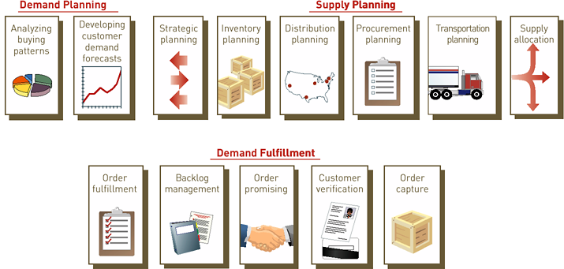
1.) E COMMERCE SCM
SCM IS A VITAL COMPONENT OF E COMMERCE

Slide 10
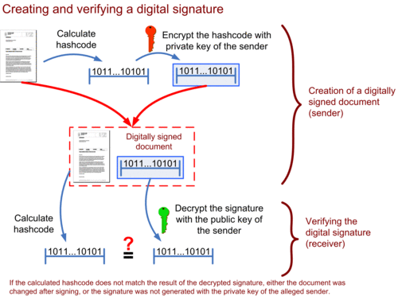
2.)WHAT IS DIGITAL SIGNATURE ?
Definition of Digital Signature
“A Digital Signature or Digital Signature Scheme is a mathematical scheme for demonstrating the authenticity of a digital message or document". Digital Signatures are commonly used for software distribution, financial transaction, and in other cases where it is important to detect forgery and tempering.

Slide 11
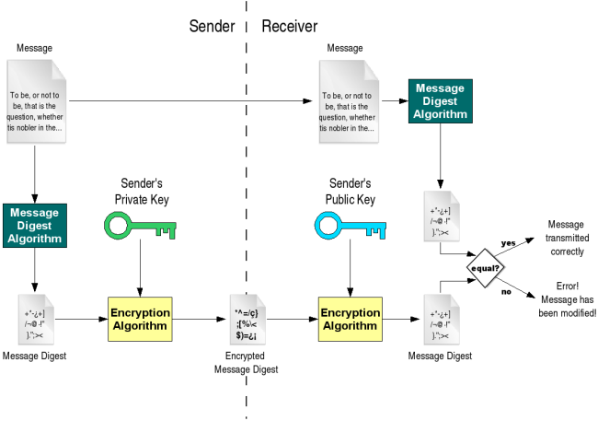
Digital Signature Technology

Slide 12

E-commerce security
E Commerce security must include a set of procedures, mechanisms and computer programs for authenticating the source of information and guaranteeing the process
The power of the E commerce also allows for the efficient, inexpensive collection of vast amounts of information with consumers consent.
It is very important to make the E commerce safe for buying and selling products on-line. Global privacy consistency is required, as E commerce usage is largely unregulated, which mean that laws in one country are not aligned with the laws in other countries.

Slide 13
The power of the E commerce also allows for the efficient, inexpensive collection of vast amounts of information with consumers consent.
E Commerce security must include a set of procedures, mechanisms and computer programs for authenticating the source of information and guaranteeing the process
E-Commerce Security
It is very important to make the E commerce safe for buying and selling products on-line. Global privacy consistency is required, as E commerce usage is largely unregulated, which mean that laws in one country are not aligned with the laws in other countries.

Slide 14

Encryption:
Deals with information hiding. It ensures you cannot spy on others during Internet banking transactions.
Auditing:
Keeps a record of operations. Merchants use auditing to prove that you bought a specific merchandise.
Authorization:
Allows only you to manipulate your resources in specific ways.
Security features
Authentication:
Verifies who you say you are. It enforces that you are the only one allowed to logon to your Internet banking account.

Slide 15
Security issues(security server)
Payments to the server is enabled with the help of a number of security mechanisms
Browser-to-Web server data encryption and integrity with SSL 3.0
Browser to database password authentication by use of encrypted digests (Kerberose,Identix,Cybersafe)
Protection for corporate databases with protocol-enabled firewalls proxying and authenticating user connection requests (Oracle has supplied sql*net proxy to all firewall vendors).
Web Application Server to Browser authentication by use of digital signatures.
Security Server provides a Certificate Authority (CA) function, including generation of public key/private key pairs and issuance of industry-standard X.509 certificates.

Slide 16
Lets see how a transaction
takes place !!!!!!

Slide 17
1
Consumer finds something she wants to buy at a “shop” on the Net
6
Verification and remittance of actual funds
Shop
2
Consumer sends on enciphered request for payment to her bank
The electronic bank sends back a secure packet of e-cash
Consumer’s Bank
3
Consumer Public Key
The shop sends the packet of cash to its bank
Merchant Server
5
Consumer sends the e-cash to the shop
4
Shop
Merchant Bank

Slide 18
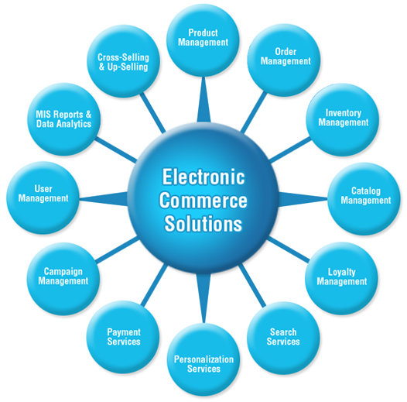

Slide 19
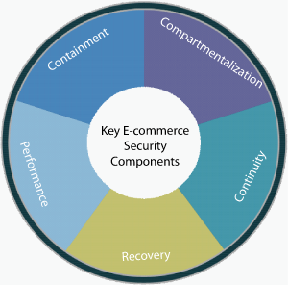
Prevent proliferation of attacks
Prevent unauthorized access to systems.
Network performance should not be reduced by security measures
Ensure seamless operation even under DDoS attack or equipment failure
Enable rapid recovery from external attack or malicious insider activity

Slide 20
Technical Discussion
Privacy concerns
More and more websites are using the Google Checkout system for secure online transactions. This is making it much easier for any consumer making purchases, and for corporate buyers to shop online with full assurance of privacy of personal and business financial information.
With the concern for online privacy and keeping one’s credit card information secure, choosing the most secure form of e-Commerce is at the highest priority level for consumers and business’ buyers wishing to shop at online e-Commerce wholesale and retail websites.

Slide 21
Technical Discussion
Arguments against privacy concern
Privacy concerns are controversial with many firms utilizing customer data for trend analysis. Firms collect information to provide customized services, identify buying trends and target good and services for specific markets. “Consumers must make choices on how much and what type of privacy they are willing to give up in exchange for outcomes that are valuable to them”
A good example is Wal–Mart, which has access to information about a broad slice of America. The data are gathered item by item at the checkout aisle, then recorded, mapped and updated by store, by state, and by region. By its own count, Wal-Mart has 460 terabytes of data stored on Tetra data mainframes. To put this in perspective, the Internet has less than half as much data, according to experts.

Slide 22
Technical Discussion
Legislation and
Self-regulation
Self-regulation should be used to handle privacy concerns but if it is inadequate, then legislation should be used as a last alternative to handle the issue. The legislation needs to be properly organized in order to be enforceable.
TrustE is a self-regulatory privacy regime “that can build consumers’ trust and confidence on the Internet through a program in which websites can be licensed to display a privacy seal or Trustmark on their websites”. The TRUSTe organization allows E-Business sites to display a Trustmark, indicating to consumers that the site adheres to the TRUSTe’s privacy principles and practices, which are approved by the U.S. Department of Commerce and the FTC. E-Businesses displaying the Trustmark must also allow oversight to ensure that they are compliant with the privacy practices.
The three goals of seals are:
Give on-line consumers control over their personal information..
Provide web publishers with standardized, cost effective solutions to satisfy businesses and address consumers’ anxiety over sharing information..
Provide governmental regulators with evidence that the industry can self regulate.

Slide 23
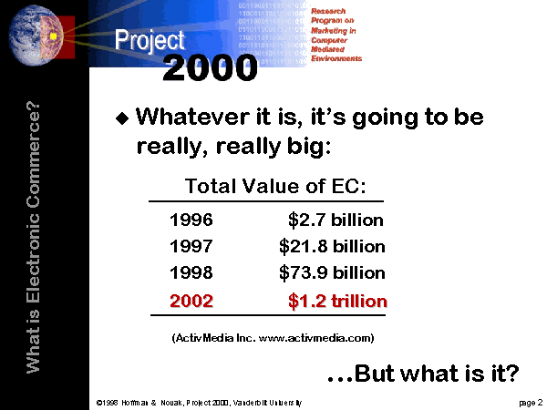
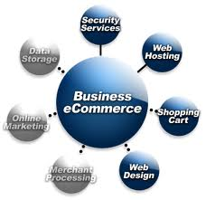
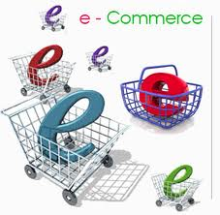

Slide 24
SELF REGULATIONS FOR SECURING E-COMMERCE
Websites should follow self-regulation if they do not want government involvement in privacy matters. The Federal Trade Commission (FTC) also prefers the websites to self regulate since the technology changes rapidly. In 1998, the On-line Privacy Alliance was formed and published a self-regulatory policy for on-line companies. To implement privacy policies, a seal system was established. Seals are given only to selected websites that promote the three goals of seals and complies with the policies
Give on-line consumers control over their personal information.
Provide web publishers with standardized, cost effective solutions to satisfy businesses and address consumers’ anxiety over sharing information.
Provide governmental regulators with evidence that the industry can self regulate.

Slide 25
ATTACKS
Attacks against e-Commerce Web sites are so alarming; they follow right after violent
crimes in the news. Practically every month, there is an announcement of an attack on a major Web site where sensitive information is obtained. Why is e-Commerce vulnerable? Is e-Commerce software more insecure compared to other software? Did the number of criminals in the world increase? The developers producing e-Commerce software are pulled from the same pool of developers as those who work on other software. In fact, this relatively new field is an attraction for top talent. Therefore, the quality of software being produced is relatively the same compared to other products. The criminal population did not undergo a sudden explosion, but the incentives of an e-Commerce exploit are a bargain compared to other illegal opportunities.
Compared to robbing a bank, the tools necessary to perform an attack on the Internet is fairly cheap. The criminal only needs access to a computer and an Internet connection. On the other hand, a bank robbery may require firearms, a getaway car, and tools to crack a safe, but these may still not be enough.

Slide 26
FUTURE TRENDS
E Wallets and secure transactions
* eWallets will eventually go away SET becomes a server-side issue
* SSL still dominates eCommerce transactions for many years
Caching technologies
* Better and cheaper caching devices appear Most * ISPs will use them within a few years if they want to retain customers

Slide 27
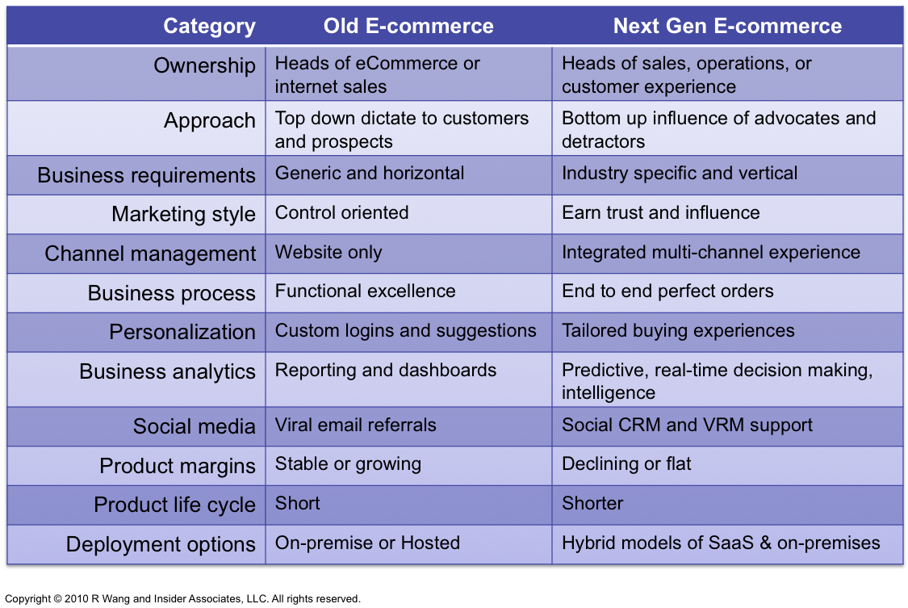
Distinguish between Old And Next Gen E-Commerce

Slide 28
Recommendation
The topic of E-Commerce Security provides an abundance of research opportunities. The authors recommend that the research should be continued. The development of new standards in order to protect the privacy of the consumers is very important and critical to the continued growth of E-Commerce. Proper laws should be legislated to ensure consumer privacy, since it has been shown that self-regulation is not always ideal.
Laws in other countries should also be researched and standard international policies should be adopted at a global level. Consumers, companies and the government should work together with integrity to protect the privacy rights of the consumers.
Many companies are already following this research trend and boosting their sales online. Many more are likely to follow and achieve large profits. It is imperative that companies understand achieving success and sustaining competitiveness in the highly volatile and demanding E-Commerce market “lies in their ability to securely protect their information assets and IT infrastructure”

Slide 29


Be Sociable, Share!

Slide 30

Thank you

