Slide 1
10 Simple & Powerful Mudras
By PRAKASH KUMAR SINGH

Slide 2
1. Gyan Mudra (Mudra of Knowledge):
Method: Touch the tip of the thumb to the tip of the index finger with the other 3 fingers stretched out.
Specialty: As it is a mudra of knowledge, it enhances the knowledge. The tip of thumb has centers of pituitary & endocrine glands. When we press these centers by index finger the two glands work actively.
Time Duration: It has no particular time duration. You can practice it any time you want.
Benefits:
o Increases memory power and sharpens the brain
o Enhances concentration and prevents Insomnia

Slide 3
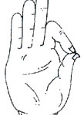
Gyan Mudra

Slide 4
2. Prithvi Mudra (Mudra of Earth):
Method: Tip of the ring finger touches the tip of the thumb, with the other three fingers stretched out.
Specialty: It reduces all physical weaknesses.
Time Duration: It has no particular time duration. You can practice it any time you want.
Benefits:
o It helps to increase the weight for weak people
o It improves the complexion of skin and makes the skin to glow.

Slide 5
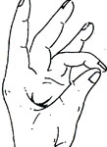
Prithvi Mudra

Slide 6
3. Varuna Mudra (Mudra of Water):
Method: Tip of little finger touches the tip of thumb, with the other three fingers stretched out.
Specialty: It balances the water content and prevents all diseases which come due to lack of water.
Time Duration: It has no specific time duration and one can practice it according to their time.
Benefits:
o It retains clarity in blood by balancing water content in the body
o Prevents the pains of Gastroenteritis and Muscle Shrinkage

Slide 7
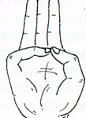
Varuna Mudra

Slide 8
4. Vayu Mudra (Mudra of Air):
Method: Keep index finger on the base of the thumb & press with thumb keeping other 3 fingers straight.
Specialty: It prevents all the diseases that occur due to the imbalance of the air.
Time Duration: The practice of this mudra for 45 minutes reduces the severity of the disease in 12 to 24 hours. For better results practice it for two months.
Benefits:
o It cures Rheumatism, Arthritis, Gout, Parkinson’s disease and paralysis without any medicine.
o It is useful for Cervical Spondilytis, paralysis to face and catching of nerve in neck.
o It corrects the disorder of gas in the stomach.

Slide 9
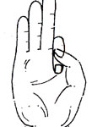
Vayu Mudra

Slide 10
5. Shunya Mudra (Mudra of Emptiness):
Method: Keep the middle finger at the mount of Venus and press it with thumb.
Specialty: It reduces the dullness in our body.
Time Duration: One can practice it for 40 to 60 minutes daily until to be cured from the disease.
Benefits:
o It relieves an earache within 4 or 5 minutes
o It is useful for the deaf and mentally challenged, but not for inborn ones.

Slide 11
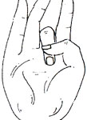
Shunya Mudra

Slide 12
6. Surya Mudra (Mudra of Sun):
Method: Bend the ring finger and press it with thumb.
Specialty: It sharpens the center in thyroid gland .
Time Duration: Practice it daily twice for 5 to 15 minutes.
Benefits:
o It reduces anxiety & cholesterol in body and helps in reducing weight.
o It corrects indigestion problems.

Slide 13
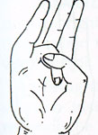
Surya Mudra

Slide 14
7. Prana Mudra (Mudra of Life):
Method: Bend ring finger & little finger and touch the tip of thumb with their tips keeping the remaining 2 fingers stretched.
Specialty: As it is the mudra of life, it improves the power of life. Weak people become strong. It reduces the clamps in blood vessels. If practiced regularly,we will become active.
Time Duration: No specific time duration. One can practice it any time.
Benefits:
o It improves immunity & power of eyes and reduces eye related diseases.
o It removes the vitamin deficiency and fatigue

Slide 15
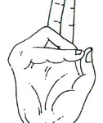
Prana Mudra

Slide 16
8. Apana Mudra (Mudra of Digestion):
Method: Tips of middle & ring finger touch the tip of thumb while other 2 fingers are stretched out.
Specialty: It plays an important role in our system. health as it regulates the excretory
Time Duration: Practice it daily for 45 minutes, but practice for longer time yields more benefits.
Benefits:
o It regulates diabetes.
o It cures constipation and piles.
o It helps excreting the normal waste regularly.

Slide 17
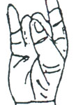
Apana Mudra

Slide 18
9. Apana Vayu Mudra (Mudra of Heart):
Method: The tips of the middle finger and ring finger touch the tip of thumb, while the index finger touches the base of thumb and little finger stretched out.
Specialty: It works like injection in the reduction of heart attack. It is as powerful as sorbitate tablet.
Time Duration: Practice it as many times as you can. Heart patients and BP patients can practice it for 15 minutes daily twice for better results.
Benefits:
o It strengthens the heart and regularizes palpitation.
o It regulates excretory system & redeems gastric trouble.

Slide 19
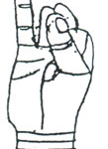
Apana Vayu Mudra

Slide 20
10. Linga Mudra (Mudra of Heat):
Method: Interlock the fingers of both the hands and keep the thumb of the left hand vertically straight and encircle it with the thumb and the index finger of the right hand.
Specialty: It generates heat in our body. Take milk, ghee, more water and fruit juices in addition to practice of this mudra for much benefits.
Time Duration: Practice it any time you want. But don’t practice it a lot as it produces heat in the body. It can cause sweating even in winter if you practice it longer.
Benefits:
o It stops production of phlegm and gives power to lungs.
o It cures severe cold and bronchial infection.
o It invigorates the body.

Slide 21
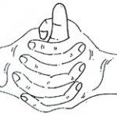
Linga Mudra

Slide 22
Thank You …
NOTE: Do not write and draw these mudras in Exam paper, just apply in your life.

