Slide 1
COST BENEFIT ANALYSIS AND PROFIT PLANNING
VISHAL PHAD ROLL NO 29
PRASHANT PAWOR ROLL NO 28
SHREE ROLL NO 14
MANDAR KAMLAKAR ROLL NO 13

Slide 2
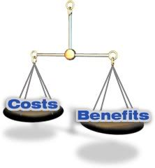
Important Concepts
1) Benefit
- marginal benefit
- total benefit
minus
2) Cost
- marginal cost
- total cost
=
3) Net benefits
- marginal net benefit
- total net benefit
!!!
An efficient allocation maximizes
Total Net Benefit
!!!

Slide 3

COST –BENEFIT ANALYSIS
Is a more sophisticated technique.
It could be fully quantitative or fully qualitative
or both
A technique designed to determine the feasibility
of a project or plan by quantifying its costs and
benefits.

Slide 4
CBA has two purposes:
To determine if it is a sound investment/decision (justification/feasibility),
To provide a basis for comparing projects. It involves comparing the total expected cost of each option against the total expected benefits, to see whether the benefits outweigh the costs, and by how much.

Slide 6
Process
The following is a list of steps that comprise a generic cost-benefit analysis.
List alternative projects/programs.
List stakeholders.
Select measurement(s) and measure all cost and benefits elements.
Predict outcome of cost and benefits over relevant time period.
Convert all costs and benefits into a common currency.
Apply discount rate.
Calculate net present value of project options.
Perform sensitivity analysis.
Adopt recommended choice.

