Slide 1



Welcome to my project

Slide 2

SYSTEM DEVELOPMENT

Slide 3

Acknowledgment
I am very thankful to our faculty of ITT Asansol Branch of EIRC of ICAI namely :-
Mr. Amartya Das Gupta
CA Debashis Banerjee
Mr. Ramesh Acharjee
Mr. Avishek Banerjee
Mr. Abhijit Dutta
For their valuable suggestion, encouragement and guideline the
execution of this project.

Slide 4
INTRODUCTION
A project encompasses all the activities undertaken from the time at which a potential requirement is identified until the resulting system is fully implemented and accepted by the end user. The process can involve many stages over a long period. The following section highlights some fundamental issues to be considered, outlines the main stages in development and procuring new systems, and indicates when and how the auditor should be involved.
SYSTEM DEVELOPMENT

Slide 5
SDLC stands for
  Systems
  Development
  Life
  Cycle
  The systems development life cycle (SDLC) therefore, refers to the development stage of the system’s life cycle.
What does it mean?
A system development life cycle supplements an Information Systems Strategy by defining in greater detail
the roles and responsibilities of the Information System Department in planning, developing, testing,
implementing and operating an organization's information systems.

Slide 6
Systems Development Life Cycle
This text highlights 6 distinct phases:
Initiation : the stage at which the project is formally commissioned and at which a firm base for the management and control of the rest of the project is established
Specification : key end products from this stage are the specification of user requirements, acceptance testing criteria, installation proposals, and education and training requirements
Design : all design tasks, both logical and physical, are completed
Development : the end product, together with its supporting documentation and business continuity plans, is produced/acquired and tested by the developers in the development environment
Acceptance testing : the system is installed in its user and operational environments, and subjected to rigorous user acceptance testing;
Operation : the operational system is closely monitored in live use, and any minor corrections and system tuning carried out. The product is then fully handed over and the development project is wound up.

Slide 7

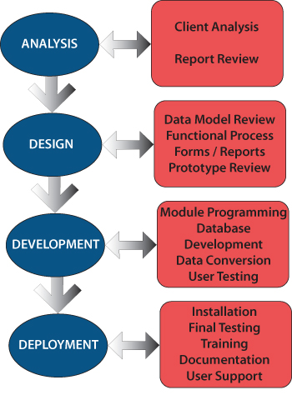

Slide 8
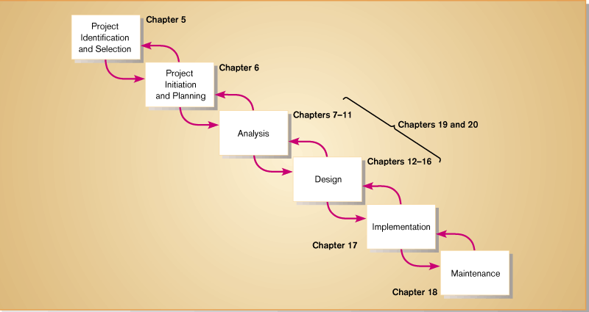
Stages of the SDLC
IS 422
Systems Design
IS 421
Systems Analysis

Slide 9

Overview of Systems Development
Participants
Initiating systems development
Information systems planning
Establishing objectives for systems development
Systems development and the Internet
Trends in systems development and enterprise resource planning

Slide 10
PARTICIPANTS
Stakeholders
  Individuals/organizations who are beneficiaries of the systems development effort
Systems analyst
  Professional who specializes in analyzing and designing business systems
Users
  Individuals who interact with the system regularly
Programmer
  Individual responsible for modifying or developing programs to satisfy user requirements

Slide 11







Managers
System stakeholders
Programmers
Systems analyst
Users
Technical
specialists
Vendors and suppliers

Slide 12

SYSTEMS ANALYST
A programmer or consultant who designs and manages the development of business applications. Typically, systems analysts are more involved in design issues than in day-to-day coding. However, systems analyst is a somewhat arbitrary title, so different companies define the role differently.

Slide 13
TYPICAL REASONS TO INITIATE A SYSTEM’S DEVELOPMENT PROJECT
Problems with existing systems
Desire to explore new opportunities
Increasing competition
Perception of potential
benefit by individual
capable of initiating
change
Systems development
process initiated
Desire to make more
effective use of information
Organizational growth
Merger or acquisition
Change in market or
external environment

Slide 14
PLANNING
Information systems planning
  The translation of strategic and organizational goals into systems development initiatives
Creative analysis
  The investigation of new approaches to existing problems
Critical Analysis
  The unbiased and careful questioning of whether system elements are related in the most effective or efficient ways
Strategic plan
IS planning
Systems development
initiatives

Slide 15
STEPS IN PLANNING
Strategic plan
Previously unplanned
system projects
Developing overall objectives
Identify IS projects
Set priorities & select projects
Analyse resource requirements
Set schedules and deadlines
Develop IS planning document

Slide 16

ESTABLISHING OBJECTIVES FOR SYSTEMS DEVELOPMENT
Performance objectives
  Quality or usefulness of the output
  The quality or usefulness of the format of the output
  The speed at which the output is generated
Cost objectives
  Development costs
  Costs related to the uniqueness of the system application
  Fixed investments in hardware and related equipment
  On-going operating costs of the system

Slide 17
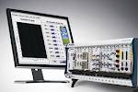
SYSTEMS DEVELOPMENT AND THE INTERNET
Applications being moved to the Internet
  Sales
  Order placement
  Product information access
Building a static Web site
Intranet tools
  Net Dynamics
  Silver Stream
  Web-Logic
  Novara
  Netscape Communications

Slide 18

Approaches to Systems Development
Essentially there are two methodical approaches to system development; the traditional step-by-step or “waterfall” (because one stage flows into the next in a logical sequence) approach, and Rapid Application Development (“RAD”).
The WATERFALL APPROACH comprises a number a discrete steps. In theory a step does not start until the previous step has been completed, although in practice there is often considerable overlap.
The RAD PHILOSOPHY is based on a recognition that businesses now rely on information technology. As a result, they must be capable of developing and deploying new information systems rapidly if they are to maintain competitive advantage or meet their political deadlines as the case may be.

Slide 19

The WATERFALL approach is tested, first by the developers in their own environment and then by the end-users in the operational environment; and if it is found to be satisfactory.....
In a waterfall project it becomes increasingly expensive to correct errors and omissions as development progresses because of the increase in the amount of re-working that is necessary as the project progresses. It is therefore important to get the business analysis and requirement specification exactly right before any software is developed. Consequently, much time can elapse before the end-users see a working system, even at the testing stage. If what they then see fails to meet their requirements, the waterfall has to be rolled back, revised requirements re-specified; new or amended designs produced; further development undertaken followed by re-testing.
The waterfall is therefore inherently slow, but due to the need for rigorous system analysis and specification it remains the preferred approach for developing systems where it is very important to get the specification exactly right (for example, in processes which are computationally complex or safety critical…)
WATERFALL APPROACH

Slide 20

RAD APPROACH
The time required for a waterfall development represents a severe constraint which RAD attacks by making two fundamental assumptions; that nothing is ever perfect first time and that 80% of the ideal solution satisfies most business needs and can be produced in 20% of the time required to deliver the ideal solution.
In RAD it is important to identify the components that will deliver the bulk of the benefits that a new system has to offer, and then to develop these as rapidly as possible. Satisfying key business requirements therefore assumes a higher priority than the quality of the system’s operational characteristics; in other words, the RAD approach is to “build the right system before you build it right”. Consequently, technical excellence, while not unimportant, becomes a means to an end rather than an end in itself. But this aspect of the RAD philosophy, if taken to extremes, can result in a poorly engineered system; for example, one which is unresponsive and which lacks important non-functional features, such as adequate security…
A life-cycle method that is designed to exploit the strengths of RAD and manage its weaknesses. Sensible conformance with a reputable methodology (e.g. the Dynamic Systems Development Method) will help to reduce the risk of an unsuccessful outcome………..

Slide 21
W
A
T
E
R
F
A
L
L
Detailed contract agreed with customer before the start of project, specifying deliverables, costs and time-scales.
Emphasis is on agreeing with the customer the process by which the business requirements will be met.
R
A
D
User participation highly desirable in the non-technical stages
User participation essential and integrated with project team .
V/s
Progress is monitored by the deliverables produced against those identified in a detailed project plan.
Progress is monitored against achievement of business requirements within defined “time-boxes”.

Slide 22
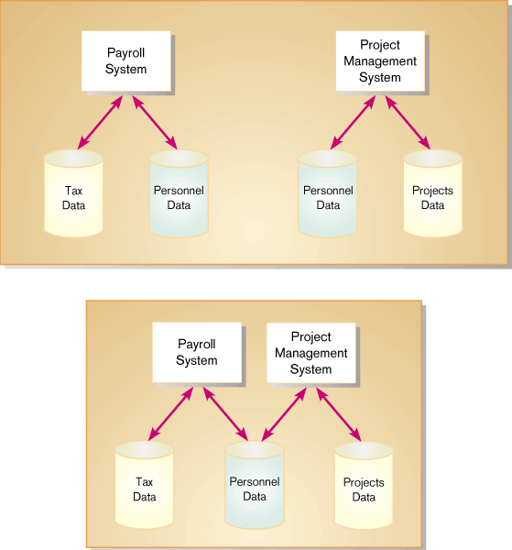
OTHER APPROACHES
Which is better, the Process Approach or the Data Approach?
Process Approach:
“Let’s look at all of our processes. Processes take precedence over data. Get the processes correct first. Then we’ll address what data is important.”
Data Approach:
“Forget the processes, let’s look at the data. Data comes first. Get the data correct, then see how the processes actually use the data.”

Slide 23

PROJECT MANAGEMENT
Project Management
  Identification of tasks to be completed
  Understanding of relationship between tasks
  Tracking of task ownership and status
  Adjustment of resources and plans in reaction to events
  Task tracking and accountability
  Management reporting and escalation

Slide 24


RISK ASSESSMENT
Many projects predictably fail do to risk profile
Major risk factors
  Scope
  Timeline
  Experience of team
  Organizational change
  Geographic scope

Slide 25


SUGGESTED STEPS FOR SYSTEM PROCUREMENT
Plan and resource system procurement project;
draw up a comprehensive statement of requirements for the new system;
define evaluation criteria for each requirement;
summarize essential requirements in a Request For Information (RFI);
circulate the RFI to 6-10 vendors;
evaluate responses against the RFI;
short-list 2-3 products for further research;
contact existing users of the products;
arrange detailed demonstrations to evaluate short-list against the RFI;
identify a preferred product;
visit reference sites;
undertake detailed testing (see step 3) using the organization's data, and if
satisfied....
complete cost and contract negotiations;
plan and resource system implementation project.

Slide 26


Testing
The auditor will need to know the extent to which the system of internal controls can be relied on to prevent errors occurring in the audited account. It is therefore desirable that both technical and non-technical controls are thoroughly exercised by the client during acceptance testing, and that both test programmers and test results are retained for audit inspection.
Testing scripts should be retained and updated throughout the entire life of the system because testing will need to be repeated periodically to confirm that the system continues to operate reliably following the installation of updated versions. This should not be treated as a foregone conclusion!

Slide 27


Post Implementation Review
This is the final stage of the system-development life cycle and should take place some month after live implementation when the end-users and technical support staff have become familiar with the new system, and any latent defects have had an opportunity to emerge.
The object of the Post Implementation Review is to assess the extent to which the new system actually satisfies the needs of the business, and to identify any lessons that might be avoided in future projects. Post Implementation Reviews can uncover some uncomfortable lessons and for this reason should be undertaken independently of the developers, perhaps by Internal Audit.

Slide 28
Bibliography
Following have helped me to complete my project:-
WEBSITES:-
BOOKS:-
www.google.com
www.caclubindia.com
DINESH MADAN
My friends &family members also help me a lot to complete this project.

Slide 29

System development
THANK YOU

