Slide 1
Studies & Examination
Madhukar N Hiregange FCA

Slide 2
Today’s Coverage
Initiatives of ICAI
Examiners Observations
Important Focus Areas
Some Important Attitudes

Slide 3
Student Initiatives in past year
Making entrance a little tougher and exit a little easy
Updating Study Material – Dec 2010/ June 2011
Timely receipt of RTP/SA – All in place 2/3 months in advance [ july/ august 2011]
System Improvement from paper setting to results
Transparency in results/ RTI

Slide 4
Student Initiatives in past year
15 minutes reading time
Papers focused on understanding at IPCC
Syllabus Relook – relevance/ skill development/ reducing bulk/ readability of SM -WIP
New E-learning initiatives – WIP
Accreditation of Colleges - WIP

Slide 5
Head Examiners Comments on poor performers
On ICAI web site – examination
Lack of understanding of question
Unduly long answer
No working notes
Poor written english [ grammar, words usage]
Poor handwriting
Selective studies
Coaching class – rote learning

Slide 6
Important Focus Areas
Emphasise on ICAI study material
  official material for paper setters as well as examiners
Latest updates/ amendments
  Do not use old study material
Evaluate yourself – Mock Examination in all subjects [ physical/ online]
Understanding the Concepts
  in practical training the concepts learnt are applied

Slide 7
Important Focus Areas
Change in emphasis to understanding, application and analysis
  Working out the problems/questions independently
Equal Importance to all Subjects
  Study difficult subjects first
Knowledge of Acts/ Rules
  Read bare act
Practice and More Practice
  work out the problems in costing, accountancy, MAFA

Slide 8
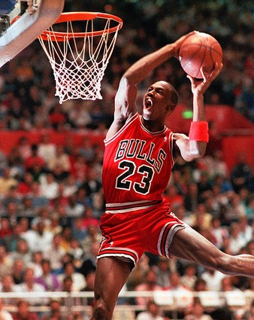
Success
“I’ve failed over and over and over again in my life, and that’s why I succeed.” - Michael Jordan

Slide 9
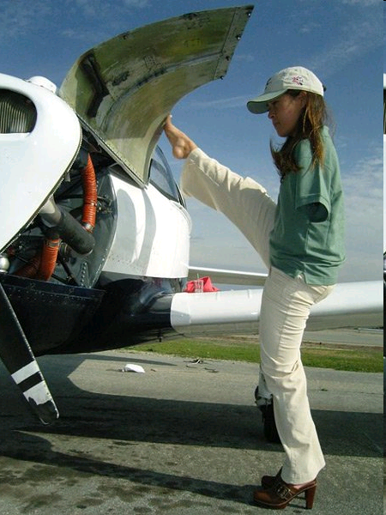
ATTITUDE
If you think you can you can
Mahatma Buddha

Slide 10

Perseverance
“There are no secrets to success. It is the result of preparation, hard work learning from failure.” - General Colin Powell

Slide 11

HARD WORK
“Success is the sum of small efforts, repeated day in and day out.” ~ Robert Collier

Slide 12
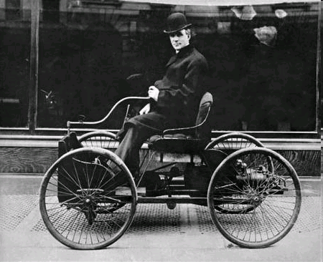
initiative
““You may never know what results come of your action, but if you do nothing there will be no result.” ~ Mahatma Gandhi”

Slide 13

ACTION
“Success seems to be connected with action. Successful people keep moving. They make mistakes, but they don’t quit.” ~ Conrad Hilton

Slide 14

Questions?? mhiregange@gmail.com
All best wishes for your examination
May you join the qualified family fast

