Slide 1
Words of wisdom

Slide 2
C.S. the Course

Slide 3
HOW TO LIVE LIFE TO THE FULLEST ?
Walk for 10-30 minutes , everyday, while smiling.
Sit quietly for at least 10 minutes everyday, in isolation.
Upon arising in the morning , one must immediately say “My goal today is …….”

Slide 4
Meditate , if possible , it will increase concentration power and back out stress.
Play more games than last year.
Read more books than last year.

Slide 5
Look at the sky at least once a day, appreciating the majesty of the world that surrounds us.
Dream more while awake.
Eat more foods that come from trees and plants. Eat less manufactured foods.

Slide 6
Drink plenty of water.
Don’t spend your precious time immersed in rumors , things from the past , negative thoughts or things beyond your control. It is better to invest your energy in positive present.
Life is a school, and we are here to learn. Problems are lesson that come and go; what we learn from them will serve us for the rest of our lives.

Slide 7
Eat breakfast like a king, lunch like a prince , and dinner like a beggar.
Remember well that we have no control over what happens to us, but only what we do.
Learn something new everyday.

Slide 8
Whether the situation is good or bad, it will change.
Work will not take care of us when we are sick. Our friends will. Stay in contact with them.
We can only enjoy the voyage. No normal can enjoy success for long.

Slide 9
Try to make at least 3 people laugh a day.
Eliminate clutter in the home, the car, and the office let a new energy enter your life.
Reject everything that is not useful, amusing , or beautiful.

Slide 10
Life is too short to waste time hating someone.
Don’t take yourself so seriously. Nobody else does.
                It is not necessary to win every argument. One must accept that the other person is not in agreement and learn from his position

Slide 11
Each day , before going to sleep say ;
I am thankful for ___________.
Today, I succeeded in __________.
Today, I lost in _________, which to be won tomorrow.
Make peace with your past, so as to not ruin your present.
We can only enjoy the voyage. No normal can enjoy success for long.

Slide 12
Life is beautiful. You must appreciate it as much as possible.
At least have one hobby and try to have it.
Before the start of the day make a list for the things to do.

Slide 13
Smile and laugh more often. Try to watch comedy films or clips it will make you lighter
Try to capture every good and happy moments of your life , it will make you happy in future while recalling.
Do everything DIL SE …..

Slide 14
MOTIVATIONAL STORIES

Slide 15
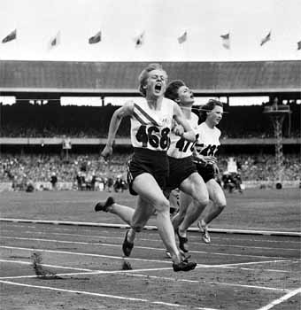
JUTTA:-
A German OLYMPIC LIGHT ATHELETE:
She had never been beaten in her life-
But the story is not about JUTTA……

Slide 16
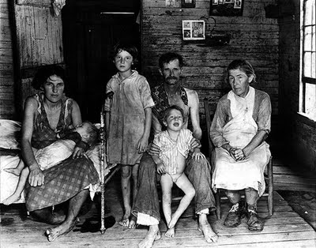
SESSION A.
WILMA’S STORY.
Wilma :-
Born into a very poor family.

Slide 17
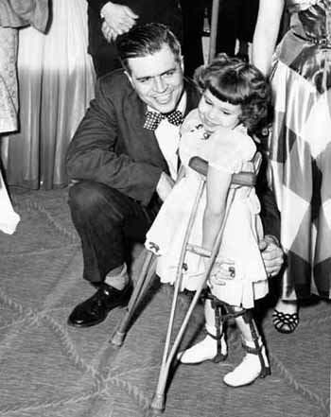
4 yrs
Had double pneumonia with scarlet fever :
a deadly combination which left her paralyzed with polio.

Slide 18
Doctor’s said “ she would never be able to walk again in her life.”
Her mother : “encouraged her to do whatever she wants to do.”
Wilma said “ I want to be fastest woman on earth.”

Slide 19
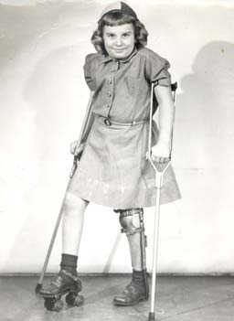
9 yrs old:-
Against the advise of doctors she removed her support and took the first step.

Slide 20
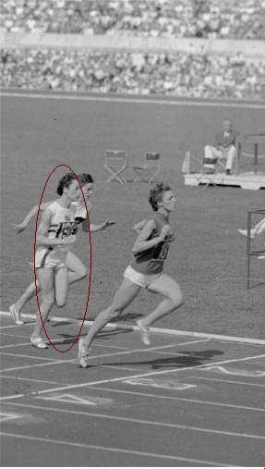
13 yrs
she entered her first race and came last, then she went for second , third , fourth and every time came last until a time when she _______.

Slide 21


In 1960 :- “A DAY OF OLYMPIC”
First event of 100 meters race:-
Wilma won a gold defeating Jutta.
Second event of 200 meters race:-
Wilma won her second gold by defeating Jutta again.

Slide 22

Third event of 400 meters relay:-
The last lap:
Wilma and Jutta were representing their teams .
Baton was passed,
But was dropped from Wilma’s hand as running on the other end.
Wilma lifted the baton again and ran like a machine to win her third gold by defeating Jutta once again.

Slide 23
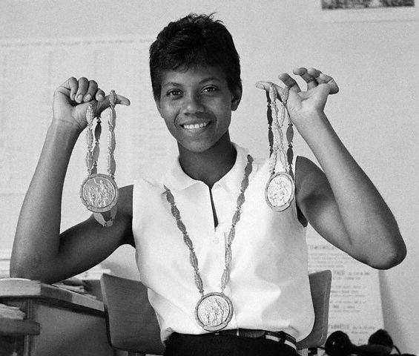
That night was special a paralytic woman on earth showed the World.
“She is the fastest woman on earth in HISTORY

Slide 24
MORAL:-
Even the most disadvantageous person can win over the most advantageous person

Slide 25

SESSION B.
MARK’S STORY.
A small, tiny, thin boy had an idea. Idea that every other guy of his age has.

Slide 26

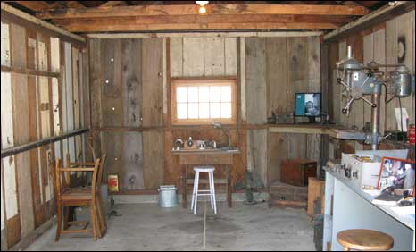
IN 2004 :-
He started working on it at the age of 19 years.
He worked day in day out for what he started.
He made his own company and opened an office in garage.

Slide 27
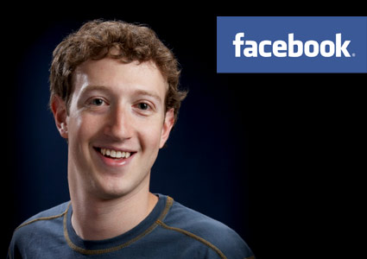
Mark owns Facebook
EARNINGS
earned $7 Billion or Rs. 350,000,000,000 in short span of 6 years.
WHICH MEANS
Rs. 5833 Crores every year,
Rs. 16 Crores everyday,
Rs. 66 Lacs every hour
Rs. 1 Lac every minute.

Slide 28

THINKING OF PEOPLE:-
Many said he just had an idea,
some said he was lucky,
others said what if tomorrow we have yet another
Facebook.

Slide 29
I personally think it was his hard work and determination.
Every guy of his age has this idea still they lead a very normal life, because they are too lazy to do it.
I leave it up to you to decide whether it is luck or hard work……

Slide 30
Moral :-
Mark was neither experienced, nor rich enough do that. Time and Hard work is essence of life.

Slide 31
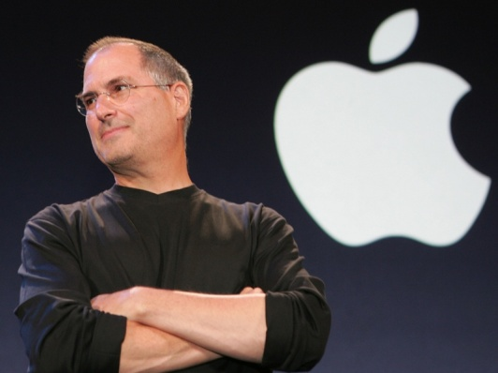
SESSION C
STEVE JOBS STORY
This is the best story of modern time’s at least for me.
February 24, 1955 : -
The day when Steve was born in the world to change the world. Since his birth world was against him. His biological parents left him.

Slide 32

In 1976:-
Steve founded a small company named “Apple” with his longtime friends.
As the years passed Apple continued to expand, company began looking for an experienced CEO to manage its expansion.
Steve brought in Scully the new CEO in his place.

Slide 33
Jobs's working relationship with Scully deteriorated.
Jobs was thrown out his own company.
Company that Steve himself built was no longer belonged to him.
He was publicly humiliated in every part of corporate America.

Slide 34
I ask you what were his options after being thrown out of your own multi millionaire company???
For 99% of ‘us’ it is end of world.
Some go back in their dad’s business
others go back to their home town
and
some slightly hardworking people would immediately take up a job.

Slide 35
Now let’s see what this Apple boy did.
This was a big failure even for Steve, but he pushed himself up and going.
Jobs founded another computer company, NeXT Computer.
Jobs kept his work going, he worked on best of best of the animation films.
He entered into partnerships with Walt Disney. Jobs was back on track doing good to great.
On the other hands Apple was not very high.
Apple called back Steve jobs and reinstated him as its CEO.

Slide 36
So now you see what the remaining1% do and what could be their rewards be?.
I personally think that Steve is highly successful today because of his attitude of
“Never Let Go”.

Slide 37
MORAL:-
Fail and try again,
Fail and try again,
Fail and try again,
Fail and try again.
One day you will get it,
or I can say it will get you.

Slide 38
SESSION D.
STORY OF FAILURES.
1809
Born February 12
1816
His family was forced out of their home and he needed to work to support his family.
1818
His mother passed away

Slide 39

1828
His sister dies
1831
His business venture failed.
1832
He ran for the election. He lost.

Slide 40
1832
He also lost his job and decided he wanted to go to law school but couldn't get in.
1833
He borrowed money from a friend to start a business. Within this year, he was bankrupt.
1835
This year he was engaged to be married. Unfortunately, his fiancée died and he was grief stricken.

Slide 41
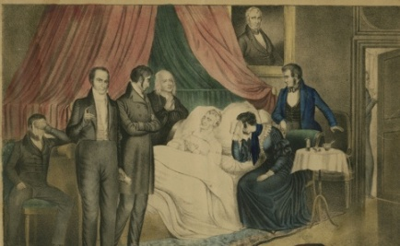
1836
He had a total nervous breakdown and for 6 months was bedridden.
He sought to become Speaker of the State Legislature. He was defeated.
1840
He sought to become Elector. He was defeated.
1842
Marries Mary Todd. They have 4 boys but only one would live to maturity.

Slide 42
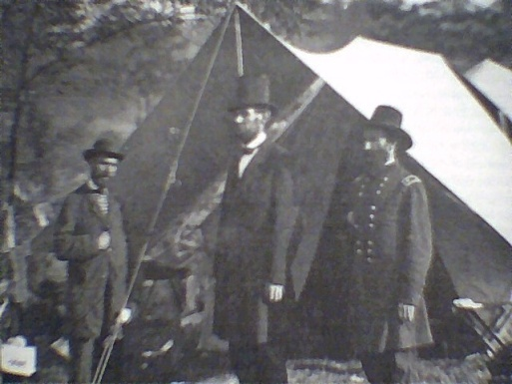

1843
He ran for Congress. He lost.
1846
He ran for Congress again. He won and moved to Washington.
1848
He ran for re-election to Congress. He lost.

Slide 43
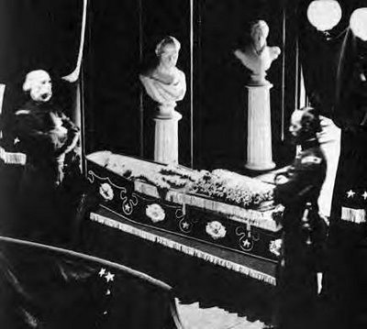
1849
He sought the job of Land Officer in his home state. He didn't get the job.
1850
His son, Edward, dies.
1854
He ran for the Senate of the United states. He lost.

Slide 44
1856
He sought the Vice Presidential nomination at a national convention. He got less than 100 votes.
1858
He ran for the Senate again. He lost again
1860
___________________________________

Slide 45
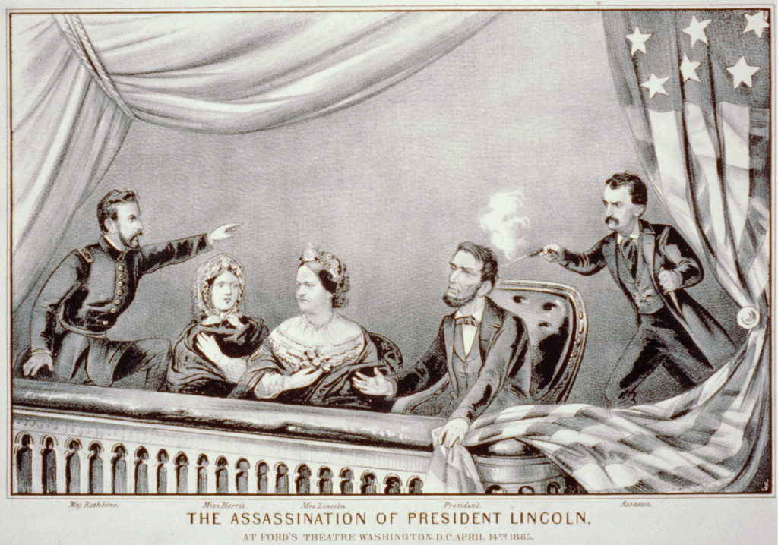
1862
His son, Willie, dies at age 12.
1865
On April 14, He is assassinated.

Slide 46
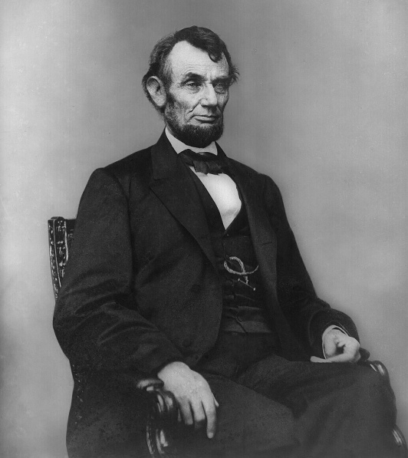
I bet 90% of you would have still not been to guess. Who is “HE”?
In 1860 :-
He won presidential elections in America,
Mr. Abraham Lincoln.

Slide 47
Now compare your story with his, and tell me which year you would have said
“I QUIT”.
President of America :
practically considered the president of World and the most powerful man on earth.
This time when Mr. Obama was in India, we all were fascinated by the food that he ate, clothes he worn, his cars, his airplanes, his helicopters and etc.

Slide 48
We all want to be in the same place.
We all fell for his way of life.
We think being a president is out of this world, and he is no normal human being.

Slide 49
MORAL :-
Normal people doing normal things with not abnormal passion and attitude make it to the place

Slide 50
SESSION E
WORLD HAS ALWAYS BEEN AGAINST THEM!
George Lucas
George Lucas spent 4 years shipping the script for Star Wars around to the various studios and facing numerous rejections in the process.
If he'd let his negative inner voice get to him he would never have ended up having the highest grossing film of all time.

Slide 51
Beethoven
Beethoven's music teacher told him he was a “hopeless composer.”
Beethoven continued to try other music teachers, but they also gave up on him.
Today he is acknowledged as one of the giants of classical music

Slide 52
Colonel Sanders
American entrepreneur who founded Kentucky Fried Chicken also known as KFC..
He was told "No" by over a thousand restaurants for more than a year while he lived in his car trying to sell his chicken recipe.

Slide 53
Tommy
At age of 4 :-
He was sent home from school with a note it read “Your tommy is addled”.
His mother homeschooled him.
Years later Tommy became Thomas Edison known as one of the most prolific inventors in history holding 1,093 U.S. patents.

Slide 54
Walt Disney
Walt Disney:-
turned down by over a hundred banks when he tried to get funding to develop Disneyland.
He was also fired from his job at a newspaper for "lacking ideas".
He also had several bankruptcies before he was able to develop Disneyland.

Slide 55
MORAL :-
World is full of people who will shove you, crush you, chuck you, abandon you. Either you will turn back or turn them back.

