Slide 1

Be the best presenter of your office.
Rajat Mohan
B.Com(H),ACA, ACS, DISA

Slide 2
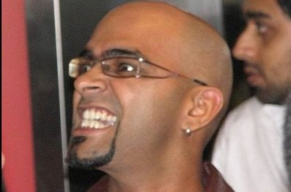
FEAR

Slide 3
FEAR
Survey in 1973
ESCALATOR ELEVATOR DARKNESS
DRIVING IN THE CAR DOGS LONLINESS
SICKNESS DEEP WATER FINANCIAL PROBLEM
INSECTS HEIGHTS FLYING

Slide 4
FEAR
DEATH
SPEAKING BEFORE A GROUP
18.7
40.6

Slide 5
How to boost your confidence.
Start by asking questions.
Deep breathing.
Don't Memorize.
COOL
Find a Friend – Shift the focus.
Somebody chose u because he knows ‘Only you can do it’.

Slide 6
Confident MAN.

Slide 7
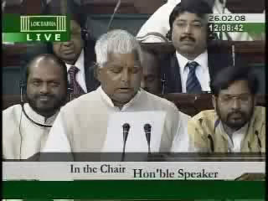

Slide 8
WHY???

Slide 9
WHY?
WHY should I waste my time with you?
WHY should I pay you?
WHY should I not sleep in class?
WHY can’t I do it on my own?

Slide 10
Why?
Board Meetings
Training
Pitching for business
Seminars/ Investor Presentations
Addressing social gatherings

Slide 11
When to enter?

Slide 12
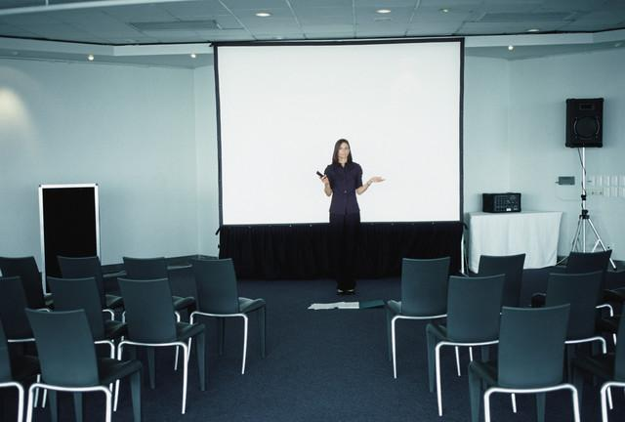
Entry of the Presenter
Option 1 - Audience enter the hall with the presenter awaiting them.

Slide 13
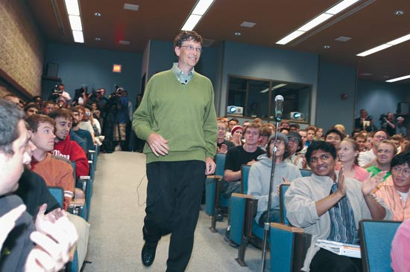
Entry of the Presenter
Option 2 - Presenter makes an entry when the audience is settled.

Slide 14
Which option do you consider better?

Slide 15
Lets see now.
Training session to students.
Board Meeting/Presentation to your Boss(MD).
Marketing
  Insurance selling AGENT.
  Bill Gates marketing WINDOWS.

Slide 16
You have 1 minute.

Slide 17
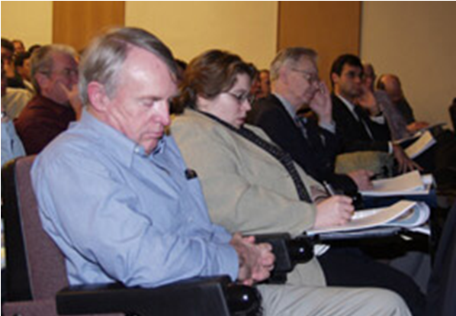

Slide 18
In first 1 minute-
Audience decides to
Hear you
Fear you
Leave You
GIVE THEM. - -- - - - - - - -
    WHY
    First few sentences should be well-rehearsed
    Hook them.
    Provide an outline

Slide 19
SIMPLE

Slide 20
Simple
"Simplicity is the ultimate sophistication.“
-- Leonardo da Vinci
Make things EASY.

Slide 21
GIVE MEANING TO NUMBERS.

Slide 22

GIVE MEANING TO NUMBERS.
Selling – MP3 player – 12 Gigabyte.

Slide 23
GIVE MEANING TO NUMBERS.
Knowledge based - New Schedule VI – Only 2 pages of BS & P & L.
It took u 10 days to prepare a 20 pages of BS & P & L
Now it will take you 1 DAY. You can save 9 days.

Slide 24
Pictures or TEXT

Slide 25
Raj Malhotra and Simran Singh are young first generation British Indians brought up and living in London. Raj is the only child of wealthy widower Dharamvir Malhotra, who spoils his son excessively. Raj is a free-wheeling party boy, who is the first student at his tertiary institution to fail. Simran is the elder daughter of petrol station/convenience store owner Chaudhry Baldev Singh, a very socially conservative Punjabi Indian man whose only dream is to one day go back to his native Punjab.
One day a letter comes from Ajit, Baldev's best friend in India, saying that his son, Kuljeet, and Baldev's daughter, Simran, should marry each other, in accordance with a promise the two fathers had made to each other when their children were infants. Simran agrees to marry him out of respect for her father, but before the wedding, she begs her father to allow her to go on a trip to Europe with her female friends; her last chance to see the world before her marriage to a complete stranger and relocation to India. Even though he is very strict, Baldev relents and permits her to go, on the condition that she promises never to betray his trust. He says that he is allowing Simran to go as she has always respected and obeyed him.
During the trip, Simran bumps into Raj, who is on the same Eurorail package tour with some friends. After some initial misadventures, mainly due to disrespectful and raucous behaviour on the part of Raj, he falls in love with Simran. Only after sometime at their moment of parting at the railway station in London does Simran realize that she too has fallen in love with Raj.
Simran goes home and tells her mother that she loves someone else and cannot go through with her wedding to Kuljeet. Baldev overhears their conversation, and is furious that Simran broke her promise that she would never betray his trust. He is adamant that she will marry Kuljeet as planned, and that her heartbreak is of her own doing, and they will leave for India as soon as possible.

Slide 26
Even though Simran does not want to marry Kuljeet, her family returns to Punjab. As it turns out, Kuljeet is an arrogant alpha male who takes pride in being a hunter and boasts to his macho friends that he will engage in marital infidelity. Lajo tries to spare her daughter's feelings, but cannot stand up to her domineering husband. Both Simran and her sister Chutki are completely unimpressed with Kuljeet and his brash friends.
Raj, however, does not give up so easily. He follows Simran to Punjab at the urging of his bold father, meets her privately, and assures her that he will save her from the arranged marriage, and marry her with the consent of her father. Raj befriends Kuljeet and pretends to be a friend of the family. He helps with the wedding preparations and soon gains everyone's friendship.
Simran's mom, Lajo catches Simran and Raj feeding each other and realizes that Raj is the boy that Simran met on her trip. She calls them both and gives all her jewelry and belongings and tells Raj to run away with Simran because no one will understand their love here. Raj tells Lajo that everything will be fine and that he will only take Simran if her dad Baldev says so.
However, everything comes crashing down when Baldev sees a photograph of Raj and Simran together when they were on their trip across Europe. He exposes Raj's true identity in front of everybody, slaps him repeatedly, and angrily tells him to leave immediately, as Simran will marry Kuljeet regardless of what anybody thinks. As Raj leaves and is sitting at the railway station, Kuljeet and his friends follow him and nearly beat him senseless with sticks for his deception. When they also attack his father, Raj is rejuvenated and flies into a rage and single-handedly beats Kuljeet and his friends. Baldev and Ajit arrive, stop Raj, and tell him and his father to go on their way. Raj and his father board a train out of the village. However, as the train begins to pull out of the station, all the females in the family arrive. Simran tries to follow, and is stopped by Baldev. She begs him to let her go, and he eventually comes to his senses and realizes that no one will ever love his daughter as much as Raj does. He tells Simran to join Raj on the train, and she enthusiastically does so.

Slide 27


Slide 28
Section 5. Definition of subsidiary and holding company.
(1) For the purposes of this Act, a corporation shall, subject to subsection (3), be deemed to be a subsidiary of another corporation, if—
(a) that other corporation—
(i) controls the composition of the board of directors of the first-mentioned corporation;
(ii) controls more than half of the voting power of the first-mentioned corporation; or
(iii) holds more than half of the issued share capital of the first-mentioned corporation (excluding any part thereof which consists of preference shares);
(b) the first-mentioned corporation is a subsidiary of any corporation which is that other corporation's subsidiary.
(2) For the purposes of subsection (1), the composition of a corporation's board of directors shall be deemed to be controlled by another corporation if that other corporation by the exercise of some power exercisable by it without the consent or concurrence of any other person can appoint or remove all or a majority of the directors, and for the purposes of this provision that other corporation shall be deemed to have power to make such an appointment if—
3) In determining whether one corporation is a subsidiary of another corporation—
(a) any shares held or power exercisable by that other corporation in a fiduciary capacity shall be treated as not held or exercisable by it;
(b) subject to paragraphs (c) and (d), any shares held or power exercisable—
by any person as a nominee for that other corporation (except where that
other corporation is concerned only in a fiduciary capacity)
(ii) by, or by a nominee for, a subsidiary of that other corporation, not being a subsidiary which is concerned only in a fiduciary capacity, shall be treated as held or exercisable by that other corporation;

Slide 29
PICTURE AND VIDEOS : Work better than TEXT
H
Holds
51% of ESC
S

Slide 30
PICTURE AND VIDEOS : Work better than TEXT
H
Holds
More than HALF Voting power
S

Slide 31
PICTURE AND VIDEOS : Work better than TEXT
H
Controls
Board of directors
S

Slide 32
Dress code

Slide 33
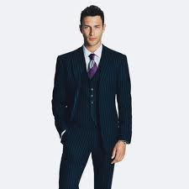

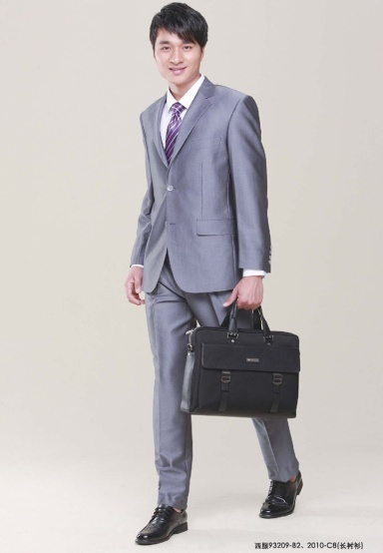
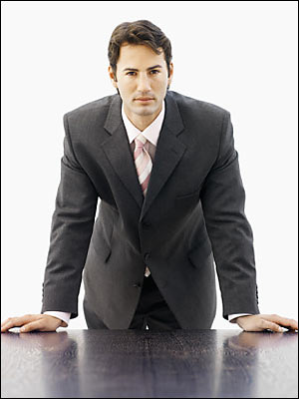
Dress Code
Suit – Better

Slide 34
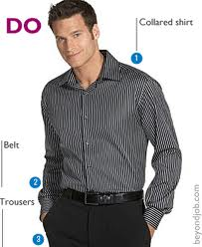
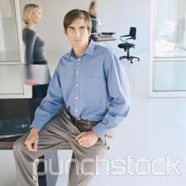
Dress Code
Shirt & trouser –works ok

Slide 35
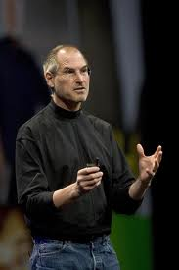
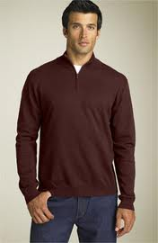
Dress Code
Casuals –not an appropriate

Slide 36
EYE contact

Slide 37
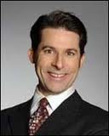
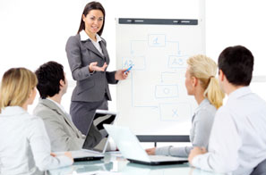
Eye Contact
DO’s

Slide 38
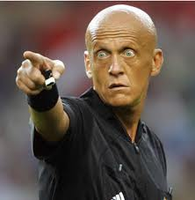
Eye Contact
DON’Ts

Slide 39
Headings

Slide 40
Twitter headlines
140 Characters.

Slide 41
Standing postures

Slide 42
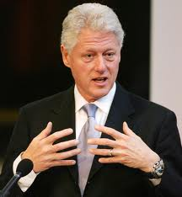
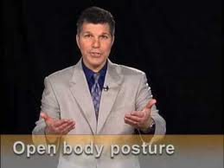
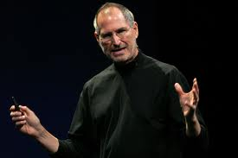
Standing postures
Do’s

Slide 43
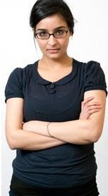
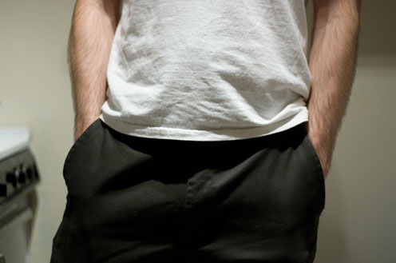
Standing postures
Don'ts

Slide 44
gestures

Slide 45
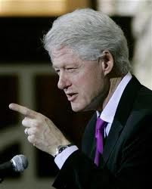
Gestures
Gestures –Hand and arm gestures are used to emphasize, point, reject, describe.
Avoid continuous gestures
Bill Clinton pointing finger.

Slide 46
Some more

Slide 47
Let them grab it.
Pause
Slow is better than fast – Tortoise is better than rabbit.

Slide 48


Slide 49
Limit the information
Max. 3

Slide 50
Miscellaneous

Slide 51
Comfort your audience
Chairs.
AC
Lighting.
Breaks
All appropriate.

Slide 52
Verbal
Short Sentences
Simple.
Don’t use abusive word’s
Correct grammar
Avoid Jargons

Slide 53
Vocal
Pitch / Tone Monotone
Voice Modulation
Speed.
Pause…take a break
Volume .
Vocal quality –Clarity
Pronunciation

Slide 54
Visual
Posture - Erect, straight, unbending
Slow Movements. Don’t move very fast.
Facial Expressions Smile / laugh
Eye contact
Don’t look tired.

Slide 55
What to do if someone asks me Questions?

Slide 56
Answering Do’s
Don’t allow questions in between of continuing topics – Allow a questions as soon as topic is finished.
Acknowledge the question
Listen for both content and intent
Ask for clarification
Answer clearly and briefly
Support with evidences and data (if possible).
You can say “I need to check this!”

Slide 57
Answering Don’ts
Don’t argue with anyone
Don’t allow one person to keep asking
Don’t say, “Anyone should know the answer of that”.

Slide 58
Content
Content is must.

Slide 59
Rehearse
Oefen , Vježbati, Répéter , Proben
Repeteren, Provare, Репетировать, odbywać próby , Cleachtadh, berlatih, repeta, oefen, përsëris,
Repitisiya etmək, рэпетаваць, репетирам, assajar ,
vježbati, nacvičovat, øve, magsanay,
kerrata, ensaiar , πρόβες , resite ,
अभ्यास करना, próbál , æfa, リハーサルをする,
Recensere ,Iestudēt, MEDITOR, Iestudēt ,
Repetuoti, Berlatih, ОТРЕПЕТИРУЙТЕ, Пробати,
Nacvičovať, ENSAYO , Mazoezi, ÖVA,
Prova yapmak , Відрепетируйте, Kể lại , Ymarfer

Slide 60

THANK YOU
WWW.FACEBOOK.COM/CA.RAJAT MOHAN
CA. Rajat Mohan
B.Com(H), ACA, ACS, DISA
MOHAN AGGARWAL & ASSOCIATES
Chartered Accountants
Head Office
18A, IInd Floor, North Avenue Road, West Punjabi Bagh, New Delhi-110026
office Phone: 011-47322696/97
Website: www.delhicamohan.com
E-mail: rajat.mohan@icai.org

