Slide 1

The Institute of Chartered Accountants of India
ITT (Information Technology Training)
Project on Internet
Prepared by: Wasi Khan
Mail: cawasi@yahoo.com
Call: 9027384087
By:
Reg.

Slide 2

Acknowledgement
First of all I thanks to the almighty for giving me the courage and confidence to successfully complete this project. Thereafter I thanks to my parents for providing me encouragement and support during my learning period. I also convey my thanks to our instructor (………NAME………….) for guiding me and solving all the curiosities and doubts which arose during the period of ITT training. I’m also thankful to my fellow trainees for maintaining a cordial and friendly atmosphere during the period of training and making this training period a memorable one.
Going through the ITT training was a very pleasant and learning experience. Preparing this project was also a very exciting and adventurous experience for me, I made use of various search engines and visited numerous websites to collect information, besides referring to the study module provided by our esteemed Institute.

Slide 3
Introduction
Today's world is characterized by intensive use of information technology which has really transformed the way we human being communicate in our daily lives. Information technology in general and internet in particular has converted this world into a small village where distances have ceased to exist. The Internet grew out of an experiment in the 1960s by the U.S. Department of Defense. The DoD wanted to create a computer network that would continue to function in the event of a disaster, such as a nuclear war. If part of the network was damaged or destroyed, the rest of the system still had to work. That network was ARPANET, (Advanced Research Projects Agency Network) which linked U.S. scientific and academic researchers. It was the forerunner of today's Internet.

Slide 4

What is Internet?
The Internet is a global system of interconnected computer networks that use the standard Internet Protocol Suite (TCP/IP) to serve billions of users worldwide. It is a network of networks that consists of millions of private, public, academic, business, and government networks of local to global scope that are linked by a broad array of electronic and optical networking technologies. The Internet carries a vast array of information resources and services, most notably the inter-linked hypertext documents of the World Wide Web (WWW) and the infrastructure to support electronic mail.
Most traditional communications media, such as telephone and television services, are reshaped or redefined using the technologies of the Internet, giving rise to services such as Voice over Internet Protocol (VoIP) and IPTV. Newspaper publishing has been reshaped into Web sites, blogging, and web feeds. The Internet has enabled or accelerated the creation of new forms of human interactions through instant messaging, Internet forums, and social networking sites.

Slide 5

Origin of internet
The origin of the Internet dates back to the 1960s when the United States funded research projects of its military agencies to build robust, fault-tolerant and distributed computer networks. This research and a period of civilian funding of a new U.S. backbone by the National Science Foundation spawned worldwide participation in the development of new networking technologies and led to the commercialization of an international network in the mid 1990s, and resulted in the following popularization of countless applications in virtually every aspect of modern human life. As of 2009, an estimated quarter of Earth's population uses the services of the Internet.
The Internet has no centralized governance in either technological implementation or policies for access and usage; each constituent network sets its own standards. Only the overreaching definitions of the two principal name spaces in the Internet, the Internet Protocol address space and the Domain Name System, are directed by a maintainer organization, the Internet Corporation for Assigned Names and Numbers (ICANN). The technical underpinning and standardization of the core protocols (IPv4 and IPv6) is an activity of the Internet Engineering Task Force (IETF), a non-profit organization of loosely affiliated international participants that anyone may associate with by contributing technical expertise.

Slide 6


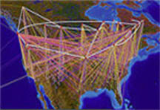
A Brief Summary of the
Evolution of the Internet
Age of
eCommerce
Begins
1995
Mosaic
Created
1993
WWW
Created
1989
Internet
Named
and
Goes
TCP/IP
1984
TCP/IP
Created
1972
ARPANET
1969
Hypertext
Invented
1965
Packet
Switching
Invented
1964
First Vast
Computer
Network
Envisioned
1962
Silicon
Chip
1958
A
Mathematical
Theory of
Communication
1948
Memex
Conceived
1945
1945
1995
Copyright 2002, William F. Slater, III, Chicago, IL, USA

Slide 7

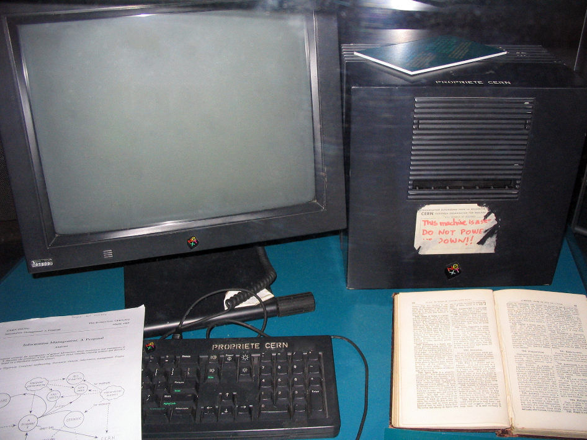
Break-through in internet Technology
Although the basic applications and guidelines that make the Internet possible had existed for almost two decades, the network did not gain a public face until the 1990s. On 6 August 1991, CERN, a pan European organization for particle research, publicized the new World Wide Web project. The Web was invented by British scientist Tim Berners-Lee in 1989. An early popular web browser was ViolaWWW, patterned after HyperCard and built using the X Window System. It was eventually replaced in popularity by the Mosaic web browser. In 1993, the National Center for Supercomputing Applications at the University of Illinois released version 1.0 of Mosaic, and by late 1994 there was growing public interest in the previously academic, technical Internet. By 1996 usage of the word Internet had become commonplace, and consequently, so had its use as a synecdoche in reference to the World Wide Web.
This NeXT Computer was used by Sir Tim Berners-Lee at CERN and became the world's first Web server.

Slide 8


Tim Berners-Lee
The inventor of HTML. Graduate of Oxford University, England, Tim is now with the Laboratory for Computer Science ( LCS)at the Massachusetts Institute of Technology ( MIT).
He directs the W3 Consortium, an open forum of companies and organizations with the mission to realize the full potential of the Web.
With a background of system design in real-time communications and text processing software development, in 1989 he invented the World Wide Web, an internet-based hypermedia initiative for global information sharing. while working at CERN, the European Particle Physics Laboratory.
Before coming to CERN, Tim was a founding director of Image Computer Systems, and before that a principal engineer with Plessey Telecommunications, in Poole, England.

Slide 9
Internet Protocols
The most prominent component of the Internet model is the Internet Protocol (IP) which provides addressing systems (IP addresses) for computers on the Internet. IP enables internetworking and essentially establishes the Internet itself. IP Version 4 (IPv4) is the initial version used on the first generation of the today's Internet and is still in dominant use. It was designed to address up to ~4.3 billion (10⁹) Internet hosts. However, the explosive growth of the Internet has led to IPv4 address exhaustion which is estimated to enter its final stage in approximately 2011.A new protocol version, IPv6, was developed in the mid 1990s which provides vastly larger addressing capabilities and more efficient routing of Internet traffic. IPv6 is currently in commercial deployment phase around the world and Internet address registries (RIRs) have begun to urge all resource managers to plan rapid adoption and conversion.
IPv6 is not interoperable with IPv4. It essentially establishes a "parallel" version of the Internet not directly accessible with IPv4 software. This means software upgrades or translator facilities are necessary for every networking device that needs to communicate on the IPv6 Internet.

Slide 10

Modern Uses of Internet
The Internet is allowing greater flexibility in working hours and location, especially with the spread of unmetered high-speed connections and web applications.
The Internet can now be accessed almost anywhere by numerous means, especially through mobile Internet devices. Mobile phones, data cards, handheld game consoles and cellular routers allow users to connect to the Internet from anywhere there is a wireless network supporting that device's technology. Within the limitations imposed by small screens and other limited facilities of such pocket-sized devices, services of the Internet, including email and the web, may be available. Service providers may restrict the services offered and wireless data transmission charges may be significantly higher than other access methods.

Slide 11
Internet Structure
The Internet structure and its usage characteristics have been studied extensively. It has been determined that both the Internet IP routing structure and hypertext links of the World Wide Web are examples of scale-free networks. Similar to the way the commercial Internet providers connect via Internet exchange points, research networks tend to interconnect into large sub networks such as GEANT, GLORIAD, Internet2 (successor of the Abilene Network), and the UK's national research and education network JANET. These in turn are built around smaller networks (see also the list of academic computer network organizations).
Many computer scientists describe the Internet as a "prime example of a large-scale, highly engineered, yet highly complex system". The Internet is extremely heterogeneous; for instance, data transfer rates and physical characteristics of connections vary widely. The Internet exhibits "emergent phenomena" that depend on its large-scale organization.

Slide 12
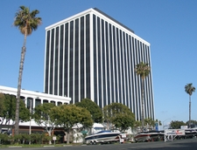
Internet Governance
The Internet is a globally distributed network comprising many voluntarily interconnected autonomous networks. It operates without a central governing body. However, to maintain interoperability, all technical and policy aspects of the underlying core infrastructure and the principal name spaces are administered by the Internet Corporation for Assigned Names and Numbers (ICANN), headquartered in Marina del Rey, California. ICANN is the authority that coordinates the assignment of unique identifiers for use on the Internet, including domain names, Internet Protocol (IP) addresses, application port numbers in the transport protocols, and many other parameters.
ICANN headquarters in Marina Del Rey, California, United States.

Slide 13
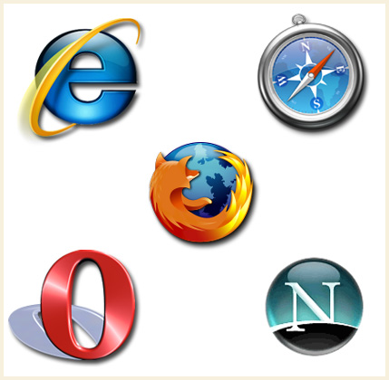
World Wide Web

Slide 14

What is World Wide Web?
The World Wide Web is a global set of documents, images and other resources, logically interrelated by hyperlinks and referenced with Uniform Resource Identifiers (URIs). URIs allow providers to symbolically identify services and clients to locate and address web servers, file servers, and other databases that store documents and provide resources and access them using the Hypertext Transfer Protocol (HTTP), the primary carrier protocol of the Web. HTTP is only one of the hundreds of communication protocols used on the Internet. Web services may also use HTTP to allow software systems to communicate in order to share and exchange business logic and data.

Slide 15
Web Pages
A web page or webpage is a document or resource of information that is suitable for the World Wide Web and can be accessed through a web browser and displayed on a monitor or mobile device.
This information is usually in HTML or XHTML format, and may provide navigation to other web pages via hypertext links.
Web pages may be retrieved from a local computer or from a remote web server. The web server may restrict access only to a private network, e.g. a corporate intranet, or it may publish pages on the World Wide Web. Web pages are requested and served from web servers using Hypertext Transfer Protocol (HTTP)

Slide 16
Color, typography, illustrations and interaction
Web pages usually include information as to the colors of text and backgrounds and very often also contain links to images and sometimes other media to be included in the final view. Layout, typographic and color-scheme information is provided by Cascading Style Sheet (CSS) instructions, which can either be embedded in the HTML or can be provided by a separate file, which is referenced from within the HTML. The latter case is especially relevant where one lengthy style sheet is relevant to a whole website: due to the way HTTP works, the browser will only download it once from the web server and use the cached copy for the whole site. Images are stored on the web server as separate files, but again HTTP allows for the fact that once a webpage is downloaded to a browser, it is quite likely that related files such as images and style sheets will be requested as it is processed. An HTTP 1.1 web server will maintain a connection with the browser until all related resources have been requested and provided. Web browsers usually render images along with the text and other material on the displayed webpage.

Slide 17
Creating a Web Page
To create a webpage, a text editor or a specialized HTML editor is needed. In order to upload the created webpage to a web server, traditionally an FTP client is needed.
The design of a webpage is highly personal. A design can be made according to one's own preference, or a premade web template can be used. Web templates let webpage designers edit the content of a webpage without having to worry about the overall aesthetics. Many people publish their own web pages using products like Geocities from Yahoo, Tripod, or Angelfire. These web publishing tools offer free page creation and hosting up to a certain size limit.
Other ways of making a webpage is to download specialized software, like a Wiki, CMS, or forum. These options allow for quick and easy creation of a webpage which is typically dynamic.

Slide 18
Elements of Web Pages
A webpage, as an information set, can contain numerous types of information, which is able to be seen, heard or interact by the end user:
Perceived (rendered) information: Textual information: with diverse render variations.
Non-textual information:
  Static images on raster graphics, typically GIF, JPEG or
  PNG; or vector formats as SVG or Flash.
  Animated images typically Animated GIF and SVG,
  Audio, typically MIDI or WAV formats or Java applets.
  Video, WMV (Windows), RM (Real Media),
  FLV (Flash Video), MPG, MOV (QuickTime)

Slide 19
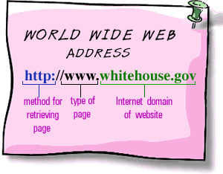
URL (Uniform Resource locator)
Typically, web pages today are becoming more dynamic. A dynamic webpage is one that is created server-side when it is requested, and then served to the end-user. These types of web pages typically do not have a permalink, or a static URL, associated with them. Today, this can be seen in many popular forums, online shopping, and even on Wikipedia. This practice is intended to reduce the amount of static pages in lieu of storing the relevant webpage information in a database. Some search engines may have a hard time indexing a webpage that is dynamic, so static web pages can be provided in those instances.

Slide 20
Domain Names
A domain name is an identification label that defines a realm of administrative autonomy, authority, or control on the Internet, based on the Domain Name System (DNS).
Domain names are used in various networking contexts and application-specific naming and addressing purposes. They are organized in subordinate levels (subdomains) of the DNS root domain, which is nameless. The first-level set of domain names are the top-level domains (TLDs), including the generic top-level domains (gTLDs), such as the prominent domains com, net and org, and the country code top-level domains (ccTLDs). Below these top-level domains in the DNS hierarchy are the second-level and third-level domain names that are typically open for reservation by end-users that wish to connect local area networks to the Internet, run web sites, or create other publicly accessible Internet resources. The registration of these domain names is usually administered by domain name registrars who sell their services to the public.

Slide 21
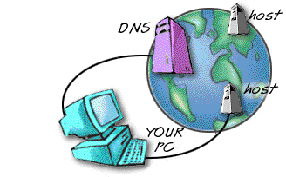
Domain Names

Slide 22
Structure of a Domain Name
Domain name has two or more parts separated by dots and consists of some form of an organization's name and a three letter or more suffix. For example, the domain name for IBM is "ibm.com"; the United Nations is "un.org." The domain name suffix is known as a generic top-level domain (gTLD). It describes the type of organization.
Currently in use gTLDs:
.aero --For the air-transport industry
.biz -- Reserved for businesses
.com --For businesses, commercial enterprises
.edu --For educational institutions and universities
.gov --Reserved for United States government agencies
.info --For all uses
.mil --For the United States military
.net –For networks; usually reserved for organizations such
as Internet service providers
.org--For non-commercial organizations

Slide 23
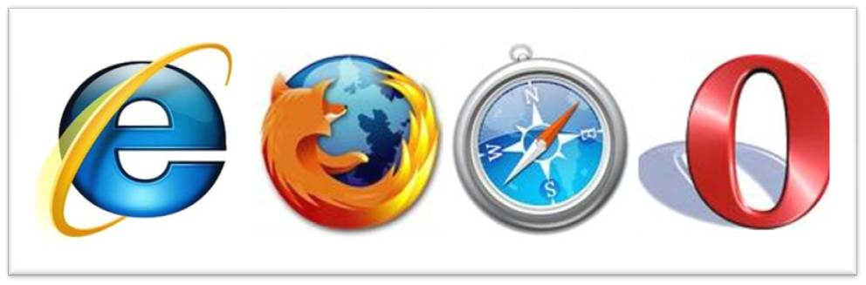
Web Browsers
World Wide Web browser software, such as Microsoft's Internet Explorer, Mozilla Firefox, Opera, Apple's Safari, and Google Chrome, let users navigate from one web page to another via hyperlinks embedded in the documents. These documents may also contain any combination of computer data, including graphics, sounds, text, video, multimedia and interactive content including games, office applications and scientific demonstrations. Through keyword-driven Internet research using search engines like Yahoo! and Google, users worldwide have easy, instant access to a vast and diverse amount of online information. Compared to printed encyclopedias and traditional libraries, the World Wide Web has enabled the decentralization of information.

Slide 24
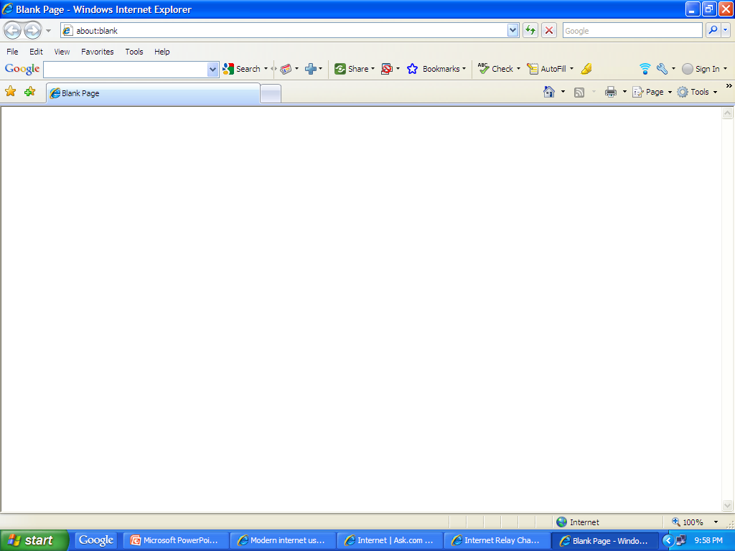
How Does a Web Browser Looks Like
c
This is the upper part of the web browser internet explorer, it has an address bar where we enters the address of the website we want to visit. Except this it has many control buttons, like backward, forward, refresh, stop and many other tools and settings which the user can configure as per its requirements.

Slide 25
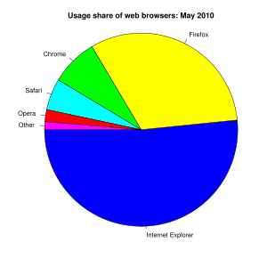
Pie Chart Showing Uses Share of Web Browsers
The usage share of web browsers
Internet Explorer (50.53%; Usage by version number)
Mozilla Firefox (31.26%; Usage by version number)
Google Chrome (7.72%)
Safari (5.15%)
Opera (1.98%)
Other (1.30%)

Slide 26

Internet Services

Slide 27

Other Services
E-Commerce
Search
E-Mail
Key Internet Services

Slide 28
E-Mail
Electronic mail is an increasingly utilized technology, which has become primary means of communication for many organisations and individuals. Electronic mail on the internet provides quick, cost-effective transfer of messages to other E-mail users worldwide. This is probably one of the fastest and most convenient way of communication.
Types of Mail Services
SMTP: The SMTP server is the mail sending server. It receives mail from a local server and forwards it to the mail server for the user we are sending the mail to.
POP: The POP server is the server we connect to get our mail. We identify to the server with a username and password and it sends us the messages.
IMAP: IMAP is another server that we connect to, to receive mail, similar to POP server. The difference is that with an IMAP, all messages stay on the server unless specifically deleted by us.

Slide 29

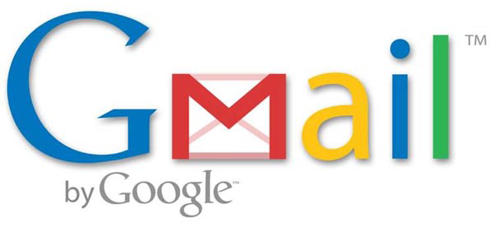

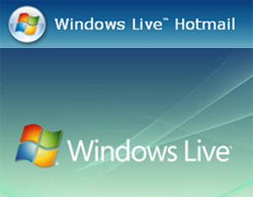

Some Free E-Mail Services

Slide 30

Some Free E-mail Services
Gmail is a free email and chat service provided by Google. Gmail has got a very simple user interface yet it is very smart. It provides practically huge free online storage which allows the user to collect and arrange all their messages.
Aol mail service is a web based service offered by AOL. It offers unlimited online storage clubbed with a very good spam protection and a rich with easy to use interface.
Windows Live Hotmail is a faster and more secure free email service provided by Microsoft. It gives 5 GB of online storage, faster search, solid security, POP access and an interface easy as a desktop email programme.
Yahoo! Mail is a free email service provided by Yahoo!. For a user it is ubiquitous email programme on the web and mobile devices with unlimited storage. It provides SMS texting instant messaging.

Slide 31
Web Search Engine
Web search engines are used extensively to collect various information from internet. Through a search engine we can get information on any subject in just a click. A web search engine is designed to search for information on the World Wide Web. The search results are usually presented in a list of results and are commonly called hits. The information may consist of web pages, images, information and other types of files. Some search engines also mine data available in databases or open directories. Unlike Web directories, which are maintained by human editors, search engines operate algorithmically or are a mixture of algorithmic and human input.

Slide 32
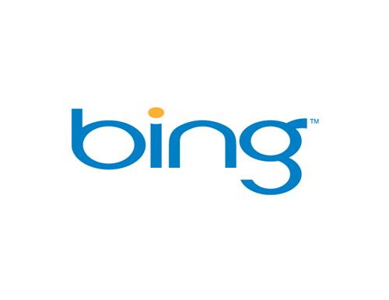
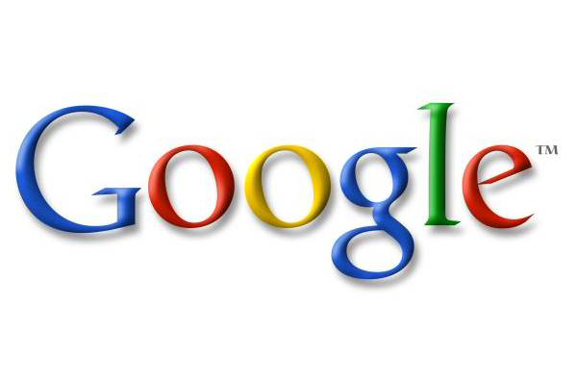




Some Popular Search Engines

Slide 33

How Web Search Engines Work
A search engine operates, in the following order
1. Web crawling
2. Indexing
3. Searching
Web search engines work by storing information about many web pages, which they retrieve from the html itself. These pages are retrieved by a Web crawler (sometimes also known as a spider) — an automated Web browser which follows every link on the site. Exclusions can be made by the use of robots.txt. The contents of each page are then analyzed to determine how it should be indexed (for example, words are extracted from the titles, headings, or special fields called meta tags). Data about web pages are stored in an index database for use in later queries. A query can be a single word. The purpose of an index is to allow information to be found as quickly as possible. Some search engines, such as Google, store all or part of the source page (referred to as a cache) as well as information about the web pages, whereas others, such as AltaVista, store every word of every page they find.

Slide 34
How Web Search Engines Work
When a user enters a query into a search engine (typically by using key words), the engine examines its index and provides a listing of best-matching web pages according to its criteria, usually with a short summary containing the document's title and sometimes parts of the text. The index is built from the information stored with the data and the method by which the information is indexed. Unfortunately, there are currently no known public search engines that allow documents to be searched by date. Most search engines support the use of the Boolean operators AND, OR and NOT to further specify the search query. Boolean operators are for literal searches that allow the user to refine and extend the terms of the search. The engine looks for the words or phrases exactly as entered. Some search engines provide an advanced feature called proximity search which allows users to define the distance between keywords. There is also concept-based searching where the research involves using statistical analysis on pages containing the words or phrases you search for. As well, natural language queries allow the user to type a question in the same form one would ask it to a human. A site like this would be ask.com.

Slide 35
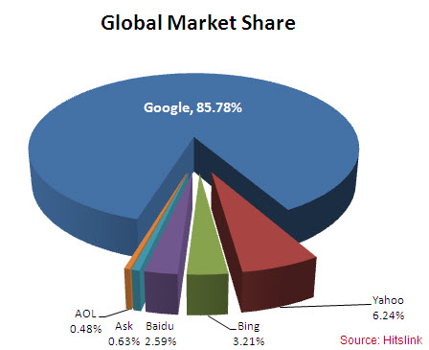
Chart Showing Global Market Share of Search Engines

Slide 36
E- Commerce
Electronic commerce, commonly known as e-commerce or eCommerce or e-business consists of the buying and selling of products or services over electronic systems such as the Internet and other computer networks. The amount of trade conducted electronically has grown extraordinarily with widespread Internet usage. The use of commerce is conducted in this way, spurring and drawing on innovations in electronic funds transfer, supply chain management, Internet marketing, online transaction processing, electronic data interchange (EDI), inventory management systems, and automated data collection systems. Modern electronic commerce typically uses the World Wide Web at least at some point in the transaction's lifecycle, although it can encompass a wider range of technologies such as e-mail as well.

Slide 37
How is the Internet relevant to e-commerce?
The Internet allows people from all over the world to get connected inexpensively and reliably. As a technical infrastructure, it is a global collection of networks, connected to share information using a common set of protocols.
Also, as a vast network of people and information the Internet is an enabler for e-commerce as it allows businesses to showcase and sell their products and services online and gives potential customers, prospects, and business partners access to information about these businesses and their products and services that would lead to purchase.
Before the Internet was utilized for commercial purposes, companies used private networks-such as the EDI or Electronic Data Interchange-to transact business with each other. That was the early form of e-commerce. However, installing and maintaining private networks was very expensive. With the Internet, e-commerce spread rapidly because of the lower costs involved and because the Internet is based on open standards.

Slide 38

Other Internet Services
Information
Communication
Data Transfer
Social Networking

Slide 39
Other Internet Services
Information: World Wide Web browser software, such as Microsoft's Internet Explorer, Mozilla Firefox, Opera, Apple's Safari, and Google Chrome, let users navigate from one web page to another via hyperlinks embedded in the documents. Through keyword-driven Internet research using search engines like Yahoo! and Google, users worldwide have easy, instant access to a vast and diverse amount of online information. The Web has also enabled individuals and organizations to publish ideas and information to a potentially large audience online at greatly reduced expense and time delay.
Communication: Internet telephony is another common communications service made possible by the creation of the Internet. VoIP stands for Voice-over-Internet Protocol, referring to the protocol that underlies all Internet communication. The idea began in the early 1990s with walkie-talkie-like voice applications for personal computers. VoIP can be free or cost much less than a traditional telephone call, especially over long distances and especially for those with always-on Internet connections such as cable or ADSL.

Slide 40
Other Internet Services
Data Transfer: File sharing is an example of transferring large amounts of data across the Internet. A computer file can be e-mailed to customers, colleagues and friends as an attachment. It can be uploaded to a website or FTP server for easy download by others. It can be put into a "shared location" or onto a file server for instant use by colleagues.
Social Networking: The Internet has enabled entirely new forms of social interaction, activities, and organizing, thanks to its basic features such as widespread usability and access. Social networking websites such as Facebook and MySpace have created a new form of socialization and interaction. Users of these sites are able to add a wide variety of information to their personal pages, to pursue common interests, and to connect with others. It is also possible to find a large circle of existing acquaintances, especially if a site allows users to represent themselves by their given names, and to allow communication among existing groups of people

Slide 41
Conclusion
We can observe that internet has really transformed the way we go about our daily lives and interacts. Internet is one of the most revolutionary discovery in the human history. It’s due to the internet that the whole world has turned into a small village and any information we want is just a click away. Today communication is fast, reliable and secure only due to internet. Internet has played key role in development of businesses and economies through E-commerce. Since the age of ARPANET internet has developed and grown tremendously. No other technology witnessed such an amazing growth. There will be new developments and inventions in the coming days making the internet more relevant and important for us.

Slide 42
Thanks

