Slide 1
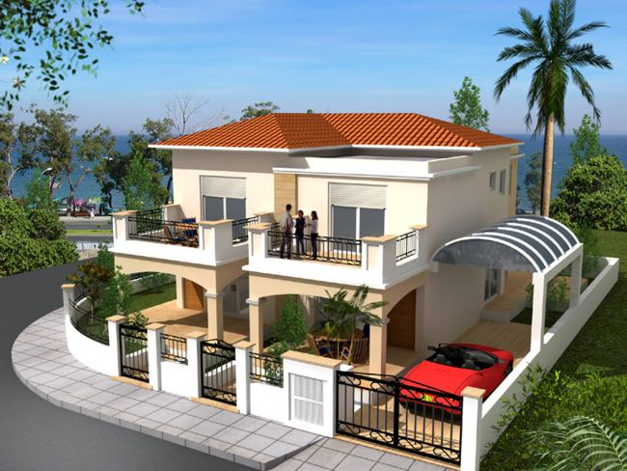
A PROJECT REPORT ON
“INCOME FROM HOUSE PROPERTY”
By .
VINIT JAIN
ERO0161104

Slide 2

THE INSTITUTE OF CHARTERED ACCOUNTANTS OF INDIA
(A STATUTORY BODY ESTABLISHED UNDER ACT OF PARLIAMENT)
BONAFIDE CERTIFICATE
This is to certify that the Project report titled
INCOME FROM HOUSE PROPERTY at the Jabalpur Branch Of The Institute Of Chartered Accountants of India has been made by MR. VINIT JAIN to fulfill the requirement of 100 Hours Information Technology Training Programme
CA AKHILESH JAIN
(Chairman)

Slide 3
ACKNOWLEDGEMENT
I would like to express my heartiest thanks to my instructors
Mr. Vishal Karanjikar (lecturer) Sir for their overwhelming support & valuable guidance towards the successful completion of my project. Sir , your painstaking help would always form a large chunk of my cherished memory with the institute.
I would like to express my sincere gratitude to
“The Institute Of ChaRtered Accountants Of India” for Organizing such training which help me in devloping my computer skills.
Finally , I wish to thanks my entire faculty & friends for directly & indirectly co-operating me to enable me to finish my project on time
VINIT JAIN
(ERO0161104)

Slide 4
INCOME FROM
HOUSE PROPERTY

Slide 5
contents
MEANING OF HOUSE PROPERTY AS PER [SEC.22].
INCOME NOT CHARGEABLE TO TAX UNDER THIS HEAD
SOME IMPORTANT TERMS.
TREATMENT OF GROSS ANNUAL VALUE.
TREATMENT OF LOAN.
CONCLUSION.
THANKING NOTE.

Slide 6
Introduction
As Per Income Tax Act,1961
Income from House Property’ is second head of income . Income of any building or land appurtenant thereto of which the assessee is the owner is chargeable to income tax under this head which is defined by Section 22.

Slide 7
MEANING OF HOUSE PROPERTY AS PER [SECTION.22]
Assessee should be the owner of the property.
2) Property should not be used by the owner for any business profession carried by him, the profit of which are chargeable.
3) Property should consist of any building or land appurtenant thereto.

Slide 8
  NOT CHARGEABLE TO TAX UNDER THIS HEAD
Income From Farm House [Sec.2(1a)(c) &Sec.10(1)];
Property Income Of A Local Authority[sec.10(20)];
Property Income Of An Approved Scientific Research Association[sec.10(21)];
Property Income Of Any Educational Institution And Hospital [Sec.10(23c)]

Slide 9
5. Property Income Of A Trade Union [Sec.10(24)];
6. House Property Held For Charitable Purposes [Sec.11];
7. House Property Income Of A Political Party[sec.13a];
8. Property Used For Own Business Or Profession [Sec.22];and
9. One Self-occupied Property[sec.23(2).
  NOT CHARGEABLE TO TAX UNDER THIS HEAD (contd.)

Slide 10
  SOME IMPORTANT TERMS
Muncipal Value(MV):-The annual rental value determined by Muncipal Corporation or local authority in their books.
Fair Rent(FR):-Fair rent means the rent which a similar property can fetch in a similar locality.
Rent received(RR):-Amount payable by Tenant in lieu to use of the property & services.
Standard Rent under Rent Control Act(SR):- The Maximum rent which a person can legally recover from his tenant & reasonable expected rent cannot exceed the standard rent (fixed or determinable) under rent control act.

Slide 11
SOME IMPORTANT TERMS (contd.)
Gross Annual Value(GAV):-Sum received from property might reasonable be expected to let out from year to year.
Tenant:- Person to whom the owner had let out his property in lieu of rent.
Subtenant:- Whom the owner let out his property to a person & he re-let the property to some other person .Income from that person is not taxable in this head.
Unrealized rent:-The rent which has not yet receive and in future there is no gurantee to be received.
Municipal tax:- Taxes which has to paid on property to local authorities ,taxes paid by tenant is not deductable.

Slide 12
TYPES OF HOUSE PROPERTIES
FULLY LET OUT HOUSE
FULLY SELF OCCUPIED PROPERTY
PARTLY LET OUT AND PARTLY SELF OCCUPIED
HOUSE PROPERTY USED IN OWN BUSINESS

Slide 13

FULLY SELF OCCUPIED HOUSE
When A Person Uses Only Single House For His Residential Purpose Is Treated As Self-occupied And All Other Houses Will Be “Deemed To Be Let Out”. Annual Value Of Self Occupied House Will Be Nil.

Slide 14
CALCULATION OF income from SELF OCCUPIED HOUSE PROPERTY
PARTICULARS | AMOUNT
GROSS ANNUAL VALUE | NIL
(-) INTEREST ON BORROWED CAPTIAL (PRE+ POST INTEREST) | (XXX)
INCOME/LOSS FROM INCOME PROPERTY | XXX

Slide 15
GROSS ANNUAL VALUE
CALCULATION OF GROSS ANNUAL VALUE-(LOP) | Amt.
STEP 1:- FAIR RENT OR MUNICIPAL VALUE WHICHEVER IS HIGHER | (a)
STEP 2:- (a) OR STANDARD RENT WHICHEVER IS LESS | (b)
STEP 3:- (b) OR (ACTUAL RENT-UNREALIZED RENT) WHICHEVER IS HIGHER | (c)
STEP 4:- (c) LESS: VACANCY ALLOWANCE | (d)
GROSS ANNUAL VALUE | XXX

Slide 16
Deduction u/s 24
Standard Deduction:-
This deduction is allowed in relation to the expenditure incurred in relation to repair , insurance premium , ground rent , land revenue etc.
  30% of net annual value.
  Nil in case net annual value is negative.
  Calculation of house property

Slide 17
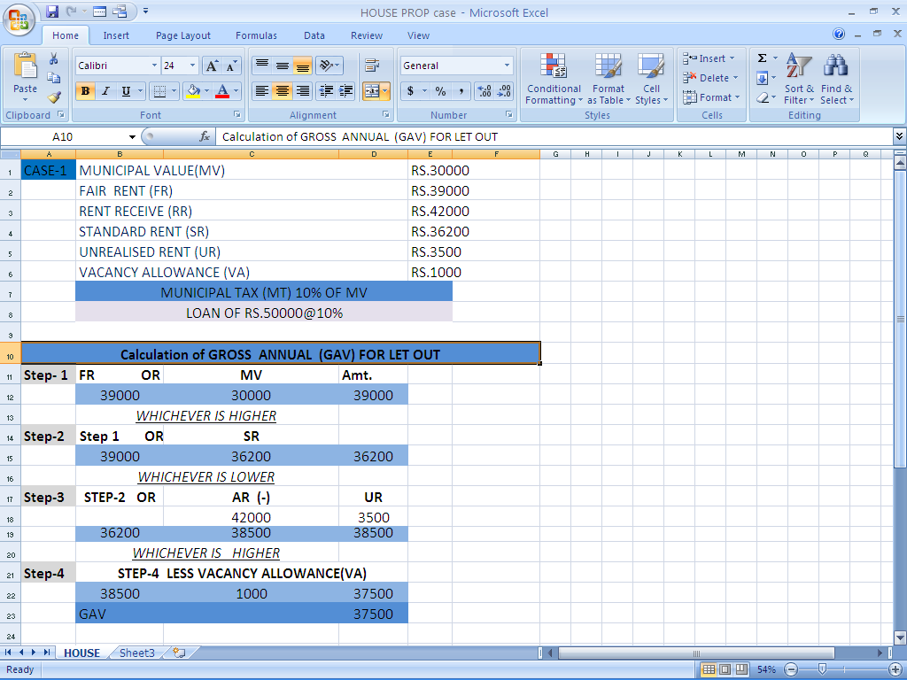

Slide 18
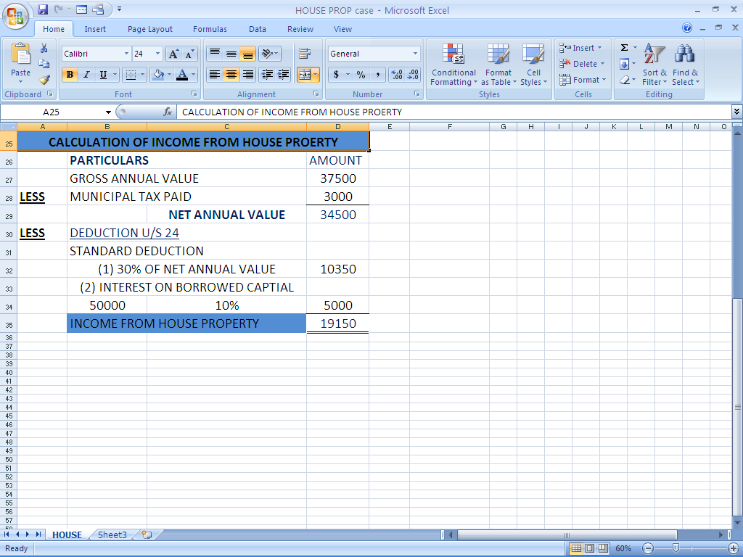

Slide 19
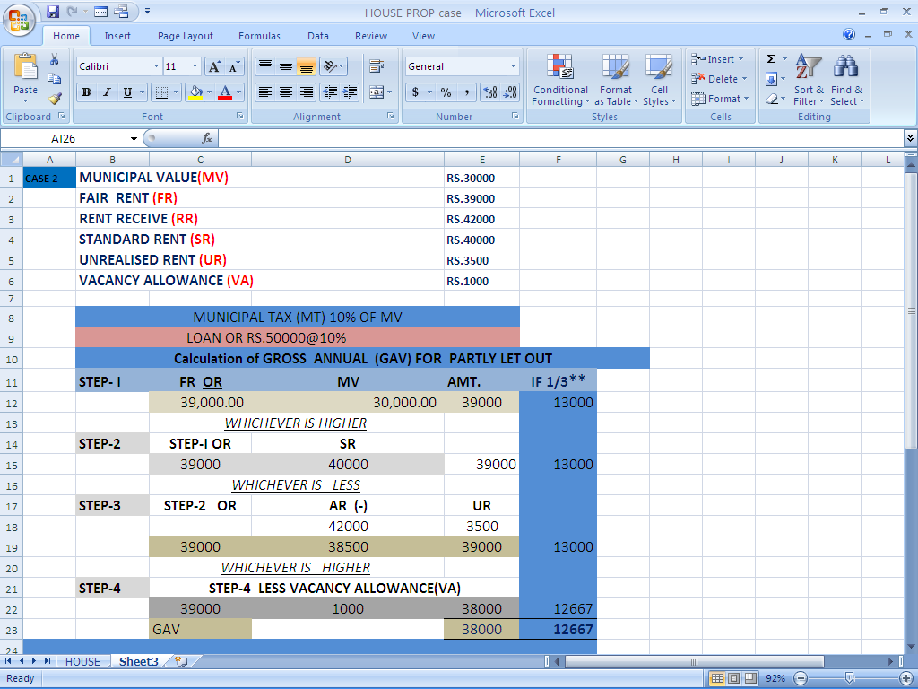

Slide 20
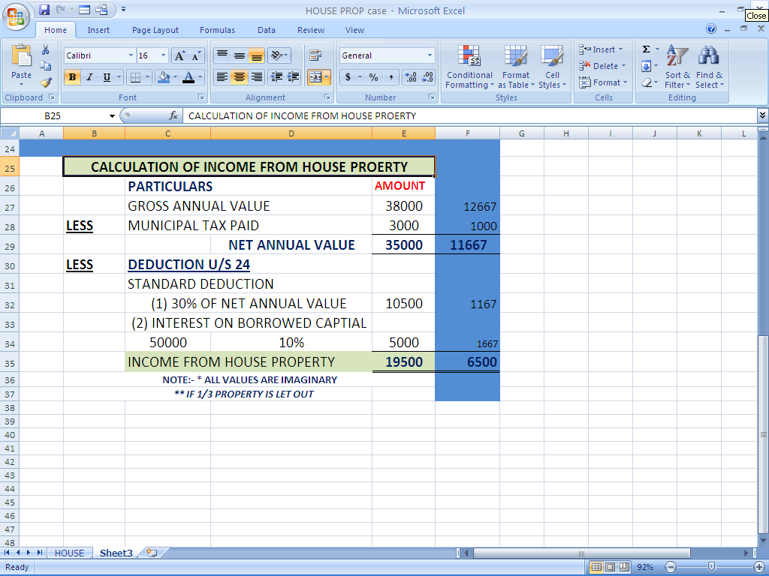

Slide 21
Section 25
( amounts not deductible)
Interest paid outside India without TDS or Without having an arrangement for TDS in India is disallowed.

Slide 22
Section 25A
( Unrealized rent recovered)
UR recovered is taxed in the year of receipt irrespective of whether assessee is the owner or not of such property in the year of such receipt . No deduction is allowed against this income If already claimed.

Slide 23
Section 25B
( Arrears of rent received)
It is taxable in the year of receipt irrespective of whether assessee is the owner or not of such property in the year of such receipt.
Deduction = 30%

Slide 24
Section 26
( Property owned by Co- Owners)
Share of co-owners definite, ascertainable ; respective share is taxable in the hands of the co owner.
Share of co-owners not definite, ascertainable; entire income is taxed as the income of AOP.

Slide 25
Interest On Borrowed Capital:-
The loan may be taken for purchase , construction, repair, renewal, reconstruction of the building.
  Deduction Allowed on accrual basis.
  Any amount paid for commission for arrangement of the loan will not be allowed as deduction.

Slide 26
Calculation of interest on borrowed capital
(A) CURRENT YEAR INTEREST X
PRECONSTRUCTION PERIOD Y
TOTAL INTEREST(A+B) = X+Y

Slide 27
Pre- Construction Period Interest
Allowed in five equal installments commencing from the year of completion.
PCP means period commencing from the date of loan or immediately preceding the March 31st of the year of completion which ever is earlier.

Slide 28
CONDITIONS RELATED TO INTEREST
Loan Is Taken On or After 01.04.1999.
Loan Is Taken For Construction Of House Property. However Refinance Is Allowed.
Construction Is Completed Within Three Years.

Slide 29
MAX AMOUNT OF INTEREST
SELF- OCCUPIED/DEEMED TO BE SELF-OCCUPIED
CONDITION FULFILED RS.150000
NOT FULFILLED RS.30000
LET OUT/DEEMED TO BE LET OUT
NO LIMIT

Slide 30
PARTLY SELF OCCUPIED & PARTLY
LET OUTHOUSE
CONDITIONS:-
(1) Self Occupied Portion- According To Provisions Related To Self Occupied.
(2) Rental Portion- Computed As Let Out House And Proportionate Rental Value Will Be Taken And Municipal Taxes And Interest On Loan Will Also Be Deducted Relating To Such Part.
SELF OCCUPIED
LET- OUT

Slide 31

HOUSE PROPERTY USED IN OWN BUSINESS
Such Property Are Taxable Under The Head Profit And Gains Under Business Or Profession:-
House To Employee
Self Property Use For Business
Paying-guest Accommodation, Etc.

Slide 32
CONCLUSION
Assessee Must Be The Owner Of Property.
Property Means Land And Attached To Land.
Property Should Not Be Used By Owner For Business Or Profession.
GAV Of Let Out Property Has To Be Comparable.
GAV Of Self Occupied Property Always Nil.
Sub-letting Is Chargeable Under Income From Other Sources.
Disputed Ownership Income Is Chargeable In The Hands Of Recipiept Of Income.
House Property Situated Abroad Is Taxable In Hands If Assessee Is Ordinary Resident.

Slide 33
THANK YOU
Vinit jain
(ERO0161104)

