Slide 1
FINANCIAL CRISIS @ 2008
REASONS AND IMPACT ON THE WORLD

Slide 2
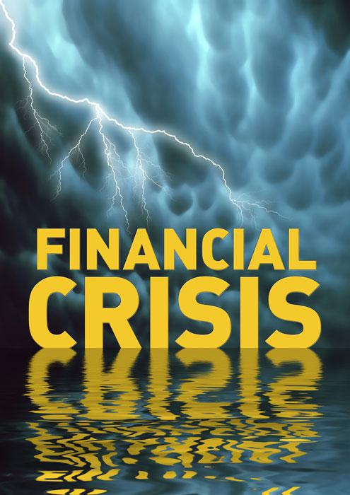
BIRTH OF FINANCIAL CRISIS
In order to understand how US economy got flooded with dollars, we need to go back in time by a decade. In 1997-98, the tiger economies of Asia (a term used to refer the countries of South East Asia like Thailand, Malaysia, Indonesia etc) suffered a major economic crisis. Though it is not necessary to know the details of this crisis, a brief overview of that crisis will help us understand the current mess in world as it is all linked.
This bubble was inflated still further by credulous foreign investors, who were all too eager to put money into faraway countries about which they knew nothing , It was also, for a while, self-sustaining: All those irresponsible loans created a boom in real estate and stock markets, which made the balance sheets of banks and their clients look much healthier than they were.

Slide 3
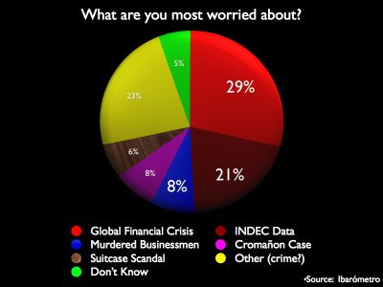
FINANCIAL CRISIS –WORRIES

Slide 4
IMPACT ON GLOBAL ECONOMY
What causes it?
An economy which grows over a period of time tends to slow down the growth as a part of the normal economic cycle. An economy typically expands for 6-10 years and tends to go into a recession for about six months to 2 years.
A recession normally takes place when consumers lose confidence in the growth of the economy and spend less.
This leads to a decreased demand for goods and services, which in turn leads to a decrease in production, lay-offs and a sharp rise in unemployment.
The defaults on sub-prime mortgages (homeloan defaults) have led to a major crisis in the US. Sub-prime is a high risk debt offered to people with poor credit worthiness or unstable incomes. Major banks have landed in trouble after people could not pay back loans.

Slide 5
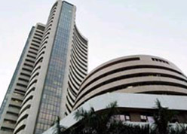
IMPACT ON INDIA
Background of the Global Financial Crisis; What is it all about?
It all began with the one and all American dream, that every American should have a home. Regardless of who you are and what you do, if you are an American, you should have something called a home. Real Estate business was in a boom, and financial agents thought that there wasn’t a better time to give away loans. The Household sector was given a boost with increased monetary supply by commercial financial companies, and people were given loans regardless of the credit rating they received. It was never expected that the boom in the Real Estate business would come to such an abrupt end, and the prices would reach all time low.

Slide 6
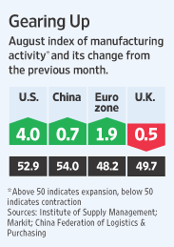
RECOVERY SIGNS IN US AND ASIA
Manufacturing gains in the U.S., Europe and Asia added to evidence the global economy is improving at a faster pace than was widely anticipated a few months ago.
For the first time since January 2008, an index based on a survey of U.S. manufacturing purchasing managers crossed a threshold indicating factory output grew. Manufacturing activity in China, France and Australia, among other countries, also expanded in August, separate surveys showed. The pace of contraction in Germany and some other nations slowed markedly One of the largest unknowns is how well the world economy can fare when the huge fiscal and monetary stimulus supplied by many governments, from the U.S. to China, wears off.

Slide 7

CAUSES OF THIS CRISIS
The Rate Of Joblessness Assumes Disturbing Proportions.
Large Companies Start Giving DepressinG Profit Figures.
Borrowers Start Defaulting.
Prices Of Essential Commodities Shoots Up.
Companies Stop Filling Vacancies.
Prices Of Property And Stocks Come Down Drastically, But Nobody Buys Them.
You Start Worrying About All Of The Above.

Slide 8
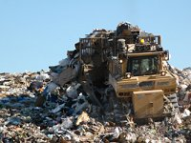
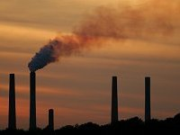
HOW CRISIS CAN HELP US
The world produces billions of tons of domestic waste each year, and 25% of this comes from the USA - even though it only accounts for 5% of the world’s population. Less consupmtion means less packaging means less material needs to be dumped in land fill.
Plasma TV’s are extremely inefficient and use more electricity than the now unfashionable CRT.
With less money for people to waste it on things they don’t need there will be a reduction is such consumer goods sold, meaning less electricity is used and less fossil fuel is burnt.
Rather than flying down to Thailand for a weekend stag party, people may take a more local trip, perhaps to the Eden project to experience tropical rainforest.

Slide 9
LESSONS OF THIS CRISIS
1. Risk Matters
Clearly, the amount of risk taken in one's investment portfolio will capture a significantly greater degree of attention in the years ahead. The decline of 2008 taught us that once-in-a-lifetime events can occur.
. Experts Don't Know Everything
We put a lot of trust in experts, including stock analysts, economists, fund managers, CEOs, accounting firms, industry regulators, government and a host of other smart people.
You Can't Live on Averages
Market projections, such as those seen in the hypothetical examples included in many 401(k) enrollment kits, always seem to show an 8% return per year, on average doubling your money every eight years

Slide 10

SUGGESTIONS TO SOLVE IT
POLICYMAKERS should include investment, employment and economic security policies in national development strategies to move ahead of the current global financial and economic crisis, said a senior United Nations (UN) official.
To offset weakening foreign demand and contracted export earnings, public spending targeted at infrastructure, alternative energy, health and education is key to stimulating the domestic economy.
“At the same time, governments should look at investment and technology policies that can help diversify the economy, which is crucial for long-term development,”

Slide 11


