Slide 1

Companies Act, 2013
AND
DIRECTOR IDENTIFICATION NUMBER

Slide 2
director
“DIRECTOR” means a director appointed to the board of the company.
“Board of Directors” or “Board”, in relation to company, means the collective board of the directors of the company.
August 23, 2014

Slide 3
CONTENTS
Introduction
Law governing DIN
Provisions of the Companies Act, 2013
Procedure to Obtain a DIN
Intimation of Change in Particulars of DIN
Surrender of DIN
Digital Signature Certificate
Possible difficulties while filing application of DIN
Apostille Vs. Notary

Slide 4


INTRODUCTION
“Director Identification Number”(DIN) means an identification number which the Central Government may allot to any individual intending to be appointed as director or to any existing directors of company for the purpose of identification as such;

Slide 5


Law governing DIN
The Companies Act,1956
Section 266A to 266G
Companies (Amendment) act, 2006
(vide notification G.S.R.649 (E) dated October 19,2006)
Notifications:
  1) G.S.R.650 (E) dated October 19,2006.
  2) G.S.R.14(E) dated January 9, 2007.
  3) G.S.R. 265(E) dated March 29, 2007
  4) G.S.R. 849(E) dated October 15, 2010
  5) G.S.R. 258(E) dated March 26, 2011
  6) G.S.R.427(E) dated June 2,2011
  7) G.S.R. 507(E) dated July 5,2011
  8) G.S.R .395(E) dated May 28, 2012.
  9) G.S.R. 429(E) dated June 5, 2012
  10) G.S.R……..(E) dated December 24,2012.
  11) G.S.R…….(E) dated December 24,2012.
  12) G.S.R….(E) dated March 15,2013.
  Please refer the webpage http://www.caclubindia.com/articles/director-identification-number-17825.asp#.U_INMRvNtIg
The Companies Act, 2013
Section 152 to 159
Companies (Appointment and Qualification of Directors) Rules, 2014

Slide 6
Provisions of Companies Act, 2013
Sec.152(3): No person shall be appointed as a director of a company unless he has been allotted the Director Identification Number under section 154.
Sec.152(4): Every person proposed to be appointed as a director by the company in general meeting or otherwise, shall furnish his Director Identification Number
Sec.153: Every individual intending to be appointed as director of a company shall make an application for allotment of Director Identification Number to the Central Government in such form and manner and along with such fees as may be prescribed
Sec.154: The Central Government shall, within one month from the receipt of the application under section 153, allot a Director Identification Number to an applicant in such manner as may be prescribed
Sec.155: No individual, who has already been allotted a Director Identification Number under section 154, shall apply for, obtain or possess another Director Identification Number.
August 23, 2014

Slide 7
Sec.156: Every existing director shall, within one month of the receipt of Director Identification Number from the Central Government, intimate his Director Identification Number to the company or all companies wherein he is a director
Sec.157(1): Every company shall, within fifteen days of the receipt of intimation under section 156, furnish the Director Identification Number of all its directors to the Registrar or any other officer or authority as may be specified by the Central Government with such fees as may be prescribed.
Sec.158: Every person or company, while furnishing any return, information or particulars as are required to be furnished under this Act, shall mention the Director Identification Number in such return, information or particulars in case such return, information or particulars relate to the director or contain any reference of any director.

Slide 8


Penalties:
Sec. 157(2): If a company fails to furnish Director Identification Number under sub-section (1) of section 157,before the expiry of the period specified under section 403 with additional fee, the company shall be punishable with fine which shall not be less than Rs. 25,000 extend to 1,00,000 ;and every officer of the company who is in default shall be punishable with fine which shall not be less than Rs. 25,000 extend to 1,00,000
Sec.159: If any individual or director of a company, contravenes any of the provisions of section 152, section 155 and section 156, such individual or director of the company shall be punishable with imprisonment for a term which may extend to 6 months or with fine which may extend to 50,000 rupees and where the contravention is a continuing one, with a further fine which may extend to 500 rupees for every day after the first during which the contravention continues.

Slide 9
Director Identification Number - e-Forms
Application for allotment of DIN – e-Form DIR-3
Intimation of DIN to the company by the Director - Form DIN-2
Intimation by company of DIN of all its Directors to Registrar - e-Form DIN-3
Application for Surrender of DIN - Form DIR-5
Intimation of Change in particulars of Director to Central Government – e-Form DIR-6

Slide 10

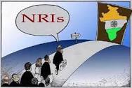

Procedure for obtaining din
Indian Director
Non Resident Indian (NRI) Director
Foreign Director
Under rule 9 of the companies (Appointment & Qualification of Directors) rules, 2014 , Every individual intending to be appointed as director of Indian company/ designated partner of Limited Liability Partnership is to make an application for allotment of Director Identification Number (DIN) in form DIR-3

Slide 11

Indian Director:
Information Required to file e-From DIR-3
Full Name (First/Middle/Last Name)
Father Name (First/Middle/ Last Name)
Date of Birth(dd/mm/yyyy)
Place of Birth
Occupation Type(Self employed/Professional/Serviceman/Home maker/Student)
Occupation
Income Tax PAN (Mandatory)
Passport Number
Driving License Number
Aadhaar Number
Permanent residential Address
Present residential Address
Digital Signature Certificate
Nationality
Educational Qualification
August 23, 2014

Slide 12

Attachments
Documents required to Attach in DIR-3
One of the following address Proofs with self attestation
Aadhaar card
Telephone bill
Electricity bill
Driving license
Ration card
Voter Identity card
Passport
Verification of particulars (Affidavit) in DIR-4 with duly stamped and notarized by Public Notary
Photograph in JPEG
Pan Card copy with self attestation
Specimen signature duly verified
(Note: As per Companies (Registration Offices and Fees) Amendment Rules, 2014 issued on 28.04.2014 – Under Rule 12(c) E-form of DIR-3 shall be filed along with attestation of photograph, identity proof and proof of residence of the applicant by the Chartered Accountant or the Company Secretary or as the case may be the Cost Accountant, in whole-time practice)

Slide 14

Non resident Indian (NRI) Director:
Information Required to file e-Form DIR-3
Full Name (First/Middle/Last Name)
Father Name (First/Middle/ Last Name)
Date of Birth(dd/mm/yyyy)
Place of Birth
Occupation Type(Self employed/Professional/Serviceman/Home Maker/Student)
Occupation
Income Tax PAN
Passport Number (Mandatory)
Driving License Number
Permanent residential Address
Present residential Address
Digital Signature Certificate
Nationality
Email ID & Mobile Number

Slide 15
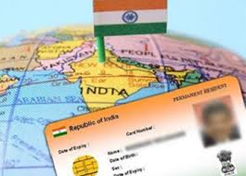
Attachments
Documents required to Attach in DIR-3
One of the following address Proofs with self attestation from attestation from public notary /Apostille in home country of residing
Telephone bill
Voter Identity card
Verification of particulars (Affidavit) in DIR-4 with attestation from public notary /Apostille in home country of residing
Photograph in JPEG
Passport copy with self attestation and attestation from public notary /Apostille in home country of residing
Specimen signature of duly verified
Electricity bill
Driving license
Any other relevant document

Slide 16

Foreign Director:
Information Required to file e-Form DIR-3
Full Name (First/Middle/Last Name)
Father Name (First/Middle/ Last Name)
Date of Birth(dd/mm/yyyy)
Place of Birth
Occupation Type(Self employed/Professional/Serviceman/Home Maker/Student)
Occupation
Income Tax PAN
Passport Number (Mandatory)
Driving License Number
Permanent residential Address
Present residential Address
Digital Signature Certificate
Nationality
Email ID & Mobile Number

Slide 17
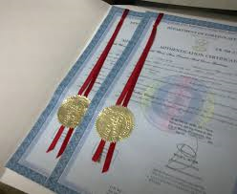
Attachments
Documents required to Attach in DIR-3
One of the following address Proofs with self attestation from attestation from public notary /Apostille in home country of residing
Telephone bill
Electricity bill
Driving license
Voter Identity card
Verification of particulars (Affidavit) in DIR-4 with attestation from public notary /Apostille in home country of residing.
Photograph in JPEG attested by Notary
Passport copy with self attestation and attestation from public notary /Apostille in home country of residing
Specimen signature duly verified
any other relevant document

Slide 20
Procedure to fill the e-From DIR-3
Step 1: Fill the applicant name and Father name same as in the PAN
Step 2: Indian National > select “YES” for citizen of India, Foreign National > select “NO”. If Option “NO” has selected select the “Nationality “of Applicant
Step 3: Enter the details of Occupation and Educational Qualification and Date of Birth
Step 4: Enter the PAN Number incase of Indian National and Verify the income tax details. For the Foreign National Passport number is mandatory to enter.
Step 5: Enter Permanent and Present residential address of the applicant and attach documents, click on the check form
Step 6: Sign the document with DSC of the Applicant and get it signed from CA/CWA/CS/Whole- time CS/ Director and Upload in the MCA after login.
Step 6: Pay Fee for filing of DIR-3 is Rs.500/- and Fee for DIR-6 is Nil.

Slide 22


Change in particulars of DIN (DIR-6)
Rule 12 of companies (Appointment and Qualification of Directors) Rules, 2014 : -
A director having approved DIN is required to intimate to MCA in case of changes in his particulars as stated in e-From DIR-3/Old form DIN1 within a period of 30 days of any such change in e-From DIR-6.
Information required:
Income tax PAN Number(Mandatory in case of Indian National)
Passport number (Mandatory in case of foreign national/NRI)
Email ID & Mobile Number
Details of change in particulars
Digital Signature Certificate
Attachments to e-From DIR-6:
Income tax PAN copy with self attestation and attested by practicing professional (i.e. CA/CS/CWA)
Passport Size Photo in JPEG
Proof for Particulars of change with self attestation and attested by practicing professional (i.e. CA/CS/CWA)
Verification of particulars by director(Affidavit) in form DIR-7 duly signed by applicant and stamped & attested by Public notary; incase of foreign/NRI director signed by applicant and attested public notary/Apostille in home country of residing.
August 23, 2014

Slide 25


surrender of din (DIR-5)
Rule 11 of the Companies (Appointment and Qualification of Director) Rules, 2014:- The central government upon being satisfied on verification of particulars attached with the application received in e-Form DIR-5 from any person cancel, deactivate the DIN in case-
(a) DIN found to be duplicated in respect of the same person
(b)The DIN was obtained in a wrongful manner
(c) Of the death of the concerned individual
(d) The concerned person has been declared as person of unsound mind by competent court
(e) If the concerned person has been adjudicated an insolvent
Information required:
Applicant’s name (First/Middle/Last Name)
DIN of the applicant
Reasons for surrender of DIN
Income tax PAN number(Mandatory in case of Indian National)
Passport (In case of NRI/Foreign national)
Any one of the Voter ID/Passport/Driving License/UID number
Permanent and Present residential address
Other information if any which applicant intends to submit regarding application
Digital signature Certificate

Slide 26

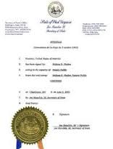
Documents required to attach to DIR-5:
Indian National:
Income tax PAN copy with self attestation
Any one of the following documents as address proof with self attestation:
  Voter ID
  Passport
  Driving license
  UID or Aadhaar
  Foreign National / NRI:
  Passport copy with self attestation and attested by public notary / Apostille
  Any one of the following documents as address proof with self attestation and attested by public notary/ Apostille:
    Voter ID
    Driving License
    Electricity bill
    Telephone Bill
    Bank Account statement
    Others – please specify

Slide 28


Digital signature certificate
(n)code solutions is a certifying authority authorized by Central Government to issue of Digital Signature Certificate of class II(Individual) for MCA filing purpose.
Indian National:
Information required to fill the application form for acquiring DSC:
Income tax PAN number (mandatory)
Applicant name (First /Middle/Last name)
Residential address with pin code
Email ID & Mobile Number
Signature validity period (for 1 year or 2 years)
Only signing or Signing & encryption
Documents required for enclosing to application form:
Pan Card copy (mandatory)
Telephone bill /Voter Id/ passport/Gas Connection form/Electricity bill/Water bill/ Driving License/Property tax receipt/Bank statement attested by bank
All the documents should be self attested and attested by Gazetted officer/ Bank Manager/ Post Master
All the utility bills shall not be older than 2 months.

Slide 29
Foreign National or NRI:
Information required to fill the application form for acquiring DSC:
Passport (mandatory)
Applicants name (First /Middle/Last name)
Residential address with Pin code
Email ID & Mobile Number
Signature validity period (for 1 year or 2 years)
Only signing or signing & encryption
Documents required for attaching to application form:
Passport(mandatory)
Telephone bill /Voter Id/ passport/Gas Connection form/Electricity bill/Water bill/ Driving License/Property tax receipt/Bank statement attested by bank.
All the documents should be self attested and attested by public notary/Apostille in the home country of residing.
All the utility bills shall not be older than 2 months.

Slide 31


Possible difficulties while filing DIN application
Form DIR-3:
Filling of Applicant Name & Father name in Point No.1&2:
First/Middle/last name should be as per Income Tax PAN Database in order to verify PAN details successfully.
Please proceed the following procedure to find the applicants First/Middle/last Name
Please login to www.incometaxindia.gov.in and click on Know your jurisdiction displayed in left side of the home page (Step 1)
Enter PAN number and numbers displayed in image and submit ( Step 2)
First /Middle/ Last name of the applicant will be displayed (Step 3)
Father name cannot be find through the portal. It can be know only after consulting one of the TIN-NSDL facilitation center

Slide 32

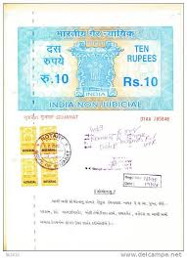

Attestation & Notary and other details:
Indian Director:
Identity Proof (i.e. PAN card) & Proof of address should be self attested by applicant and attested by Practicing professional (CA/CS/CWA)
(Note: As per Companies (Registration Offices and Fees) Amendment Rules, 2014 – Under Rule 12(c) E-form of DIR-3 shall be filed along with attestation of photograph, identity proof and proof of residence of the applicant by the Chartered Accountant or the Company Secretary or as the case may be the Cost Accountant, in whole-time practice)
2. All the utility bills ( Telephone Bill/ Electricity bill /Bank Statements) should not be older than 2 months. Bank statement should be attested by Bank Manager
Document of Verification of particulars in DIR-4 should get done franking/ Take print on Stamp paper of Rs.10 or above and notarized by public notary

Slide 33
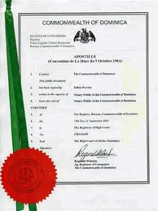
Attestation & Notary and other details:
Foreign /NRI Director:
Identity Proof (i.e. Passport) & Proof of address should be self attested by applicant and attested by Public Notary/ Apostille in the country of applicant residing or by Whole time Director/ Director of company in which director to be appointed.
2. If the NRI Director is in India and having multiple entry visa/Overseas citizen of India/ Person of Indian Origin Card at the time of application for DIN, documents can be attested by public notary/ Practicing professional (CA/CS/CWA) in India.
All the utility bills ( Telephone Bill/ Electricity bill /Bank Statements) should not be older than 2 months. Bank statement should be attested by Bank Manager
Apostille is a French word (pronounced "ah-poh-steel"), meaning a certificate issued by a government of a country, authenticating the signature and or seal of a public official on a public document issued by that country, and intended for use in a foreign country.

Slide 34
Document of Verification of particulars in DIR-4 should be notarized by public notary/ Apostille in home country of residing.
5. If documents are in language of foreign country , those documents should be translated into English by authorized translator or public notary and notarized by public notary.

Slide 35

Apostille Vs. Notary
Legalization of Documents:
The use of foreign public documents (e.g. birth certificate, Address Proofs and Identity Proofs, high school diploma, university diploma etc.) in international legal transactions requires that they be legalized, unless bilateral or multilateral treaties stipulate otherwise.
Apostille:
The Hague Convention of 5 October 1961 Abolishing the Requirement of Legalization for Foreign Public Documents and simplified the legalization procedure so public documents are subject to single authentication by the competent body of the country they were issued in. Information about said convention and its parties can be found at www.hcch.net
the Apostille Convention, or the Apostille Treaty is an international treaty drafted by the Hague Conference on Private International Law. It specifies the modalities through which a document issued in one of the signatory countries can be certified for legal purposes in all the other signatory states. Such a certification is called an Apostille (French: certification). It is an international certification comparable to a notarization in domestic law, and normally supplements a local notarization of the document. Documents that have been notarized are eligible for Apostille

Slide 36
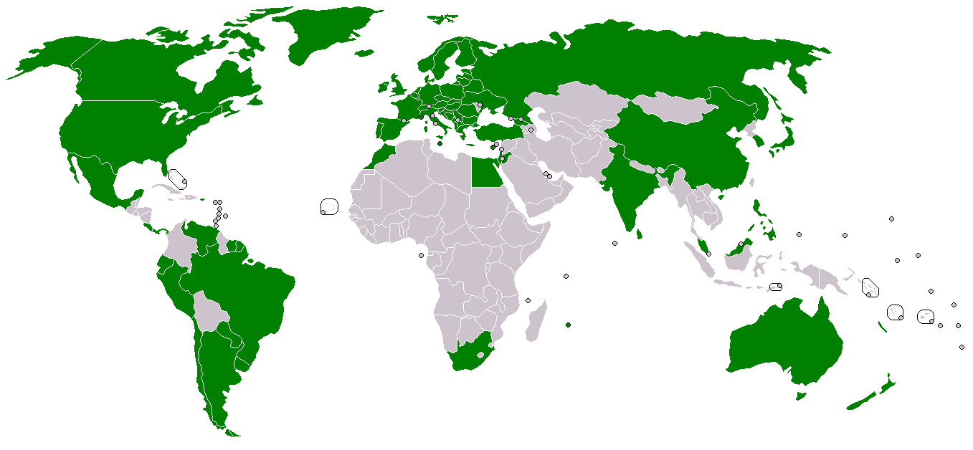
Countries Participated in Hague Apostille Convention

Slide 37




Slide 38


Notary:
An Embassy Legalization is required, when the country where you intend to use your documents or the country in whose the documents issued is a non-member of the Hague Apostille Convention
Procedure of Attestations:
1. Notary in Home country/ State
2. Attestation by Authority which issued the documents
3. Attestation by Ministry of External Affairs of the country
4. Attestation by Indian Embassy or Consulate (in the Country)
5. Attestation by Ministry of Foreign Affairs in India

Slide 39


Slide 41
THANK YOU
Presentation by ---
Siva Nageswararao

