Slide 1
A PRESENTATION
ON
COMPANIES ACT, 2013
Jayant Sethia
R. C. Chadda & Co. LLP
Chartered Accountants

Slide 2
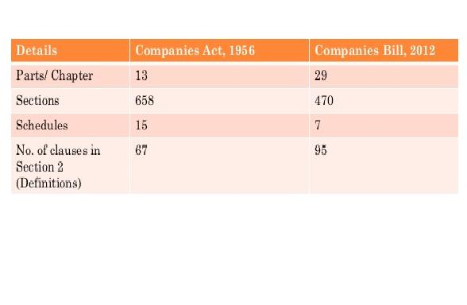
COMPANIES BILL,2012 V/S COMPANIES ACT,1956

Slide 3
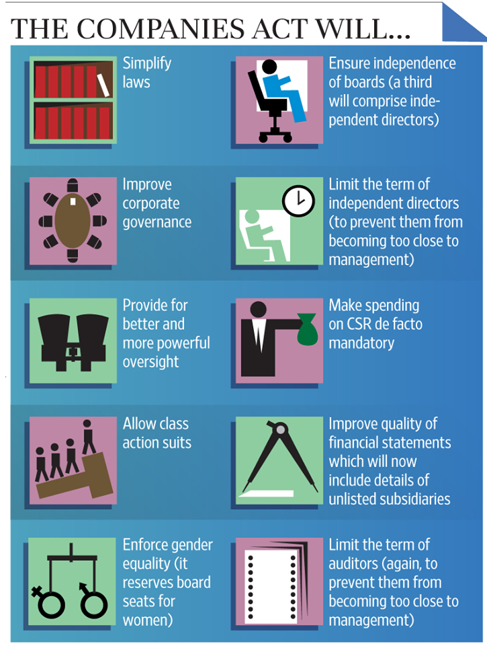
Significant Features of Companies Act, 2013

Slide 4
FRAMEWORK OF THE BILL
Concise
  The entire bill has been divided into 29 chapters.
  The Bill has 470 sections and 7 schedules as against 658 Sections and 15 schedules in the existing Companies Act, 1956.
  Many new chapters have been introduced, viz., Registered Valuers (ch.17); Government companies (ch. 23); Companies to furnish information or statistics (ch. 25); Nidhis (ch. 26); National Company Law Tribunal & Appellate Tribunal (ch. 27); Special Courts (ch. 28)
  The Bill prescribes 33 new definitions including Associate, Promoter, Related Party.
Applicability
  The Bill is forward looking in its approach which empowers the Central Government to make rules, etc. through delegated legislation (clause 469 and others).

Slide 5
FRAMEWORK OF THE BILL
Definitions
  New definitions are introduced in the Bill, some of which are accounting standards, auditing standards, associate company, CEO, CFO, control, deposit, employee stock option, financial statement, global depository receipt, Indian depository receipt, independent director, interested director, key managerial personnel, promoter, one person company, small company, turnover, voting right etc.

Slide 6
INCORPORATION
Types of entities
  Public company
  Private Company
  Introduction of ‘One Person Company’ ,‘Small Companies’ and ‘Dormant Companies’
  Companies with charitable and social objects also known as non –profit companies
Private Companies
  Number of shareholders increased from the existing 50 to 200
  Private company being a subsidiary of a public company will be deemed to be a public company
  Can accept deposits only from its members subject to certain compliances
  Exemptions and privileges of a private company curtailed with most provisions being applicable to all companies

Slide 7
INCORPORATION
Investment / Holding Companies
  Companies can make investment through only two layers of investment companies
  Subsidiary of a foreign public company may be a public company. No exemption as provided in existing Act vide section 4 (7)
  Process of Incorporation
  Process made more stringent
  Directors / shareholders to now give affidavits for various information provided
  Directors to file their interest in various companies whether directly or indirectly
  Incorporation of a company can be revoked / struck off if the information provided at the time of Incorporation are false or incorrect
  No requirement as to bifurcaton of the objects clause of the Memorandum of Association into main, ancilliary and other objects.

Slide 8
SHARE CAPITAL AND FUNDRAISING
Security with Differential Rights
  Provides the issuance of equity shares with differential rights as to voting or dividend
  Provides that proposition of voting rights of equity shareholders now related to total capital of the company which includes even preference share capital
  First subscribers to get money within 180 days from the date of Incorporation
Restriction on use of securities premium account
  For certain class of companies as may be prescribed, amount of securities premium cannot be used for writing off preliminary expenses or payment of premium on redemption of preference share or debenture
Further issuance of share capital
  To any person (other than rights issue), vide a special resolution at a price determined by the valuation report of a Registered Valuer, subject to conditions as may be prescribed

Slide 9
SHARE CAPITAL AND FUNDRAISING
Restrictions on transfer
  Public company can provide restriction on free transferability based on contractual obligation
Discount
  No shares may be issued at a discount other than sweat equity
Manner of fund raising
  Public companies: public issue, private placement, bonus issue, rights issue
  Private companies: private placement, bonus issue, rights issue
  Disclosure made stringent. Timelines for allotment prescribed
  All preferential allotments require shareholder consent

Slide 10
BOARD AND GOVERNANCE
Number of directors
  Maximum number of directors in any company is increased to 15
  A director can hold a maximum of 20 directorships (including a maximum of 10 in public companies)
  For the purpose of maximum directorships, even holding position as an alternate director is included
  Other requirements
  One woman director required only in prescribed classes of company
  One director must stay in India (Resident Director) for not less than 182 days during the preceding calendar year
  Resignation of Director shall be effective on date accepted by the company or date mentioned in resignation letter, whichever is later
  Director’s to provide detailed reason for resignation while forwarding copy of resignation to the Registrar of Companies (“RoC”)

Slide 11
BOARD AND GOVERNANCE
Duties imposed
  Duties of Directors provided.
Vacation of Office as a Director
  Director has to attend at least one meeting in twelve months, else even when leave of absence granted, he will have to vacate office.
  Meetings of Board of Directors
  One board meeting in each quarter with gap of not more than 120 days between two meetings
  First board meeting within 30 days of date of Incorporation
  Participation through video conferencing permissible and also considered for valid quorum
  Minimum seven days notice for board meeting

Slide 12
BOARD AND GOVERNANCE
Independent Directors
  Public companies on par with public listed companies. Central Government to specify the number of independent directors required in a public company
  Code for Independent Directors prescribed, which includes roles, functions and duties
Corporate Social Responsibility
  Constitution of CSR Committee mandatory for companies having a net worth of INR 500 Crores (approx. US$ 5 billion) or more, or a turnover of INR 1,000 Crores (approx. US$ 10 billion) or more or net profits of INR 5 Crores (approx. US$ 50 million)
  At least 2% of the average net profits of the company made during the three immediately preceding financial years in pursuance of its CSR policy
  The company shall give preference to the local area and areas around it where it operates
  If the company fails to spend such amount, the Board shall, in its report specify the reasons for not spending the amount

Slide 13
ACCOUNTS AND AUDIT
Auditors
  Mandatory auditor rotation for listed and other prescribed companies every 5 years
  Members of a company may resolve to provide that in the audit firm appointed by it, the auditing partner and his team shall be rotated at such intervals as may be specified in the resolution
  Auditor will be required to immediately report to the central government upon reasonable suspicion of any offence involving fraud
Accounts
  Cash flow statement is mandatory part of Financial statements
  Shareholders to receive accounts not less than 21 days before the date of meeting
  Reopening and Recasting of books of accounts of Company on an application by Central Government, Income Tax, SEBI or other statutory / regulatory authority
  Voluntary revision of financial statements or Board’s report

Slide 14
COMPROMISES, ARRANGEMENTS AND AMALGAMATIONS
Short Form M&A for small companies and holding – sub M&As
  Arrangements between ‘small companies’ and between holding company and wholly owned subsidiaries do not have to approach the Tribunal
  Permissions from RoC, Official Liquidator, Central Government and shareholder/creditors required
Cross border mergers
  New Provisions for mergers between Foreign company and Indian company
  Consideration limited to IDRs and cash
  Approval of the RBI required and Rules to be prescribed in consultation with RBI
Reverse Mergers constrained
  Mergers of listed companies into unlisted companies does not result in automatic listing for the unlisted company

Slide 15
COMPROMISES, ARRANGEMENTS AND AMALGAMATIONS
Procedural changes
  Shareholders below 10% and creditors below 5% cannot object to scheme of amalgamation
  Dispensation from calling of creditors meeting by the Tribunal if 90% in value agree and confirm
  Notice of amalgamation must be given to Central Government, RBI, SEBI (only for listed companies), CCI etc. Specific timelines given to the authorities to respond
  Voting to be in person or postal ballot or by proxy
  Disclosure obligations increased
  No treasury stock permitted
Powers of the Tribunal Increased
  Tribunals may also pass orders for the following
    (i) protection of creditors
    (ii) exit option to dissenting shareholders

Slide 16
INVESTOR PROTECTION
Class action suits
  Any class of members or depositors, in specified numbers, may initiate proceedings against the Company, its directors if they are of the opinion that its affairs are being carried out in a manner unfairly prejudicial to the interests of the company
  Damages may be claimed against directors, auditors, expert or advisor or consultant. “expert” includes an engineer, a valuer, a chartered accountant, a company secretary, a cost accountant and any other person who has the power or authority to issue a certificate in pursuance of any law for the time being in force;
Exit option to shareholders
  The Bill provides for instances where an exit option must be given to (dissenting) shareholders namely:
    In a scheme of M&A (especially where a listed company is merging into an unlisted company)
    If, in a public issue, the company changes the objects for which the capital was raised (at any point in time through a change in the MOA or otherwise)

Slide 17
MISCELLANEOUS
Financial Year
  April 1st – March 31st : Universal financial year format prescribed for all companies. Only certain companies with the prior approval of the Tribunal may have a different financial year
Loans and Advances and Investment
  Restriction applicable to all companies including private companies
  Investments / loans / guarantees to subsidiary companies require corporate compliances
Listed Companies
  Defined to mean a company which has any of its securities listed on any recognized stock exchange
Insider Trading
  Prohibition of insider trading introduced for all companies, covering Directors, Key Managerial Personnel and Officers of the Company

Slide 18
COMPLIANCE – PRIVATE LIMITED COMPANY
First board meeting to be held within 30 days of incorporation
No business to be carried out or any borrowing to be made, unless the initial capital has been brought in and declaration filed with RoC
Capitalization of the Company to be completed and declaration filed within 180 days
Time period between two board meetings shall not exceed 120 days, and a minimum of one board meeting to be held every quarter
Notice to Board meetings to be sent 7 days in advance to all directors unless the directors consent to a Board meeting convened at a shorter notice
A minimum of one director must be present in India for a period of 182 days or more in the previous calendar year
Director to be present, in at least one Board meeting, during a calendar year. Presence through video conferencing counted for quorum

Slide 19
COMPLIANCE – PRIVATE LIMITED COMPANY
Managing Director to be appointed for not more than 5 years at a time.
Director to be appointed in a general meeting, other than Additional director and Alternate director
Appointment of persons other than retiring director needs to deposit INR 100,000
DIN and consent, mandatory prior to appointment as Director
Declarations on concern or interest and about the eligibility to continue as director to be provided upon appointment and at the end of each financial year
Resignation of a director shall take effect from the date on which the notice is received by the company or the date, if any, specified by the director in the notice, whichever is later
Resigning director to provide detailed reasons in the resignation letter and file the same with RoC within 30 days of resignation

Slide 20
COMPLIANCE – PRIVATE LIMITED COMPANY
Director’s report disclosures cover most corporate actions
Director’s responsibility statement to mention that proper systems are devised to ensure compliance with the provisions of all applicable laws and that such systems were adequate and operating effectively
Appointment of Auditors to be on rotational basis. 10 years appointment, in case of a firm and 5 years appointment for individuals
Audited accounts must be placed before Shareholders within six months from the date of ending of financial year of the company.
Financial statements to be sent to members 21 days before annual general meeting.
Annual general meeting shall be called during business hours, that is, between 9 a.m. and 6 p.m. on any day that is not a National Holiday

Slide 21
COMPLIANCE – PRIVATE LIMITED COMPANY
Financial statements, to be signed by the Chairperson of the company or by two directors out of which one shall be Managing Director and the Chief Executive Officer, if he is a director in the company, the Chief Financial Officer and the Company Secretary of the company, wherever they are appointed.
Financial statements, to be filed with the RoC within thirty days
Annual return based on financial year, to be filed with the RoC, within sixty days
Secretarial Compliance Certificate is now part of Annual return
Further issue of shares, including Stock options requires shareholders consent (other than rights issue)
Related party transactions require an approval from the Board of Directors and in certain cases, prior approvals from the Company by a Special Resolution
Related party transactions cover almost every contract for supply of goods, materials and services including property by lease or sale

Slide 22
COMPLIANCE – PRIVATE LIMITED COMPANY
Loans and Investments require shareholder’s approval
Sale of undertaking, borrowings etc. require shareholder’s approval
Deposits / Loans only from Shareholders. (unless provided otherwise in rules, if any)
Delayed filings up to 270 days beyond the original date allowed without prosecution on payment of additional fees
Delays beyond additional time, attracts severe penalties
Penalties and liabilities for non-compliance increased manifold
Imprisonment provisions in over 50 clauses

Slide 23
COMPLIANCE – PUBLIC LIMITED COMPANY
Minimum three directors to be appointed on the Board
Quorum for a General meeting - Five members personally present
No loan or guarantee, security or otherwise, any financial assistance for purchase or subscription for any shares in the company or in its holding company
Two thirds of the board of directors, liable to retire by rotation
Managing director remuneration should be in accordance with the Act
A casual vacancy in board can be filled in by Board meeting
Company Secretary to provide a report to the Board that compliances under all applicable laws have been made by the Company
Audit committee, Nomination and Remuneration committee, Independent Director

Slide 24


Jayant Sethia
Contact: +91-9782297977
Whatsapp:+91-8505854213
Facebook: www.facebook.com/jackysethia
E-mail: jayantsethia18@gmail.com

