Slide 1
Joint Stock Companies
BY CA.SAYANTAN BASU

Slide 2
Meaning
In a partnership firm we know that the number of partners cannot exceed 20.
So there is a limit to the contribution of capital.
Secondly, even if the partners could contribute a large amount of capital, they would hesitate to do so considering the risk involved in business and their unlimited liability.
Mainly to take care of these two problems, a company form of business organisation came into existence.

Slide 3
Meaning
A company form of business organisation is known as a Joint Stock Company.
It is a voluntary association of persons who generally contribute capital to carry on a particular type of business, which is established by law and can be dissolved only by law.
Persons who contribute capital become members of the company.

Slide 4
Features of Joint Stock Company
Legal formation
  No single individual or a group of individuals can start a business and call it a joint stock company.
  A joint stock company comes into existence only when it has been registered after completion of all formalities required by the Indian Companies Act, 1956.

Slide 5

Features of Joint Stock Company
Founded in July 1996 by Sabeer Bhatia
Grew to have more than 10 million subscribers by 1997
Was bought over by Microsoft for $400 Mn.
Currently Hotmail Ltd does not exist.
But is known as MSN Hotmail
Artificial person
  Just like an individual, who takes birth, grows, enters into relationships and dies, a joint stock company takes birth, grows, enters into relationships and dies.
  However, it is called an artificial person as its birth, existence and death are regulated by law and it does not possess physical attributes like that of a normal person.

Slide 6
Features of Joint Stock Company
Separate legal entity
  Being an artificial person, a joint stock company has its own separate existence independent of its members.
  It means that a joint stock company can own property, enter into contracts and conduct any lawful business in its own name.
  It can sue and can be sued by others in the court of law.
  The shareholders are not the owners of the property owned by the company.
  Also, the shareholders cannot be held responsible for the acts of the company

Slide 7

Features of Joint Stock Company
Common seal
  A joint stock company has a seal, which is used while dealing with others or entering into contracts with outsiders.
  It is called a common seal as it can be used by any officer at any level of the organisation working on behalf of the company.
  Any document, on which the company's seal is put and is duly signed by any official of the company, become binding on the company

Slide 8
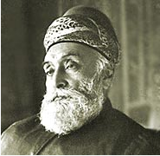
Features of Joint Stock Company
Perpetual existence
  A joint stock company continues to exist as long as it fulfils the requirements of law.
  It is not affected by the death, lunacy, insolvency or retirement of any of its members
Jamsetji Tata founded Tata Group of companies.
He died in 1904. But the Tata legacy continues.
Currently, the Group is being headed by Ratan Tata.
Tata is a limited company. The company will always have someone leading it even in case of death of founding members, retirement etc

Slide 9
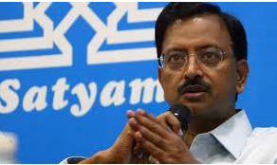
Features of Joint Stock Company
Limited liability
  In a joint stock company, the liability of a member is limited to the extent of the value of shares held by him.
  While repaying debts, for example, if a person owns 1000 shares of Rs.10 each, then he is liable only up to Rs 10,000 towards payment of debts.
  That is, even if there is liquidation of the company, the personal property of the shareholder can not be attached and he will lose only his shares worth Rs. 10,000.
Ramlingraju founded Satyam in 1987.
Over time he laundered more than Rs.7000 Crore.
But he had done this in the name of Satyam.
Thus making his personal liability nil.
Only his share holding was diluted to recover a portion of the loss.

Slide 10
Types of Companies
On Basis of Ownership | On Basis of Nationality
Private | Indian
Public | Foreign
Government

Slide 11
Types of Companies
Private Companies
  These companies can be formed by at least two individuals having minimum paid–up capital of not less than Rupees one lakh.
  As per the Companies Act, 1956 the total membership of these companies cannot exceed 50.
  The shares allotted to its members are also not freely transferable between them.
  These companies are not allowed to raise money from the public through open invitation.
  They are required to use “Private Limited” after their names.
  The examples of such companies are Combined Marketing Services Private Limited, Indian Publishers and Distributors Private Limited, Oricom Systems Private Limited, etc.

Slide 12
Types of Companies
Public Companies
  A minimum of seven members are required to form a public limited company.
  It must have minimum paid–up capital of Rs 5 lakhs.
  There is no restriction on maximum number of members.
  The shares allotted to the members are freely transferable. These companies can raise funds from general public through open invitations by selling its shares or accepting fixed deposits.
  These companies are required to write either ‘public limited’ or ‘limited’ after their names.
  Examples of such companies are Hyundai Motors India Limited, Steel Authority of India Limited, Jhandu Pharmaceuticals Limited etc.

Slide 13
Types of Companies
Government Company
  In these companies the Government (either state or central government or both) holds a majority share capital i.e., not less than 51%.
  However, companies having less than 51% share holding by the government can also be called Government companies provided control and management lies with the government.
  Examples of government companies are: Mahanagar Telephone Nigam Limited, Bharat Heavy Electricals Limited.

Slide 14
Types of Companies
Indian Company
  A company having business operations in India and registered under the Indian Companies Act, 1956 is called Indian Company. An Indian company may be formed as a public limited, private limited or government company.
Foreign Company
  A foreign company is a company formed and registered outside India having business operations in India.

Slide 15
Types of Companies
Holding Companies
  A holding company is a company or firm that owns other companies' outstanding stock.
  It usually refers to a company which does not produce goods or services itself; rather, its purpose is to own shares of other companies..
Subsidiary Companies
  A subsidiary, in business matters, is an entity that is controlled by a separate higher entity.
  he controlled entity is called a company, corporation, or limited liability company; and in some cases can be a government or state-owned enterprise, and the controlling entity is called its parent (or the parent company).

Slide 16
Formation of a Company
The formation of a company can be divided into the following stages:
  Promotion Stage
  Selection of Name
  Incorporation Stage
  Capital Subscription
  Business Commencement Stage

Slide 17
Promotion Stage
Promotion of a company means developing an idea and subsequently arranging for necessary resources to achieve the idea and making profits.
The people who take up this initiative are called ‘Promoters’.
They procure man, materials, money and machines for this purpose.

Slide 18
Steps in Promotion Stage
The Steps in Promotion are:
Discovery of Business Opportunity
Conduct Preliminary Investigations.
Assembling
Financing

Slide 19
Steps in Promotion Stage
Discovery of Business Opportunity – a company starts with a few business opportunities are discovered. Promoters select the best idea after estimation.
Conduct Preliminary Investigation – a study is conducted on the feasibility of the opportunity. Parameters such as turnover, working capital requirements, costs etc are understood. The preliminary investigation is done by professionals and experts.

Slide 20
Steps in Promotion Stage
Assembling – Next stage is to collect the necessary equipment like land, labor, money, managerial ability. This stage includes initial work made by the promoters and involves entering into contractual agreements with many parties.
Finance – After the 1st 3 steps mentioned above, they must prepare the financial statements and understand the ways of raising the required funds.

Slide 21
Steps in Promotion Stage (Example)
1. Lets assume you want to start a Café.
2. Find out what are the procedures, laws to follow, licenses needed to start the Café.
3. Acquire the relevant machines such as coffee makers, furniture for seating and human resources for managing the operations of the Café.
4. Acquire the finances for the resources mentioned in step 3.

Slide 22
Selection of Name
To enable a company to get into preliminary contracts, it is necessary for the promoters to select a name.
There is no restriction on selecting a name, except that it should not resemble the name of an existing company or carry the Government name or emblem (unless a Govt. company)
There should be no objection by anyone with respect to its proposed name

Slide 23

Incorporation Stage
A sole proprietorship or partnership firm can be formed to carry out its business even without any registration.
But a company can not be formed or permitted to run its business without registration.
In fact, a company comes into existence only when it is registered with the Registrar of Companies

Slide 24
Incorporation Stage
The following are the important documents to be submitted to the RoC:
Memorandum of association
Articles of Association
Written consent of all directors to act as Directors (in case of Public co.)
Agreement with managing agents or secretaries and treasuries.
Statutory declaration by an advocate or CA regarding requirements
Agreement of Directors to take qualification shares (in case of Public co.)
Public Company must prepare a prospectus or a statement in lieu of prospectus to be submitted to Registrars

Slide 25
Memorandum of Association
The Memorandum of Association usually contains the following six clauses:
Name Clause: It contains the name by which the company will be established. As you know, the approval of the proposed name is taken in advance from the Registrar of the companies.
Situation Clause: It contains the name of the state in which the registered office of the company is or will be situated. The exact address of the company's registered office may be communicated within 30 days of its incorporation to the Registrar of Companies.
Objects Clause: It contains detailed description of the objects and rights of the company, for which it is being established. A company can undertake only those activities which are mentioned in the objects clause of its memorandum.

Slide 26
Memorandum of Association
Liability Clause: It contains financial limit upto which the shareholders are liable to pay off to the outsiders on the event of the company being dissolved or closed down.
Capital Clause: It contains the proposed authorised capital of the company. It gives the classification of the authorised capital into various types of shares, (like equity and preference shares) with their numbers and nominal value. A company is not allowed to raise more capital than the amount mentioned as its authorised capital. However, the company is permitted to alter this clause as per the guidelines prescribed by the companies Act.

Slide 27
Memorandum of Association
Subscription Clause: It contains the name and address of at least seven members in case of public limited company and two members in case of a private limited company, who agree to associate or join hands to get the undertaking registered as a company. It contains a declaration by persons who are desirous of being formed into and agree

Slide 28
Articles of Association
Articles of Association of a company generally contain rules and regulations with regard to the following matters:
Preliminary contracts
Use and custody of common seal
Allotment, calls and lien on shares
Transfer and transmission of shares
Forfeiture and re-issue of shares
Alteration of share capital
Issue of share certificates and share warrants
Conversion of shares into stock

Slide 29
Articles of Association
Procedure of holding and conducting company meetings
Voting rights and proxies of members
Qualification, appointment, remuneration and power of Directors
Borrowing powers and methods of raising loans
Payment of dividends and creation of reserves
Accounts and audit
Winding up.

Slide 30
Prospectus
After getting the Certificate of Incorporation or Registration a public limited company invites the public to subscribe to its shares.
This is done by issuing a document called Prospectus.
Under the Companies Act, a prospectus has been defined as "any document described or issued as a prospectus and includes any notice, circular, advertisement or other document, inviting deposits from the public or inviting offers from the public for the subscription or purchase of shares or debentures of a company or body corporate

Slide 31
Prospectus
Contents of Prospectus
Name and address of the company
Main objects of the company
Details of shares
Details regarding listing of shares at stock exchange
Details regarding debentures and redeemable preference shares
Details of share qualification and dividend structure
Details of share qualification of directors

Slide 32
Prospectus
Names of directors, secretaries, promoters, bankers, managing agents etc
Minimum subscription details
Details of subscription list
Details of calls on shares
Details on underwriters
Details of estimated preliminary expenses
Details regarding reserves and surplus likely to be maintained
Details on voting rights, meetings of shareholders, Directors etc

Slide 33
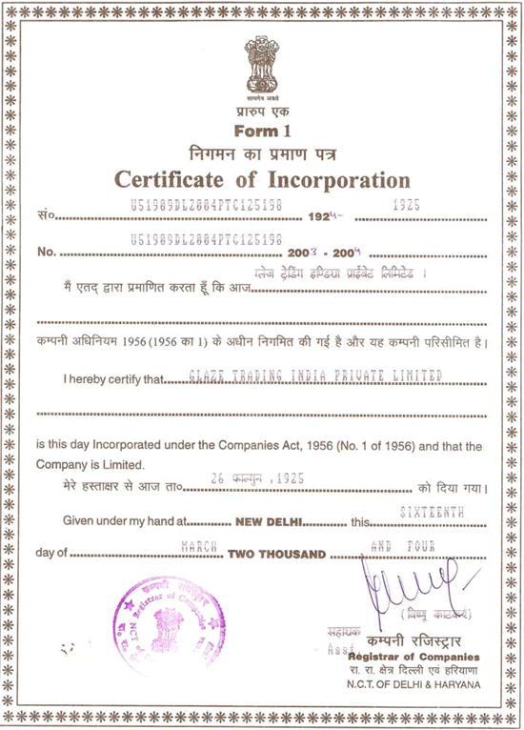
Business Commencement Stage
A private limited company can commence business on receipt of certificate of incorporation.
A public company has, however, to wait to commence business till a certificate of commencement of business is received from the registrar of the joint stock companies

Slide 34
Advantages
Huge Capital
Large Scale Operation
Limited Liability
Continuity of Business
Easy Transfer of shares
Democratic Operations
Availability of Credit
Easy to expand
Better management
Government Controls

Slide 35
Disadvantages
Excessive legal formalities
Separation of ownership and control
Absence of personal touch
Red tapism and delay in decision making
Disunity in management
Reckless speculation
Neglect of minority interest
Greater chance of fraud

Slide 36
Applicability
Suitable if large scale operations are to be undertaken
Suitable when greater managerial skills are needed
Suitable for an organization which intends to exist for a long period of time
Suitable when greater capital is required
Suitable when owners want to have limit the liability to control losses
Suitable for both manufacturing and trading unit as well as service industry.
Suitable for non profit organization.
Suitable for financial and corporate sector organization

Slide 37
Liquidation
Liquidation is usually the last stage of a workout plan or bankruptcy proceeding for a company.
It occurs when it has been determined that a company cannot continue on as a viable entity and it is believed that there exists more value in the assets of the company than in the company as a going concern.
Occasionally a company's assets will be liquidated when the owner decides to quit, not because he has gone bankrupt but because he doesn't want to go through the effort and trouble of finding a buyer.

Slide 38
Types of Liquidation
The first of the three types of liquidation that will be looked at is the members' voluntary liquidation agreement, this form of liquidation occurs when the company has enough money in order to pay off all the debts owed.
This is usually the chosen method for shareholders when an important person dies or the company no longer sees a future for itself.
Although the downfall of any business is bad, by doing a voluntary members' liquidation agreement, the company can ensure that it fulfils its obligations to its debtors and ends within good faith, which is the best way in terms of ethics.

Slide 39
Types of Liquidation
The second of the three is the creditors' voluntary liquidation agreement, this differs from the first in that rather than having the full amount of money needed in order to pay off its debtors, they unfortunately have very little and as such it tends to be the debtors that enforce their rights in order to send the company into voluntary liquidation in order to fulfil its debts.
However, it is important to note that it is still the shareholders that decide whether to keep the business running or not and it will then be down to the debtors to launch a winding up petition in an attempt at forcing the company into administration.

Slide 40
Types of Liquidation
The third type of voluntary liquidation is, as earlier mentioned, compulsory liquidation.
Compulsory liquidation is when a winding up petition has been issued and the court has found in favour of the debtors, this is probably the less likely occurrences as business prefer to be paid in full rather then shut a company down in order to recover less than it wants to due to the business simply not having the money to pay.

Slide 41
JOINT STOCK COMPANIES
THANK YOU ……….

