Slide 1
XBRL
EXTENSIBLE
BUSINESS
REPORTING
LANGUAGE
PRESENT BY
P. NAGALAKSHMI, (CA - FINAL )

Slide 2
Presentation Sequence:
Introduction on XBRL
Purpose of this presentation
FS Before XBRL mode
Guidance note by ICAI
FS in XBRL mode
Responsibility of a management
Certification engagement
Responsibility of a practitioner
Certification procedure
Concluding the presentation

Slide 3
Introduction on XBRL
2008
Extensible Business Reporting Language (XBRL)
Extensible Financial Reporting Markup Language (XFRML)
XML based financial statements
1998
Extensible Markup Language (XML)

Slide 4
Scope of XBRL:
Processes
Business operations
Internal financial reporting
External financial reporting
Investment, lending, regulations
Economic policy making
Participants
Companies
Financial publishers
and data aggregators
Investors
Central banks
Trade partners
Management accountants
Auditors
Regulators
Software vendors

Slide 5
Purpose of this presentation:
To disseminate the requisites for certifying the financial statements for uploading in XBRL mode

Slide 6
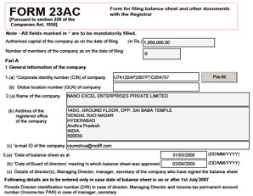
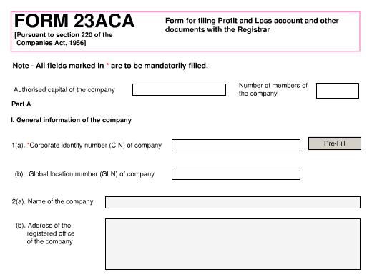
Filing of financial statements before XBRL
Duly signed financial statements
Scanning of the financial statements
Uploading to MCA

Slide 7
Notification of MCA
[Circular No: 09/2011]
From the Year 2010 – 2011, the following
companies in India has to file their Financial statements in
XBRL form only
Listed companies in India
Companies having paid up capital ≥ 5 cr.
Companies having turnover ≥ 100 cr.
But not for:
Power companies
Banking companies
Insurance companies
NBFC

Slide 8
Filing of financial statements in XBRL
Management
AUDITED FINANCIAL STATEMENTS WITH ENGAGEMENT LETTER
Practitioners
CONVERT THE AUDITED FINANCIAL STATEMENTS
XBRL mode
PREPARE INSTANCE DOCUMENT
validation
IF THERE IS NO ERROR LOGS THEN
Upload& Certify

Slide 9
Filing of financial statements in XBRL
Management
CONVERT THE AUDITED FINANCIAL STATEMENTS USING XBRL SOFTWARE
XBRL mode
PREPARE INSTANCE DOCUMENT
validation
GIVE INSTANCE DOCUMENT ONLY FOR UPLOADING AND CERTIFICATION
Practitioners
IF THERE IS NO ERROR LOGS THEN
Upload& Certify

Slide 10
Guide note by ICAI:
One of the requirements contained in the Forms 23 AC XBRL and Form 23ACA XBRL is CERTIFICATION of these financial statements by CA/CS/CWA(in Whole time practice)
ICAI has issued a Guide Note on certification of XBRL financial statements for the benefit of practitioners.

Slide 11
Need for certification:
Certification is one of the requirements for uploading the XBRL mode financial statements as notified by MCA like:
“XBRL document(s) fairly present, in all material respects, the audited financial statements of the company, in accordance with the XBRL taxonomy as notified under Companies (Filing of documents and forms in Xtensible Business Reporting Language) Rules, 2011”

Slide 12
Responsibility of a management:
To ensure the XBRL financial statements are in accordance with Taxonomy by exercising control over:
  Selection, maintenance and testing of
taxonomy
Accurate mapping and tagging of data
elements
Enforcing change management
procedures

Slide 13
Responsibility of practitioners:
To verify that XBRL financial statements are prepared on the basis of audited financial reports of the company
To map the financial statement items to appropriate tags in the taxonomy
Finally to certify the XBRL financial statements

Slide 14
CERTIFICATION OF XBRL FSS
CERTIFICATION INCLUDES THE FOLLOWING 6 STEPS
GETTING ENGEGEMENT LETTER
CONVERTION OF AUDITED FSS INTO XBRL MODE.
MAPPING AND CREATION OF INSTANCE DOCUMENTS.
VALIDATING OF INSTANCE DOCUMENTS
IF THERE IS NO ERROR LOGS , THEN UPLOAD
AND CERTIFY THE SAME

Slide 15
STEP1: Letter of Engagement :
Letter of Engagement is given by the Management to the practitioner to certify their financial statements.
Letter of Engagement is given to avoid any misunderstanding at a later period between the management and the practitioner.

Slide 16
Letter of Engagement includes:
Scope of the engagement.
The responsibility of the management.
The responsibility of the Practitioner.
Written representation from the management
Billing arrangement.
Restrictions, if any, on distribution of certificate.
Completeness,accuracy,mapping of data
Thedesign,implimentation,effectiveness
Conversion of audited financial statements
Certification of the XBRL financial statements

Slide 17
Letter of Engagement does not includes:
Performing procedures that would enable the practitioner to express an opinion on the truth and fairness of such XBRL financial statements.
Performing procedures to verify the completeness or accuracy of information provided by the management.
Performing procedures that would enable the practitioner to express an opinion on the effectiveness of the design, implementation, effectiveness, and monitoring of controls over the preparation of these XBRL financial statements by the management.

Slide 18
STEP2: Conversion of FSS
The conversion of audited financial statements into XBRL financial statements requires application of judgment(mapping of financial data into appropriate tags).
Example: In many sectors ,due to huge data ,they are not able to map some items in appropriate tag , in this case selection of most appropriate tag to represent the fiancial item /account head is mandatory

Slide 19
STEP3: Mapping and creation of instance document
Mapping means grouping of data into appropriate tags
Instance document means a XML file that contains business reporting information and represents a collection of financial facts and report-specific information using tags from one or more XBRL taxonomies.

Slide 20
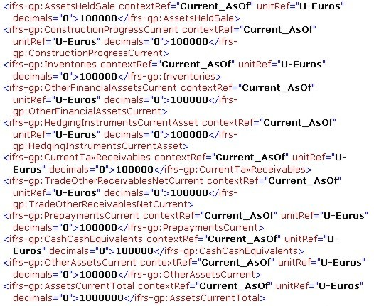

Slide 21
STEP4: validation:
It is a process of checking that instance documents and taxonomies correctly meet the rules of the XBRL specification.
validation with the source documents such as audited accounts, director’s report, auditor’s report and subsidiary information.
On examination with the necessary information, the XBRL document has to again to be validated by the tool provided by Ministry of Corporate Affairs (MCA Tool) before filing.
If there are any errors arising out of such validation has to be addressed before XBRL documents are being filed with the company law authorities.

Slide 22
If there is any exeptions:
Any exceptions observed during this process have to be brought to the notice of the management.
If the exceptions are significant, they should be communicated to the management immediately for necessary rectification before filing.
If it is not possible to rectify these exceptions or if the management refuses to take necessary corrective action, these exceptions should be reported by practitioner in his certificate giving reasons. Whether it would affect the XBRL filing as a whole

Slide 23
Important aspects to be noted:
Planning
Documentation
Relaying upon the work of the expert

Slide 24
Format of certiicate issued:
Addressed to the engaged party
Items covered should be specified
What are all documents converted should be specified
Resposibility of the management
Responsibility of the practitioners
Any assumptions
Any limitations

Slide 25
Certification format:
To The Board of Directors of ……………… Company Limited
We have examined the attached Balance Sheet of ……………. Company Limited ("the Company") as at March 31, XXXX, and the Profit and Loss Account and the Cash Flow Statement of the Company ("the Financial Statements") for the year ended on that date, both annexed thereto, prepared by the Company in the eXtensible Business Reporting Language (XBRL) mode ("the XBRL financial statements"). These XBRL financial statements have been prepared on the basis of the audited financial statements of the Company for the year ended March 31, XXXX, on which we/ M/s……………. Chartered Accountants have expressed an opinion vide our/their Audit Report dated _________, XXXX.
The Management of the Company is responsible for the preparation of the XBRL financial statements in accordance with the taxonomy
specified by the Ministry of Corporate Affairs for filing of the financial statements in the XBRL mode. Our responsibility is to certify the
XBRL financial statements based on our examination, which was conducted in accordance with the Guidance Note on Certification of
XBRL Financial Statements issued by the Institute of Chartered Accountants of India.
Based on our aforesaid examination and to the best of our knowledge and belief and according to the information, explanations and
representations given to us by the management of the Company, we certify that these XBRL financial statements fairly present, in all
material respects, the aforementioned audited financial statements of the Company for the year ended March 31, XXXX, in accordance
with the taxonomy specified by the Ministry of Corporate Affairs for filing of the financial statements in the XBRL mode.
This Certificate is intended solely for your information and for purposes of filing of the Company's financial statements in the XBRL
mode in accordance with the Ministry of Corporate Affairs' General Circular No. 43/2011 dated 7th July, 2011 and is not to be used,
referred to or distributed for any other purpose without our prior written consent.
For …………………………………………
Chartered Accountants
(Firm Registration No.______)
…………………….…………………………
(Name of the member)
Designation:
(Membership No. _______)
Place: …………………………
Date: ……………….………..
Specimen Certificate

Slide 26
Conclusion:
An brief introduction on XBRL was given
XBRL financial statements (Form 23 AC and Form 23 ACA) were highlighted
The need for certification and MCAs
requirements were detailed
The responsibilities of the management
and the practitioners were explained
Certification engagement was discussed
Certification procedure was discussed
Finally a specimen was shown

Slide 27
Disclaimer:
This presentation is intended to make practitioners aware of items involved in certification of XBRL financial statements. Though the presentation may not cover all the items involved, an initiative was made at first.

Slide 28
Thanking the ONE and ALL
P.Nagalakshmi

