Slide 1
NEW SCHEDULE VI
AN OVERVIEW

Slide 2
ELIMINATION OF THE CONCEPT OF “SCHEDULE”
In the old Schedule VI , break-up of amounts disclosed on the face of the balance sheet and profit and loss account was given in the schedules. Additional information was furnished in the notes to accounts. The revised Schedule VI has eliminated the concept of schedule and such information will now be provided in the notes to accounts.
This is in line with the practice under IFRS. Further, all information relating to a particular item of balance sheet and P&L account disclosed in the notes is required to be cross-referred to that item on the face of balance sheet/ P&L account.

Slide 3
Schedule VI vs AS
In case of any conflict between Accounting standard (AS) and Schedule VI, the AS will override Schedule VI.

Slide 4
BALANCE SHEET

Slide 5
Balance sheet
EQUITY AND LIABILITIES
Shareholders’ funds
  Share capital
  Reserves and surplus
  Money received against share warrants
Share application money pending allotment
Non-current liabilities
  Long-term borrowings
  Deferred tax liabilities (Net)
  Other Long term liabilities
  Long term provisions
Current liabilities
  Short term borrowings
  Trade payables
  Other current liabilities
  Short term provisions

Slide 6
ASSETS
Non current assets
  Fixed assets
    Tangible assets
    Intangible assets
    Capital work-in-progress
    Intangible assets under development
  Non current investments
  Deferred tax assets (net)
  Long term Loans & advances
  Other non current assets
Current assets
  Current Investments
  Inventories
  Trade receivables
  Cash & cash equivalents
  Short term loans & advances
  Other current assets

Slide 7
DEFINITION
Current assets:
An asset shall be classified as current when it satisfies any of the following criteria:
(a) it is expected to be realized in, or is intended for sale or consumption in, the company’s normal operating cycle;
(b) it is held primarily for the purpose of being traded;
(c) it is expected to be realized within twelve months after the reporting date; or
(d) it is cash or cash equivalent unless it is restricted from being exchanged or used to settle a liability for at least twelve months after the reporting date.

Slide 8
CURRENT LIABILITIES
A liability shall be classified as current when it satisfies any of the following criteria:
(a) it is expected to be settled in the company’s normal operating cycle;
(b) it is held primarily for the purpose of being traded;
(c) it is due to be settled within twelve months after the reporting date; or
(d) the company does not have an unconditional right to defer settlement of the liability for at least twelve months after the reporting date. Terms of a liability that could, at the option of the counterparty, result in its settlement by the issue of equity instruments do not affect its classification.

Slide 9
Trade receivable
A receivable shall be classified as a ‘trade receivable’ if it is in respect of the amount due on account of goods sold or services rendered in the normal course of business.

Slide 10
Trade payables
A payable shall be classified as a ‘trade payable’ if it is in respect of the amount due on account of goods purchased or services received in the normal course of business.

Slide 11
SHARE CAPITAL
A reconciliation of the number of shares outstanding at the beginning and at the end of the reporting period should be given.
Shares in the company held by each shareholder holding more than 5 percent shares specifying the number of shares should be given.
If shares are allotted for consideration other than cash, as bonus shares, bought back during 5 years immediately preceding the balance sheet date, the following should be disclosed:
a) Aggregate number and class of shares allotted as fully paid up pursuant to contract(s) without payment being received in cash.

Slide 12
SHARE CAPITAL contd…..
b) Aggregate number and class of shares allotted as fully paid up by way of bonus shares.
c) Aggregate number and class of shares bought back.
Shares reserved for issue under options and contracts/commitments for the sale of shares/disinvestment, including the terms and amounts should be disclosed.
The rights, preferences and restrictions attaching to each class of shares including restrictions on the distribution of dividends and the repayment of capital; should be disclosed.

Slide 13
RESERVES AND SURPLUS
Classified as follows:
  Capital Reserve
  Capital Redemption Reserve
  Securities Premium Reserve
  Debenture Redemption Reserve
  Revaluation Reserve
  Share Options Outstanding Account
  Other reserves-nature and purpose to be specified
  Surplus i.e balance in Profit & Loss A/c
Additions and deductions since last Balance sheet to be shown separately under each heads.

Slide 14
RESERVES AND SURPLUS contd…
Debit balance of P & L shall be shown as negative figure under ‘Surplus’ instead of presenting on the asset side .
The balance in ‘Reserves & Surplus’ , after adjusting the negative balance in the head ‘Surplus’, shall be shown under the head “Reserves & Surplus” even if the resulting figure is in the negative.

Slide 15
LONG TERM BORROWINGS
Classified as follows:
  Bonds/ debentures
  Term Loans
  Deferred Payment Liabilities
  Deposits
  Loans & advances from related parties
  Long term maturities of finance lease obligations
  Others
Notes:
Foll should be referred:
Def pay lts
Continuing default

Slide 16
LONG TERM BORROWINGS contd…
To be further classified as Secured & Unsecured
Bonds & Debentures to be stated in descending order of maturity /conversion
Terms of repayment of term loans and other loans shall be stated.
Following should be specified ,in case of continuing default in repayment of loans and interest as on the balance sheet date:
  Period
  Amount

Slide 17
OTHER LONG TERM LIABILITIES
Classified as follows:
  Trade Payables
  Others

Slide 18
LONG TERM PROVISIONS
Classified as follows:
  Provision for employee benefits
  Others(nature to be specified)

Slide 19
SHORT TERM BORROWINGS
Classified as follows:
  Loans repayable on demand from banks & others
  Loans and advances from related parties
Following should be specified ,in case of default in repayment of loans and interest as on the balance sheet date:
  Period
  Amount

Slide 20
OTHER CURRENT LIABILITIES
Classified as follows:
  Current maturities of long-term debt
  Current maturities of finance lease obligations
  Interest accrued but not due on borrowings
  Interest accrued and due on borrowings
  Income received in advance
  Application money received for allotment of securities and due for refund and interest accrued thereon.
    Share application money includes advances towards allotment of share capital.
Notes:
Int accrued & due on borrowings

Slide 21
OTHER CURRENT LIABILITIES contd….
    The terms and conditions including the number of shares proposed to be issued, the amount of premium ,if any, and the period before which shares shall be allotted shall be disclosed.
    It shall also be disclosed whether the company has sufficient authorized capital to cover the share capital amount resulting from allotment of shares out of such share application money.

Slide 22
OTHER CURRENT LIABILITIES contd….
    Further, the period for which the share application money has been pending beyond the period for allotment as mentioned in the document inviting application for shares along with the reason for such share application money being pending shall be disclosed.
    Share application money not exceeding the issued capital and to the extent not refundable shall be shown under the head Equity and share application money to the extent refundable i.e., the amount in excess of subscription or in case the requirements of minimum subscription are not met, shall be separately shown under ‘Óther current liabilities’

Slide 23
SHORT TERM PROVISIONS
Classified as follows:
  Provision for employee benefits
  Others(nature to be specified)

Slide 24
FIXED ASSETS
New classification under “Intangible assets under development”
Assets under lease shall be separately specified under each class of asset.
Note:
Capital advances are now required to be presented separately under the head “Loans and advances” rather than as part of “Capital work in progress” or fixed assets.

Slide 25
NON CURRENT INVESTMENTS
Non-current investments shall be classified as trade investments and other investments and further classified as:
  Investment property;
  Investments in Equity Instruments;
  Investments in preference shares Investments in Government or trust securities;
  Investments in debentures or bonds;
  Investments in Mutual Funds;
  Investments in partnership firms
  Other non-current investments (specify nature)

Slide 26
NON CURRENT INVESTMENTS contd…
Under each classification, details shall be given of names of the bodies corporate (indicating separately whether such bodies are (i) subsidiaries, (ii) associates, (iii) joint ventures, or (iv) controlled special purpose entities) in whom investments have been made and the nature and extent of the investment so made in each such body corporate (showing separately investments which are partly-paid). In regard to investments in the capital of partnership firms, the names of the firms (with the names of all their partners, total capital and the shares of each partner) shall be given.
Investments carried at other than at cost should be separately stated specifying the basis for valuation thereof.
The following shall also be disclosed: Aggregate amount of quoted investments and market value thereof; Aggregate amount of unquoted investments; Aggregate provision for diminution in value of investments

Slide 27
LONG TERM LOANS & ADVANCES
To be classified as :
  Capital Advances
  Security Deposits
  Loans and advances to related parties (giving details thereof)
  Other loans and advances (specify nature).
The above shall also be separately sub-classified as: Secured, considered good; Unsecured, considered good; Doubtful.
Allowance for bad and doubtful loans and advances shall be disclosed under the relevant heads separately.

Slide 28
LONG TERM LOANS & ADVANCES contd….
Loans and advances due by directors or other officers of the company or any of them either severally or jointly with any other persons or amounts due by firms or private companies respectively in which any director is a partner or a director or a member should be separately stated.

Slide 29
OTHER NON CURRENT ASSETS
To be classified as :
  Long Term Trade Receivables (including trade receivables on deferred credit terms)
  Others (specify nature)
Sub classified as :
  Secured, considered good
  Unsecured considered good
  Doubtful
Allowance for bad and doubtful debts shall be disclosed under the relevant heads separately.

Slide 30
OTHER NON CURRENT ASSETS contd…
Debts due by directors or other officers of the company or any of them either severally or jointly with any other person or debts due by firms or private companies respectively in which any director is a partner or a director or a member should be separately stated.

Slide 31
CURRENT INVESTMENTS
To be classified as:
  Investments in Equity Instruments
  Investment in Preference Shares
  Investments in government or trust securities
  Investments in debentures or bonds
  Investments in Mutual Funds
  Investments in partnership firms
  Other investments (specify nature)

Slide 32
CURRENT INVESTMENTS contd….
Under each classification, details shall be given of names of the bodies corporate (indicating separately whether such bodies are (i) subsidiaries, (ii) associates, (iii) joint ventures, or (iv) controlled special purpose entities) in whom investments have been made and the nature and extent of the investment so made in each such body corporate (showing separately investments which are partly-paid). In regard to investments in the capital of partnership firms, the names of the firms (with the names of all their partners, total capital and the shares of each partner) shall be given.

Slide 33
CURRENT INVESTMENTS
The following should also be disclosed:
  The basis of valuation of individual investments
  Aggregate amount of quoted investments and market value thereof
  Aggregate amount of unquoted investments
  Aggregate provision for diminution in value of investments

Slide 34
INVENTORIES
To be classified as follows:
  Raw materials
  Work-in-progress
  Finished goods
  Stock-in-trade
  Stores and spares
  Loose Tools
  Others
Goods-in-transit shall be disclosed under the relevant sub-head of inventories

Slide 35
TRADE RECEIVABLES
Aggregate amount of Trade Receivables outstanding for a period exceeding six months from the date they are due for payment should be separately stated.
Sub – classified as follows:
  Secured, considered good
  Unsecured considered good
  Doubtful
Allowance for bad and doubtful debts shall be disclosed under the relevant heads separately
Debts due by directors or other officers of the company or any of them either severally or jointly with any other person or debts due by firms or private companies respectively in which any director is a partner or a director or a member should be separately stated.

Slide 36
CASH AND CASH EQUIVALENTS
To be classified as follows:
  Balances with banks
  Cheques, drafts on hand
  Cash on hand
  Others (specify nature)
Earmarked balances with banks (for example, for unpaid dividend) shall be separately stated.
Balances with banks to the extent held as margin money or security against the borrowings, guarantees, other commitments shall be disclosed separately.
Repatriation restrictions, if any, in respect of cash and bank balances shall be separately stated.
Bank deposits with more than 12 months maturity shall be disclosed separately.

Slide 37
SHORT-TERM LOANS AND ADVANCES
To be classified as:
  Loans and advances to related parties (giving details thereof)
  Other loans and advances (specify nature)
  (Same as long term L&Adv)

Slide 38
OTHER DISCLOSURES:
Amount of dividend proposed to be distributed to equity & preference shareholders for the period and the related amount per share shall be disclosed separately.
Arrears of fixed cumulative dividends on Preference shares shall also be disclosed separately.
Where in respect of an issue of securities made for a specific purpose, the whole or part of the amount has not been used for the specific purpose at the balance sheet date, there shall be indicated by way of note how such unutilized amounts have been used or invested.
If, in the opinion of the Board, any of the assets other than fixed assets and non-current investments do not have a value on realization in the ordinary course of business at least equal to the amount at which they are stated, the fact that the Board is of that opinion, shall be stated.

Slide 39
PROFIT & LOSS ACCOUNT
Revenue from operations ***********
Other income ***********
Total Revenue ***********

Slide 40
PROFIT & LOSS ACCOUNT
Cost of materials consumed
Purchases of Stock-in-Trade
Changes in inventories of finished goods work-in-progress and Stock-in-Trade
Employee benefits expense
Finance costs
Depreciation and amortization expense
Other expenses

Slide 41
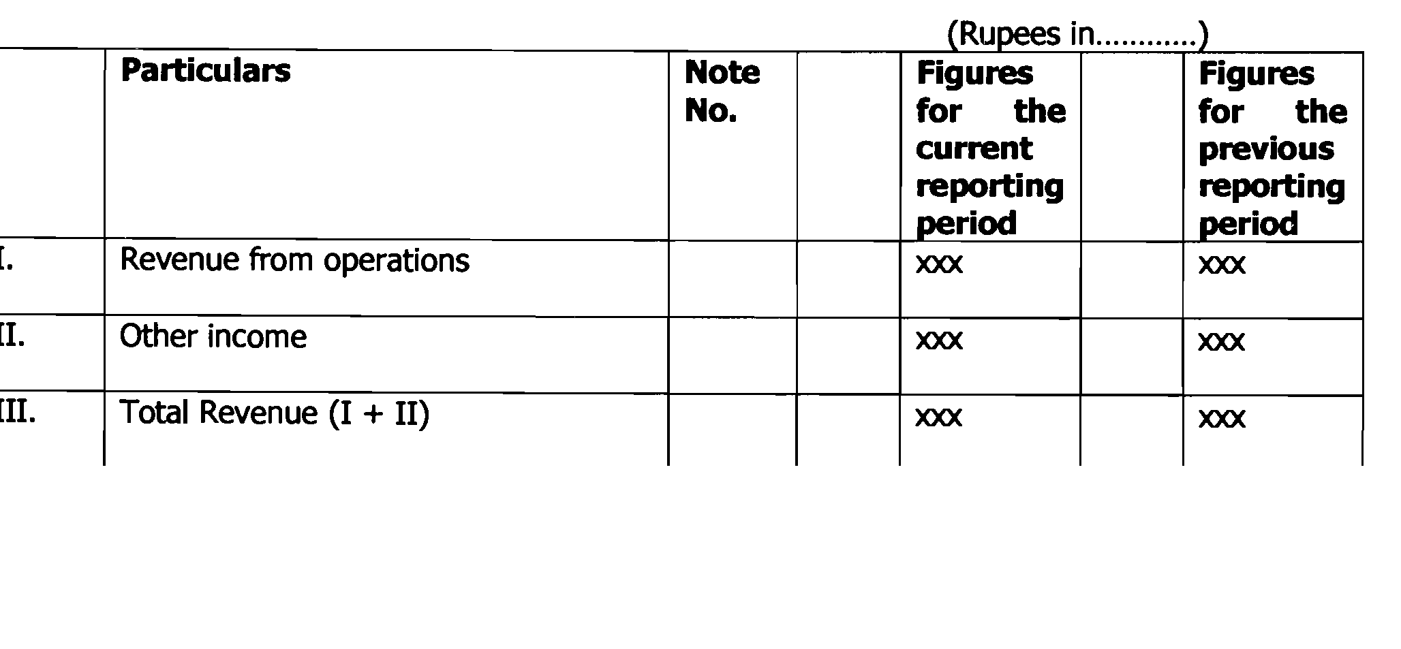
Profit & Loss A/c

Slide 42
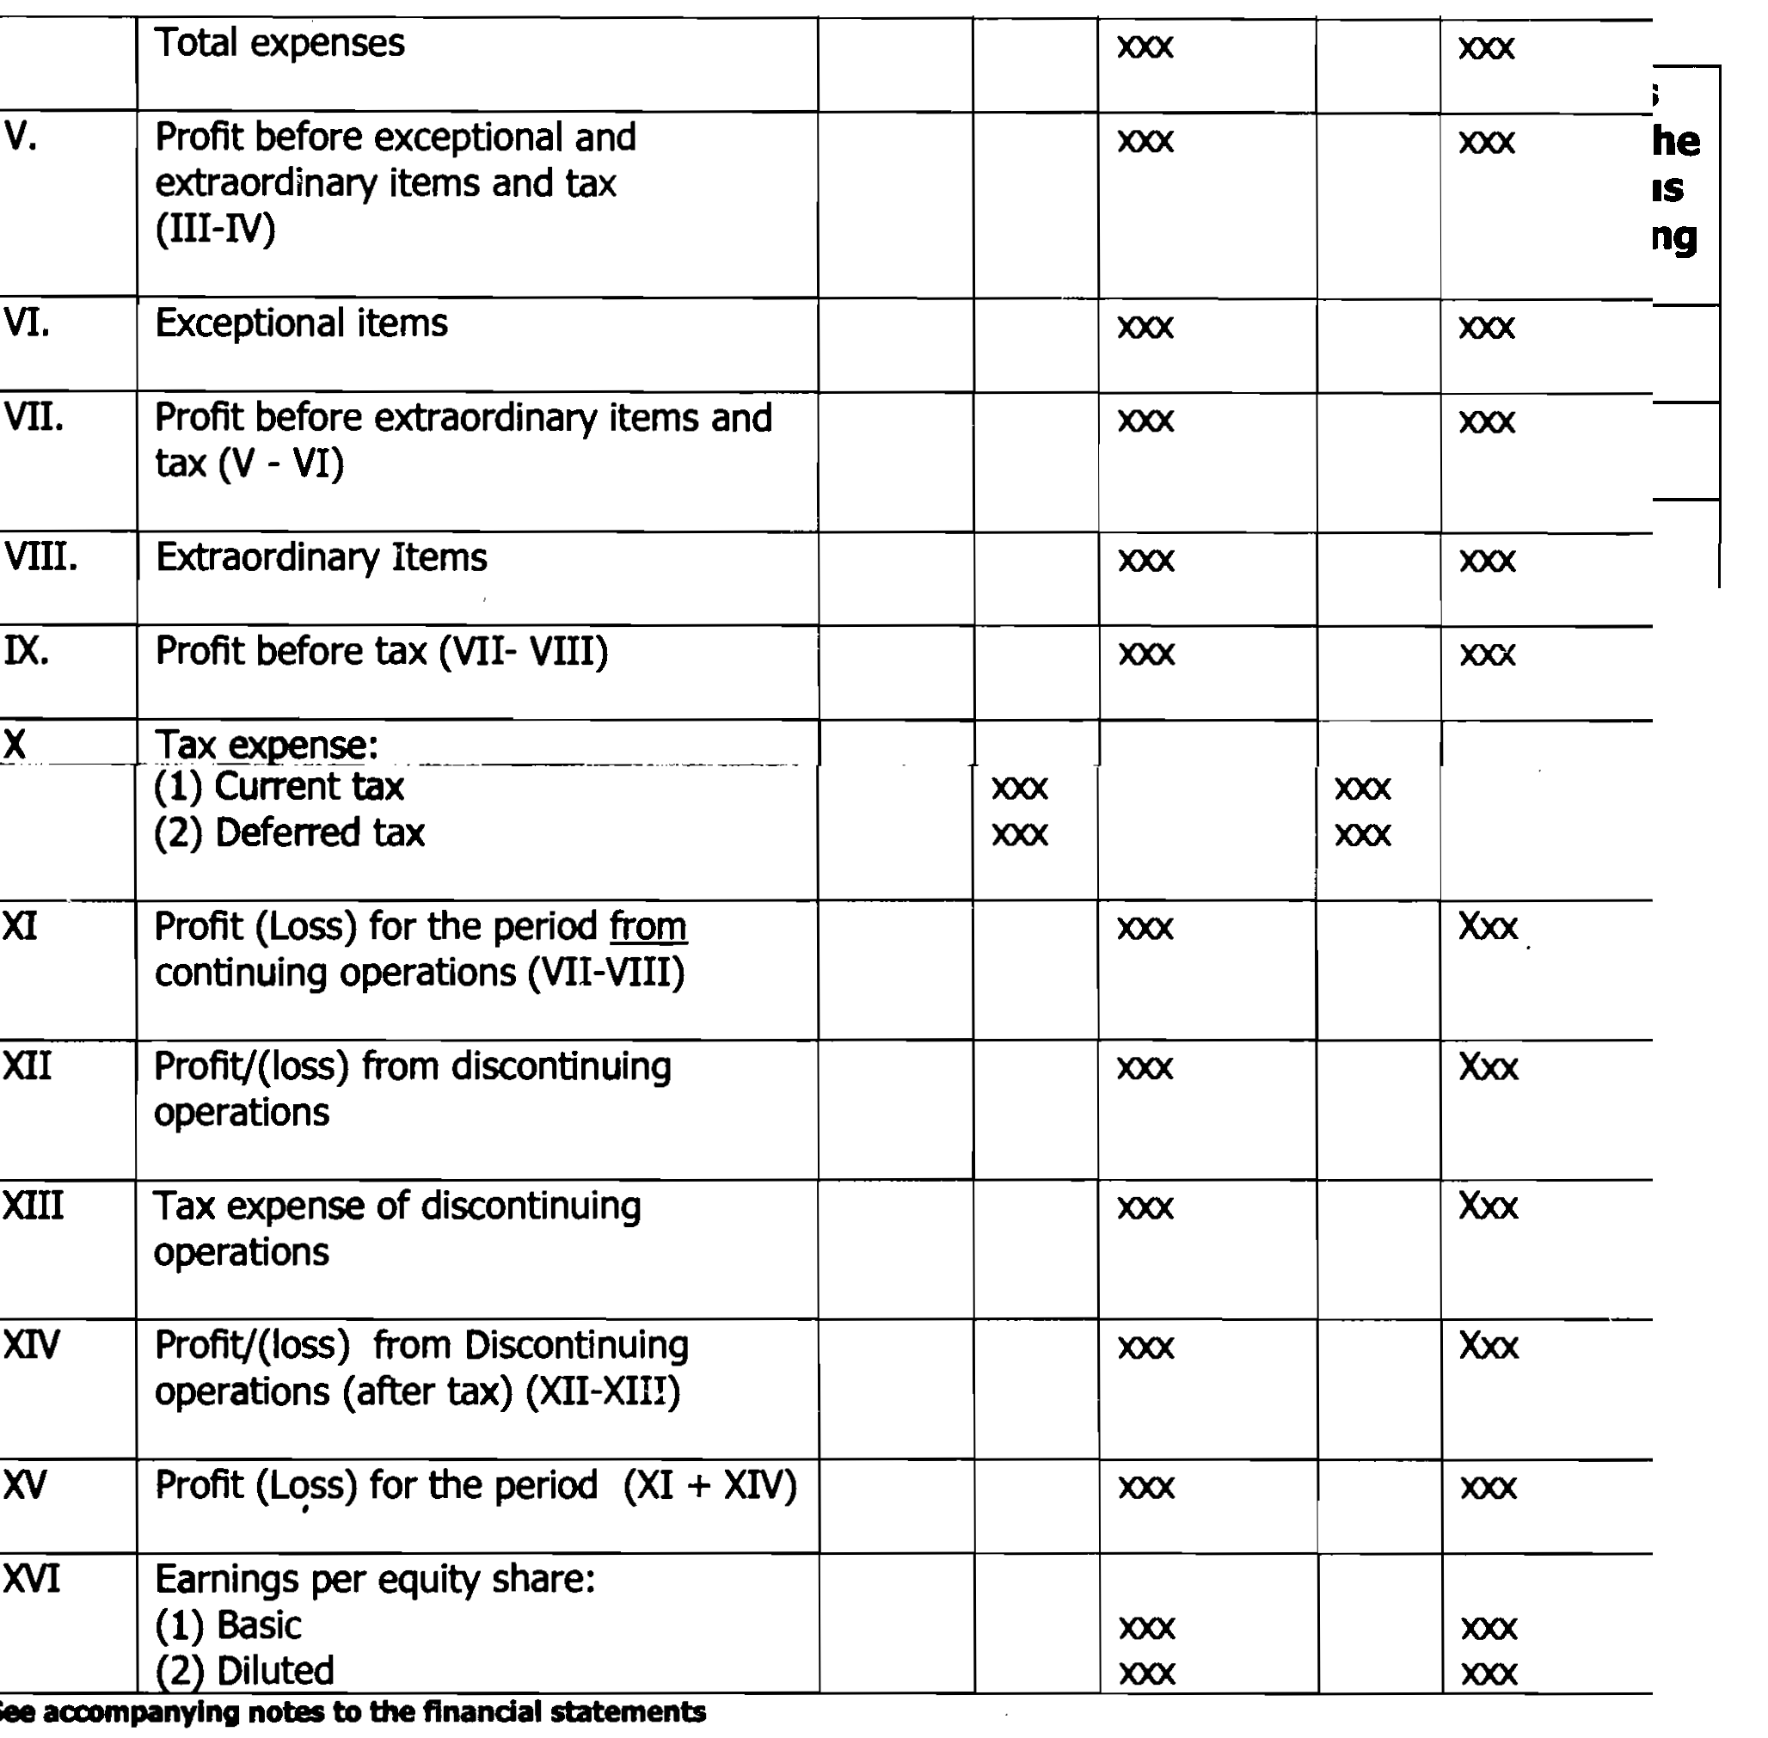

Slide 43
FINANCE COSTS
Should be classified as follows:
  Interest income
  Other borrowing costs
  Applicable net gain/loss on foreign currency transactions and translation.

Slide 44
OTHER INCOME
Should be classified as follows:
  Interest income
  Dividend income
  Net gain/loss on sale of investments
  Other non operating income(net of expenses directly attributable to such income)
  Note :
  AS per AS 9,Dividend income should be recognised only when the right to receive the dividend arises before the balance sheet date.

Slide 45
Simplification of disclosure requirements
Disclosures regarding licensed, installed capacity, actual production is withdrawn.
Disclosures of quantitative details of raw material consumed is withdrawn. It simply requires presentation of expenditure on account of raw material and goods purchased under broad heads.
Removal of disclosure requirement of managerial remuneration.

