Slide 1

Dear All
Today topic is……..

Slide 2

Incorporation
of
Company

Slide 3
AS
Indian Company
Foreign Company

Slide 4
Incorporation of
Company
Involved
Various
Step

Slide 5
STEPS Involved
1. Selection of type of company
Promoter to be decided the form of company as:
Private Limited
Public Limited

Slide 6
STEPS Involved
2. Selection of Company Name
(a) Applying for ascertaining the availability of the selected Name.

Slide 7
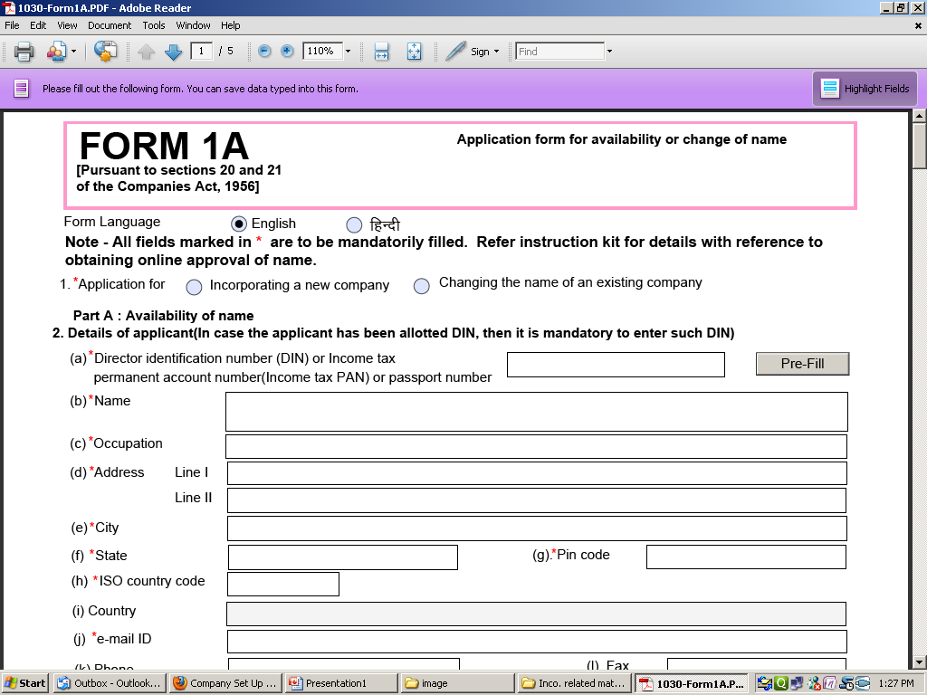
Application for Availability of Name to be file in Form 1A along with fee of Rs. 500

Slide 8
STEPS Involved
2. Selection of Company Name
(b) Approval of the name.
Registrar shall intimate whether the Name is available or not in 7 day’s. The confirmation of the name available shall be valid for a period of 60 day’s.

Slide 9
STEPS Involved
3.Requirement for having
DIN
DSC

Slide 10
Document Required for DIN:-
DIN Form-I
Proof of identity
Proof of residence
Verification Annaxure-1.
All copy proofs shall be certified an approved authority along with his seal must be clearly indicated. ( Mandatory in case of NRI)

Slide 11
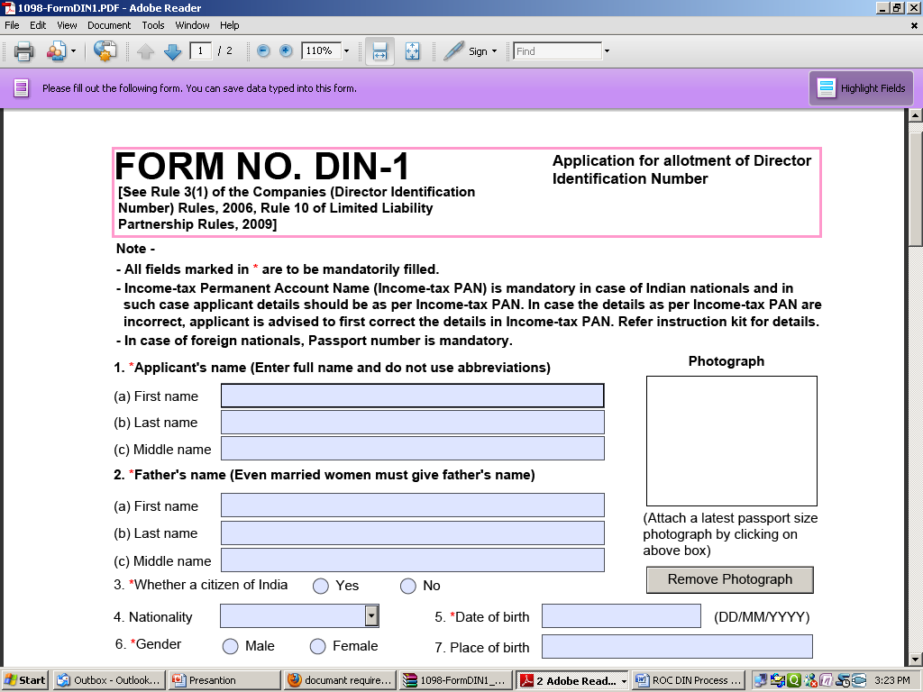
DIN is a unique number. There is a fixed fee of Rs 100 and it can only be paid through online mode

Slide 12
Types of Digital Signature Certificates:-
Class 1: These certificates do not hold any legal validity as the validation process is based only on a valid e-mail ID and involves no direct verification.
Class 2: Here, the identity of a person is verified against a trusted, pre-verified database.
Class 3: This is the highest level where the person needs to present himself or herself in front of a Registration Authority (RA) and prove his/ her identity.
For MCA related work’s used only class II & III type of DSC.

Slide 13
Document Required for DSC:-
Application Form duly filled in,
Photograph of Applicant ( Must be pasted on form with Cross Signature ),
Duly Attested Photocopy of anyone of PASSPORT/ DRIVING LICENCE/ PANCARD/ GOVT. ISSUED ID CARD as ID Proof of Applicant ,
Self Attested copy of any one of the latest bill of WATER / ELECTRICITY / POWER / TELEPHONE / CREDIT CARD or VOTER'S ID CARD / DRIVING LICENSE/PASSPORT in the applicant's name for address confirmation. (as Proof of residence),
Declaration Letter (Format Attached ).

Slide 14
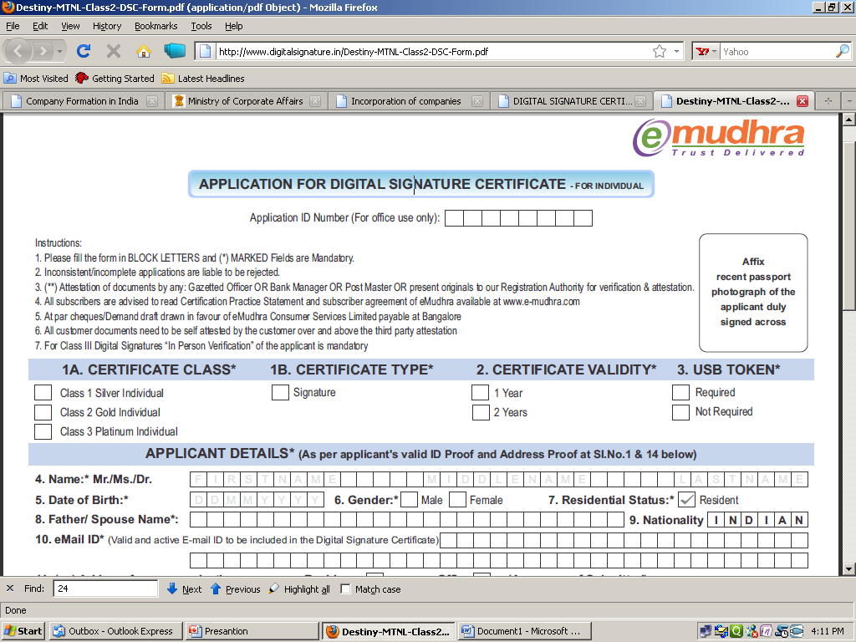
Digital Signature certificate (DSC) are the digital equivalent (that is electronic format) of physical or paper certificates

Slide 15
STEPS Involved
4.Preparation of Draft
MEMORANDUM
OF
ASSOCIATION
ARTICLES
OF
ASSOCIATION

Slide 16
MEMORANDUM OF ASSOCIATION:-
This Document is constitution of a company. This is divided into five clauses.-
Name clause,
Registered Office clause,
Object clause-
- Main objects
- Other objects
Liability clause
Capital clause
Subscription.

Slide 17
ARTICLES OF ASSOCIATION:-
The AOA contains regulation relating to the internal Management. The important clauses contained in this document are:-
Share Capital & Variation of Right.
Lien of company on share.
Calls on shares.
Share Certificate.
Transfer of Share
Transmission of share
Forfeiture of share
Board of Director Power
Share warrants.
Alteration of share capital
General meeting
Voting Power of member
Manager or Secretary
Accounts
Winding up.
Indemnity.
Etc.

Slide 18
STEPS Involved
5.Done various work
Vetting of MOA & AOA,
Printing of MOA & AOA,
Stamping of MOA & AOA,
Signing of MOA & AOA,
Power of Attorney.

Slide 19
STEPS Involved
6.Prepare other document required to be filed to ROC.
Other Document Include:-

Slide 20
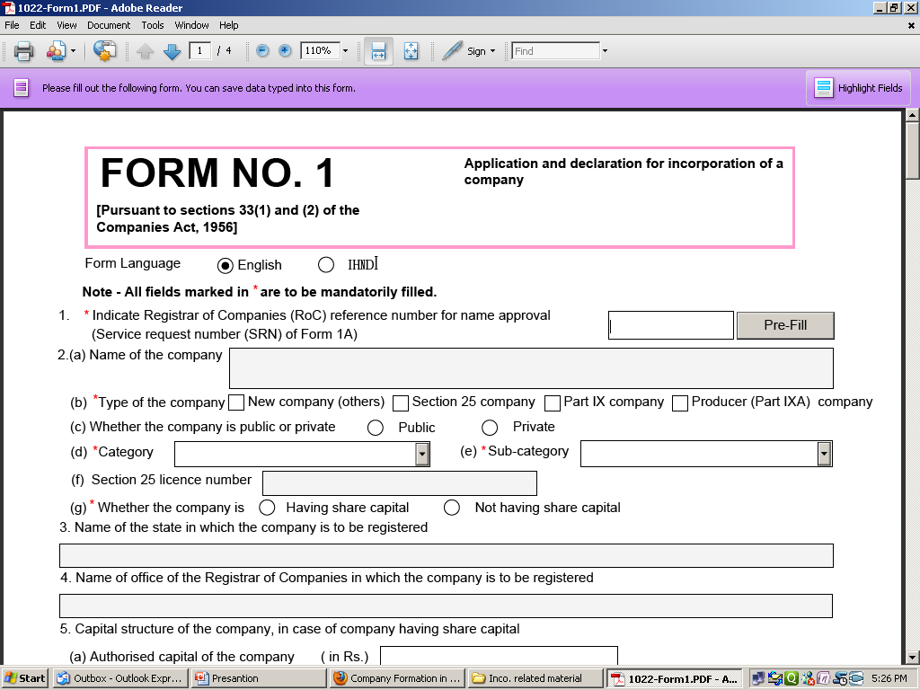
e-Form 1:- Statutory declaration that all legal requirements in connection with incorporation are complied with.

Slide 21
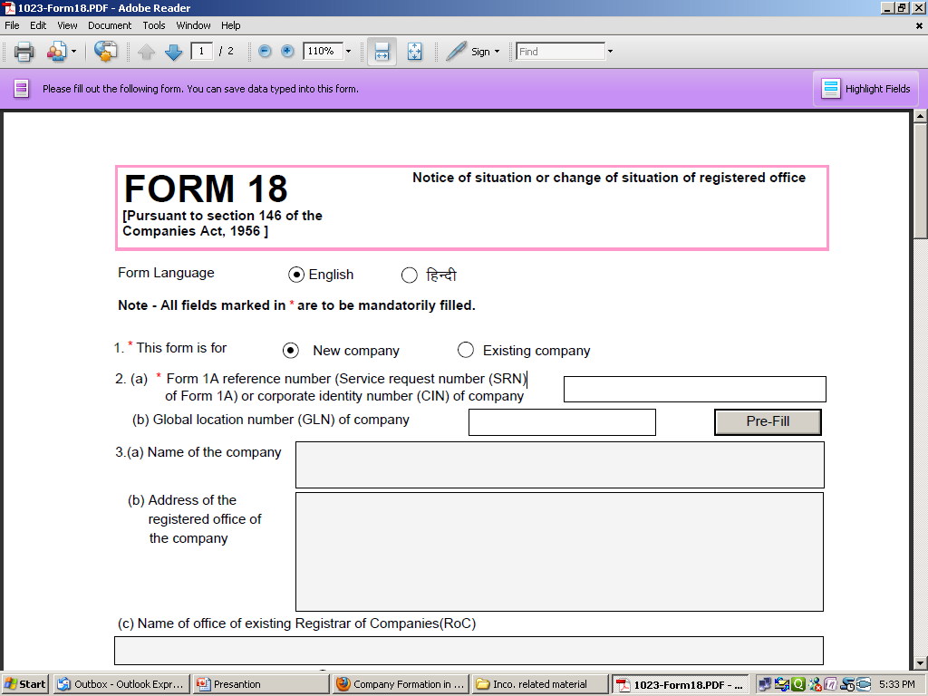
e-Form 18:- Full address of registered office.

Slide 22
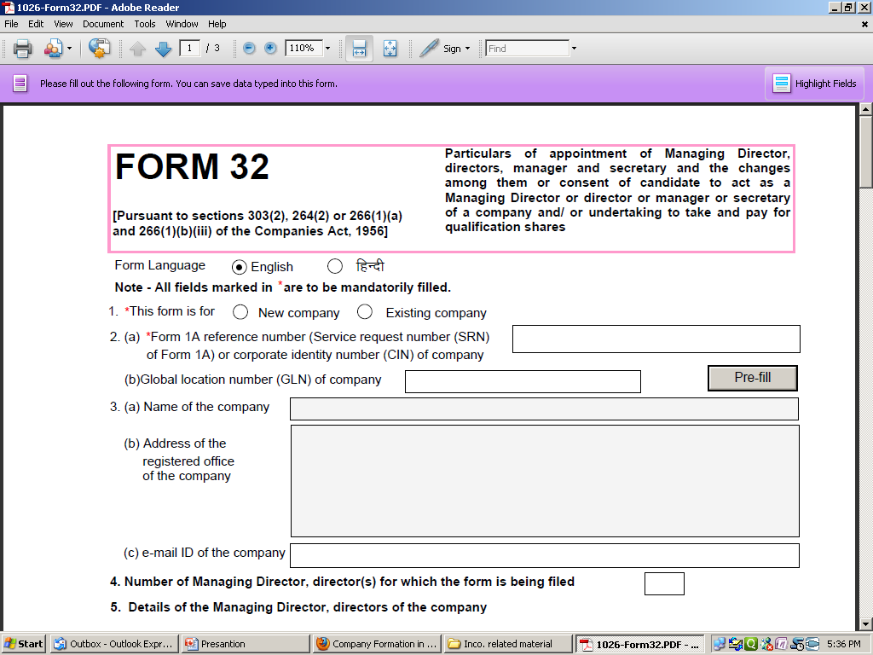
e-Form 32:- Composition & Consent of Director

Slide 23
STEPS Involved
7.Payment to Registration fees
The Quantum of registration fee has been prescribed in Schedule X to Companies Act.

Slide 24
STEPS Involved
8. Certificate of Incorporation (section 33 and 34)
Registrar normally issue certificate of incorporation within 7 days of the receipt of documents. This document are know as.
Birth Certificate of Company

Slide 25
STEPS Involved
9. Commencement of Business
A Private limited company and a company not having share capital may commence its business activities from the date of its incorporation. However, a public Limited Company having share capital is required to take certificate of commencement of business before it can commence business.

Slide 26
Thanks to ALL
Created by:-
Shubham Shrivastava
From S Lohia & Associates

