Slide 1
XBRL
eXtensible
Business
Reporting
Language

Slide 2
AGENDA
WHAT IS XBRL?
XBRL IN THE INDIAN CONTEXT
HOW DOES XBRL WORK?
HOW IS TAGGING DONE?
HOW TO CREATE AN INSTANCE DOCUMENT?
PROCEDURE FOR E-FILING OF XBRL DOCUMENTS.

Slide 3
What IS XBRL?

Slide 4
What is XBRL?
DATA
TAXONOMY
Language for the electronic communication of business and financial reports.
XBRL is Extensible XML (Extensible Markup Language).
Provides benefits in the preparation, analysis and communication of business information.
Offers cost savings, greater efficiency and improved accuracy and reliability.
XBRL INSTANCE
Tax Computation
Statutory Accounts
Bank Filings
Regulatory Filings
Corporate Website

Slide 5
KEY XBRL TERMINOLOGY
XML
Extensible Mark Up Language has been a standard computer format for exchanging information online for many years.
TAXONOMY
Electronic collections or classifications of XBRL tags (elements) that define financial and other information and the relationships between them, related to a defined reporting framework (e.g.: Schedule VI or IFRS Taxonomy)
TAGGING
Association of the relevant XBRL taxonomy concept with a specific report disclosure item (e.g. depreciation expense) enabling the creation of an XBRL document (or XBRL instance) suitable for online filing.
For e.g. “INR 15m” a financial fact in a XBRL document is tagged against a concept “Revenue” in the Indian Schedule VI taxonomy. The financial fact “INR 15m” has a tag to the “Revenue” concept in the taxonomy.
EXTENSIBILITY
Refers to a taxonomy being extended for modifications including additions of XBRL concepts.

Slide 6
XBRL – More Than Just Definitions
Presentation
Comptant et Comptant Equivalents
Presentation
現金及び現金等価物
Presentation
Гроші та їх еквіваленти
Presentation
Деньги и их эквиваленты
Presentation
Kas en Geldmiddelen
Presentation
现金与现金等价物
Standardization
Presentation
Geld & Geld nahe Mittel
Presentation
Cash & Cash Equivalents
Label
cashCashEquivalentsAndShortTermInvestments
References
GAAP I.2.(a)
Instructions
Ad Hoc disclosures
XBRL
Item
XML
Item
XBRL
Item
Calculation
Cash = Currency + Deposits
Formulas
Cash ≥ 0
Contexts
US $
FY2004
Budgeted
Validation
Notes:
XBRL provides more than just XML Schema for addressing these problems; it provides XML Schema in connection with XML Link (or XLink) to provide multidimensionality. The XBRL Item is connected to its label or machine definition via a schema concept; then XBRL goes beyond the use of Schema to link the element to a range of additional concepts:
Presentation – providing a human readable label…..in this case with English, French, German, Dutch, Chinese, Japan, Russian, and Ukrainian presentation alternatives for this item label.
Reference – can be any other concept such as reference materials, business process guidance, a Web service or even another business rule.
Calculation – provides an internal mathematical check or validation on the item.
Context – provides the item with transferable context around currency, period, nature (actual, budgeted, forecasted, etc.).
The combination of XML Schema and XML Link provide the data with significant standardization and validation context that can be shared across applications, platforms and entities via domain level taxonomies.

Slide 7
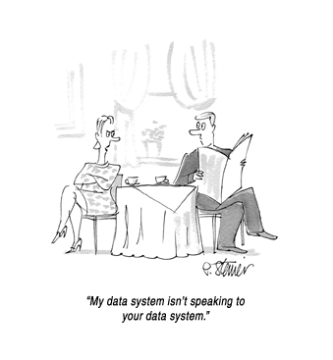

Is there a problem ?

Slide 8


Barcode has done for product distribution
what XBRL is doing for business reporting.

Slide 9

XBRL INTERNATIONAL
XBRL has been developed by XBRL International
Not-for-profit consortium of over 450 companies and organizations

Slide 10
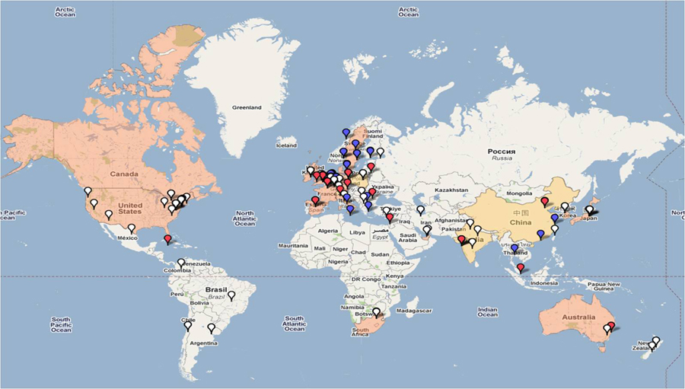

Slide 11
XBRL IN THE INDIAN CONTEXT

Slide 12
XBRL INDIA
XBRL India is the Indian Jurisdiction of XBRL International.
Main objective: promote and encourage adoption of XBRL as the standard for electronic business reporting.
Members include regulators, stock exchanges, software companies and others.

Slide 13
Applicability of XBRL in India
The MCA vide its General Circular No. 37/2011, dated June 07, 2011 has required the following class of companies to file the financial statements in XBRL form only from the year 2010– 2011:
All companies listed in India and their Indian subsidiaries;
All companies having a paid up capital of Rs 5 crores and above; and
All companies having a turnover of Rs 100 crores and above
(Exclusions: Banking, Insurance, Power companies and NBFC)

Slide 14
Key Requirements as Specified by the MCA
Minimum Tagging Requirements
Balance Sheet
Profit & Loss Accounts
Cash-Flow Statements
Schedules related to Balance Sheet and P&L Account
Notes to the Accounts
Statement pursuant to section 212 of the Companies Act, 1956 relating to subsidiary companies.
MCA specific requirements ( Director’s Report, Auditor’s Report, Signatories to Balance Sheet, General Information about the Company)
No extensions to the core taxonomy are allowed.
A validation tool shall be provided in the MCA portal for validating the XBRL instance – this is a pre-requisite for filing .

Slide 15
4. Separate instance documents need to be created for the following:
Stand Alone Balance sheet of the company.
Stand Alone Profit and Loss Account of the company.
Consolidated Balance sheet of the company.
Consolidated Profit and Loss Account of the company.
5. The instance document should contain the financial information for both the current as well as the previous financial year.

Slide 16
HOW DOES XBRL WORK?

Slide 17
XBRL makes the data readable with the help of 2 documents :
TAXONOMY
INSTANCE DOCUMENT
Physical Financial Statements of the Co.
XBRL Format
(Instance Document)
TAXONOMY

Slide 18
TAXONOMY
These are dictionaries that contain the terms used in the financial statements and their corresponding XBRL tags. They define the elements and their relationships based on the regulatory requirements and the basic XBRL properties.
It includes terms such as net income, earnings per share, cash, etc. Each term has specific attributes that help define it, including label and definition and potential references.

Slide 19
For Example, LoansAdvances has the following attributes:
Definition: The total amount of loans and advances given by the entity to all parties.
Data type : Monetary
Substitution Group : Item
Balance type : Debit
Period Type : Instant

Slide 20
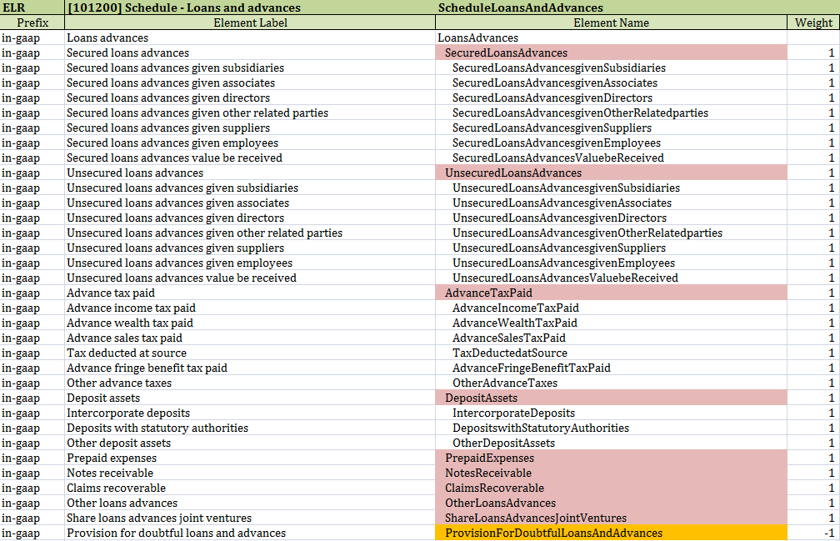
The calculation of Loans Advances in the taxonomy is as follows:

Slide 21

In India, the taxonomy has been developed by the Ministry of Corporate Affairs (MCA),based on the requirements of:
Schedule VI of Companies Act,
The Accounting Standards; and
SEBI Listing requirements.

Slide 22
INSTANCE DOCUMENT
A file that contains business reporting information and represents a collection of financial facts and report-specific information using tags from one or more XBRL taxonomies.
It is a business report in an electronic format created according to the rules of the XBRL. It contains the facts that are defined by the elements in the taxonomy it refers to, together with their values and an explanation of the context in which they are placed.
Instances documents must be linked to at least one taxonomy, which defines the contexts, labels or references.

Slide 23
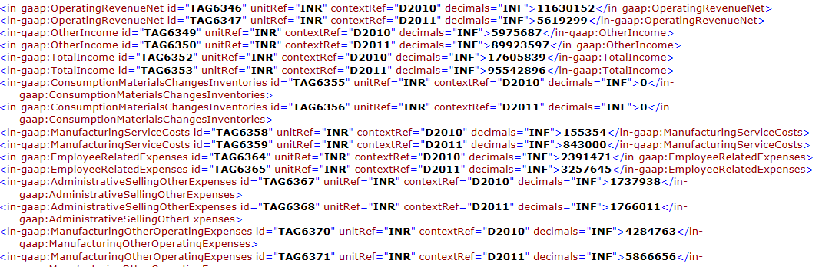
Illustration of Instance Document
Period
Fact Name
Unit
Scale

Slide 24
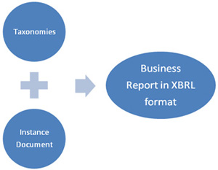
The entities use the prescribed taxonomies to map their reports and generate a valid instance document.

Slide 25
HOW IS TAGGING DONE ?

Slide 26
MAPPING DATA
To map an XBRL taxonomy means to locate within a taxonomy structure a concept equivalent in attributes to an identified data point.
This process of mapping is known as “tagging.” It is essentially the joining of the 2 vocabularies-electronic to reported facts.
The effort associated with XBRL mapping has often been understated as a simple one-to-one matching process.
Our experience in XBRL demonstrates that the detailed tagging of notes to financial statements is a complex process requiring the knowledge of accounting and exercise of judgment by the financial reporting specialists.

Slide 27
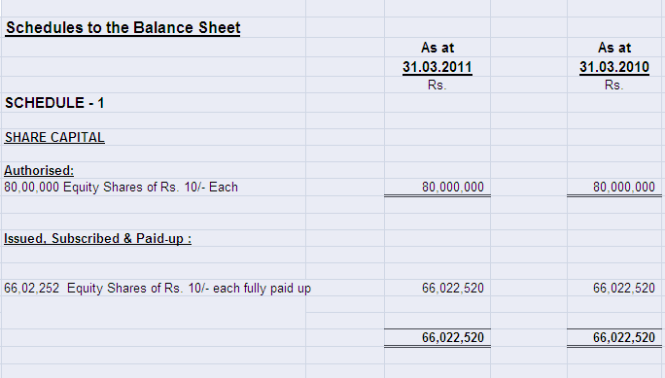
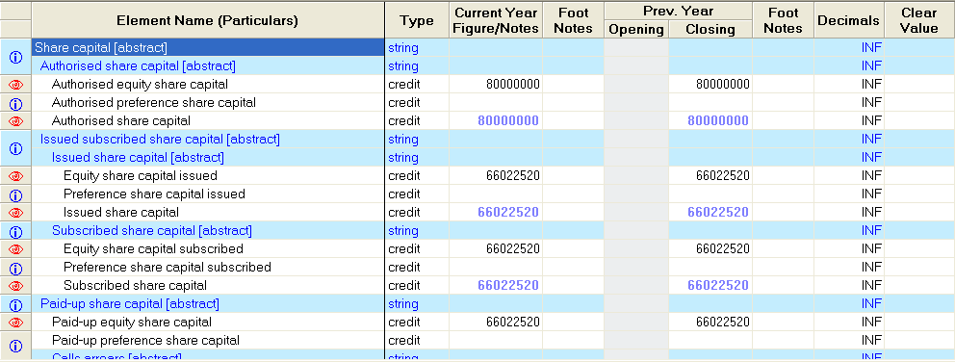
TAGGING OF SHARE CAPITAL SCHEDULE

Slide 28
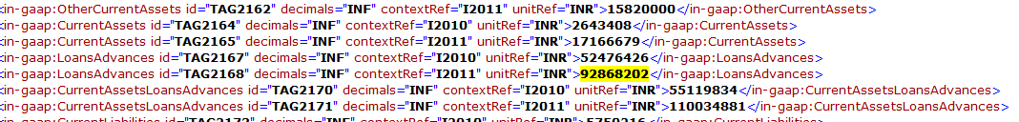
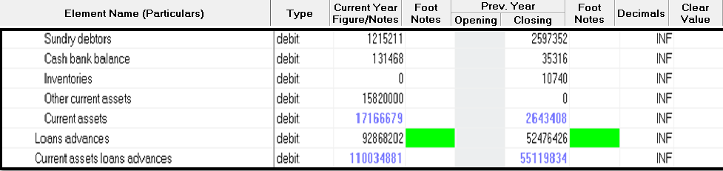
TAGGING-ILLUSTRATION
92868202-What is being tagged?
Loans advances:92868202
Currency : INR
Balance: debit
Company: Abc Co. Ltd
(ABC COMPANY LTD.)

Slide 29
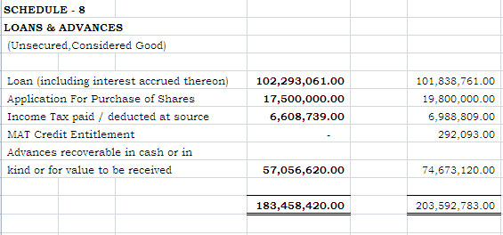
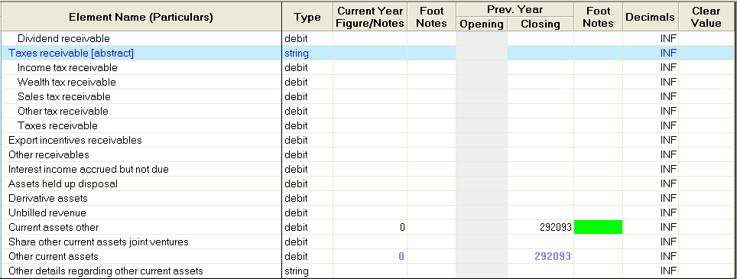

Slide 30
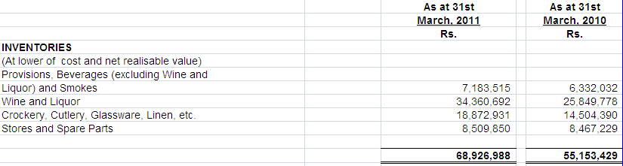
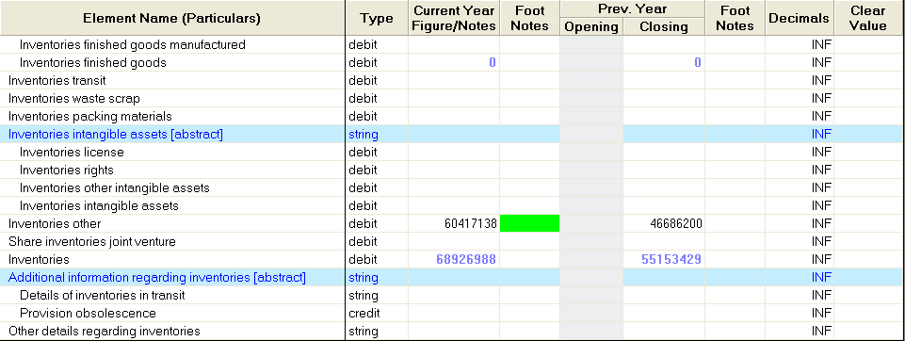
Inventory of Service providing companies is neither manufactured, nor traded, so it has been tagged under Other Inventories

Slide 31
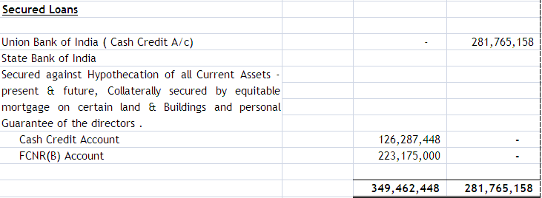
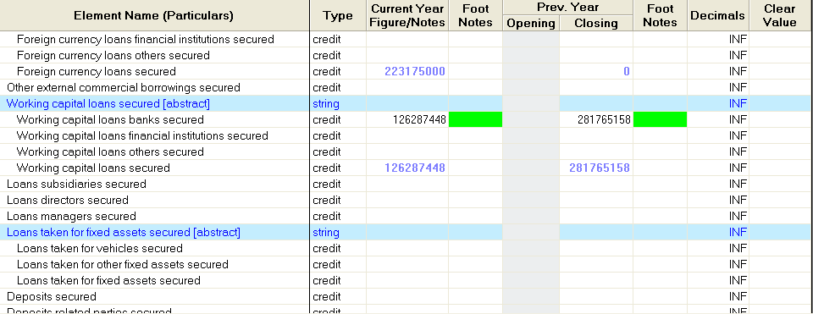

Slide 32
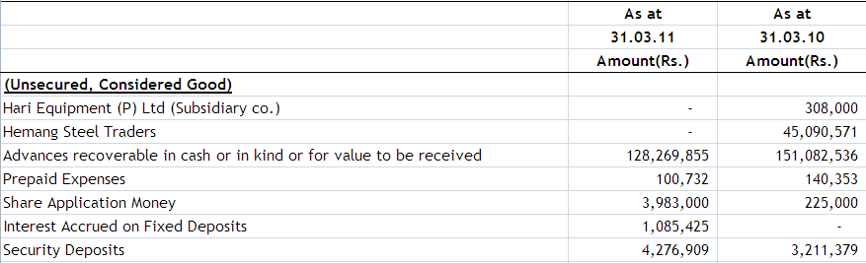
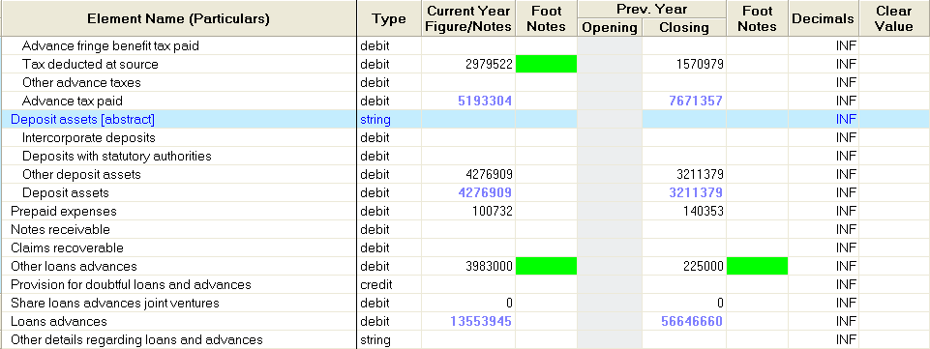

Slide 33
HOW TO CREATE AN INSTANCE DOCUMENT?

Slide 34
Creation of XBRL Instance Document
Obtaining audited financial statements.
These audited financial statements would preferably be in Excel and/ or Word format.
Preparation of the source document based on the audited financial statement for XBRL conversion.
Mapping the source document to the Target Taxonomy as mandated by MCA.
Validating the mapped document to create instance document.

Slide 35
Eliminating errors arising out of validation based on error logs.
Approval of Instances and mapping by the Board of Directors before creating XBRL instance document.
Creating XBRL instance document.
Validation of the XBRL instance document by the management using the tool provided by the MCA before filing with the Office of the Registrar of Companies (ROC).
The following slide shows a validated instance document.

Slide 36
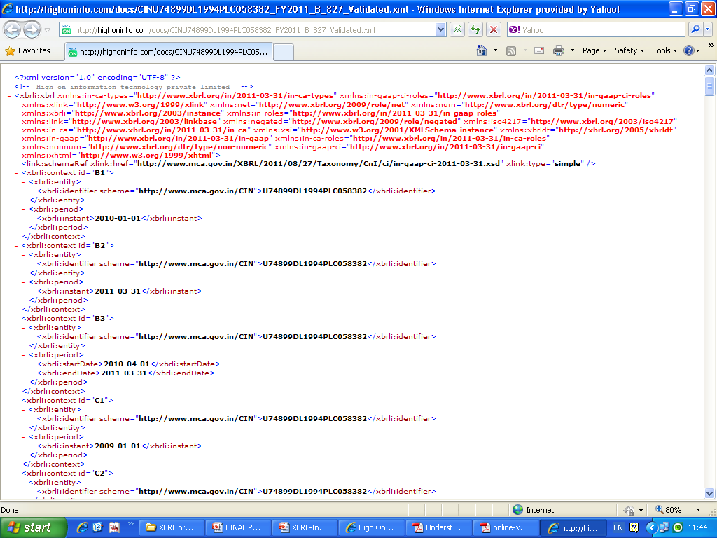

Slide 37
Procedure to be followed for e-filing of XBRL documents

Slide 38
MCA XBRL e-Filing Process
Financial Statements
MCA Taxonomy
Tagging
XBRL Instance
MCA Validation Tool
Validate Instance
Compulsory Pre-Scrutiny
Form 23 ACA
Form 23 AC
XBRL Instance
P&L
Balance Sheet
MCA e-21 Filing Platform

Slide 39
Download MCA XBRL validation tool from MCA portal
STEP 1
Validating the instance document is a pre requisite before filing the balance sheet and profit & loss account on MCA portal.
The MCA XBRL validation tool can be downloaded from the XBRL website of the Ministry.

Slide 40
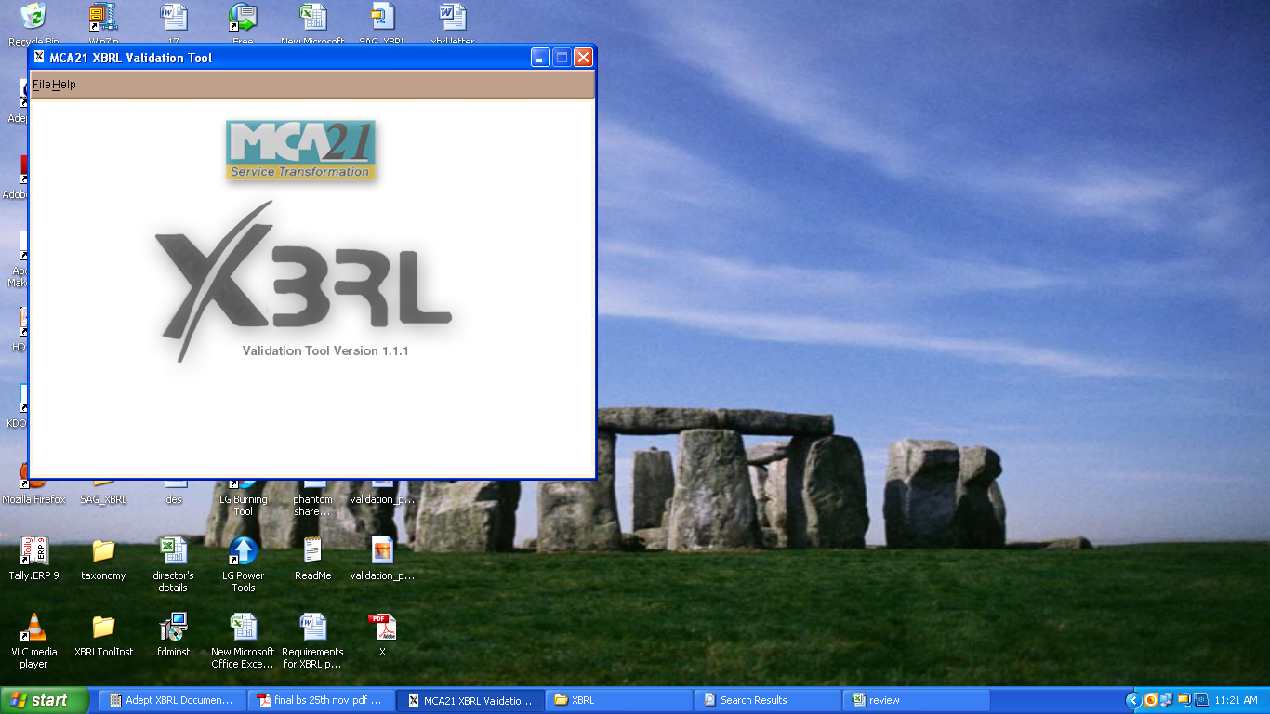

Slide 41
Load the Instance Document in the validation tool
STEP 2
To load the instance document, you need to click the open button, select the instance document and open it. The detail of the company is available under the General Information tag in the XBRL viewer.

Slide 42
Use the tool to validate the instance document
STEP 3
The next step is to validate the instance document. The following validations shall be performed by the tool :
Validating that the instance document is as per the latest and correct version of taxonomy prescribed by MCA.
All mandatory elements have been entered.
Other business rules as specified by MCA.
Other validations as per taxonomy.

Slide 43
Perform pre-scrutiny of the validated instance document through the tool
STEP 4
Once the instance document is successfully validated from the tool, the next step is to pre-scrutinize
the validated instance document with the help of the same tool.
For pre-scrutinizing the instance document, a working internet connection shall be required.
In the Pre-scrutiny, the server side validations (i.e. validations which are to be validated from the MCA21 system) shall be performed.

Slide 44
Final verification post pre-scrutiny of the document
STEP 5
Once the instance document has been successfully pre-scrutinized, the next step is to generate pdf by using ‘Export to pdf’ functionality in the tool to verify the final instance document.
It is imperative that the company and the professional certifying the instance documents should use this feature to verify the accuracy of the instance document.

Slide 45
Attach instance document to the Form 23AC-XBRL and Form 23ACA-XBRL
STEP 6
There shall be a separate set of Form 23AC-XBRL and Form 23ACA-XBRL available on the MCA portal for filing in XBRL form.
First Form 23AC-XBRL and 23ACA-XBRL are to be filled up. Thereafter, the validated and pre-scrutinized instance document for Balance sheet are to be attached to Form 23AC-XBRL.
Similarly, the instance document for Profit and Loss account is to be attached to Form 23ACA-XBRL. Separate instance documents need to be attached w.r.t. Standalone financial statements and consolidated financial statements.

Slide 46
Submitting the Form 23AC-XBRL and Form 23ACA-XBRL on the MCA portal
STEP 7
After the forms are filled, you are required to perform pre-scrutiny of the form, sign the form and then upload the same as per the normal e-Form filing process. It shall be validated that the attached instance documents are validated and pre-scrutinized from the XBRL validation tool.

Slide 47
Viewing of balance sheet and profit and loss submitted in XBRL form on MCA portal
STEP 8
The XBRL instance documents submitted along with Form 23AC-XBRL and 23ACA-XBRL are in machine readable format. Therefore, for viewing the same in a human readable format, these shall be converted into human readable format by the MCA21 system.
For viewing the same on MCA portal and for taking certified copies of the same, these converted documents shall be made available.

Slide 48
It has to be ensured that the XBRL financial statements generated are as per the taxonomy defined by MCA.
This includes ensuring completeness, accuracy, mapping and structure of the XBRL financial statements.
Completeness means that all required information is formatted at the required levels.
Mapping means consistency with the meaning of the associated concepts in the source information.
Accuracy means consistency with the source information.
Structure means that XBRL files are structured in accordance with the requirements of the entity’s reporting environment.

Slide 49
REVIEW
REVIEWING the generated reports is an essential step to ensure high-quality submissions which meet the appropriate regulatory requirements. The review process should include:
Selecting the most appropriate XBRL tags.
Ensuring all details present in the existing filings are properly captured.
Verifying that the XBRL rendering reflects the related official filing.
Ensuring that XBRL documents comply with other aspects that cannot be assessed solely by viewing an XBRL instance document.

Slide 50
Advantages of xbrl

Slide 51
WHAT ARE THE ADVANTAGES OF XBRL?
Automation, more reliable and more accurate handling of data
Improved analysis, better quality of information and decision-making.
Cost Saving, Time Saving
Enables us to concentrate effort on analysis, aided by software which can validate and manipulate XBRL information.
Flexible language, intended to support all current aspects of reporting in different countries and industries.
Extensible: can be adjusted to meet particular business requirements, even at the individual organization level.

Slide 52
Better details leads to better management… much better governance… far better markets.
XBRL assists in getting right information at right time.
For instance, in a Banking business, XBRL assists in decreasing the number of days to update financial information from 11 to a day or two, and lessen time spent on mechanics from 90% to 10%, so that most of the time is available for analysis, which is much better for banks and reduce risk.

Slide 53
RESPONSIBILITY OF THE MANAGEMENT
The management needs to exercise appropriate controls over the following three areas :
Selecting, maintaining, and testing the taxonomy;
Accurately mapping and tagging data elements to XBRL reports; and
Enforcing change management procedures for XBRL processes.

Slide 54
XBRL READINESS
SELECTING THE SOFTWARE
CONSIDERING IMPLEMENTATION OPTIONS
BUILDING THE RIGHT TEAM
ANTICIPATING XBRL NEEDS : DATA & METADATA MAINTENANCE
MAPPING DATA : TAGGING TAKES TIME TO WORK THROUGH
ENSURING QUALITY : THOROUGH REVIEW OF THE XBRL DOCUMENTS IS NECESSARY
GETTING THE TIMING RIGHT : THE FILING SHOULD BE COMPLETED WITHIN THE DEADLINE

Slide 55

THANKYOU
ANY QUESTIONS?
Compiled by : Raina Sanghai

