Slide 1
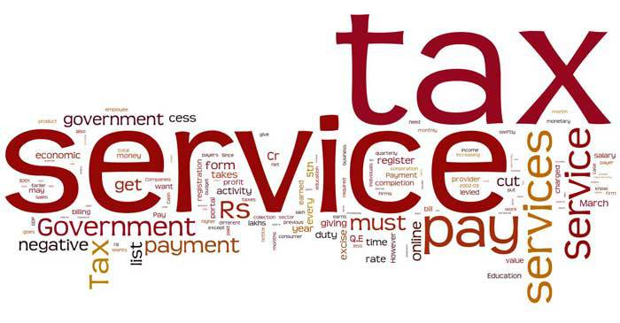
Service Tax

Slide 2



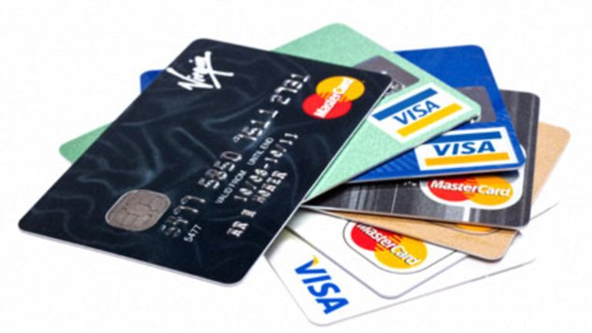


Service Tax
Banking
Food Services
Advertisement
Debit / Credit Card
Construction Services
Insurance Services

Slide 3

Service Tax
Introducing Krishi Kalyan Cess
Krishi Kalyan Cess Is Introduce With Increase OF 0.5% Rate In Service Tax With Total Rate Of 15% With The Effect Of 01/06/2016 u/s 66B Of Finance Act , 1994.
Notes:
The cenvat credit of Krishi Kalyan Cess shall be available and shall be utilized only for the payment of KKC. Thus, separate accounts needs to be maintained. Refund of this KKC shall also be allowed as the cenvat credit is there.

Slide 4
Service Tax
Changes in Point of Taxation Rules 2011 with respect to New Levy of Krishi Kalyan Cess
For Service Provider :
Krishi Kalyan Cess not payable if the payment has been received before 1st June, 2016 and invoice has been issued either prior to 1-6-2016 or within fourteen days i.e. Upto 14-06-2016.
For Service Recipient :
(i). Service Received from Government or Local Authority: -
Tax is payable on earlier of
– Payment became due
– Payment received
(ii). Service Received from other than Government or Local Authority: -
Where the invoice is issued prior to 1-6-2016 but payment received later on then then POT will be date of issue of invoice. Thus KKC is not payable if service has been provided and the invoice issued before 01-06-2016 and merely payment received after 1-6-2016.

Slide 5
Service Tax
NEGATIVE – LIST ( Section 66D)
Following Are The Changes In Negative List Come W.e.f. 14-05-2016 :-
Educational Services :-
Educational services by way of (a) pre-school education and education up to higher and secondary school or equivalent, (b) education as a part of a curriculum for obtaining a qualification recognized by any law for the time being in force and (c) education as a part of an approved vocational education course under notification no. 25/2012- ST as Amendmend.
Construction , Erection : -
Service tax exemption towards construction, erection, commissioning or installation of original works pertaining to monorail or metro, in respect of contracts entered into on or after 1 March 2016 has been withdrawn.
Notes:
Education services by way of pre school and higher and secondary education was added into negative list u/s 66D which was welcome step by finance minister as it will directly effect the fees of school and college and help people.
Exemption given on construction, erection of metro or monorail for service tax foe supporting in earlier time has been amend and exemption has been withdrawal which will increase revenue of govt.

Slide 6
Service Tax
Transportation of passengers :-
Transportation of passengers, with or without accompanied belongings, by a stage carriage (except non air-conditioned stage carriage)– From 1 June, 2016 . The current service tax exemption on transportation of passengers, with or without accompanied belongings, by a stage carriage is proposed to be withdrawn from 1 June 2016. Further, abatement of 60% is proposed on the same (i.e. tax to be paid on 40% of value) subject to the condition that no credit of inputs, input services and capital goods has been claimed. However, exemption would continue on such services provided by non air-conditioned stage carriage.
4. Services provided by senior advocate:-
Exemption on services provided by a senior advocate to an advocate or partnership firm of advocates withdrawn. However, services by a senior advocate would be exempt when the service is provided to a person other than a person ordinarily carrying out any activity relating to industry, commerce or any other business or profession.
Notes:
3. Exemption given on transporation of passenger in air condition by a stage carriage has been withdrawal by amendment in section 66D. But transportaion of passanger by stage carrige (non air- condition) will continoue to exempt under section 66D.

Slide 7
Service Tax
5. Services provided by a person represented on an Arbitral Tribunal :-
Exemption on services provided by a person represented on an Arbitral Tribunal to the Arbitral Tribunal withdrawn in budget 2016 for giving relaxation to Public in appealing in the tribunal.
6.. Transport of passengers, with or without accompanied belongings, by ropeway, cable car or aerial tramway : -
Exemption is being withdrawn on transport of passengers, with or without accompanied belongings, by ropeway, cable car or aerial tramway.

Slide 8
Service Tax
Mega Exemption
Exemptions introduced :-
Services of life insurance provided by way of annuity under the National Pension System regulated by the Pension Fund Regulatory and Development Authority.
Services provided by Securities and Exchange Board of India (SEBI) set up under SEBI Act, 1992, by way of protecting the interests of investors in securities and to promote the development of, and to regulate, the securities market.
Services provided by National Centre for Cold Chain Development under Department of Agriculture, Cooperation and Farmer’s Welfare, Government of India, by way of knowledge dissemination.
Services provided by Insurance Regulatory and Development Authority (IRDA) of India.
Notes:
As per the budget 2016 service of life insurance under nation pension scheme has been exempted from service tax which will come enforce to giving more benefit of insurance to public.
Service provided by SEBI by way has been exempted from service tax for protecting the interest of investor in security and for development of security market.
Service provided by nation centre for agriculture , cooperation , farmer welfare has been exempted from service tax for supporting agriculture and development thereof.

Slide 9
Service Tax
Mega Exemption
Exemptions introduced :-
Services of general insurance business provided under “Niramaya” Health Insurance scheme launched by National Trust for the Welfare of Persons with Autism, Cerebral Palsy, Mental Retardation and Multiple Disability in collaboration with private/ public insurance companies.
Services provided by way of skill/vocational training by Deen Dayal Upadhyay Grameen Kaushalya Yojana training partners.
Services of assessing bodies empanelled centrally by Directorate General of Training, Ministry of Skill Development & Entrepreneurship.
Exemption limit for services provided by a performing artist in folk or classical art forms of music, dance or theatre, is being increased from Rs 1 lakh to Rs 1.5 lakh per performance.

Slide 10
Service Tax
Changes in reverse charge mechanism notification:-
(effective from 1.04.2016 )
Services provided by mutual fund agents/distributors to a mutual fund or an asset management company has been removed from the ambit of reverse charge.
Services of senior advocate are being excluded from reverse charge – Hence, senior advocates would be liable to charge service tax on their services.
All services provided by Government are being covered under reverse charge mechanism. Earlier only support services provided by the Government were covered under reverse charge.

Slide 11
Service Tax
Compliance and other changes :-
Interest provisions rationalized:-
The interest provisions would be as under:
- Delayed payment of service tax – 15%
- Service tax collected but not deposited – 24%
Composition rate for single premium annuity policies revised to 1.4%, from 1 April 2016, hitherto which was taxable at 3.5% .
The ordinary period of limitation for issuance of show cause notice increased from 18 months to 30 months.
Notes:
Interest rate for delayed payment has been rationalized to 18% for all cases which was different for different situation in earlier provision like 15% , 18% , 30%. But interest rate on service tax collected but not deposit is now 24% for all cases which was a positive step by finance minister.
Composition rate for single premium annuity has been reduce from 3.5% to 1.4% .

Slide 12
Service Tax
Compliance and other changes :-
Personal penalty waiver if Service tax and interest paid within 30 days of show cause notice.
Power to arrest now applicable only where assesse collects Service tax amounting to Rs 2 crore or more but doesn't deposit the same within six months.
Exporter of goods extended retrospective rebate of service tax paid on services used beyond factory during the period 1 July 2012 to 2 February 2016.
Notes:
1. Penalty of service tax will be waived if service tax is deposit within 30 days from the date of notice issue by board.

Slide 13
Service Tax
Further amendments in Chapter V of the Finance Act, 1994:
Lottery:- If any state Govt. sell the tickets either it self or through distributor selling agent , than it is leviable to service tax under section 65B the provision of the lotteries Act , 1998 As it become principal agent contract.
Declared Services (Section 66E):- As per section 66E of Finance Act 1994 As Amendment By Finance Act 2016, Assignment by the government of the right to use the radio – frequency spectrum and subsequent transfer thereof is proposed to be service under section 66E.
Notes:
Any ticket sell by state govt. is exempt under service tax in A/Y 2016-17 which was withdrawal in A/Y 2017 -18 for not giving any benefit to lottery of any kind.
use the radio – frequency spectrum and subsequent transfer thereof is added in service tax . Hence it is taxable as the rate of 15%.

Slide 14
Service Tax
(C). Amendment to section 75 of Finance Act :-
New Provision :-
Section 75 of the Finance Act is proposed to be amended so that a higher rate of interest would apply to a person who has collected the amount of service tax from the service recipient but not deposited the same with the Central Government.
Existing Provision :-
Any person, liable to pay service tax in accordance with the provisions who fails to pay such tax, shall pay, in addition to such tax and the interest on that tax in accordance with the provisions of section 75, a penalty which shall not be less than one hundred rupees for every day during which such failure continues or at the rate of one percent of such tax, per month, whichever is higher.

Slide 15
Service Tax
Section 89 of the Finance Act, 1994 :-
Existing Provision :-
The monetary limit for filing complaints for punishable offences is 1 crore .
Proposed Provision :-
The monetary limit for filing complaints for punishable offences is proposed to be enhanced to Rs. 2 crore.

Slide 16
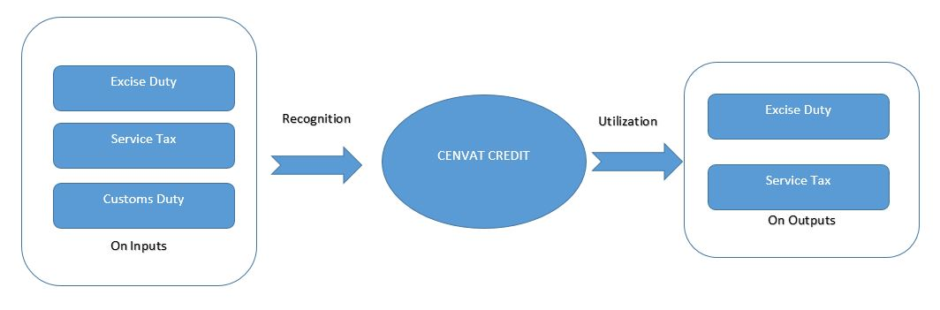
Service Tax
CENVAT Credit:
(The below changes are effective from 1 April 2016)
CENVAT credit of capital goods used exclusively in manufacture of exempted goods or provision of exempt services permitted after a period two years from the date of commencement of production or provision of services, But in existing provision no such rule for CENVAT credit for capital good used in manufacturing of Exempted good.

Slide 17
Service Tax
CENVAT Credit :-
Credit of CENVAT shall be allowed if input good have been sent from the godown to service provider As per Rule 6 of CENVAT Credit Rule 2004. But As per Amendment Given In budget 2016 , Rule 6 is amend and Input Good sent from godown shall not be allowed to take credit .
As per the provision of CENVAT credit , 2004 utilization of CENVAT credit was on the FIFO basis. But this is amendment in the budget 2016 and utilization of CENVAT credit on FIFO basis has been deleted.
The permission given by an Assistant Commissioner or Deputy Commissioner to a manufacturer of the final products for sending Inputs or partially processed inputs can be send outside factory to a job-worker and clearance there from on payment of duty is valid for 3 financial years which was 6 month In existing provision.

Slide 18
Service Tax
CENVAT Credit :-
Rule 6(3B) Allow banks and other financial institutions to reverse credit in respect of exempted services on actual basis in addition to the option of 50% reversal.
As per the Amendment in budget 2016 provider of Output Services Also requires to file an Annual Return for each financial year, by the 30th day of November of the succeeding year in the form as specified by a notification by the Board which was not enforce on or before 1.4.2016.
As per the provision of CENVAT credit rule 2004 , Any Capital goods used other than factory shall not be allowed for any credit. But as per the amendment in budget 2016 , The Capital goods used in office located within factory is also eligible for Cenvat Credit.

Slide 19
Service Tax
CENVAT Credit :-
CENVAT credit on inputs and capital goods used for pumping of water, for captive use in the factory, is being allowed even where such capital goods are installed outside the factory enforce from 1.04.2016 But before amendment only generator installed outside the factory shall be allowed to take credit.
All capital goods having value upto Rs.10,000/- per piece are being included in the definition of inputs that is not effect from any defination of capital good which was given in CENVAT credit rule , 2004.

Slide 20

Service Tax

