Slide 1
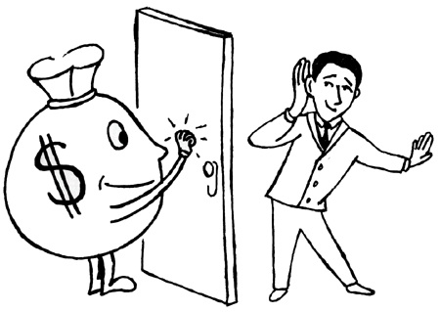
Tax Practice Management

Slide 2
MYTHS
Simplicity in the legislations will reduce the opportunities in tax practice- Is it getting simpler?
Too many members in practice, and new entrants will not have opportunities- True in case of traditional areas + a generalist
Not true for Specialist { FTP, DGFT, Domestic/ Intl Transfer pricing for SME, Customs + FEMA , Insurance, Environmental audit, CSR consultants + Many other new New areas opening up?

Slide 3
MYTHS
Practice is monotonous – Very very invigorating if you love what you do- Mindset – Choose what you like or like what you have chosen - Exercise
CA seen as business advisor?- All large corporate now work as SBUs, SPVs, Person in charge responsible.
Less remunerative in the initial stages – Yes- However in long term – self-satisfying, comfortable, eternal commendation, name/ fame

Slide 4

Each generation goes further than the generation preceding it, because it stands on the shoulders of that generation. You will have opportunities beyond anything you've ever known.
Ronald Reagan- Former US President

Slide 5
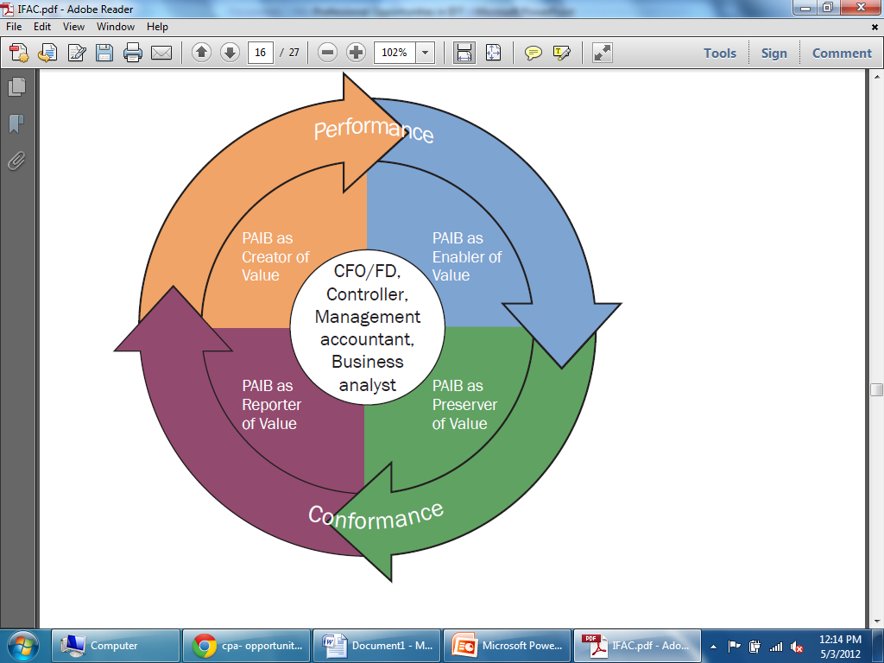
IFAC- International Federation of Accountants- Role of a Professional

Slide 6
Creator of Value
By taking leadership roles in the design and implementation of strategies, policies, plans, structures, and governance measures that set the course for delivering sustainable value creation.
-> What model? LTU, SEZ, Thru JW – Trader, Service provider or manufacturer
-> Where located? Tax holiday areas
-> Tax Optimisation
To start with compliances and move up till you reach here.

Slide 7
Enabler of Value
By informing and guiding managerial and operational decision making and implementation of strategy for achieving sustainable value creation, and the planning, monitoring, and improvement of supporting processes.
-> SOP for tax: Internal control
-> Technology usage
-> Training of employees
-> Hand Holding in Implementation period
Value Addition is Key – Each SBU/ SPV wants good results- Knowledge of SBU/ SPV Critical

Slide 8
Preserver of Value
By ensuring the protection of a sustainable value creation strategy against strategic, operational, and financial risks, and ensuring compliance with regulations, standards, and good practices.
-> Internal / operational/ management audit to include Tax [ DT + IDT]
-> Plan for changing laws – New Co law, GST…
-> Disclosure of facts- No surprises
Empathy; Current Global/ Indian Environment;
Impact of Law, regulation broadly – to provide specialised advice in area of your specialisation

Slide 9
Reporter of Value
By enabling the transparent communication of the delivery of sustainable value to stakeholders.
-> Credibility of Financial Statements
- > Quarterly reporting
-> Independent Authentic certification
Statutory/ Income Tax/ Vat 240 Audits, Internal Audit, Certification – TDS, Credits, Refund, Liability…
Independence + No bias
+ Professional Skeptisism

Slide 10
Traditional Areas for CAs
Accounting – Not unless huge nos + HR skills
Tax Audit VAT 240 Audit – Limitation of fees- huge risk.
Company Audits – Limitation of fees- Huge risk
Internal Audit – Can be grown into a great compliance exercise covering Regulatory + Tax Compliance + Operational aspects
Financial Service – Raising of fund from bank/ Fin Inst.

Slide 11
What the Industry / Trade wants
One Stop Shop- Multidisciplinary Vs Specialised Niche Professional Service
End to End – take responsibility for compliance
Business Advice [ confirmation- validation]
Problem To be solved
Reduction in costs/ time to resolve
Ensuring benefits accrue as due
All function by consultant to provide value addition

Slide 12
What the Industry / Trade wants
Saving in resource costs
Optimisation of credits [ Deferred Tax/ CST/ VAT/ CE/ ST]
Cashing in of Refunds/ Incentives
Governance/ safeguard that things all right
Consistent [ Can a proprietor provide?]
Speedy Solution- Expect you resolve after they have slept over matter
….many more

Slide 13
General Areas of Tax Practice
Registration/ Amendment- procedural
Initial disclosures/ procedures to the dept.
Payment of duty/taxes after verification
Certification under IT [ Deduction, credits]
Periodical return verification and submission
Periodical review of IT/VAT/ CE/CUS/ST
Review of the above before departmental audit
Assistance in dealing with routine letters

Slide 14
Specialized Area of Tax Practice
Providing opinions/clarifications
Transfer Pricing
Transaction Structuring
Impact on the changes-budget, notifications, case laws
Obtaining refunds
Rectification of errors made earlier

Slide 15
Specialized Area of Tax Practice
Reply to the departmental letter
Reply to the Show cause notice
Litigation- Representation before adjudicating authority
Reply and representation at appellate forums
Assistance to lawyers at High Court/Supreme Court

Slide 16
Expertise obtained by:
Start by choosing area and persevere [ Demand Vs Supply, Strengths, Strong suits ]
Reading/ discussing subject/ enroll in course
Invest in e-resources + books + online sites
Attending workshops/ seminars
Teaching the Subject to College students/ juniors
Writing articles/books
Being a speaker to other members in the industry/departmental officials

Slide 17
Baby Steps
Proprietorship Vs Partnership Vs LLP *
Friends, Family, Neighbors, Principal, Piggy back on CA (assignments), Start networking with peers
Professional Approach to clients – get needs in writing or communicate back in writing -> get a goods understanding of the client -> deliver a bit more than being paid. [ Initial stages opportunity more important than fees.]

Slide 18
Baby Steps
Be sure you want to practice
Initial stages build rapport and reputation [ Work on your strength]
Identify mentor – role model
Get into buddy structure – make someone responsible to question you along with authority to do so.
Birds of the same feather flock together

Slide 19
Move to higher level
Own/ shared office – If possible good location
Systematic Operating method
Empathy par ordinary
Use acknowledgment as tool
Hire after careful screening and interviewing – article to wholeheartedly agree with firms philosophy
Train yourself and staff every week
Gain visibility

Slide 20

What is Client Interfacing
..is a process for providing competitive advantage and adding benefits in order to maximize the total value to the customer.
.. is the commitment to providing value added services to external and internal customers, including attitude knowledge, technical support and quality of service in a timely manner.

Slide 21
Practice Risks
The organization fails to recognize the extent of the customer interface and its effects.
The organization reacts to transitioning to a new business paradigm with discontent and resistance.
CAs promise the world and fail to point out any tradeoffs that are involved.
CAs are insensitive to specialized customer requirements.
Customers fail to recognize benefits properly and see only the loss of flexibility.
Loud claims- falling short, not delivering what you promised
Clients value confidentiality- Like doctor – you know something which no one knowns

Slide 22
Growth of Practice
Addressable market for services
Positioning oneself
Client Acquisition
Client Retention
Share of Client spend
Client Recommendation
CA Recommendation – Only if no conflict
Balance Between execution + running profession
Continuous learning

Slide 23
“If you do build a great experience, customers tell each other about that. Word of mouth is very powerful.”
Jeff Bezos, CEO Amazon.com

Slide 24
Thank You…
Wish you all an extraordinary joyous life
madhukar @hiregange@com

