Slide 1
Declared Services
By Rajat Agrawal

Slide 2
Disclaimer
All images are for representational purposes only. All images are property of and belong to their respective owners.
Presentation has been prepared from a speaker’s point of view for purpose of a seminar and thus it has not been described in detail.
Law updated as per Finance Act, 2015
Suggestions for improvement may be mailed to rajat.agrawal@aol.com

Slide 3
History of Service Tax
Introduced in 1994 with 3 services, namely:- Stock Brokers Service, General Insurance Service and Telephone Services.
Expanded to 120 services by 2012.
Govt. brought an end to Selective Taxation Scheme and brought out Comprehensive Taxation Scheme (Negative List Regime)
Brought out definition of service in 2012.
Goods and Service Tax (GST) in pipeline, soon to replace existing tax laws.

Slide 4
Need of Declared Service
Overlap of services.
Validity of transactions.
Clarity to individual services.
Facilitate collection of revenue.

Slide 5

Meaning and concept of service
Introduction

Slide 6
Service - Meaning
Essential ingredients of the definition “service” as defined in Section 65B(44):
Activity
Carried out by a person for another
Consideration
Includes a Declared Service

Slide 7
Service – Non Inclusions
Transfer of title in goods or property by sale or gift.
Transfer, delivery or supply of any goods which is deemed to be a sale within the meaning of Clause (29A) of Article 366 of the Constitution.
Transaction in money or actionable claim.
Employment contract.
Fee taken in Court or Tribunal.

Slide 8
Declared Service
What is declared service?
Activity carried out by one person to another for consideration.
Must be specified in Section 66E of the Act.

Slide 9
Declared Service - List
Renting of Immovable Property.
Construction of a complex, building, civil structure or a part thereof.
Temporary transfer or permitted the use or enjoyment of any intellectual property right.
Development, design, programming, customisation, adaptation, upgradation, enhancement, implementation of information technology software.
Agreeing to the obligation to refrain from an act, or to tolerate an act or a situation, or to do an act.
Transfer of goods by way of hiring, leasing, licensing or in any such manner without transfer of right to use such goods.
Activities in relation to delivery of goods on hire purchase or any system of payment by instalments.
Service portion in the execution of works contract.
Service portion in an activity wherein goods, being food or any other article of human consumption or any drink (whether or not intoxicated) is supplied in any manner as a part of activity.

Slide 10
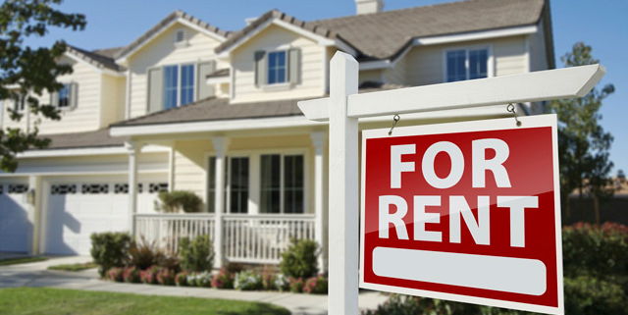
Renting of Immovable Property
SL. No. 1

Slide 11
DECLARED SERVICE
As per Section 66E(a) of the Finance Act, ‘Renting of Immovable Property’ is a declared service.
“Immovable Property’ shall include land, benefits to arise out of land, and things attached to the earth, or permanently fastened to anything attached to earth.”
Renting means-
Allowing, permitting or granting access, entry, occupation, use or any such facility, wholly or partly, in an immovable property, with or without the transfer of possession or control of the said immovable property, and
Includes letting, leasing, licensing or other similar arrangements in respect of immovable property.

Slide 12
Negative list aspects
Renting or leasing of vacant land, with or without a structure incidental to use for agriculture or agricultural use.
Renting of residential dwelling for use as residence.
Renting out property to RBI.
Renting of any property by a Government or a Local Authority to a non-business entity.

Slide 13
SCOPE
Use of property for a temporary purpose like conduct of a marriage or any social function will be taxable.
Hall rooms let out for organizing functions is taxable.
Compensation received for damage caused to building will not be taxable.
Renting of land or building for entertainment or sports shall be taxable.

Slide 14
exemption
Renting of precincts of religious place.
Services by hotels etc. with tariff less than Rs. 1,000 or equivalent.
Property taxes paid are exempted on actual basis. Interest and penalty isn’t deductible.
Renting to exempted educational institutions. w.e.f. 11.07.2014

Slide 15
abatement
An abatement of 40% is provided in respect of renting of hotels i.e. 60% of value is liable for service tax.
There is no abatement for pandal and shamiana services. But if there exists a bundled service, (accommodation service with supply of eatables) then abatement will be applicable at 30%.

Slide 16
FAQ
Is service tax liable on furnished flats given on rent for temporary stay (a few days)
What is the implication if renting of immovable property for use is partly for residence and partly non-residence purposes?

Slide 17
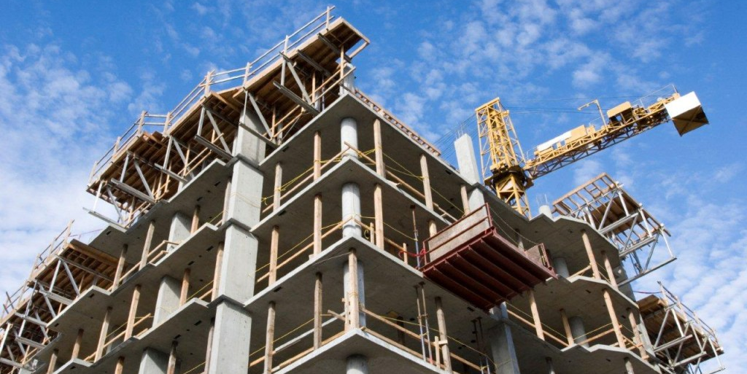
Construction of a complex/ building
SL. No. 2

Slide 18
Declared service
As per Section 66E(b) of the Finance Act, 1994, construction of a complex, building, civil structure or a part thereof, including a complex or building intended for sale to a buyer, wholly or partly, except where the entire consideration is received after issuance of completion certificate by the competent authority.
Competent authority means the Government or any authority authorised to issue completion certificate.

Slide 19
SCOPE
If entire consideration is received after the issuance of completion certificate, the same will be called a ‘sale’ and it is not liable to service tax.
This entry covers the services provided by builders or developers or any other person, where building complexes, civil structure or part thereof are offered for sale and payment for such building or complex or part thereof is received before the issuance of completion certificate.

Slide 20
exemption
Construction/ Works Contract Services provided to the Government, Local Authority or a Governmental Authority:
  Civil Structure construction or any other works meant for use other than for commerce, business or profession. w.e.f. 1-4-2015
  Historical monument, archaeological site or remains of national importance, archaeological excavation or antiquity.
  Structure meant for use as educational, clinical or art or cultural establishment. w.e.f. 1-4-2015
  Canal, dam or irrigation works.
  Pipeline, conduit or plant for water supply, water treatment or sewage treatment and disposal.
  Residential complex meant for use of their employees. w.e.f. 1-4-2015

Slide 21
Exemption (contd..)
Construction/ Works Contract Services for construction for general public:
  Road, bridge, tunnel or terminal for road construction.
  Civil Structure under Jawaharlal Nehru National Urban Renewal Mission or Rajiv Awaas Yojana.
  Building owned by entity for charitable trust and purposes and religious use by general public.
  Pollution control or effluent treatment.
  Structure for funeral, burial or cremation.

Slide 22
Exemption (contd..)
Construction/ Original work pertaining to infrastructure projects etc.
  Airport, port or railways, including monorail or metro (w.e.f. 1-4-2015)
  Single residential unit
  Low cost houses up to carpet area of 60 square metres per house
  Post harvest storage infrastructure for agriculture produce.
  Mechanised food grain handling system and units for processing agriculture produce excluding alcoholic beverages.
  Sub- contractor services.

Slide 23
aspects
Construction of two floor houses.
Repair, maintenance of an airport, port or railways.

Slide 24
ABATEMENT
Particulars | Abated Value | Taxable Value
For residential unit having carpet area less than 2000 square feet AND where the amount charged is less than Rs. 1 crore; | 75% | 25%
(ii) For other than the (i) above | 70% | 30%
Notes:
Notification No. 26/2012-ST had prescribed abatement of 75% of construction of all kinds of complexes (civil, industrial, residential).
Notification No. 9/2013-ST replaced the word ‘OR’ to ‘AND’ (which was prescribed in Notification No. 2/2013-ST.

Slide 25
ABATEMENT (contd..)
Conditions for abatement:
CENVAT Credit on inputs used for providing the taxable service has not been taken under the provisions of CENVAT Credit Rules, 2004.
The value of land is included in the amount charged from the service receiver.

Slide 26
Tripartite business model
In a tripartite business model, there are 3 parties:
Landowner;
Builder or Developer;
Contractor who undertakes construction.
Issue: Liability to pay service tax on flats/ houses agreed to be given by builder/ developer to land owner towards the land/ development rights to other buyer and its valuation aspects.
Sale of land by landowner to builder is not a service.

Slide 27
Redevelopment model
In this case, land is owned by a society, comprising of members of society with each member entitled to his share by way of an apartment.
Society/ individual flat owners give ‘NOC’ to builder for reconstruction.
The builder makes new flats and may additionally make rental accommodation or construct additional flats for sale or pay an amount to flat owners.

Slide 28
Conversion model
It involves conversion of any untaxed part of a complex into a civil structure or a building to be used for commerce or industry.
A mere change in use of building does not result into service tax implications. If the renovation activity is done on a contract basis, the same becomes chargeable to service tax under “WORKS CONTRACT”

Slide 29
Collaboration model
If the landowner transfers development rights to builder, who in turn transfers developed buildings back to landowner, will the original landowner be required to pay service tax on future sale of flats?
The transaction of sale of developed flats will be leviable to service tax if any consideration is received by him before receipt of completion certificate.

Slide 30
Build, operate, transfer (BOT) model
First Level
Government transfers right to use or develop the land to developer or builder (concessionaire) for a specific period. Developer/ builder will pay upfront lease amount or annual charges to Government.
Second Level
Builder or developer will begin development and construction on land given by Government. Since he works on his own, he is NOT a service provider and he remains owner of that structure for that specific period (concession period)
Third Level
The concessionaire enters into agreement with several users for commercially exploiting the building developed/ constructed by him during lease period.

Slide 31
faq
Value of “free supplies” provided by service receiver for incorporation in constructions to service provider. Would it be considered as consideration for service?
Whether construction of other structures inside a residential complex viz., fountain, sculptors, car parking lot, tool-shed are liable to service tax within construction services?
Whether construction of servant quarters within a residential complex liable to service tax?

Slide 32

Temporary use & Transfer of ipr
SL. No. 3

Slide 33
Declared service
As per Section 66E(c) of Finance Act, 1994, ‘temporary transfer of or permitting the use or enjoyment of any intellectual property right is a declared service.’
Intellectual Property Right (IPR) includes copyright, patents, trademarks, design etc.

Slide 34
SCOPE
Exhibition of cinematograph films in places other than cinema hall or theatre is taxable.
Registration of IPR outside India is also covered.
Distribution of music by music company having the copyright of sound recording is taxable.
Royalty for allowing the recording of song for further distribution by the composer is exempt.
Arrangements entered into for screening of cinematographic films by producers/ distributors/ exhibitors is exempt.

Slide 35
IMPORT of TECHNOLOGY
On import of technology, R & D cess paid is exempted.
Conditions:
The R & D Cess is paid within 6 months from date of invoice or in case of associated enterprises, the date of credit in books of account.
The records of R & D Cess are maintained for establishing the linkage between the invoice or the credit entry as case may be.

Slide 36
FILM Distributor and film exhibitor
Type of arrangement | Movie exhibited on whose account | Service Tax Implication
Case I: Distributor and Exhibitor are operating on independently. | (a) Movie is exhibited by exhibitor on his own account i.e. distributor has temporarily transferred copyright in films to exhibitor. | Temporary transfer of copyright in films is exempt from service tax.
 | (b) Movie is exhibited by exhibitor on behalf of Distributor, i.e. no transfer of copyrights. | In this situation, exhibitor provides renting of immovable property to distributor and is liable to service tax.
Case II: Arrangement between Distributor and Exhibitor amounts to unincorporated collaboration (Joint Venture). | Service provided by each of the persons, i.e.- The new entity/ Joint Venture The Exhibitor; and The Distributor or Producer Is liable to service tax under applicable service head of each person.

Slide 37
ISSUES
IPR is goods and such IPR is sold.
IPR is goods and there is transfer of right to use such IPR.
IPR is goods but there is no transfer of right to use such IPR.
IPR is not goods.
IPR is not goods and there is permanent transfer to use such IPR.
IPR is not goods but there is temporary transfer to use such IPR.

Slide 38
FAQ
Theatre owners paying distributor entire box office collection after deducting entertainment tax and show rentals – whether it amounts to taxable value chargeable to service tax?

Slide 39

Information technology software
SL. No. 4

Slide 40
Declared service
As per Section 66E(d) of the Finance Act, 1994, development, design, programming, customization, adaptation, upgradation, enhancement, implementation of information technology software is a declared service.

Slide 41
Aspects of service
Sale of pre-packaged or canned software not liable to tax.
On-site development of software is liable to service tax.
Advice, consultancy and assistance on matters relating to information technology is liable to service tax.
Licence to use pre-packaged software is liable to service tax.
Customized development of software and delivery to the client on media like a CD is liable to service tax.
Software transactions can be covered under Intellectual Property Service.
Software given on hire is liable to service tax u/s 66E(f).

Slide 42
FAQ
Does transforming blank CDs into software loaded CDs amount to manufacture or not?
Will I have to pay service tax if I buy and download software from outside India?
Will payment of licence and renewal of licence attract service tax?
What happens if the licence and the media both come together in single box as shrink wrapped software?

Slide 43

Refraining acts
SL. No. 5

Slide 44
DECLARED SERVICE
As per Section 66E(e) of the Finance Act, 1994, agreeing to the obligation:
To refrain from an act, or
To tolerate an act or a situation, or
To do an act,
Has been specified as declared service.

Slide 45
Scope of service
In terms of this entry, the following activities, if carried out by a person for another for consideration would be treated as provision of service:
Agreeing to the obligation to refrain from an act.
Agreeing to the obligation to tolerate an act or a situation.
Agreeing to the obligation to do an act.

Slide 46
FAQ
Would non compete agreements be considered a provision of service?
Payment in settlement of dispute – is it consideration?

Slide 47
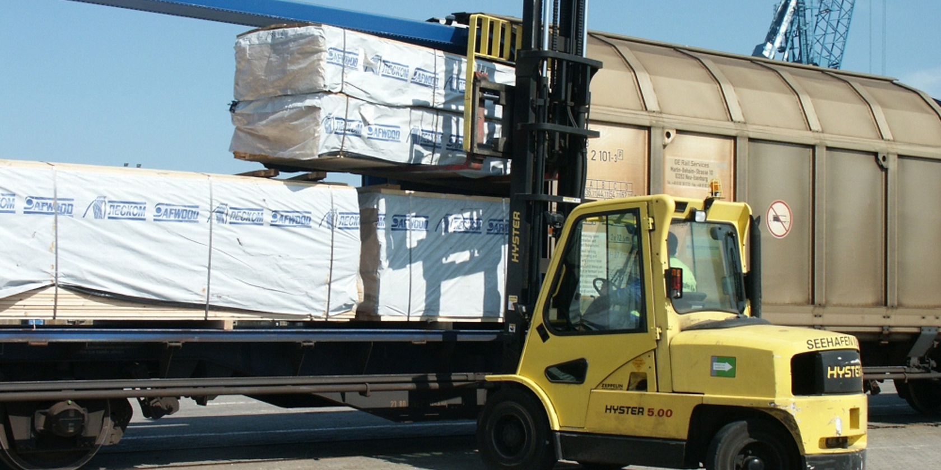
hiring, leasing & licensing of goods
SL. No. 6

Slide 48
Declared service
As per Section 66E(f), ‘transfer of goods by way of hiring, leasing, licensing or any such manner without transfer of right to use such goods is a declared service.’

Slide 49
Meaning of ‘transfer of right to use such goods’.
The Hon’ble SC in BSNL v. UOI held that transfer of right to use the goods must have following attributes:
There must be goods available for delivery.
There must be a consensus ad idem as to the identity of the goods.
It involves transfer of possession and effective control over such goods.
Apart from transferring of possession, the transferee must be given the legal rights to use such goods and all legal consequences including any permission or licenses should be made available to transferee.
For period during which transferee has legal rights, it has to be the exclusion of transferor.
During the period for which the owner has transferred the right to use the goods, he cannot again transfer the same rights to others.

Slide 50
scope
Transactions not involving transfer of right to use goods:
A car given on hire along with driver on payment of charges per month on mileage basis.
Supply of dump trucks, cranes, etc. for use in particular project subject to certain terms and conditions relating to manner of use and return after specific time, maintenance and upkeep.
Pandal/ shamiana contract.
Hiring of bank lockers.
Hiring out of vehicles where it is the responsibility of the owner to abide by all laws relating to motor vehicles.
Hiring of audio-visual equipment where risk is of the owner.

Slide 51
Exemption
Services by way of giving on hire | Persons to whom service must be rendered.
(1) A motor vehicle meant to carry more than 12 passengers. | to a state transport undertaking.
(2) A means of transportation of goods. | to goods transport agency.

Slide 52
abatement
In respect of motor cab – 60% abatement
Condition: No CENVAT Credit on inputs and capital goods allowed. CENVAT on input services of renting of motor cab has been taken in following manner:
  Full CENVAT Credit of such input service received from a person who is paying service tax on 40%.
  Up to 40% of CENVAT Credit of such input credit received from a person who is paying service tax on full value.

Slide 53
Person liable to pay tax
Service Provider located in taxable territory must be either Individual, or HUF, or Partnership Firm registered or not (including LLP) or AOP. Service Receiver located in taxable territory must be a Body Corporate.
Description of service | % of tax payable by PROVIDER | % of tax payable by RECIPIENT
Renting of motor cab on ABATED Value | Nil | 100%
Renting of motor cab on NON-ABATED Value | 50% (Prior to 1-10-2014, it was 60%) | 50% (Prior to 1-10-2014, it was 40%)

Slide 54
FAQ
A company ‘A Ltd.’ provided bus with driver and conductor for transportation of employees of company ‘B Ltd.’ from residence to factory and back. Is it leviable to service tax?
Setting up pandal/ shamiana including furniture, fittings and fixtures. Is it liable to service tax?

Slide 55

Delivery of Goods on Hire Purchase
SL. No. 7

Slide 56
Declared service
As per Section 66E(g) of the Finance Act, 1994, ‘Activities in relation to delivery of goods on hire purchase or any system of payment by instalments’ is a declared service.
Hire purchase is a system/ agreement where goods are let out on hire and under which hirer has option to purchase them. Agreement includes terms for possession of goods on delivery by owner to person on condition that amount for it is paid in instalments, property in goods to pass on payment of last instalment and person has right to terminate the agreement any time before property passes.

Slide 57
Scope of service
Delivery of goods is taxable, related services isn’t.
Deemed sale means transfer of possession and not just custody.
Hirer has option or obligation to purchase goods in accordance with T & C of agreement.
Operating lease is not covered. Finance leases are covered.

Slide 58
Value of taxable service
Abatement of 90% has been provided.
Transfer of right to use results into taxability of VAT and not Service Tax. Service tax implications arises when right to use hasn’t been transferred.

Slide 59
FAQ
Is supply of electricity meter by electricity supply board to consumer is taxable?

Slide 60

execution of works contract
SL. No. 8

Slide 61
Declared service
As per Section 66E(h) of the Finance Act, 1994, service portion in execution of works contract is a declared service.
Works Contract means:-
A contract wherein transfer of property in goods involved in the execution of such contract, is leviable to tax as sale of goods.
Such contract is for purpose of carrying out construction, erection, commissioning, installation, completion, fitting out, repair, maintenance, renovation, alteration of any movable or immovable property or for carrying out any other similar activity or a part thereof.

Slide 62
Determination of value
Value of Works Contract Service [Rule 2A(i)]
Value of Works Contract Service = Gross amount charged for the works contract – Value of property in goods transferred
Gross value shall not include VAT or CST on transfer of property in goods
Sums includible are: Labour charges, amount paid to sub-contractors, architect’s fees, hire charges for machines and tools, cost of consumables, cost of establishment, other similar expenses and profit earned by service provider.

Slide 63
Determination of value (contd..)
Value of Works Contract Service [Rule 2A(ii)]
Particulars | Value of Service Portion
(A) Where works contract is for execution of original work. | 40% of total amount charged.
(B) Works Contract for maintenance or repair or servicing of goods or immovable property. | 70% of total amount charged. (Prior to 1-10-2014, value of service portion was 60% for immovable property).

Slide 64
Determination of value (contd..)
Computation of Total Amount as per Rule 2A(ii)
Particulars | Amt (Rs.)
Gross amount charged for the works contract | xxx
Add: FMV of all goods and services | xxx
Less: Amount charged for such goods or services by supplier and VAT | xxx
Total amount charged for Valuation purposes. | xxx

Slide 65
exemptions
All exemptions discussed above w.r.t Construction apply for Works Contract Services also.

Slide 66
exemption
Works Contract Services provided to the Government, Local Authority or a Governmental Authority:
  Civil Structure construction or any other works meant for use other than for commerce, business or profession. w.e.f. 1-4-2015
  Historical monument, archaeological site or remains of national importance, archaeological excavation or antiquity.
  Structure meant for use as educational, clinical or art or cultural establishment. w.e.f. 1-4-2015
  Canal, dam or irrigation works.
  Pipeline, conduit or plant for water supply, water treatment or sewage treatment and disposal.
  Residential complex meant for use of their employees. w.e.f. 1-4-2015

Slide 67
Exemption (contd..)
Works Contract Services for construction for general public:
  Road, bridge, tunnel or terminal for road construction.
  Civil Structure under Jawaharlal Nehru National Urban Renewal Mission or Rajiv Awaas Yojana.
  Building owned by entity for charitable trust and purposes and religious use by general public.
  Pollution control or effluent treatment.
  Structure for funeral, burial or cremation.

Slide 68
Exemption (contd..)
Original work pertaining to infrastructure projects etc.
  Airport, port or railways, including monorail or metro (w.e.f. 1-4-2015)
  Single residential unit
  Low cost houses up to carpet area of 60 square metres per house
  Post harvest storage infrastructure for agriculture produce.
  Mechanised food grain handling system and units for processing agriculture produce excluding alcoholic beverages.
  Sub- contractor services.

Slide 69
Person liable to pay tax
Partial Reverse Charge mechanism: Service Provider must be either an Individual, or HUF or Partnership Firm whether or not registered (including LLP) located in taxable territory and Service Receiver must be a body corporate located in taxable territory.
Support Service Provided by Government: Entire service tax will be paid by Service Recipient irrespective of constitution.
Other cases: In cases not covered in (1) and (2) above, Service Provider will pay the entire service tax.

Slide 70
Cenvat Credit
CENVAT of Inputs is allowed. Credit of inputs in relation to sale portion is not available. For Rule 2A(i)
Service provider is not entitled for CENVAT of excise duty paid on inputs used. For Rule 2A(ii)
CENVAT Credit on input services and capital goods is allowable to service provider

Slide 71
faq
Is completion and finishing services result in ‘original works’?

Slide 72

Restaurants, hotels and catering
SL. No. 9

Slide 73
Declared service
As per Section 66E(i) of the Finance Act, 1994, ‘Service portion in an activity wherein goods, being food or any other article of human consumption or any drink (whether or not intoxicating), is supplied in any manner as a part of the activity is specified as declared service.’

Slide 74
Scope
Activities covered in this declared list entry:
Restaurant Service
Outdoor Catering
Thus both restaurant service and outdoor catering service are covered under declared service.
Deemed Sale: Supply of any goods, being food or any other article of human consumption or any drink (whether or not intoxicating), in any manner as part of a service for cash, deferred payment or other valuable consideration, is deemed to be a sale of such goods. Therefore service portion shall not include the value of goods so supplied in course of providing service.

Slide 75
Exemption
Restaurants without air-conditioning or central air heating.
Catering meals including mid-day meals provided to educational institutions.
Services in air-conditioned/ central air-heating canteen of factory.

Slide 76
Value of taxable service
Service Portion in activity of supply of food and drinks | Taxable (%)
In a restaurant | 40
As part of outdoor catering | 60
Total amount means gross amount charged and FMV of all goods and services supplied in or in relation to supply of food or any article of human consumption or any drink (whether or not intoxicating) after deducting the amount charged for such goods or services and VAT.
CENVAT Credit is not allowable.
For bundled service of renting and supply of food, the abatement is 30%.

Slide 77
FAQ
In a complex, where both AC and non-AC restaurants source food from same kitchen, will service tax be applicable on both?
In a hotel, if services are provided by an AC restaurant or centrally heated restaurant in other areas viz. swimming pool, will service tax arise?
Will service tax be applicable on goods sold on MRP basis across the counter as part of bill or invoice?
Whether supply of food and beverage served on train amount to service?

Slide 78

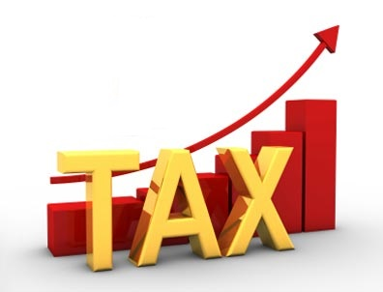
IMPACT OF NEGATIVE LIST REGIME OF SERVICE TAX

Slide 79
Service tax contribution

Slide 80


