Slide 1
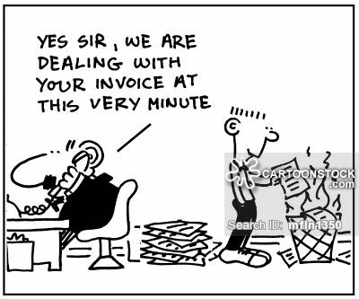
Procedure for Issuing Bill/Challans
By Prerna Agrawal

Slide 2
Rule 4A & 4B
Every person providing taxable service shall
not later than 30 days from date of completion or receipt of payment
Issue Invoice

Slide 3
Time Limit for Issue of Invoice
Normal Provision
- Payment of service
-Completion of service
(Earlier)
Continous Supply
-Payment of service
-Deemed Completion
(Earlier)
Within 30/45days

Slide 4
Contents of Invoice
Such invoice/bill/challan shall be serially numbered and shall contain the following:
The name,address and the registeration no. of such person;
The name and address of the person receiving taxable service;
Description and value of taxable service provided or agreed to be provided ; and
The service tax payable thereon.

Slide 5
Special Cases
Input Service Distributor
Banking Co.
Goods Transport by Road

Slide 6

Input Service Distributor
Every Input Service Distributor distributing credit of taxable services shall,in respect of credit distributed,issue an invoice ,signed by the person authorized by him,for each of the recipient of the credit distribute and such invoice ,bill, or as the case may be,challan shall be serially numbered .

Slide 7

Banking Co.
Banking company providing service to any person,an invoice,bill or as the case may be,challan shall include any document,by whatever name called,whether or not serially numbered,and whether or not containing address of the person receiving taxable service but containing other information in such documents as required under this rule;Provided also that in case the provProviding servicdere to any person ,the period within which the invoice,bill or challan as the case may be,is to be issued,shall be 45 days.

Slide 8

Goods Transport by Road
Provided further that in case of tranport of goods by road,an invoice etc. shall include any document, by whatever name called,which shall contain the detail of the consignment note, number and date, gross weight of the consignment and also other information as required under this rule.

