Slide 1

General overview in Service Tax
Introduction, Negative list and Point of Taxation

Slide 2
Evolution of Service Tax in India
First levied on 15 July 1994
Firstly, it was applicable for three sectors : telephone, insurance and broker
Selective Approach

Slide 3
Present Scenario of Service tax
Comprehensive approach
More than 60% of GDP
Wide area coverage

Slide 4

Definition of service
“Service” means any activity carried out by a person for consideration and includes declared service, but shall not include:
(a) an activity which constitutes merely,
(i) a transfer of title in goods or immovable property, by way of
sale, gift or in any other manner ; or
(ia) such transfer, delivery or supply of any goods which is
deemed to be a sale within a meaning of clause 29(A) of articles
366 of the constitution ; or
(ii) a transaction in money or actionable claim
(b) In case there is employee-employer relationship
(c) Fees taken in any court or tribunal established under any law

Slide 5
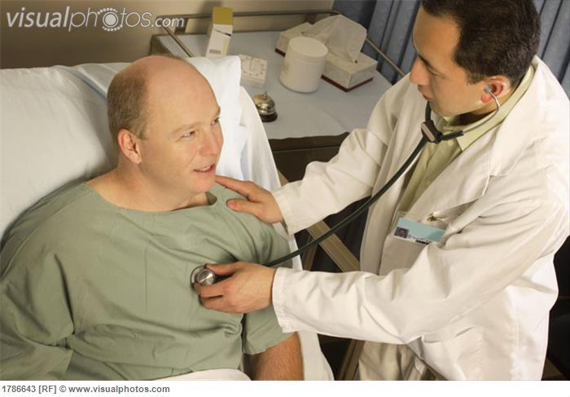
What is ‘Activity’?
Not defined in Finance Act 2012
Education Guide
“the word activity would include an act done, a deed done, an operation carried out, execution of an act, provision of facility etc. It is a term with very wide connotation.

Slide 6
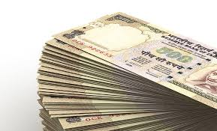
Consideration
‘Consideration’ means everything received or recoverable in return for a provision of service which includes monetary payment and any consideration of a non-monetary nature or deferred consideration as well as recharges between establishments located in a non-taxable territory and taxable territory in another hand.

Slide 7
Rate of Service Tax
Tax @ 12%
2% education cess and 1% SHEC charge.

Slide 8
Valuation of Taxable Service
Consideration in money Gross amount
charged
Consideration in Kind Market Value
Consideration not ascertainable Rules framed
by govt

Slide 9
Point of taxation rules
Applicable From 1.4.2011
Definition :
“Point of taxation means the time when
service shall be deemed to have been
provided”

Slide 10
POT Rule 2A : Date of payment
Payment is entered in the book of accounts
or
Date on which new payment is credited
whichever is earlier

Slide 11
Rule 3: Determination of POT
1st case
If invoice issued within 30 days of completion of service
DOP or DOI Whichever is earlier
2nd case
If invoice is not issued within 30 days of completion of service
DOP or Date of completion Whichever is
earlier
Note :The limit is 45 days for bank and financial institution

Slide 12
Rule 4: Changes in effective rate of service tax
Service provided before change in rate
After change invoice issued and payment
received DOI or DOP whichever is earlier
Invoice before change but payment
received after change Date of invoice
Payment received before change but
invoice after change Date of Payment

Slide 13
Cont’d
Service provided after change
Invoice before change but payment received after change Date of payment
Before change invoice issued and payment received DOI or DOP whichever is earlier
Payment received before change but invoice after change Date of Invoice

Slide 14
Rule 5: New service taxable for first time
Before becoming taxable, invoice issued and payment received
- No tax payable
Payment received before tax and invoice issued in 14 days of the date when service is taxed for the first time
- No tax payable

Slide 15
Rule 7: In case of reverse charge
The date on which payment is made
Rule 8: Copyrights, Patents and Trademark
In such consideration arises by the use of such rights.
Each time when payment is received or invoice is issued whichever is earlier.
Rule 8A : Determination of Point of Taxation
If point of taxation can’t be determined then Central Excise Officer shall determine the point of taxation to the best of his judgement.

Slide 16
Payment of Service Tax
Individual or Firm
5th of the following quarter
Others
5th of the following calendar month
6th If paid electronically in both the cases
Assesse who has service tax of 10 lakhs or more shall deposit the tax electronically

Slide 17
Thank You
Dipendra Prasad Poudel
Article Assistant (Audit)
mailfordipendra@gmail.com
Click the below Slideshare for more presentations.
SLIDESHARE
Facebook
Happy Reading

