Slide 1

DREAM
“Whatever the mind can conceive and believe the mind can achieve.” -Napoleon Hill

Slide 2
Direct Vs Indirect
Direct
Indirect
On Margin
Total 500,000 Cr
Set off- Nil
Normal Impact on Product – 3-7%; On Services 7-12%
Developed Law
Less Disputes
On Gross Value
Central Total 500,000Cr
State Total 700,000Cr
Set Off- Centre – 700,000
S-O – State – 2,800,000 cr
Normal Impact – Goods – 20- 25%; on Service 10- 15%
Underdeveloped new laws
Huge Litigation

Slide 3
Act
Case Laws
Rules
Indirect Tax Laws
Trade Notices
Circulars

Slide 4
Levy Taxable
Event
3 Limbs of tax laws
Assessment
Collection

Slide 5
Origin based
Eg : Excise
Indirect Tax Laws
Destination based
Eg: Service Tax
Consumption based
Eg: VAT

Slide 6
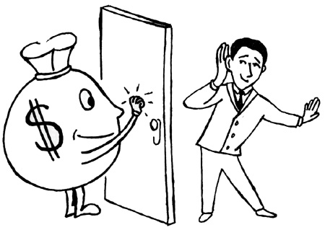
Opportunities in IDT

Slide 7
Coverage Today
Myths in Profession
Professional Opportunities- Status check
IFAC Classification –IDT
General Areas of practice in IDT
Specialised Areas in IDT
As an Employee or as Advisor

Slide 8
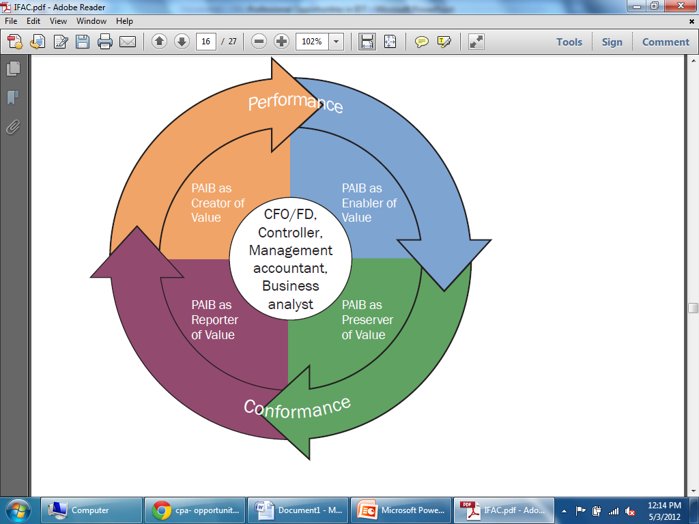
IFAC- International Federation of Accountants- Role of a Professional

Slide 9
Creator of Value
By taking leadership roles in the design and implementation of strategies, policies, plans, structures, and governance measures that set the course for delivering sustainable value creation.
-> What model? LTU, SEZ, Thru JW
-> Where located?
-> Tax Optimisation
-> Export Benefits

Slide 10
Enabler of Value
By informing and guiding managerial and operational decision making and implementation of strategy for achieving sustainable value creation, and the planning, monitoring, and improvement of supporting processes.
-> SOP for IDT: Internal control
-> Technology usage- ERP integration
-> Training of employees
-> Hand Holding in Implementation period

Slide 11
Preserver of Value
By ensuring the protection of a sustainable value creation strategy against strategic, operational, and financial risks, and ensuring compliance with regulations, standards, and good practices.
-> Internal / operational/ management audit to include IDT
-> Plan for changing laws – GST?
-> Disclosure of facts- no surprises

Slide 12
Reporter of Value
By enabling the transparent communication of the delivery of sustainable value to stakeholders.
-> Credibility of Financial Statements
- > Quarterly reporting
-> Independent Authentic certification

Slide 13
General Areas of Practice
Registration procedures
Initial disclosures/ procedures to the dept.
Maintaining Accounts, Payment of duty/taxes
Periodical return verification and submission
Periodical review of CE/CUS/ST
Review of the above before departmental audit

Slide 14
Specialized Area of Practice
End to End Solutions
Providing opinions/clarifications
Transaction Structuring
Impact on the changes-budget, notifications, case laws
Obtaining refunds
Rectification of errors made earlier
Attest Functions – Certification, Audit

Slide 15
Specialized Area of Practice
Reply to the departmental letter
Reply to the Show cause notice
Litigation- Representation before adjudicating authority
Reply and representation at appellate forums
Assistance to lawyers at High Court/Supreme Court
Strategic Consulting – Board Level

Slide 16
ST- Major Shift - Areas
Specified Services to Activity
Classification continues
Burden of Proof
POPS & Exports
Restrictions in Credits
Valuation changes
Joint Charge

Slide 17
New areas…
9. Sub contract
10. Exemptions
11. Arrest
12. VCES

Slide 18

OPPORTUNITY
“Opportunity is missed by most because it is dressed in overalls and looks like work.” - Thomas Alva Edison

Slide 19
How to become an Expert?
IDT net/ E sites contribution
Evaluator for IDT paper
Teaching the Subject
Writing articles/books
Being a speaker to other members in the industry/departmental officials
Being updated and current
…. many more

Slide 20

Formulae to success
Quality Services
Appropriate fees
Following ethical standards

Slide 21
“Understanding SERVICE in new Levy”

Slide 22
Service Tax Levy
Section 66B of the Finance Act. (from July 2012)
Tax on the Value of the Services
Other than covered under Negative List
Provided or to be Provided in a Taxable Territory
By One person to another

Slide 23
Service means
Any activity
For consideration
Carried out by a person
For another
And includes a declared service
But excludes…….

Slide 24
Service shall not include
Any activity which constitutes merely
Transfer of title in goods or immovable property
Transaction of deemed sales
Providing of service by employee to employer
Fees taken by Court or Tribunal
Transaction in money pr actionable claim
Shall not include

Slide 25
Declared Service (Deemed)
Should satisfy two basic conditions conjunctively:
it must be an activity by one person to another for consideration
it must be specified(i.e. declared) under section 66E
All activities where disputes existed with regard to whether service , jurisdiction…

Slide 26
Declared Service includes:
Renting of immovable property
Construction of a complex, building, civil structure, including a complex or building intended for sale to a buyer, except where the entire consideration is received after issuance of certificate of completion by a competent authority;
Temporary transfer or permitting the use or enjoyment of any intellectual property right;
Development, design, programming, customisation, adaptation, upgradation, enhancement, implementation of ITS

Slide 27
Cont……..
Agreeing to the obligation to refrain from an act, or to tolerate an act or a situation, or to do an act;
Transfer of goods by way of hiring, leasing, licensing or any such manner without transfer of right to use such goods;
Activities in relation to delivery of goods on hire purchase or any system of payment by installment
Service portion in execution of WC
Service portion in an activity wherein goods, being good or any article of human consumption is supplied in any manner as part of the activity

Slide 28
Declared Service - Analysis
Renting of immovable property
  Renting means facility allowing, permitting or granting access, entry, occupation, use.
  Facility has to be in an immovable property,
  Facility may be provided with or without transfer of possession
Covers:
  Renting for entertainment or sports
  Renting of theatres by owners to film distributor

Slide 29
Declared Service - Analysis
Construction of Complex – Covers
  Construction of a complex, building, civil structure or part thereof;
  Intended for sale to a buyer
  where consideration received before completion certificate
Construction
  includes additions, alterations, replacements or remodeling of any existing civil structure
Whether Construction or Works Contract?
When construction in final stages?

Slide 30
Declared Service - Analysis
Intellectual Property Right – Covers
  There should be an intellectual property right
  Such right is being temporarily transferred to the service receiver or
  It is permitting the use or enjoyment of such right
IPR includes
  Copyright
  Patents
  Trademarks
  Designs
  Any other similar right to an intangible property

Slide 31
Declared Service - Analysis
  Agreeing to the obligation to refrain from an act,
    Ex. In a merger and acquisition deal, promoter of selling company agrees not to do similar business for an agreed period- Non compete [ Vat Vs ST??]
  Agreeing to tolerate of an act or a situation
    Ex. a person give personal guarantee to a bank against loan advanced to a borrower. Guarantor undertakes to honour outstanding dues
Agreeing to do an act

Slide 32
Declared Service - Analysis
Hiring, leasing, licensing without transfer of right to use goods – essential elements:
  There has to be goods (whether tangible or intangible)
  Such goods would be transferred from one person to another
  Such transfer is by way of hiring or, leasing or licensing or in any such manner
  Such transfer would be without transfer of right to use such goods

Slide 33
Declared Service - Analysis
Hire purchase/Installment payment system
  ‘hire purchase agreement’ agreement where goods are let out on hire & under which the hirer has the option to purchase them including an agreement under which –
  Possession of goods is delivered by the owner thereof to a person who pays the agreed amount in periodical installments, and
  The property in the goods is to pass to such person on the payment of the last installments, and
  Such person can terminate the agreement at any time before the property passes;

Slide 34
Declared Service - Analysis
Service Portion in execution of Works Contract
  There would be a contract for provision of service
  During the provision of service, there is transfer of property in goods leviable to VAT and
  The scope of the contract is for construction, erection, commissioning, installation, completion, fitting out, repairs, maintenance, renovation, alteration or any other similar activity
  Such activity has to be either on movable or immovable property

Slide 35
Declared Service - Analysis
Supply of Food or other articles of Human Consumption
The following are the pre-requisites to fall under this entry:
  There is an activity
  Activity involves an element of service
  Such activity is in relation to goods
  The goods being food or any other article for human consumption or
  Any drink whether intoxicating or not and
  This is supplied in any manner as a part of such activity.

Slide 36

Life Isn’t About Finding Yourself, Life Is About Creating Yourself
George Bernard Shaw

Slide 37

Thank You!!!
Pdicai.org
madhukar@hiregange.com

