Slide 1
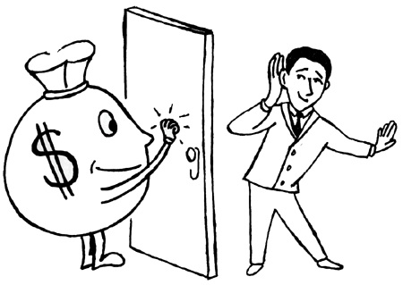
Opportunities in Service Tax

Slide 2
Creator of Value
By taking leadership roles in the design and implementation of strategies, policies, plans, structures, and governance measures that set the course for delivering sustainable value creation.
-> What model? LTU, SEZ, ..
-> Where located?
-> Tax Optimisation

Slide 3
Enabler of Value
By informing and guiding managerial and operational decision making and implementation of strategy for achieving sustainable value creation, and the planning, monitoring, and improvement of supporting processes.
-> SOP for ST: Internal control
-> Technology usage
-> Training of employees
-> Hand Holding in Implementation period

Slide 4
Preserver of Value
By ensuring the protection of a sustainable value creation strategy against strategic, operational, and financial risks, and ensuring compliance with regulations, standards, and good practices.
-> Internal / operational/ management audit to include ST
-> Plan for changing law
-> Disclosure of facts- no surprises

Slide 5
Reporter of Value
By enabling the transparent communication of the delivery of sustainable value to stakeholders.
-> Credibility of Financial Statements
- > Quarterly reporting
-> Independent Authentic certification

Slide 6
General Areas of Practice
Registration procedures
Initial disclosures/ procedures to the dept.
Payment of duty/taxes
Periodical return verification and submission
Periodical review of ST
Review of the above before departmental audit

Slide 7
Specialized Area of Practice
Providing opinions/clarifications
Transaction Structuring
Impact on the changes-budget, notifications, case laws
Obtaining refunds
Rectification of errors made earlier

Slide 8
Specialized Area of Practice
Reply to the departmental letter
Reply to the Show cause notice
Litigation- Representation before adjudicating authority
Reply and representation at appellate forums
Assistance to lawyers at High Court/Supreme Court

Slide 9
Reaching Expertise Level?
Read as many authors as possible
Join the IDT Net
Join online sites : pdicia.org, caclubindia, …
Join a practitioner for 6m -12m
Evaluate IDT papers
Teaching the Subject
Writing articles/books
Being a speaker to other members in the industry/departmental officials

Slide 10

Formulae to success
Quality Services
Appropriate fees
Following ethical standards

Slide 11
“Success is, when preparation meets Opportunity”

Slide 12
Thank You…
mhiregange@gmail.com

